Slide 1
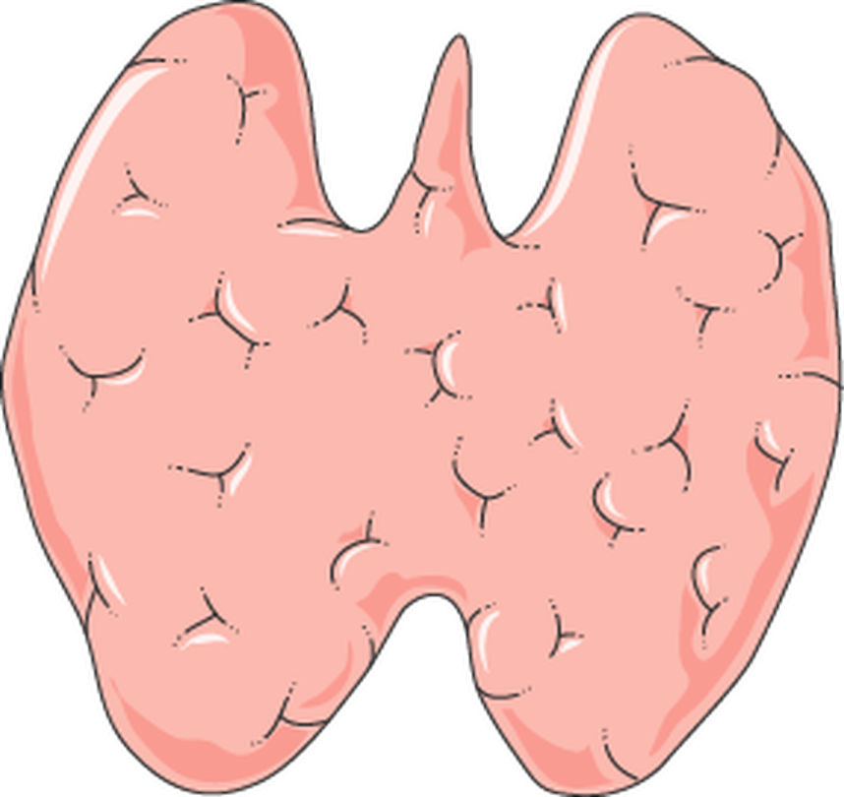
MEDICAL PRESENTATION
Goiter
Enlargement of the Thyroid Gland
Definition
Causes
Classification
Clinical Manifestations
Diagnosis
Management
Prevention
Prepared for Nursing & Medical Students

Slide 2
OVERVIEW
Contents
01
Introduction
05
Classification / Stages
09
Medical Management
02
Definition
06
Signs and Symptoms
10
Nursing Management
03
Risk Factors
07
Complications
11
Prevention
04
Causes
08
Diagnosis
12
References
GOITER | Medical Presentation
02

Slide 3



01 · INTRODUCTION
The Thyroid Gland
LOCATION
Anterior neck — just below the larynx
Wraps around the trachea
HORMONES
T4 (thyroxine) & T3 (triiodothyronine)
Regulate metabolism, growth & development
ALSO SECRETES
Calcitonin
Contributes to calcium homeostasis
Butterfly-shaped thyroid gland
GOITER | Medical Presentation
03

Slide 4

01 · INTRODUCTION
A Global Health Problem
One of the oldest documented human diseases
Still a major global health problem
1.5–2
BILLION
People at risk of iodine deficiency
~200
MILLION
People living with a goiter
4–10×
MORE COMMON
In women than in men
↑
WITH AGE
Prevalence rises as age increases
GOITER | Medical Presentation
04

Slide 5




01 · INTRODUCTION
Why It Matters Clinically
KEY POINT
Most goiters are benign & asymptomatic — but not all are harmless
Compression
Can press on the airway & esophagus
Dysfunction
May reflect hypo- or hyperthyroidism
Hidden malignancy
In a small % of nodular goiters
The nurse’s role
Early detection · perioperative care · patient education
GOITER | Medical Presentation
05

Slide 6
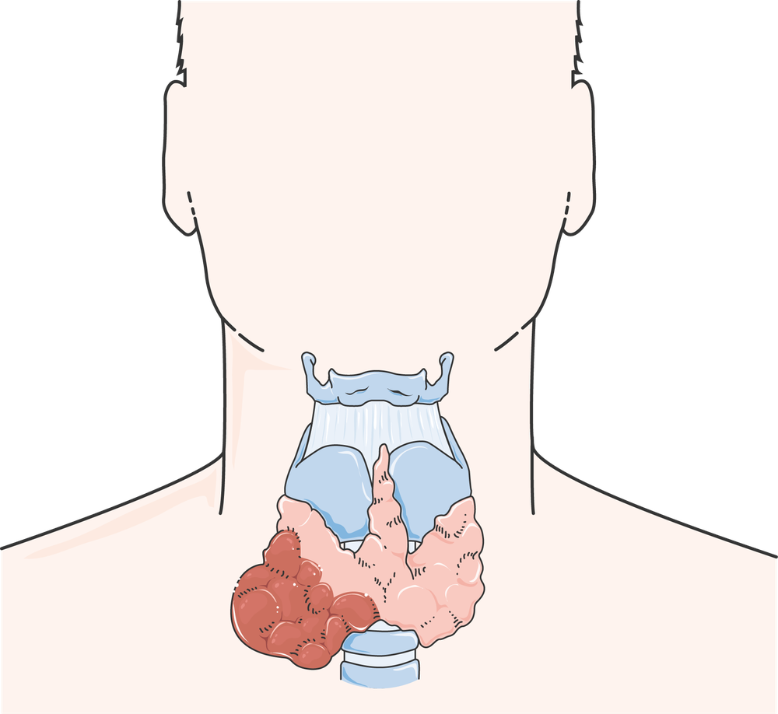


02 · DEFINITION
What Is a Goiter?
LATIN · GUTTUR = “THROAT”
Enlargement of the thyroid gland — regardless of cause or function
WHEN IS THE THYROID ENLARGED?
ON EXAMINATION
Each lobe > terminal phalanx of the patient’s thumb
ON ULTRASOUND
Total volume > ~18 mL (women) · > 25 mL (men)
Enlarged thyroid in the neck
GOITER | Medical Presentation
06

Slide 7
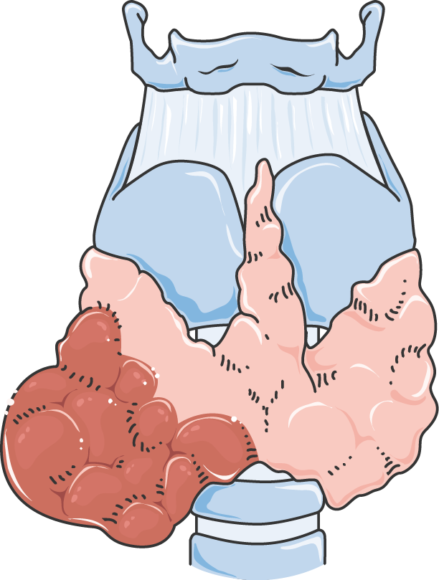


02 · DEFINITION
Descriptive Terms
BY SHAPE
Diffuse
Uniform, symmetrical enlargement of the whole gland
BY SHAPE
Nodular
One (uninodular) or multiple (multinodular) palpable nodules
BY FUNCTION
Simple (non-toxic)
No hyper- or hypothyroidism · no inflammation or neoplasia
BY FUNCTION
Toxic
Excess hormone production — e.g., Graves’, toxic MNG
GOITER | Medical Presentation
07

Slide 8



02 · DEFINITION
Descriptive Terms — Continued
Endemic
Affects > 10% of a population — usually regional iodine deficiency
Sporadic
Individual cases — genetic, dietary, drug-related or autoimmune
Retrosternal
(Substernal) — extends below the sternum into the superior mediastinum
GOITER | Medical Presentation
08

Slide 9




03 · RISK FACTORS
Who Is at Risk?
#1 WORLDWIDE
Iodine deficiency
Leading risk factor worldwide — mountainous & inland regions far from the sea
Female gender
Women affected 4–10× more often than men
Age over 40 years
Prevalence increases with age
Family history / genetics
Inherited defects of hormone synthesis (dyshormonogenesis)
GOITER | Medical Presentation
09

Slide 10





03 · RISK FACTORS
Who Is at Risk? — Continued
Hormonal changes
Puberty, pregnancy & menopause ↑ hormone demand
Radiation exposure
Prior head/neck irradiation or nuclear fallout
Medications
Lithium · amiodarone · immunosuppressants
Dietary goitrogens
Excess cassava, cabbage, broccoli, soy — worse with iodine deficiency
Smoking
Thiocyanate in smoke interferes with iodine uptake
GOITER | Medical Presentation
10

Slide 11



04 · CAUSES
How Iodine Deficiency Builds a Goiter
MOST COMMON CAUSE WORLDWIDE
Iodine deficiency → endemic goiter
01
Iodine deficiency
02
↓ Hormone synthesis
03
↑ TSH
04
Glandular hyperplasia
GOITER | Medical Presentation
11

Slide 12
04 · CAUSES
Other Causes
CAUSE | MECHANISM / NOTES
Hashimoto's thyroiditis | Autoimmune destruction ·most common cause in iodine-sufficient regions· leads to hypothyroidism
Graves' disease | TSH-receptor stimulating antibodies → diffuse toxic goiter with hyperthyroidism
Multinodular goiter | Multiple adenomatous nodules · may become autonomously functioning (toxic)
Solitary thyroid nodule | Adenoma, cyst or carcinoma —≈ 5% of palpable nodules are malignant
Thyroiditis | Subacute (De Quervain), postpartum or silent — often painful or transient dysfunction
GOITER | Medical Presentation
12

Slide 13
04 · CAUSES
Other Causes — Continued
CAUSE | MECHANISM / NOTES
Thyroid cancer | Papillary (most common) · follicular · medullary · anaplastic
Drugs | Lithium · amiodarone (iodine-rich) · interferon-alpha · tyrosine kinase inhibitors
Pregnancy / HCG | HCG weakly stimulates TSH receptors → mild physiological enlargement
Iodine excess | Paradoxically, chronic excess iodine can also induce goiter
GOITER | Medical Presentation
13

Slide 14
05 · CLASSIFICATION / STAGES
WHO Clinical Grading of Goiter
GRADE | PALPABLE | VISIBLE | FINDING
0 | ✕ | ✕ | No palpable or visible goiter
1 | ✓ | ✕ | Palpable — not visible with neck in normal position 1a · palpable only 1b · visible with neck extended
2 | ✓ | ✓ | Clearly visible with neck in normal position
GOITER | Medical Presentation
14

Slide 15
05 · CLASSIFICATION / STAGES
Classification at a Glance
BY
Morphology
Diffuse
Uninodular
Multinodular
BY
Function
Non-toxic (euthyroid)
Toxic (hyperthyroid)
Hypothyroid (e.g., Hashimoto’s)
BY
Epidemiology
Endemic — > 10% of population (iodine-deficient areas)
Sporadic — individual causes
GOITER | Medical Presentation
15

Slide 16


06 · SIGNS & SYMPTOMS
Local (Mass) Effects
LOCAL (MASS) EFFECT
Visible or palpable anterior neck swelling
Symmetrical or nodular · moves upward on swallowing
Dysphagia
Esophageal compression
Dyspnea / stridor
Tracheal compression or deviation — worse when lying flat
Anterior neck swelling
GOITER | Medical Presentation
16

Slide 17



06 · SIGNS & SYMPTOMS
Local Effects — Continued
Hoarseness of voice
Recurrent laryngeal nerve compression — a red flag for malignancy
Persistent cough
With a sensation of throat tightness
PEMBERTON'S SIGN
Arms raised overhead → facial flushing, congestion & venous engorgement
Thoracic inlet obstruction by a retrosternal goiter
GOITER | Medical Presentation
17

Slide 18


06 · SIGNS & SYMPTOMS
If Thyroid Dysfunction Coexists
Hypothyroidism
e.g., Hashimoto’s
Hyperthyroidism
e.g., Graves’, toxic MNG
Fatigue
Weight gain
Weight loss
Heat intolerance
Cold intolerance
Constipation
Palpitations
Tremor
Sweating
Bradycardia
Dry skin
Depression
Anxiety
Insomnia
Diarrhea
Menstrual irregularities
Exophthalmos (Graves’)
GOITER | Medical Presentation
18

Slide 19







06 · SIGNS & SYMPTOMS
⚠ Red Flags
Rapid growth
Firm / fixed hard mass
Hoarseness
Cervical lymphadenopathy
Age < 20 or > 60
Prior neck irradiation
ACTION
Suspect malignancy — refer promptly
GOITER | Medical Presentation
19

Slide 20

07 · COMPLICATIONS
Complications
Esophageal compression
→ Progressive dysphagia
MOST SERIOUS ACUTE COMPLICATION
Airway obstruction
Tracheal compression — an emergency if severe
Superior vena cava syndrome
With large retrosternal goiters
Recurrent laryngeal nerve palsy
→ Hoarseness / vocal cord paralysis
GOITER | Medical Presentation
20

Slide 21


07 · COMPLICATIONS
Complications — Continued
Thyrotoxicosis
Autonomous nodules secrete hormone (secondary hyperthyroidism)
Hypothyroidism
End-stage autoimmune destruction
Malignant transformation
A small proportion of nodular goiters harbor carcinoma
Cosmetic & psychosocial
Anxiety · body-image disturbance
GOITER | Medical Presentation
21

Slide 22





07 · COMPLICATIONS
Complications After Surgery
AFTER THYROIDECTOMY
Post-surgical complications
Hemorrhage / hematoma
With airway compromise
Hypocalcemia / tetany
From hypoparathyroidism
Recurrent laryngeal nerve injury
Voice change
Hypothyroidism
Requiring lifelong replacement
GOITER | Medical Presentation
22

Slide 23


08 · DIAGNOSIS
The Diagnostic Pathway
1
2
3
4
Neck
TSH
FT4 / FT3
Ultrasound
FNAB
Lymph nodes
Antibodies
RAI scan
CT / MRI
Pemberton’s
X-ray
GOITER | Medical Presentation
23

Slide 24

08 · DIAGNOSIS
History & Physical Examination
STEP 1 · HISTORY & PHYSICAL EXAMINATION
Neck inspection & palpation
Size · symmetry · consistency · nodules · movement with swallowing
Lymph nodes
Check for cervical lymphadenopathy
Pemberton’s sign
Retrosternal extension
Signs of thyroid dysfunction
Hypo- or hyperthyroid features
Inspect & palpate the neck
GOITER | Medical Presentation
24

Slide 25


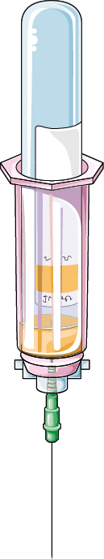

08 · DIAGNOSIS
Laboratory Tests
STEP 2 · FIRST-LINE SCREENING
TSH
Then free T4 / free T3 to classify function
ANTIBODIES
Anti-TPO / anti-thyroglobulin
→ Hashimoto’s thyroiditis
ANTIBODIES
TSH-receptor antibodies (TRAb)
→ Graves’ disease
SPECIAL
Serum calcitonin
If medullary carcinoma is suspected
AFTER SURGERY
Serum calcium
Post-op follow-up
GOITER | Medical Presentation
25

Slide 26
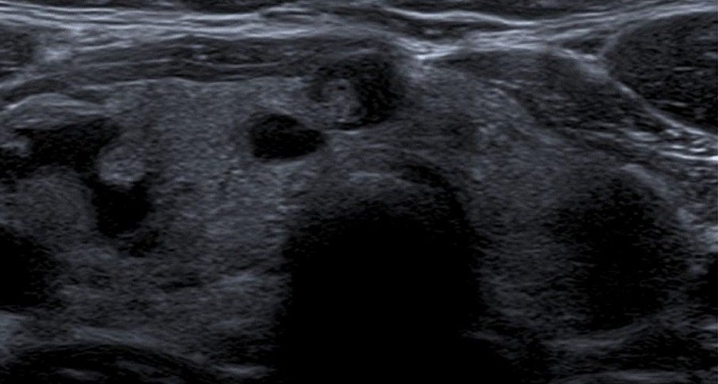

08 · DIAGNOSIS
Imaging — Ultrasound & Scintigraphy
Size
Volume
Nodule characterization
TI-RADS risk stratification
Ultrasound — multinodular goiter
“Hot” = toxic
“Cold” = suspicious
GOITER | Medical Presentation
26

Slide 27
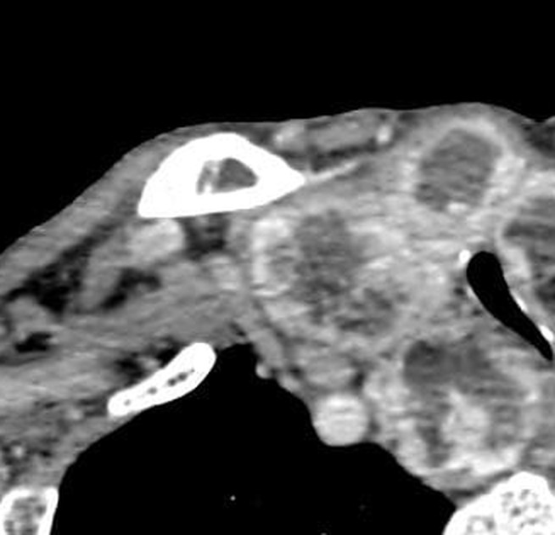

08 · DIAGNOSIS
Imaging — CT, MRI & X-ray
CROSS-SECTIONAL
CT / MRI of neck & chest
Retrosternal extension · airway & esophageal compression assessment
PLAIN FILM
Chest X-ray
Tracheal deviation
CT — enlarged nodular thyroid (arrow)
GOITER | Medical Presentation
27

Slide 28



08 · DIAGNOSIS
Tissue Diagnosis
STEP 4 · TISSUE DIAGNOSIS — GOLD STANDARD
Fine-needle aspiration biopsy (FNAB)
For evaluating suspicious nodules
Gold standard
For tissue diagnosis of suspicious nodules
Bethesda classification
Used to report FNAB results
GOITER | Medical Presentation
28

Slide 29



09 · MEDICAL MANAGEMENT
Medical Management
Observation
Small, asymptomatic, euthyroid goiters → periodic clinical & ultrasound follow-up
Iodine supplementation
For iodine-deficiency goiter — e.g., potassium iodide; dietary correction
TSH suppression — simple diffuse goiter
Mandatory after total thyroidectomy
Treats hypothyroidism
GOITER | Medical Presentation
29

Slide 30

09 · MEDICAL MANAGEMENT
Treating Thyroid Overactivity
Antithyroid drugs
Methimazole or propylthiouracil (PTU) — toxic goiter / Graves’
Beta-blockers
Propranolol — symptom control
Radioactive iodine
RAI, I-131 · ablates hyperfunctioning tissue · shrinks toxic MNG & Graves’ goiter
GOITER | Medical Presentation
30

Slide 31


09 · MEDICAL MANAGEMENT
Surgery — Thyroidectomy
SURGERY · THYROIDECTOMY — INDICATIONS
Compressive symptoms
Suspected / proven malignancy
Retrosternal extension
Cosmetic concern
Failed medical therapy
Total
Near-total
Lobectomy
Large nodular goiter
GOITER | Medical Presentation
31

Slide 32
SECTION 10
Nursing Management
Pre-op / Non-surgical
Post-op Airway
Hypocalcemia
Recovery
Nursing Pearls

Slide 33

10 · NURSING MANAGEMENT
Preoperative / Non-surgical Care
AT EVERY ENCOUNTER
Assess airway, breathing pattern, voice & swallowing
Report stridor immediately
Medication adherence
Levothyroxine on an empty stomach · separate from calcium / iron by 4 hours
Nutritional counseling
Adequate iodine — iodized salt, seafood, dairy · avoid excess goitrogens
Psychosocial support
For body-image concerns
GOITER | Medical Presentation
33

Slide 34



10 · NURSING MANAGEMENT
Postoperative Care — Airway First
POST-THYROIDECTOMY · PRIORITY
AIRWAY — monitor continuously
Tracheostomy set + suction at the bedside
Watch for neck swelling / hematoma
Semi-Fowler's position
Support the neck when moving
CHECK THE DRESSING
Front and back of the neck
GOITER | Medical Presentation
34

Slide 35
10 · NURSING MANAGEMENT · POST-OP
Hypocalcemia Watch
SIGN 1
Chvostek's
Tap the facial nerve → facial twitching
SIGN 2
Trousseau's
BP cuff inflated → carpal spasm
ASSESS & ACT
◆Perioral tingling · muscle cramps
◆Monitor serum calcium
◆Keep IV calcium gluconate available
Parathyroid injury → hypocalcemia
GOITER | Medical Presentation
35

Slide 36


10 · NURSING MANAGEMENT · POST-OP
Recovery & Teaching
Assess the voice
Recurrent laryngeal nerve injury
Deep breathing
Encourage regularly
Pain & nausea
Manage promptly
DISCHARGE TEACHING
Lifelong hormone replacement after total thyroidectomy
Plus the signs of hypo- / hyperthyroidism to report
GOITER | Medical Presentation
36

Slide 37
10 · NURSING MANAGEMENT
High-Yield Nursing Pearls
01
02
03
Airway first
Hematoma can obstruct within hours
Calcium checks
Catch hypoparathyroidism early
Levothyroxine
Empty stomach · same time daily · never stop abruptly
GOITER | Medical Presentation
37

Slide 38

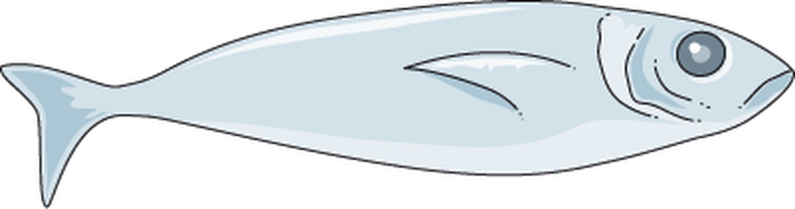
11 · PREVENTION
Iodine — the First Line of Defense
RECOMMENDED DAILY IODINE
ADULTS
≈ 150
mcg / day
PREGNANCY / LACTATION
220–250
mcg / day
SINGLE MOST EFFECTIVE MEASURE
Universal salt iodization
Use iodized salt in daily cooking
Seafood
Dairy
Eggs
Iodized salt
GOITER | Medical Presentation
38

Slide 39



11 · PREVENTION
Prevention — Beyond Iodine
Limit goitrogenic foods
Raw cassava, very large amounts of cruciferous vegetables — especially in iodine-deficient areas
Screen high-risk groups
Pregnant women · endemic regions · lithium/amiodarone users · family history
Avoid unnecessary neck radiation
Use thyroid shielding when imaging
Early medical evaluation
Of any new neck swelling
GOITER | Medical Presentation
39

Slide 40
12 · REFERENCES
References
01
World Health Organization (WHO). Goiter assessment / Iodine deficiency disorders (who.int)
02
American Thyroid Association (ATA). Thyroid Nodules & Differentiated Thyroid Cancer Guidelines (thyroid.org)
03
Mathew P, Rawla P. Hyperthyroidism; Goiter. StatPearls Publishing, NCBI Bookshelf (ncbi.nlm.nih.gov/books)
04
Mayo Clinic. Goiter — Symptoms and causes; Diagnosis and treatment (mayoclinic.org)
05
Medscape (eMedicine). Goiter: Practice Essentials, Pathophysiology, Etiology (emedicine.medscape.com)
06
NIDDK. Hashimoto’s Disease & Graves’ Disease (niddk.nih.gov)
07
Hegedüs L, Bonnema SJ, Bennedbæk FN. Management of simple nodular goiter: current status and future perspectives. Endocrine Reviews
GOITER | Medical Presentation
40

Slide 41
WITH GRATITUDE
Thank you
for listening — and for caring.
Questions are welcome

