Slide 1
Smart Library Management System
SIC 8
Coding and Programming Course
Team 1
Notes:
Note:

Slide 2
Agenda
Team
Introduction
Problem Statement
Methodology
Key Tasks
Results and Insights
Conclusion
Q&A
Notes:
Note:

Slide 3
Project Team
Mohamed Ayman
Habiba ElGohary
Simon AbdelMalak
Amr Mohamed

Slide 4
Agenda
Team
Introduction
Problem Statement
Methodology
Key Tasks
Results and Insights
Conclusion
Q&A
Notes:
Note:

Slide 5
Introduction
Most small libraries still track their books the old way.
A notebook, or maybe a messy spreadsheet.
We wanted to fix that with something simple like a command
line app that handles the whole flow adding books, magazines
and digital resources, registering members, borrowing and returning
items, and pulling up reports whenever you need them. It's not fancy
but it's fast, reliable, and it actually works the way a librarian thinks.
Notes:
Note:

Slide 6
Agenda
Team
Introduction
Problem Statement
Key Tasks
Methodology
Results and Insights
Conclusion
Q&A
Notes:
Note:

Slide 7
Problem Statement
If you're running a small library and everything's on paper or in a spreadsheet, things fall apart fast and you lose track of who has what
,you miss due dates, and there's no quick way to check what's overdue or what's even available right now. We wanted something in between a paper log and a full-blown database system that is light enough to run anywhere, but smart enough to actually manage the library properly.
Notes:
Note:

Slide 8
Agenda
Team
Introduction
Problem Statement
Methodology
Key Tasks
Results and Insights
Conclusion
Q&A
Notes:
Note:

Slide 9
Methodology
Object-Oriented Design
Uses a main base template for items (`LibraryItem`) and simple separate types like books, magazines, and digital files to handle their own unique rules.

Slide 10
Methodology
Simple Input Checks
Checks member IDs and emails using quick validation patterns so users cannot enter broken or incorrect information.

Slide 11
Agenda
Team
Introduction
Problem Statement
Methodology
Key Tasks
Results and Insights
Conclusion
Q&A
Notes:
Note:

Slide 12
Key Tasks
Easily add books, magazines, or digital files to the system.
Automatically creates unique IDs for every new item.
Registers new members while double-checking their details.
Searches through inventory quickly by title or author name.
Quickly check out items and set automatic due dates.
Process returned items and calculate small late fees if overdue.
Keep track of what items are currently checked out.
Print a simple summary showing available vs. borrowed items.

Slide 13
Data Ingestion
Json File storage
Managed neatly inside a dedicated storage helper class.
Saves active library catalogs and member lists into a simple `library_data.json` file.
Formats the file text nicely with neat indentation so it is easy to read.

Slide 14
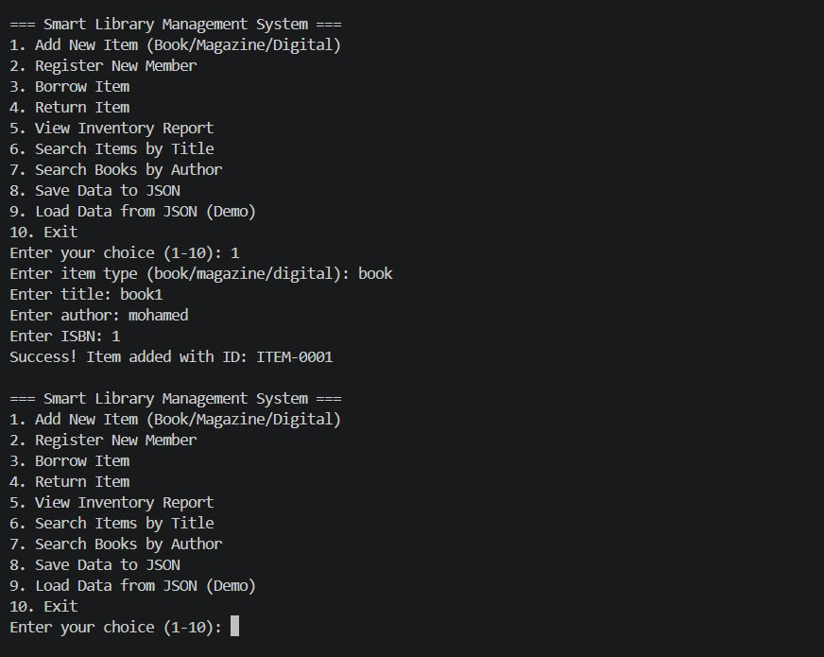
Runtime code

