Slide 1
THE DEEP COMEDY Deep Learning Project
Amoriello Nicola 000952269
Policarpi Andrea 000950326

Slide 2
DATASET & PREPROCESSING
01
RNN WITH CUSTOM LOSS
02
TABLE OF CONTENTS
TRANSFORMER
03
CONCLUSIONS
04
exploitation and processing of the input/train dataset
A recurrent neural network with a custom loss developed for the task
A state-of-the-art architecture to improve our results
positive and negative sides of the work done

Slide 3
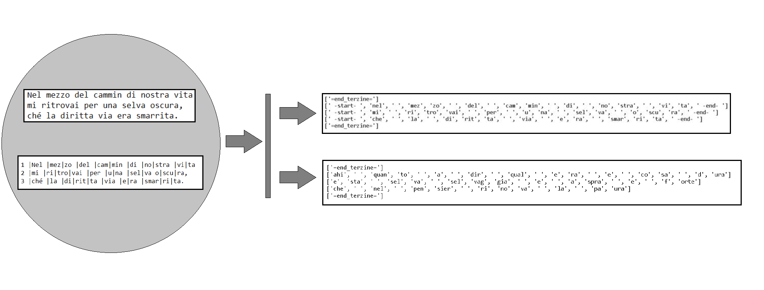
DATASET & PREPROCESSING (1)

Slide 4
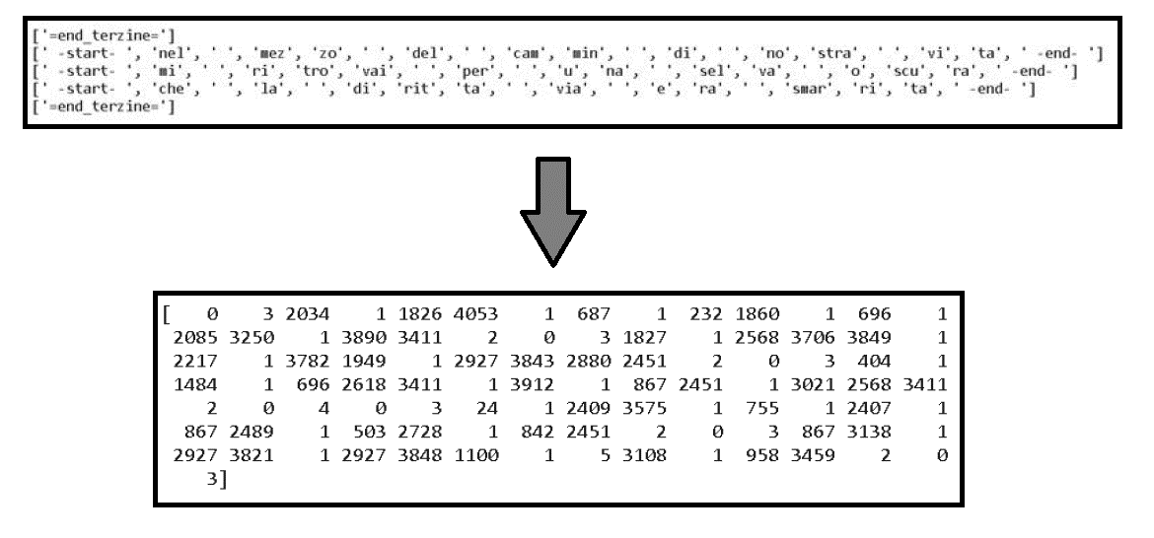
DATASET & PREPROCESSING (2)

Slide 5
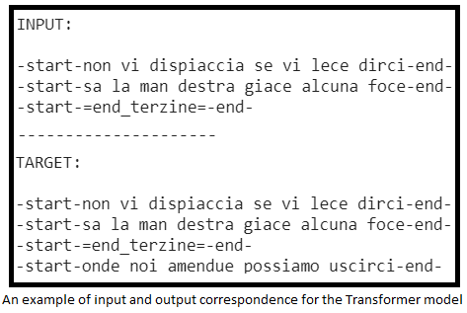
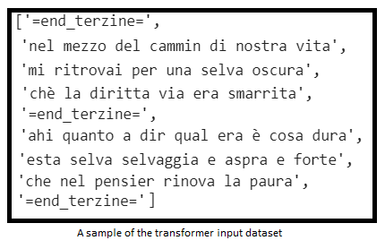
TRANSFORMER
For the Transformer the phase of preprocessing is a little different. The previous steps are only needed to create the token vocabulary.
In fact, the transformer input consist in N verses, which will be tokenized during the training step.

Slide 6
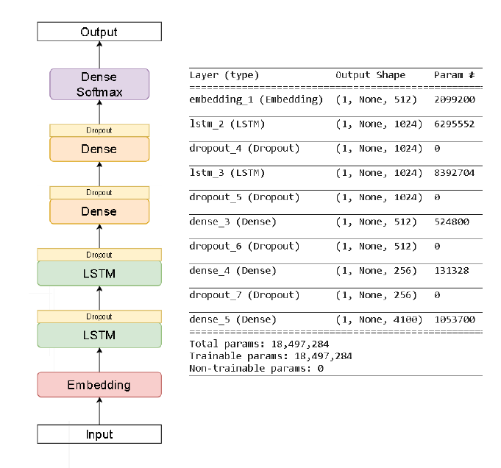
RNN

Slide 7
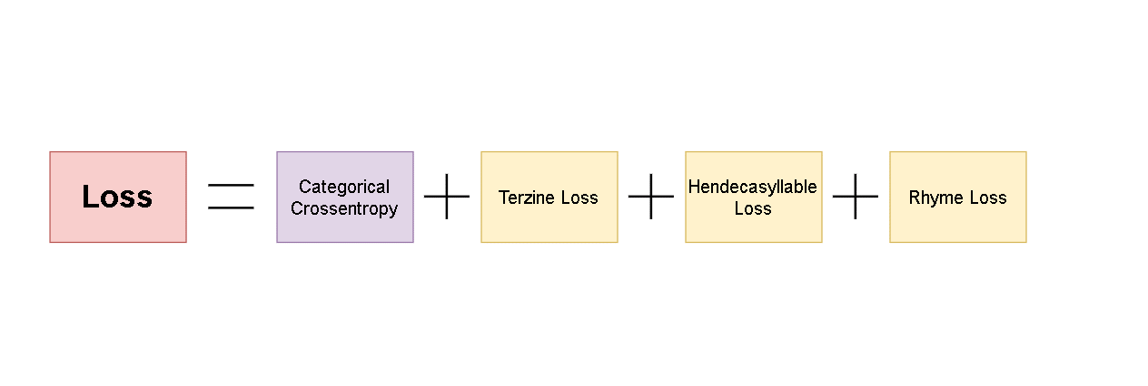
CUSTOM LOSS

Slide 8
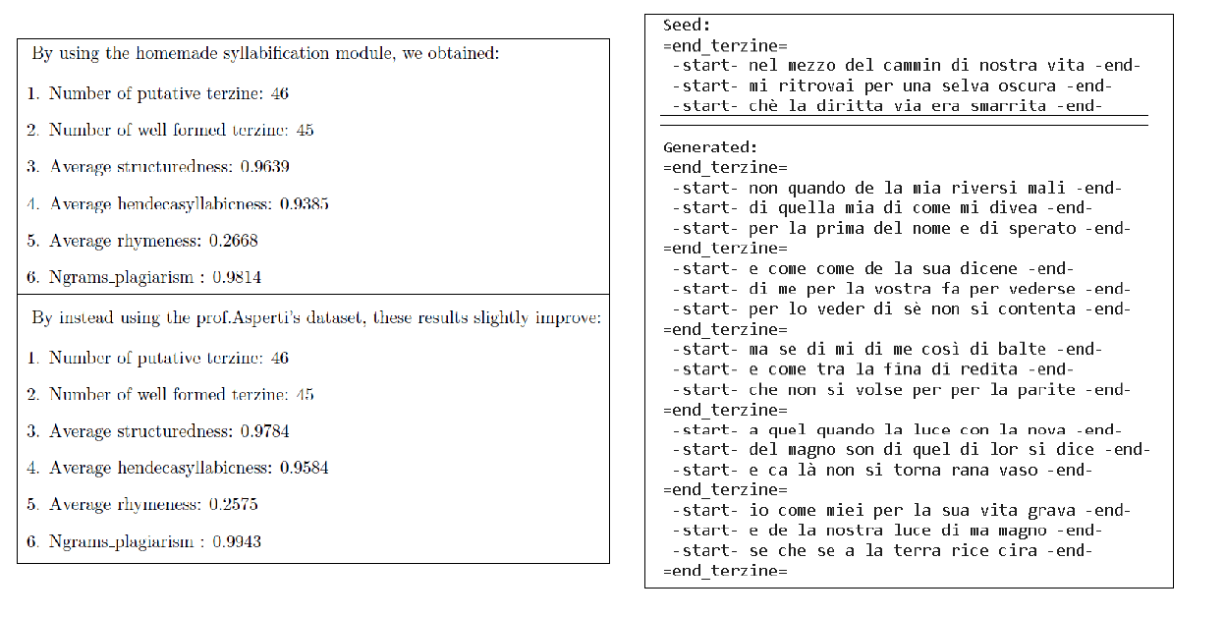
RESULTS: RNN + CUSTOM LOSS

Slide 9
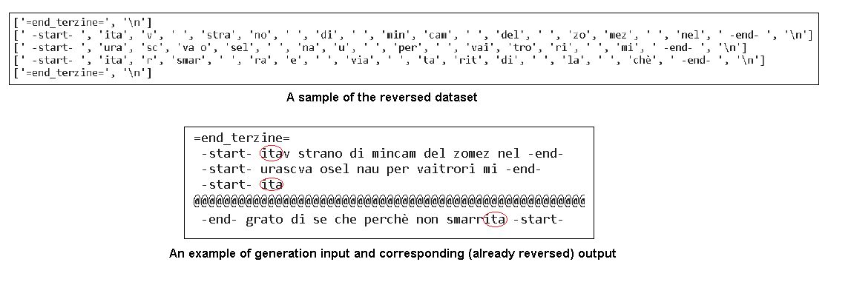
Using the model with a forced-rhymes approach

Slide 10
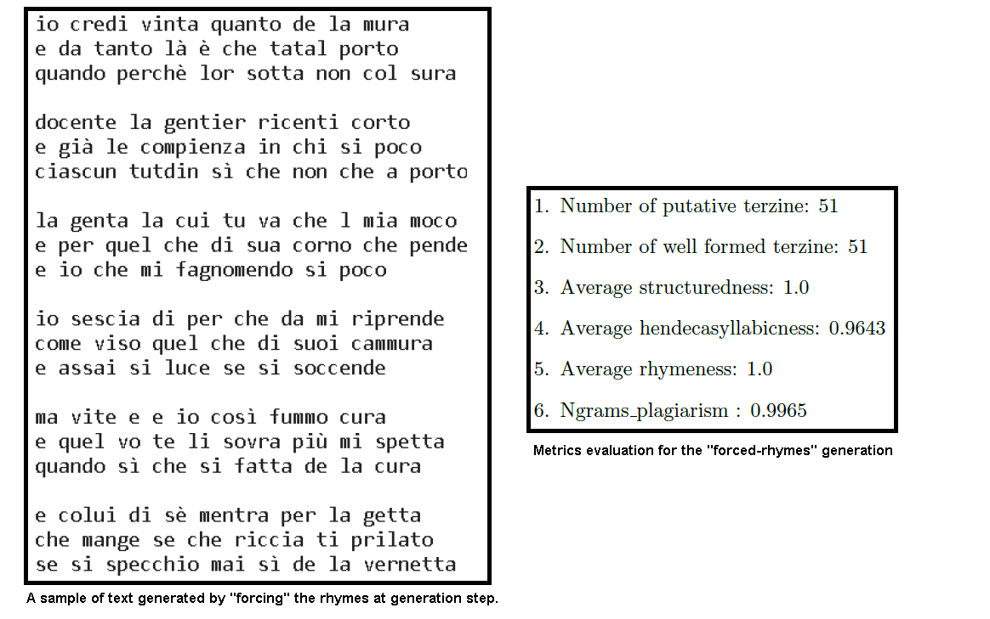
FORCED-RHYMES, RESULTS

Slide 11
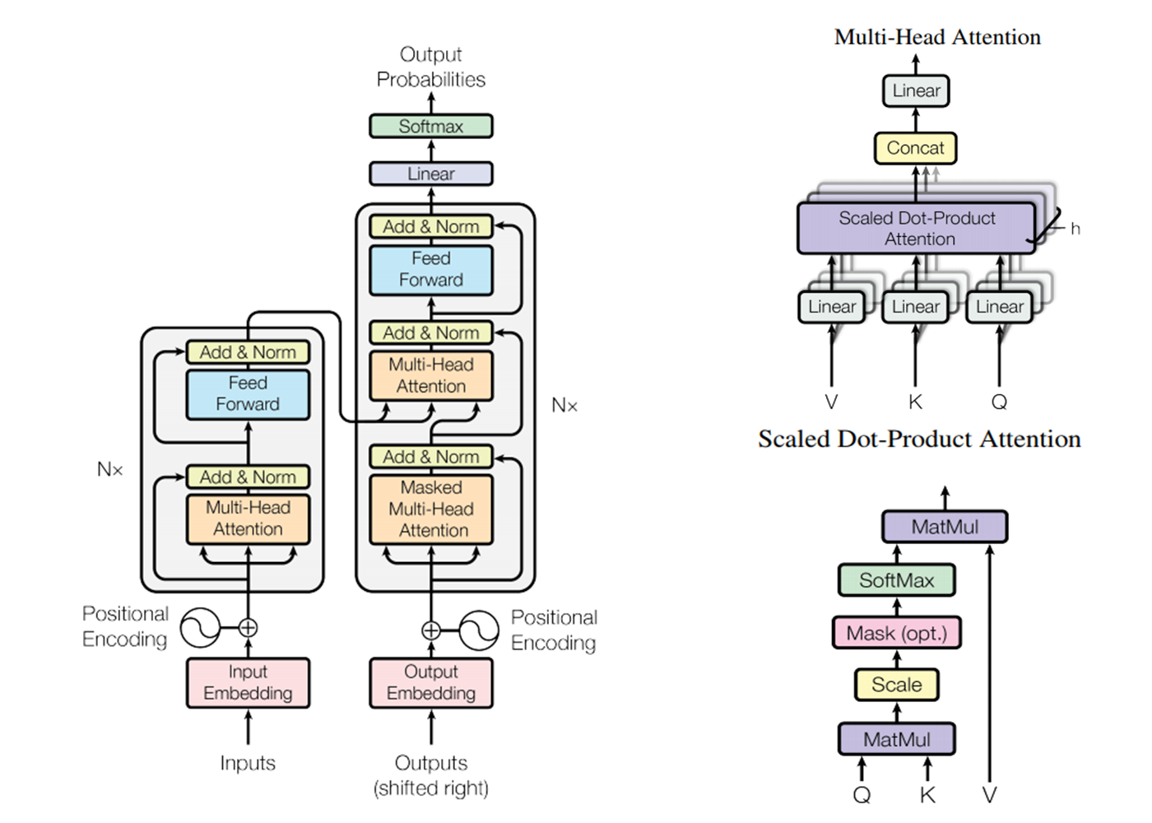
TRANSFORMER

Slide 12
TRANSFORMER (hyperparameters)
Layers for Encoder / Decoder: 4
Heads for the Multi-Head Attention: 4
Sub-layers dimension: 256
Feed-Forward layers dimension: 512
Dropout rate: 0.2
Seq_length: 3
Batch: 64
Epochs: 120

Slide 13
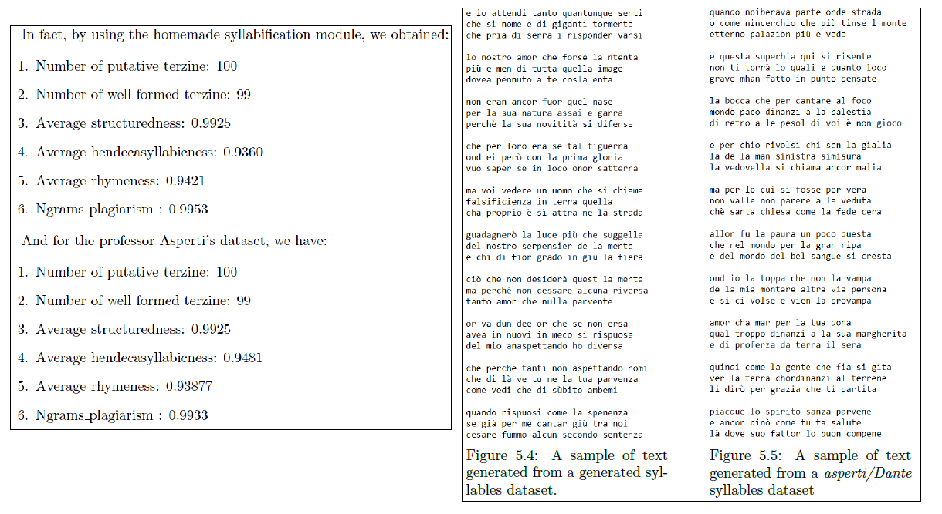
RESULTS: TRANSFORMER

Slide 14
FINAL RESULTS
MODEL | N° PUTATIVE TERZINE | N° WELL FORMED TERZINE | AVG STRUCTUREDNESS | AVG HENDECASYLLABNESS | AVG RHYMENESS | NGRAMS PLAGIARISM
RNN + Custom Loss 1 | 46 | 45 | 0.9639 | 0.9385 | 0.2668 | 0.9814
RNN + Custom Loss 2 | 46 | 45 | 0.9784 | 0.9584 | 0.2575 | 0.9943
RNN + Custom Loss with forced rhymes | 51 | 51 | 1.0 | 0.9643 | 1.0 | 0.9965
Transformer 1 | 100 | 99 | 0.9925 | 0.9360 | 0.9421 | 0.9953
Transformer 2 | 100 | 99 | 0.9925 | 0.9481 | 0.9387 | 0.9933

Slide 15
Thanks for the attention!

