Slide 1
THE DEEP COMEDY Deep Learning Project
Amoriello Nicola 000952269
Policarpi Andrea 000950326

Slide 2
DATASET & PREPROCESSING
01
RNN WITH CUSTOM LOSS
02
TABLE OF CONTENTS
TRANSFORMER
03
CONCLUSIONS
04
exploitation and processing of the input/train dataset
A recurrent neural network with a custom loss developed for the task
A state-of-the-art architecture to improve our results
positive and negative sides of the work done

Slide 3
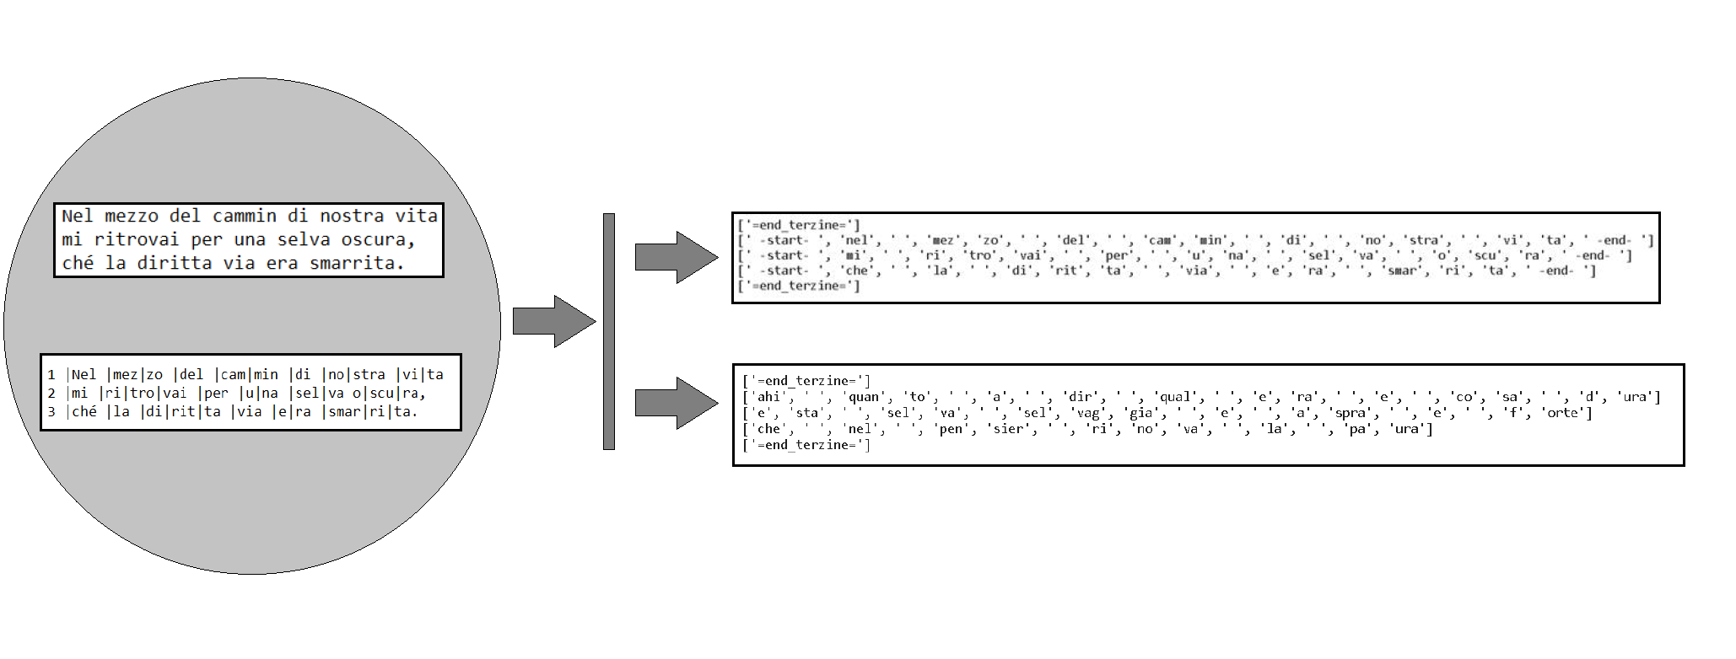
DATASET & PREPROCESSING (1)

Slide 4
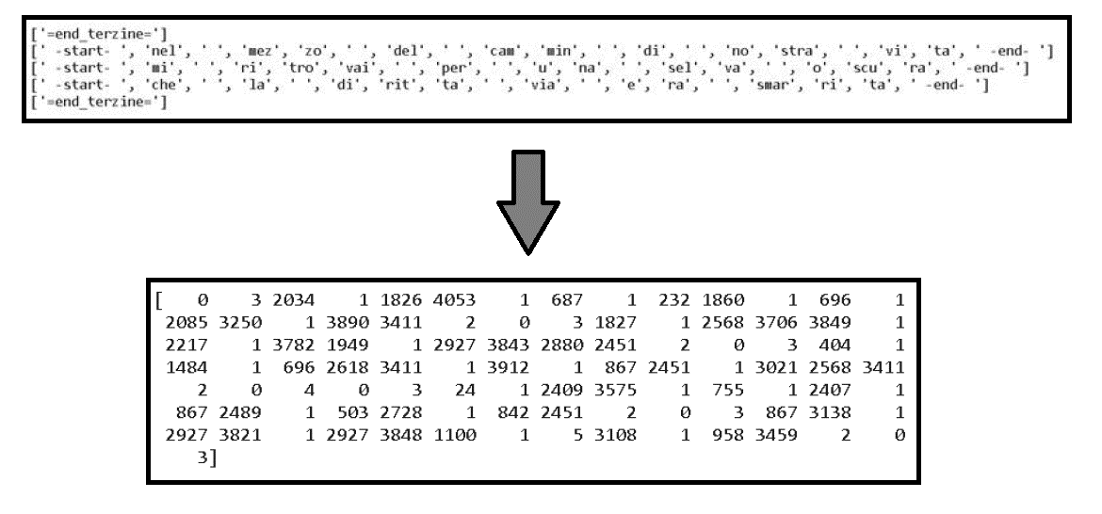
DATASET & PREPROCESSING (2)

Slide 5
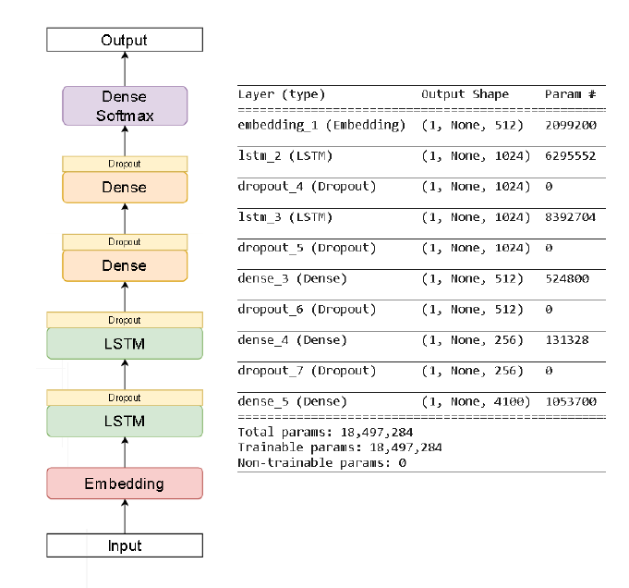
RNN

Slide 6
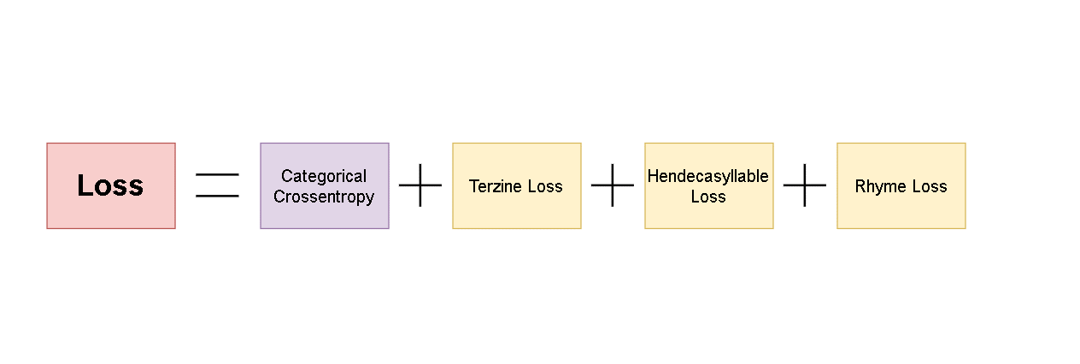
CUSTOM LOSS

Slide 7
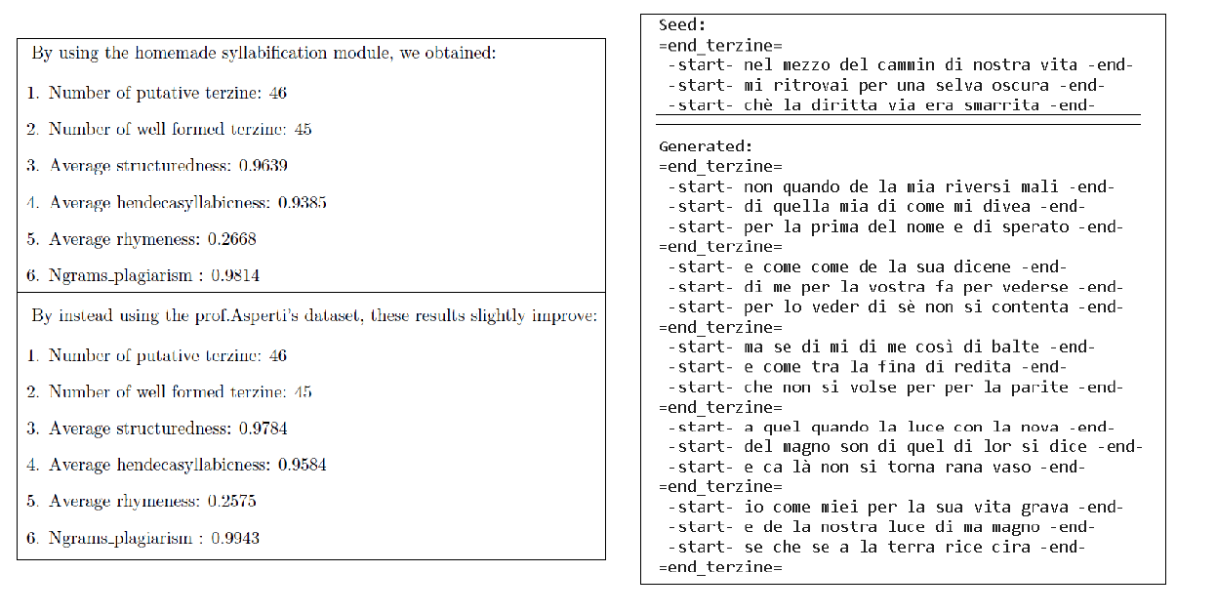
RESULTS: RNN + CUSTOM LOSS

Slide 8
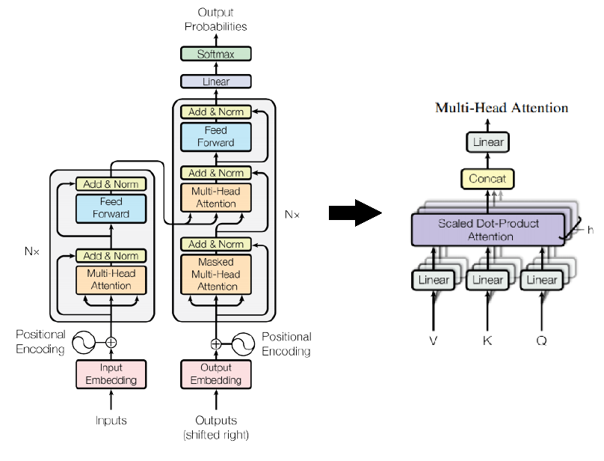
TRANSFORMER

Slide 9
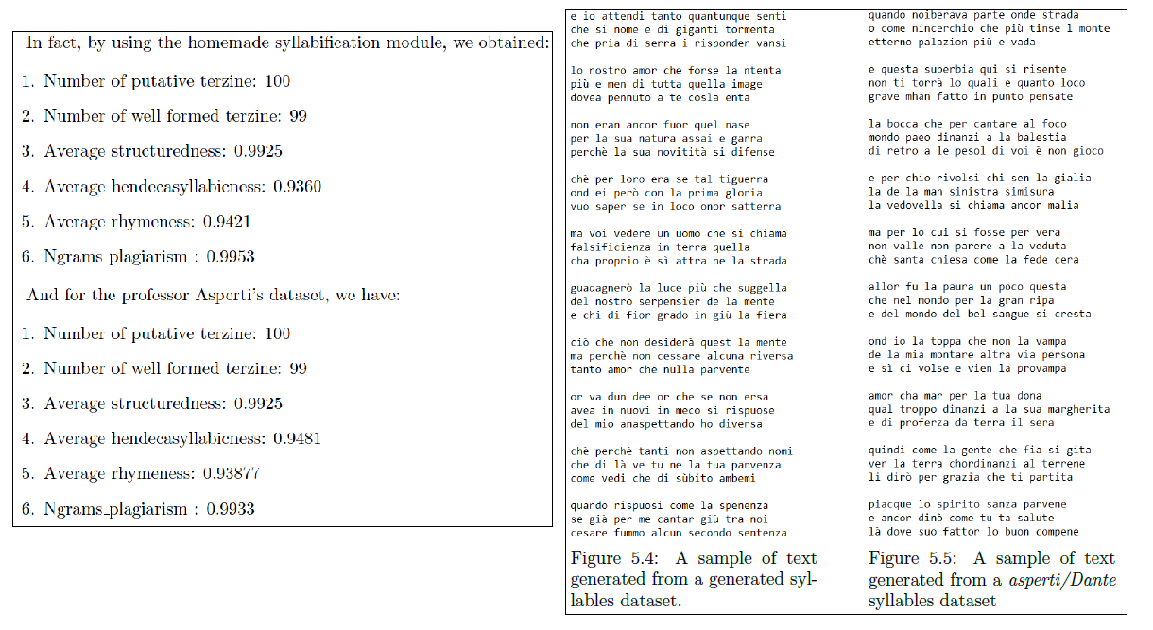
RESULTS: TRANSFORMER

Slide 10
FINAL RESULTS
MODEL | N° PUTATIVE TERZINE | N° WELL FORMED TERZINE | AVG STRUCTUREDNESS | AVG HENDECASYLLABNESS | AVG RHYMENESS | NGRAMS PLAGIARISM
RNN + Custom Loss 1 | 46 | 45 | 0.9639 | 0.9385 | 0.2668 | 0.9814
RNN + Custom Loss 2 | 46 | 45 | 0.9784 | 0.9584 | 0.2575 | 0.9943
RNN + Custom Loss with forced rhymes | 51 | 51 | 1.0 | 0.9643 | 1.0 | 0.9965
Transformer 1 | 100 | 99 | 0.9925 | 0.9360 | 0.9421 | 0.9953
Transformer 2 | 100 | 99 | 0.9925 | 0.9481 | 0.9387 | 0.9933

Slide 11
Thanks for the attention!

