Slide 1
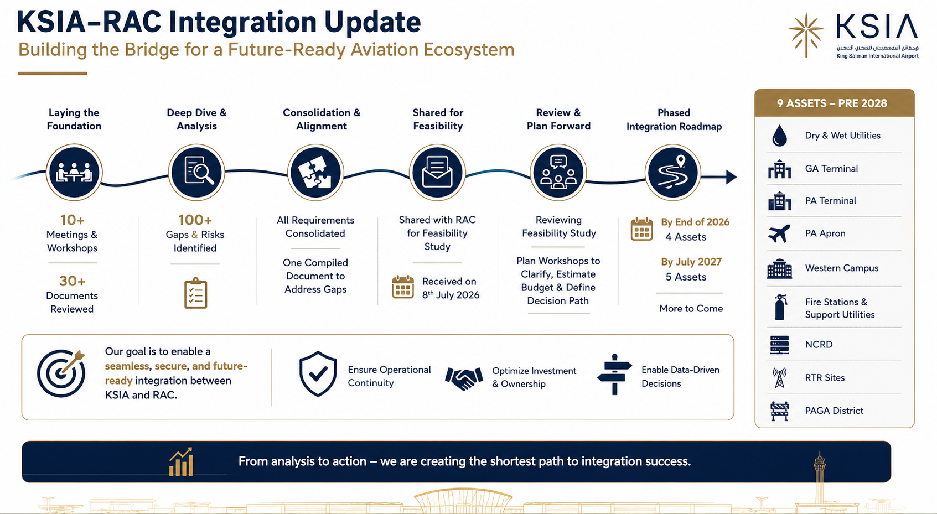

Slide 2
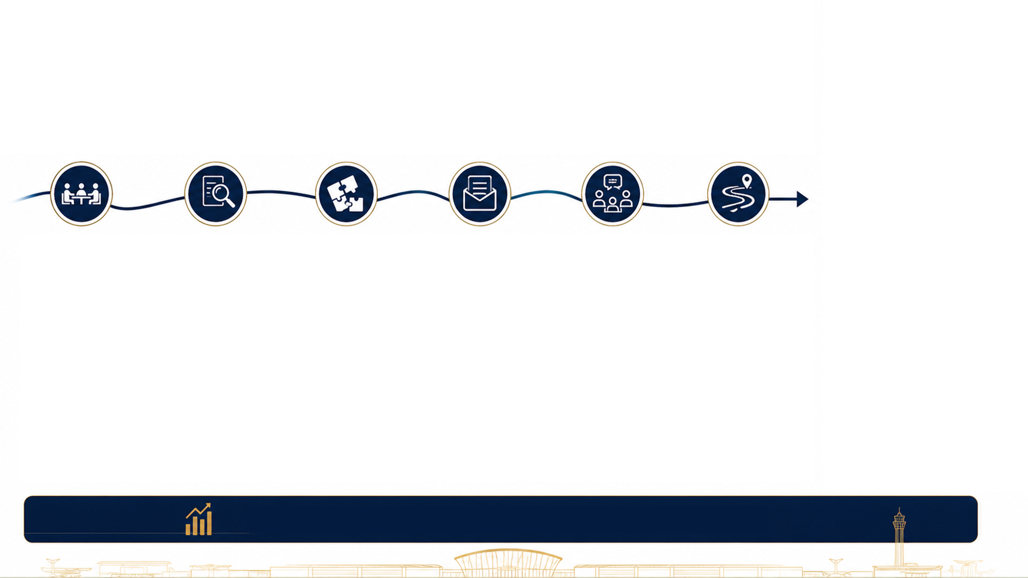
















KSIA–RAC Integration Update
Building the Bridge for a Future-Ready Aviation Ecosystem
Phased
Integration Roadmap
Laying the
Foundation
Deep Dive &
Analysis
Consolidation &
Alignment
Shared for
Feasibility
Review &
Plan Forward
9 ASSETS – PRE 2028
Dry & Wet Utilities
GA Terminal
PA Terminal
10+ Meetings &
Workshops
100+ Gaps & Risks Identified
All Requirements
Consolidated
Shared with RAC
for Feasibility
Study
Reviewing
Feasibility Study
PA Apron
By End of 2026
30+ Documents
Reviewed
One Compiled
Document to
Address Gaps
Plan Workshops to
Clarify, Estimate
Budget & Define
Decision Path
4 Assets
Western Campus
By July 2027
Received on
8th July 2026
5 Assets
Fire Stations &
Support Utilities
More to Come
Ensure Operational
Continuity
Optimize Investment
& Ownership
Enable Data-Driven
Decisions
NCRD
Our goal is to enable a seamless, secure, and future-
ready
integration between
KSIA and RAC.
RTR Sites
PAGA District
From analysis to action – we are creating the shortest path to integration success.

