Slide 1
The Hadoop Distributed Filesystem (HDFS)
Elsayed Hemayed
The original slides are from EMC and IBM, and Prof. Dong Wang.

Slide 2
Overview of Topics
Motivation
Architecture and Concepts
Inside HDFS
HDFS User Interface
Notes:
The topics covered in this lesson are listed.

Slide 3
Motivation Questions
Problem 1: Data is too big to store on one machine.
HDFS: Store the data on multiple machines!

Slide 4
Motivation Questions
Problem 2: Very high end machines are too expensive
HDFS: Run on commodity hardware!

Slide 5
Motivation Questions
Problem 3: Commodity hardware will fail!
HDFS: Software is intelligent enough to handle hardware failure!
Notes:
1%-10%-100%

Slide 6
Motivation Questions
Problem 4: What happens to the data if the machine stores the data fails?
HDFS: Replicate the data!

Slide 7
Motivation Questions
Problem 5: How can distributed machines organize the data in a coordinated way?
HDFS: Master-Slave Architecture!

Slide 8
HDFS Architecture: Master-Slave
Master
Name Node: Controller
File System Name Space Management
Block Mappings
Data Node: Work Horses
Block Operations
Replication
Secondary Name Node:
Checkpoint node
Name Node (NN)
Secondary Name Node (SNN)
Data Node (DN)
Slaves
Single Rack Cluster

Slide 9


HDFS – Architecture
Master / Slave architecture
Master: NameNode
manages the file system namespace and metadata
FsImage
EditLog
regulates client access to files
Slave: DataNode
many per cluster
manages storage attached to the nodes
periodically reports status to NameNode
NameNode
File1
a
b
c
d
a
b
a
c
b
a
d
b
d
c
c
d
DataNodes
Notes:
Secondary namenode
Import checkpoint
Rebalancing
SafeMode
Recovery Mode
The entire file system namespace, including the mapping of blocks to files and file system properties, is stored in a file called the FsImage. The FsImage is stored as a file in the NameNode’s local file system. Contains the metadata on disk (not exact copy of what is in RAM, but a checkpoint copy)
The NameNode uses a transaction log called the EditLog to persistently record every change that occurs to file system metadata, synchronizes with metadata in RAM after each write.
The NameNode can be potential single point of failure (expected to solved in Hadoop v2 with NameNode federation)
don’t use inexpensive commodity hardware for the NameNode
mitigate by backing up to other storage
In case of power failure on NameNode, recover using FsImage and EditLog.

Slide 10
HDFS Architecture: Master-Slave
Multiple-Rack Cluster
Switch
Switch
Name Node (NN)
Secondary Name Node (SNN)
Data Node (DN)
Data Node (DN)
Data Node (DN)
Rack 1
Rack 2
. . .
Rack N

Slide 11
HDFS Architecture: Master-Slave
Multiple-Rack Cluster
Reliable Storage
Switch
Switch
I know all blocks and replicas!
NN will replicate lost blocks in another node ☺
Name Node (NN)
Secondary Name Node (SNN)
Data Node (DN)
Data Node (DN)
Data Node (DN)
Rack 1
Rack 2
. . .
Rack N

Slide 12
HDFS Architecture: Master-Slave
Multiple-Rack Cluster
Rack Awareness
Switch
Switch
I know the topology of the cluster!
NN will replicate lost blocks across racks ☺
Name Node (NN)
Secondary Name Node (SNN)
Data Node (DN)
Data Node (DN)
Data Node (DN)
Rack 1
Rack 2
. . .
Rack N

Slide 13
HDFS Architecture: Master-Slave
Multiple-Rack Cluster
Switch
Switch
Do not ask me, I am down ☹
Single Point of Failure
Name Node (NN)
Secondary Name Node (SNN)
Data Node (DN)
Data Node (DN)
Data Node (DN)
Rack 1
Rack 2
. . .
Rack N

Slide 14
HDFS Architecture: Master-Slave
Multiple-Rack Cluster
How about network performance?
Switch
Switch
Keep bulky communication within a rack!
Name Node (NN)
Secondary Name Node (SNN)
Data Node (DN)
Data Node (DN)
Data Node (DN)
Rack 1
Rack 2
. . .
Rack N

Slide 15
HDFS Inside: Name Node
Name Node
Snapshot of FS
Edit log: record changes to FS
Filename | Replication factor | Block ID
File 1 | 3 | [1, 2, 3]
File 2 | 2 | [4, 5, 6]
File 3 | 1 | [7,8]
Data Nodes
1, 2, 5, 7,
4, 3
1, 5, 3,
2, 8, 6
1, 4, 3,
2, 6

Slide 16

HDFS Inside: Name Node
Name Node
Periodically
Secondary Name Node
FS image
FS image
Edit log
Edit log
House Keeping
Backup NN Meta Data
Reply
(Control Info.
Embedded)
Data Nodes
Notes:
Heart beating every 3 seconds. If NN does not hear from DN in 10 mins, it starts to replicate the blocks

Slide 17
HDFS Inside: Blocks
HDFS is designed to support very large files
Each file is split into blocks
Hadoop default: 64MB
V2: 128MB
Blocks reside on different physical DataNode
Behind the scenes, 1 HDFS block is supported by multiple operating system blocks
If a file or a chunk of the file is smaller than the block size, only needed space is used. E.g.: a 402 MB file is split as
64 MB → 128 MB (V2)
HDFS blocks
OS blocks
128 MB
128 MB
128 MB
18 MB
Notes:
Data in a Hadoop cluster is broken down into smaller pieces (called blocks) and distributed throughout the cluster. In this way, the map and reduce functions can be ex­ecuted on smaller subsets of your larger data sets, and this provides the scal­ability that is needed for big data processing.
http://www-01.ibm.com/software/data/infosphere/hadoop/hdfs/

Slide 18
HDFS Inside: Blocks
Q: Why do we need the abstraction “Blocks” in addition to “Files”?
Reasons:
File can be larger than a single disk
Block is of fixed size, easy to manage and manipulate
Easy to replicate and do more fine grained load balancing

Slide 19
HDFS Inside: Blocks
HDFS Block size is by default (64 MB Hadoop V1) and (128 MB in V2), why it is much larger than regular file system block (512 Byte)?
Reasons:
Minimize overhead: disk seek time is almost constant
Example: seek time: 10 ms, file transfer rate: 100MB/s, overhead (seek time/a block transfer time) is 1%, what is the block size?
100 MB (HDFS-> 128 MB)
Notes:
HDFS block is 32K times larger than regular file system

Slide 20
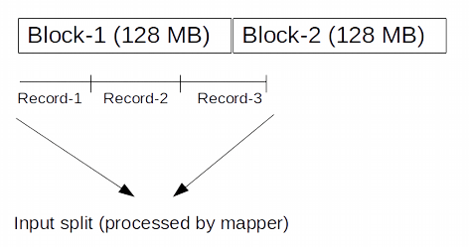
Input Split Vs HDFS blocks
HDFS block is the physical representation of the data,
Input split is the logical representation of the data.
Data is stored in HDFS with no consideration for record boundaries.
For example if each record is 50 MB then two records will fit with in the block but the third record won’t fit, 28 MBs of the third record will be stored in another block.
If a mapper processes a block then it won’t be able to process the third record as it won’t get the full record.
Input split honors logical record boundaries. Using the starting record in the block and the byte offset it can get the complete record even if it spans the block boundaries.
Thus the mapper working on the input split will be able to process all 3 records even if part of third record is stored in another block.

Slide 21
HDFS Inside: Read
1
Name Node
Client
2
3
4
DN1
DN2
DN3
. . .
DNn
Client connects to NN to read data
NN tells client where to find the data blocks
Client reads blocks directly from data nodes (without going through NN)
In case of node failures, client connects to another node that serves the missing block
Notes:
Analogy: Name Node is like the Index cards in library. When you borrow a book, go to find its index in the central place and then go to book shelves and find those books

Slide 22
HDFS Inside: Read
Q: Why does HDFS choose such a design for read? Why not ask client to read blocks through NN?
Reasons:
Prevent NN from being the bottleneck of the cluster
Allow HDFS to scale to large number of concurrent clients
Spread the data traffic across the cluster

Slide 23
HDFS Inside: Read
Q: Given multiple replicas of the same block, how does NN decide which replica the client should read?
HDFS Solution:
Rack awareness based on network topology

Slide 24
HDFS Inside: Network Topology
The critical resource in HDFS is bandwidth, distance is defined based on that
Measuring bandwidths between any pair of nodes is too complex and does not scale
Basic Idea:
Processes on the same node
Different nodes on the same rack
Nodes on different racks in the same
data center (cluster)
Nodes in different data centers
Bandwidth becomes less
Notes:
scarece

Slide 25
HDFS Inside: Network Topology
HDFS takes a simple approach:
See the network as a tree
Distance between two nodes is the sum of their distances to their closest common ancestor
Rack 1
Rack 2
Rack 3
Rack 4
n1
n3
n5
n7
n2
n4
n6
n8
Data center 1
Data center 2
Notes:
Do a short excise

Slide 26
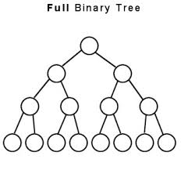
HDFS Inside: Network Topology
What are the distance of the following pairs:
Dist (d1/r1/n1, d1/r1/n1)=
Dist(d1/r1/n1, d1/r1/n2)=
Dist(d1/r1/n1, d1/r2/n3)=
Dist(d1/r1/n1, d2/r3/n6)=
0
2
Data center
4
Rack
6
Node
Rack 1
Rack 2
Rack 3
Rack 4
n1
n3
n5
n7
n2
n4
n6
n8
Data center 1
Data center 2
Notes:
Do a short excise

Slide 27
HDFS Inside: Write
1
Name Node
Client
2
4
3
DN1
DN2
DN3
. . .
DNn
Client connects to NN to write data
NN tells client write these data nodes
Client writes blocks directly to data nodes with desired replication factor
In case of node failures, NN will figure it out and replicate the missing blocks
Notes:
Q: what happens if a node fails during write?

Slide 28
HDFS Inside: Write
Q: Where should HDFS put the three replicas of a block? What tradeoffs we need to consider?
Tradeoffs:
Reliability
Write Bandwidth
Read Bandwidth
Q: What are some possible strategies?

Slide 29


HDFS Inside: Write
Replication Strategy vs Tradeoffs
 | Reliability | Write Bandwidth | Read Bandwidth
Put all replicas on one node
Put all replicas on different racks

Slide 30

HDFS Inside: Write
Replication Strategy vs Tradeoffs
 | Reliability | Write Bandwidth | Read Bandwidth
Put all replicas on one node
Put all replicas on different racks
HDFS: 1-> same node as client 2-> a node on different rack 3-> a different node on the same rack as 2

Slide 31
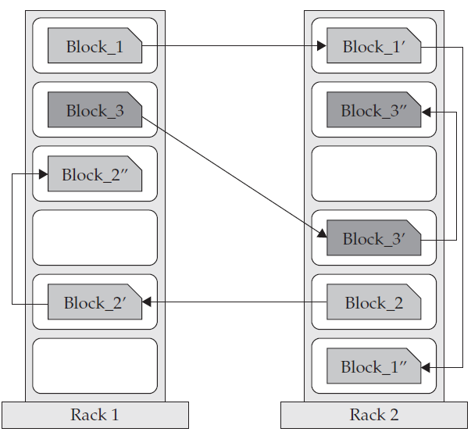
HDFS Inside: Replication
Blocks of data are replicated to multiple nodes
Behavior is controlled by replication factor, configurable per file
Default is 3 replicas
Common case:
one replica on one node in the local rack
another replica on a different node in the local rack
and the last on a different node in a different rack
This cuts inter-rack network bandwidth, which improves write performance
Notes:
To ensure reliability and performance, the placement of replicas is critical to HDFS. HDFS can be distinguished from most other distributed file systems by replica placement. This feature requires tuning and experience. Improving data reliability, availability, and network bandwidth utilization are the purpose of a rack-aware replica placement policy. The current implementation for the replica placement policy is a first effort in this direction. The short-term goals of implementing this policy are to validate it on production systems, learn more about its behavior, and build a foundation to test and research more sophisticated policies.
Large HDFS instances run on a cluster of computers that commonly spread across many racks. Communication between two nodes in different racks has to go through switches. In most cases, network bandwidth between machines in the same rack is greater than network bandwidth between machines in different racks.
The NameNode determines the rack id each DataNode belongs to via the process outlined in Rack Awareness(http://hadoop.apache.org/docs/r0.17.1/hdfs_user_guide.html#Rack+Awareness). A simple but non-optimal policy is to place replicas on unique racks. This prevents losing data when an entire rack fails and allows use of bandwidth from multiple racks when reading data. This policy evenly distributes replicas in the cluster which makes it easy to balance load on component failure. However, this policy increases the cost of writes because a write needs to transfer blocks to multiple racks.
For the common case, when the replication factor is three, HDFS’s placement policy is to put one replica on one node in the local rack, another on a different node in the local rack, and the last on a different node in a different rack. This policy cuts the inter-rack write traffic which generally improves write performance. The chance of rack failure is far less than that of node failure; this policy does not impact data reliability and availability guarantees. However, it does reduce the aggregate network bandwidth used when reading data since a block is placed in only two unique racks rather than three. With this policy, the replicas of a file do not evenly distribute across the racks. One third of replicas are on one node, two thirds of replicas are on one rack, and the other third are evenly distributed across the remaining racks. This policy improves write performance without compromising data reliability or read performance.

Slide 32
HDFS Good and Bad
Very large files
Streaming data access
Commodity hardware
Low-latency data access
Lots of small files
Multiple writers, arbitrary file modifications

Slide 33



Hadoop Distributed File System (HDFS)
Distributed, scalable, fault tolerant, high throughput
Data access through MapReduce
Files split into blocks
3 replicas for each piece of data by default
Can create, delete, copy, but NOT update
Designed for streaming reads, not random access
Data locality: processing data on or near the physical storage to decrease transmission of data

Slide 34
HDFS Interface
Web Based Interface
http://localhost:50070/
Command Line: Hadoop FS Shell
https://hadoop.apache.org/docs/r2.8.0/hadoop-project-dist/hadoop-common/FileSystemShell.html

Slide 35
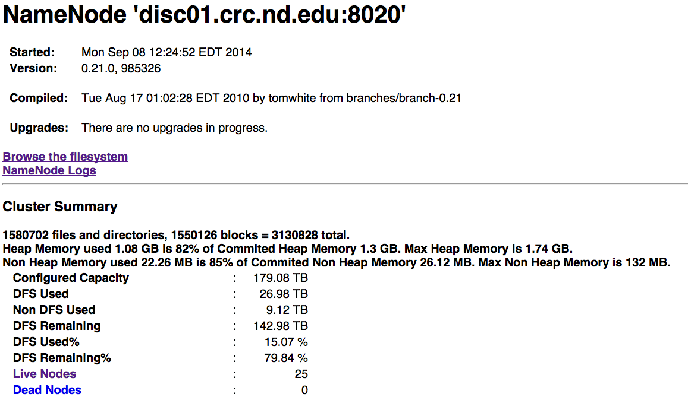
HDFS-Web UI

Slide 36
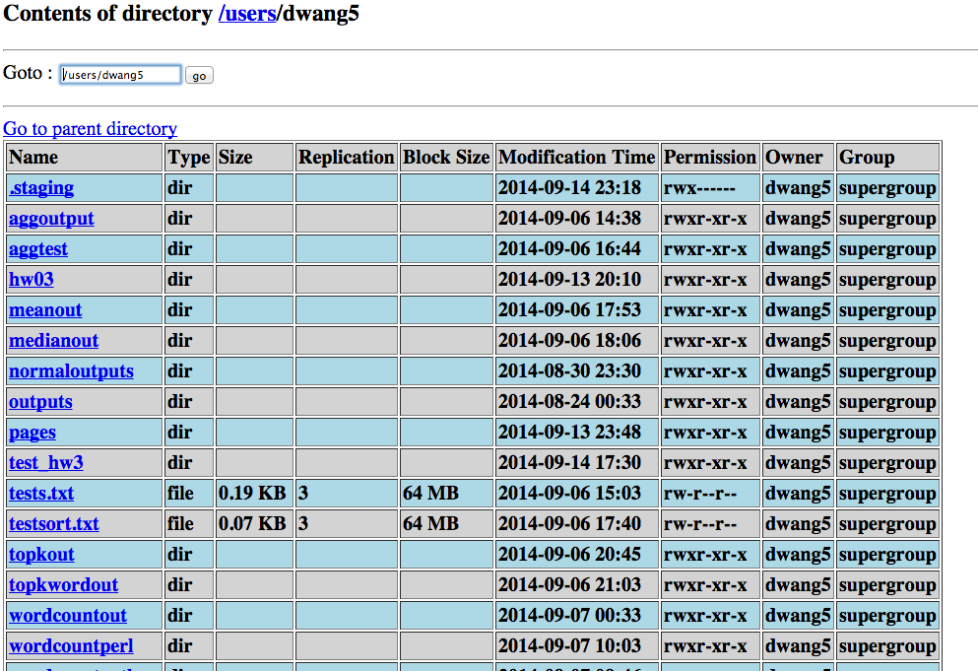
HDFS-Web UI

Slide 37
Command Line: Hadoop FS Shell
File System Shell (fs)
Invoked as follows:
hadoop fs <args>
hdfs dfs <args>
Example:
Listing the current directory in hdfs
hadoop fs –ls .
37
Notes:
Now let’s talk about the HDFS command line interface.
HDFS can be manipulated through a Java API or through a command line interface. All commands for manipulating HDFS through Hadoop's command line interface begin with "hadoop", a space, and "fs“ (or “dfs”). This is the file system shell. This is followed by the command name as an argument to "hadoop fs". These commands start with a dash. For example, the "ls" command for listing a directory is a common UNIX command and is preceded with a dash. As on UNIX systems, ls can take a path as an argument. In this example, the path is the current directory, represented by a single dot.
As we saw, ‘fs’ is one of the options for ‘hadoop’. If you just type ‘hadoop’ by itself, you will see other options.

Slide 38
Command Line: Hadoop FS Shell
FS shell commands take URIs as argument
URI format:
scheme://authority/path
Scheme:
For the local filesystem, the scheme is file
For HDFS, the scheme is hdfs
Authority is the hostname and port of the NameNode
hadoop fs –copyFromLocal
file:///myfile.txt
hdfs://localhost:9000/user/keith/myfile.txt
Scheme and authority are optional
Defaults are taken from configuration file core-site.xml
38
Notes:
As we saw for the "ls" command, the file system shell commands can take paths as arguments. These paths can be expressed in the form of uniform resource identifiers or URIs. The URI format consists of a scheme, an authority, and path. There are multiple schemes supported. The local file system has a scheme of "file". HDFS has a scheme called "hdfs".
For example, let us say you wish to copy a file called "myfile.txt" from your local filesystem to an HDFS file system on the localhost. You can do this by issuing the command shown. The copyFromLocal command takes a URI for the source and a URI for the destination.
“Authority” is the hostname of the NameNode. For example, if the NameNode is in localhost on port 9000, “authority” would be localhost:9000
The scheme and the authority do not always need to be specified. Instead you may rely on their default values. These defaults can be overridden by specifying them in a file named core-site.xml in the conf directory of your Hadoop installation.

Slide 39
Command Line: Hadoop FS Shell
Many POSIX-like commands
cat, chgrp, chmod, chown, cp, du, ls, mkdir, mv, rm, stat, tail
Some HDFS-specific commands
copyFromLocal, put, copyToLocal, get, getmerge, setrep
39
39
Notes:
HDFS supports many POSIX-like commands. HDFS is not a fully POSIX (Portable operating system interface for UNIX) compliant file system, but it supports many of the commands. The HDFS commands are mostly easily-recognized UNIX commands like cat and chmod. There are also a few commands that are specific to HDFS such as copyFromLocal. We'll examine a few of these.
Note there is no ‘cd’ command for HDFS

Slide 40
HDFS – FS shell commands
copyFromLocal / put
Copy files/dir from the local file system into fs
hadoop fs -copyFromLocal <localsrc> .. <dst>
Or
hadoop fs -put <localsrc> .. <dst>
40
40
Notes:
copyFromLocal and put are two HDFS-specific commands that do the same thing - copy files from the local filesystem to a location on another filesystem.
Their opposite is the copyToLocal command which can also be referred to as get.

Slide 41
HDFS – FS shell commands
copyToLocal / get
Copy files/dir from fs into the local file system
hadoop fs -copyToLocal [-ignorecrc] [-crc]
<src> <localdst>
Or
hadoop fs -get [-ignorecrc] [-crc]
<src> <localdst>
41
41
Notes:
The copyToLocal (a.k.a get) command copies files out of the file system you specify and into the local file system.
get
Usage: hadoop fs -get [-ignorecrc] [-crc] <src> <localdst>
Copy files to the local file system. Files that fail the CRC check may be copied with the -ignorecrc option. Files and CRCs may be copied using the -crc option.
Example:
hadoop fs -get hdfs:/mydir/file file:///home/hdpadmin/localfile

Slide 42
Using HDFS
hadoop fs
[-ls <path>]
[-du <path>]
[-cp <src> <dst>]
[-rm <path>]
[-put <localsrc> <dst>]
[-copyFromLocal <localsrc> <dst>]
[-moveFromLocal <localsrc> <dst>]
[-get [-crc] <src> <localdst>]
[-cat <src>]
[-copyToLocal [-crc] <src> <localdst>]
[-moveToLocal [-crc] <src> <localdst>]
[-mkdir <path>]
[-touchz <path>]
[-test -[ezd] <path>]
[-stat [format] <path>]
[-help [cmd]]
Basically we see most commands look similar
hadoop “some command” options
If you just type hadoop fs you get all possible commands

Slide 43
Parallel Copying Between Clusters with distcp
% hadoop distcp file1 file2
% hadoop distcp dir1 dir2
(You can specify multiple source paths)
% hadoop distcp -update dir1 dir2
(update only the files that have changed)
% hadoop distcp -update -delete -p hdfs://namenode1/foo hdfs://namenode2/foo
distcp is implemented as a MapReduce job (default 20 maps and no reduce). (argument –m 20)
It is important to keep an HDFS Cluster Balanced. (How?)

