Slide 1
YARN (Yet Another Resource Negotiator)
Elsayed Hemayed
The original slides are from EMC and IBM.

Slide 2
Overview of Topics
MapReduce V1 (before YARN) vs. V2 (YARN)
Scheduling in YARN and Configuration
Queue placement, Preemption and Delay Scheduling
Dominant Resource Fairness (DRF)
Notes:
The topics covered in this lesson are listed.

Slide 3
MapReduce Engine –V1 (before YARN)
Master / Slave architecture
Single master (JobTracker) controls job execution on multiple slaves (TaskTrackers).
JobTracker
Accepts MapReduce jobs submitted by clients
Pushes map and reduce tasks out to TaskTracker nodes
Keeps the work as physically close to data as possible
Monitors tasks and TaskTracker status
TaskTracker
Runs map and reduce tasks
Reports status to JobTracker
Manages storage and transmission of intermediate output
cluster
Computer 1
JobTracker
TaskTracker
TaskTracker
TaskTracker
TaskTracker
Computer 2
Computer 3
Computer 4
Computer 5
Notes:
If one TaskTracker is very slow, it can delay the entire MapReduce job - especially towards the end of a job, where everything can end up waiting for the slowest task. With speculative-execution enabled, however, a single task can be executed on multiple slave nodes.
For jobs scheduling, by default Hadoop uses FIFO (First in, First Out), and optional 5 scheduling priorities to schedule jobs from a work queue

Slide 4
How does Hadoop run MapReduce jobs- V1
1. run job
2. get new job ID
MapReduce
program
JobClient
JobTracker
5. initialize job
4. submit job
client JVM
jobtracker node
client node
6. retrieve
input splits
7. heartbeat
(returns task)
3. copy job
resources
Distributed file system (e.g. HDFS)
TaskTracker
8. retrieve
job resources
9. launch
child JVM
Child
Client: submits MapReduce jobs
JobTracker: coordinates the job run, breaks down the job to map and reduce tasks for each node to work on the cluster
TaskTracker: execute the map and reduce functions
10. run
MapTask
or
ReduceTask
tasktracker node
Notes:
1.The process of running a MapReduce job on Hadoop consists of 8 major steps.
The first step is the MapReduce program you've written tells the JobClient to run a MapReduce job.
2. This sends a message to the JobTracker which produces a unique ID for the job.
3. The JobClient copies job resources, such as a jar file containing a Java code you have written to implement the map or the reduce task, to the shared file system, usually HDFS.
4. Once the resources are in HDFS, the JobClient can tell the JobTracker to start the job.
5. The JobTracker does its own initialization for the job. It calculates how to split the data so that it can send each "split" to a different mapper process to maximize throughput. (?)
6. It retrieves these "input splits" from the distributed file system. NOT THE DATA itself.
7. The TaskTrackers are continually sending heartbeat messages to the JobTracker.
8. Now that the JobTracker has work for them, it will return a map task or a reduce task as a response to the heartbeat.
The TaskTrackers need to obtain the code to execute, so they get it from the shared file system.
9. Then they can launch a Java Virtual Machine with a child process running in it
10. and this child process runs your map code or your reduce code. The result of the map operation will remain in the local disk for the given TaskTracker node (not in HDFS)
The output of the Reduce task is stored in HDFS file system using the number of copies specified by replication factor.

Slide 5
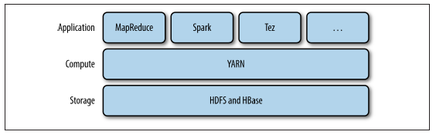
YARN
Hadoop’s cluster resource management system.
YARN was introduced in Hadoop 2 to improve the MapReduce implementation
YARN provides APIs for requesting and working with cluster resources,
but they are not used directly, rather through other distributed computing frameworks built on YARN and hide the resource management details from the user.

Slide 6
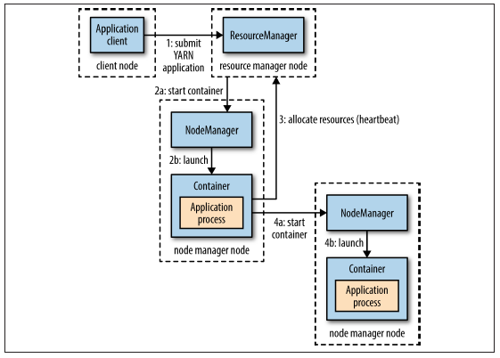
How YARN runs an application

Slide 7
How does Hadoop run MapReduce jobs- V2
Step 1: A client contacts the resource manager and asks it to run an application master process.
Step 2: The resource manager then finds a node manager that can launch the application master in a container
The application master could simply run a computation in the container it is running in and return the result to the client. Or
Step 3: it could request more containers from the resource managers
Step 4: It uses the containers to run a distributed computation.
Note:
YARN does not provide any way for the parts of the application (client, master, process) to communicate with one another

Slide 8
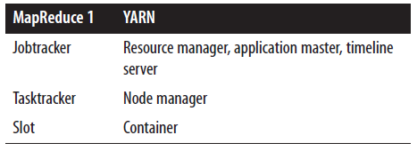
YARN Compared to MapReduce 1
Scalability: (4,000→10,000 nodes, 40,000→100,000 tasks)
Availability: provide HA for the resource manager, then for YARN applications (on a per-application basis).
Utilization: In YARN, a node manager manages a pool of resources, rather than a fixed number of designated slots as in MR 1.
Multitenancy: YARN opens up Hadoop to other types of distributed application beyond MapReduce

Slide 9
Resource Requests
A request for a set of containers include
Computer resources required for each container (memory and CPU), and
Locality constraints for the containers in that request. (on specific node, rack, off-rack)
If locality constrain is not met then
either no allocation is made or,
optionally, the constraint can be loosened.
A YARN application can make all of its requests up front, (Spark, MapReduce Map). or
It can requests more resources dynamically to meet the changing needs of the application. (MapReduce Reduce, failed tasks)

Slide 10
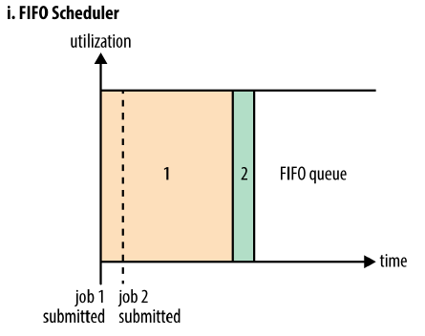
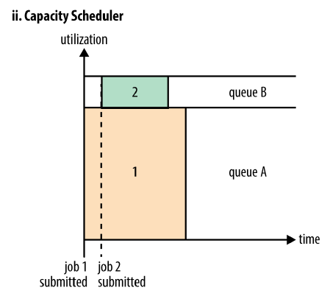
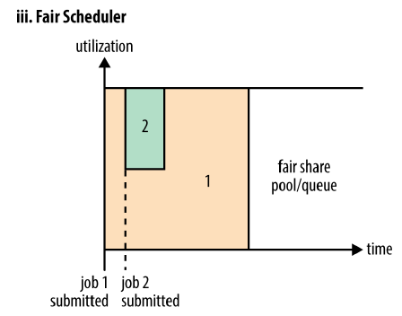
Scheduling in YARN
First In First Out
It’s not suitable for shared clusters.
Fairness?
Capacity Scheduler
A separate dedicated queue allows the small job to start as soon as it is submitted.
Within a queue, applications are scheduled using FIFO scheduling
Utilization?
Fair Scheduler
No capacity reservation, it dynamically balance resources between all running jobs.

Slide 11
Capacity Scheduler Configuration (queue elasticity)
If there is more than one job in the queue and there are idle resources available, then the Capacity Scheduler may allocate the spare resources to jobs in the queue, even if that causes the queue’s capacity to be exceeded.
If the property yarn.scheduler.capacity.<queue-path>.user-limit-factor is set to a value larger than 1 (the default), then a single job is allowed to use more than its queue’s capacity.

Slide 12
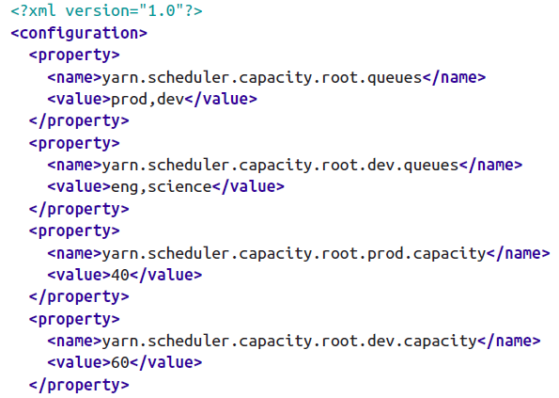
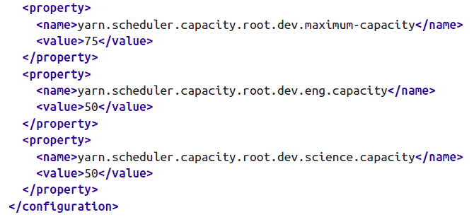
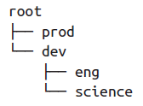
Capacity Scheduler Configuration (capacity-scheduler.xml)
40 → 100
60 →75
50 → 100 (dev)
50 → 100 (dev)
yarn.scheduler.capacity.<queue-path>.<sub-property>
See reference page for details:
http://hadoop.apache.org/docs/current/hadoop-yarn/hadoop-yarn-site/CapacityScheduler.html

Slide 13
Queue placement
To specify which queue an application is placed in is specific to the application.
In MapReduce, you set the property mapreduce.job.queue name to the name of the queue you want to use.
If the queue does not exist, then you’ll get an error at submission time.
If no queue is specified, applications will be placed in a queue called default.

Slide 14
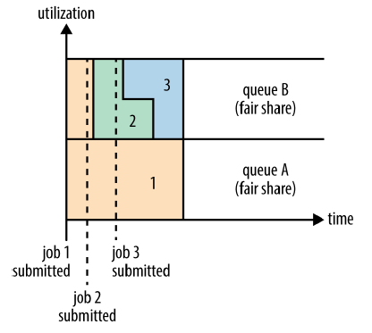
Fair Scheduler Configuration (yarn-site.xml)
Setting the schedule in yarn-site.xml
yarn.resourcemanager.scheduler.class=
org.apache.hadoop.yarn.server.resourcemanager.
scheduler.fair.FairScheduler
The default in some hadoop (not Cloudera)
org.apache.hadoop.yarn.server.resourcemanager.scheduler.capacity.CapacityScheduler
Fair sharing between user queues A, B

Slide 15
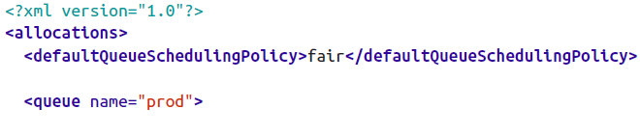
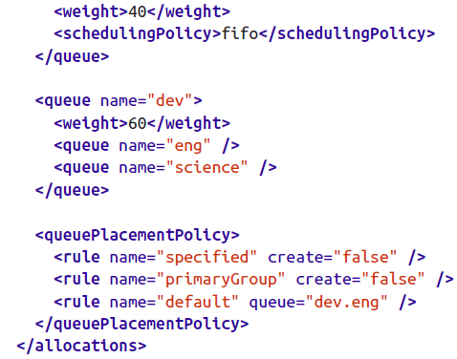
Fair Scheduler Configuration (fair-scheduler.xml)
Can be 2 and 3
(does not have to be %)
See reference page for details:
http://hadoop.apache.org/docs/current/hadoop-yarn/hadoop-yarn-site/FairScheduler.html

Slide 16
Queue Placement
The Fair Scheduler uses a rules-based system to determine which queue an application is placed in.
The queuePlacementPolicy element contains a list of rules, each of which is tried in turn until a match occurs.
The first rule, specified, places an application in the queue it specified;
if none is specified, or if the specified queue doesn’t exist, then the rule doesn’t match and the next rule is tried.
The primaryGroup rule tries to place an application in a queue with the name of the user’s primary Unix group;
If there is no such queue, rather than creating it, the next rule is tried.
The default rule is a catch-all and always places the application in the dev.eng queue.

Slide 17


Queue Placement
If the queuePlacementPolicy is
omitted then the default behavior
is applied
Another simple queue placement
policy: all applications are placed in the
same (default) queue. This allows
resources to be shared fairly between
applications, rather than users.
Or by setting yarn.scheduler.fair.user-as-default-queue to false and set yarn.scheduler.fair.allow-undeclared-pools should be set to false so that users can’t create queues on the fly

Slide 18
Preemption
Preemption allows the scheduler to kill containers for queues that are running with more than their fair share of resources so that the resources can be allocated to a queue that is under its fair share.
Note that preemption reduces overall cluster efficiency, since the terminated containers need to be re-executed.
Preemption is enabled globally by setting yarn.scheduler.fair.preemption to true.

Slide 19
Preemption (Minimum Share)
If a queue waits for as long as its minimum share preemption timeout without receiving its minimum guaranteed share, then the scheduler may preempt other containers.
The default timeout is set for all queues via the defaultMinSharePreemptionTimeout
and on a per-queue basis by setting the minSharePreemptionTimeout

Slide 20
Preemption (Fair Share)
If a queue remains below half of its fair share for as long as the fair share preemption timeout, then the scheduler may preempt other containers.
The default timeout is set for all queues via the defaultFairSharePreemptionTimeout
and on a per-queue basis by setting fairSharePreemptionTimeout.
The threshold may also be changed from its default of 0.5 by setting defaultFairSharePreemptionThreshold and fairSharePreemptionThreshold (per-queue).

Slide 21
Delay Scheduling
All the YARN schedulers try to honor locality requests. On a busy cluster, if an application requests a particular node and it is not available. Then the scheduler loosen the locality requirement and allocate a container on the same rack.
When using delay scheduling, the scheduler waits for up to a given maximum number of scheduling opportunities (Heartbeat every second) to occur before loosening the locality constraint and taking the next scheduling opportunity.
Capacity Scheduler: set yarn.scheduler.capacity.node-locality-delay to positive integer
Fair Scheduler: set yarn.scheduler.fair.locality.threshold.node to proportion of the cluster size
Set yarn.scheduler.fair.locality.threshold.rack the threshold before another rack is accepted instead of the one requested

Slide 22
Dominant Resource Fairness (DRF)
Example
Imagine a cluster with a total of 100 CPUs and 10 TB of memory.
Application A requests containers of (2 CPUs, 300 GB),
Application B requests containers of (6 CPUs, 100 GB).
A’s request is (2%, 3%) of the cluster, so memory is dominant.
B’s request is (6%, 1%), so CPU is dominant.
Since B’s container requests are twice as big in the dominant resource (6% versus 3%), it will be allocated half as many containers under fair sharing.
By default DRF is not used, and only memory is considered. To use DRF:
Capacity Scheduler: set yarn.scheduler.capacity.resource-calculator to org.apache.hadoop.yarn.util.resource.DominantResourceCalculator in capacity-scheduler.xml.
Fair Scheduler: set QueueSchedulingPolicy to drf

Slide 23
DRF Fair Share Calculation
A requirement: 2x CPUs + 300x GB Memory (2 CPUs and 300 GB Memory for each container)
B Requirement: 6y CPUs + 100y GB Memory (6 CPUs and 100 GB Memory for each container)
Total Requirement:
2x + 6y <= 100 CPUs
300x + 100y <= 10000 GB Memory
DRF will try to equalize the dominant needs of A and B
A's dominant need: 300x / 10000 GB (300x out of 10000 GB of total memory)
B's dominant need: 6y / 100 CPUs (6y out of 100 CPUs)
DRF will try to equalize the percentage RAM needs of Job A to the percentage CPU needs of Job B
(300x / 10000) = (6y / 100)
Solving the above equation gives x = 2y
If you substitute x = 2y and solve 2x + 6y <= 100 CPUs, you will get x=20 and y=10.
Application A is allocated 20 containers: (40 CPUs, 6000 GB of memory)
Application B is allocated 10 containers: (60 CPUs, 1000 GB of memory)
Job A RAM = 300/10000*20 = 6/10
Job B CPU = 6/100*10 = 6/10 fair

Slide 24
Key Points
MapReduce V1 (before YARN) vs. V2 (YARN)
Scheduling in YARN and Configuration
Queue placement, Preemption and Delay Scheduling
Dominant Resource Fairness (DRF)

