Slide 1
Hadoop I/O
Elsayed Hemayed

Slide 2
Overview of Topics
Data Integrity
Compression
Compression and Input Splits
Using Compression in MapReduce
Serialization
File-Based Data Structures
SequenceFile
MapFile
Avro Datafiles
Row-oriented versus column-oriented storage
Notes:
The topics covered in this lesson are listed.

Slide 3
Data Integrity
Detecting corrupted data by computing a checksum for the data when it first enters the system, and whenever it is transmitted.
HDFS uses CRC-32C
HDFS checksums all data written to it and by default verifies checksums when reading data.
A separate checksum is created for every dfs.bytes-per-checksum bytes of data.
The default is 512 bytes so the storage overhead is less than 1%. (32/512)

Slide 4
Data Integrity in HDFS
Datanodes are responsible for verifying the data they receive (from clients or other Datanodes) before storing the data and its checksum.
HDFS can “heal” corrupted blocks by copying one of the good replicas to produce a new, uncorrupt replica.
If bad block then
Report to Namenode
Namenode marks the block replica as corrupt
Namenode schedules a copy of the block to be replicated on another datanode
The corrupt replica is deleted

Slide 5
Data Integrity in HDFS (cont.)
When clients read data from datanodes, they verify checksums.
Each datanode keeps a persistent log of checksum verifications (the last time each of its blocks was verified).
When a client successfully verifies a block, it tells the datanode, which updates its log.
Keeping statistics such as these is valuable in detecting bad disks.
In addition to block verification on client reads, each datanode runs a DataBlockScanner in a background thread that periodically verifies all the blocks stored on the datanode.
This is to guard against corruption in the physical storage media

Slide 6
Data Integrity in HDFS (cont.)
It is possible to disable verification of checksums by using the -ignoreCrc option with the -get or -copyToLocal command.
This feature is useful if you have a corrupt file that you want to inspect so you can decide what to do with it.
You can find a file’s checksum with hadoop fs -checksum. This is useful to check whether two files in HDFS have the same contents

Slide 7
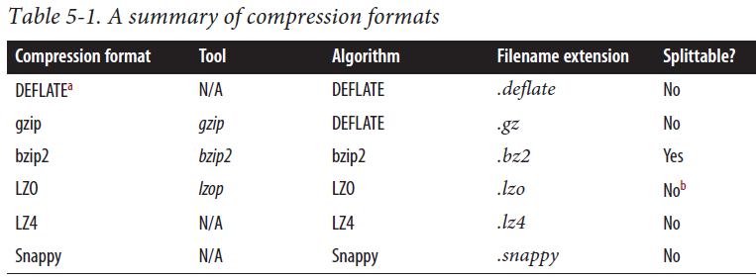
Compression
Save space and data transfer
Compression algorithms exhibit a space/time trade-off,
–1 means optimize for speed, and -9 means optimize for space. Example: % gzip -1 file

Slide 8
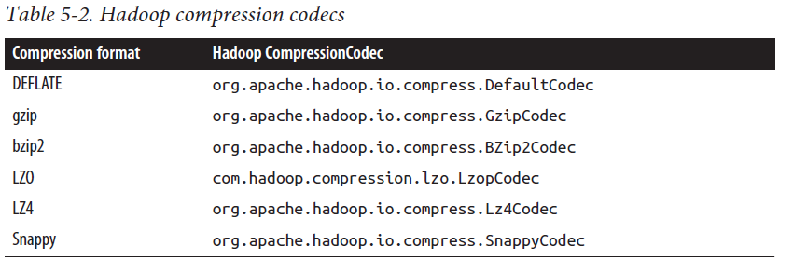
Codec
Implementation of a compression-decompression algorithm

Slide 9
Compression and Input Splits
For uncompressed file in HDFS whose size is 1 GB. With an HDFS block size of 128 MB,
stored as eight blocks,
a MapReduce job will create eight input splits/maps.
For a gzip-compressed file (does not support split) whose compressed size is 1 GB.
HDFS will store the file as eight blocks.
However it is impossible for a map task to read its split independently of the others.
In this case, MapReduce will not try to split the gzipped file, since it knows that the input is gzip-compressed (by looking at the filename extension) and that gzip does not support splitting.
This will work, but at the expense of locality: a single map will process the eight HDFS blocks, most of which will not be local to the map.
Also, with fewer maps, the job is less granular and so may take longer to run.

Slide 10
Which Compression Format Should I Use?
Use a container file format such as sequence files, Avro datafiles, ORCFiles, or Parquet files, all of which support both compression and splitting.
Use a compression format that supports splitting, such as bzip2 (although bzip2 is fairly slow), or one that can be indexed to support splitting, such as LZO.
Split the file into chunks in the application, and compress each chunk separately using any supported compression format (it doesn’t matter whether it is splittable).
In this case, you should choose the chunk size so that the compressed chunks are approximately the size of an HDFS block.
Store the files uncompressed.

Slide 11
Using Compression in MapReduce
If your input files are compressed, they will be decompressed automatically as they are read by MapReduce, using the filename extension to determine which codec to use.
In order to compress the output of a MapReduce job, in the job configuration, set the mapreduce.output.fileoutputformat.compress property to true and set the mapreduce.output.fileoutputformat.compress.codec property to the classname of the compression codec you want to use.
For sequence output files, you can set the mapreduce.output.fileoutputformat.compress.type property to
RECORD (default) (compress individual records) or
BLOCK, (compresses groups of records), is recommended because it compresses better

Slide 12
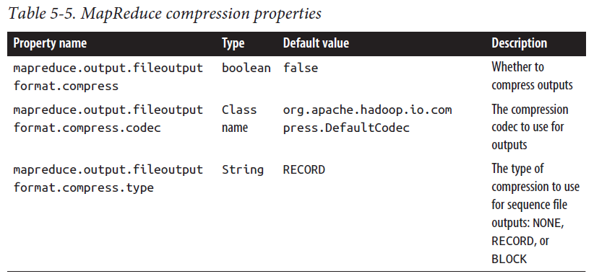
MapReduce Compression Properties

Slide 13
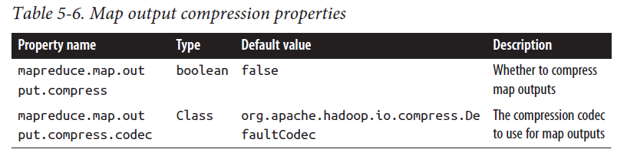
Compressing Map Output
Why?

Slide 14
Serialization
Serialization is the process of turning structured objects into a byte stream for transmission over a network or for writing to persistent storage.
Deserialization is the reverse process of turning a byte stream back into a series of structured objects.
Serialization is used mainly for interprocess communication and for persistent storage.
In Hadoop, RPC is used for interprocess communication between nodes

Slide 15
Serialization Format
RPC serialization format (also storage format) should be
Compact
Fast
Extensible
Interoperable
Hadoop uses its own serialization format, Writables,
Avro is another serialization frameworks supported in Hadoop.

Slide 16
File-Based Data Structures SequenceFile
For some applications, you need a specialized data structure to hold your data.
Sequence files are binary files containing serialized key/value pairs.
Sequence files are binary files, so they provide faster read/write than that of text file format
You can compress a sequence file at the record (key-value pair) or block levels. This is one of the advantage of using sequence file.

Slide 17
Record Compression

Slide 18
Block Compression

Slide 19
Packing Smaller Files into SequenceFiles
One data file of 128 MB is represented by two namespace objects on the NameNode (1 file inode + 1 block) and consumes approximately 300 bytes of memory.
By contrast, 128 files of 1 MB each are represented by 256 namespace objects (128 file inodes + 128 blocks) and consume approximately 38,400 bytes.
SequenceFiles can be used as containers for smaller files
Packing files into a SequenceFile makes storing and processing the smaller files more efficient (Processing a whole file as a record).

Slide 20
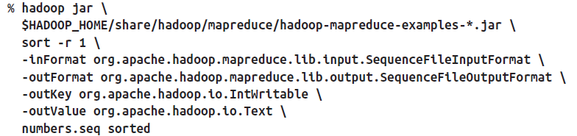
Sorting and Merging SequenceFiles
We can use MapReduce to sort and merge SequenceFiles.
Using the sort example that comes with Hadoop by specifying that the input and output are sequence files and by setting the key and value types.

Slide 21
Displaying a SequenceFile with the command-line interface
The hadoop fs command has a -text option to display sequence files in textual form.
% hadoop fs –text filename
It can attempt to detect the type of the file and appropriately convert it to text.
It can recognize gzipped files, sequence files, and Avro datafiles; otherwise, it assumes the input is plain text.

Slide 22
File-Based Data Structures MapFile
A MapFile is a sorted SequenceFile with an index to permit lookups by key.
The index is itself a SequenceFile that contains a fraction of the keys in the map (every 128th key, by default).
The idea is that the index can be loaded into memory to provide fast lookups from the main data file, which is another SequenceFile containing all the map entries in sorted key order.
MapFile offers a very similar interface to SequenceFile for reading and writing—the main thing to be aware of is that when writing using MapFile.Writer, map entries must be added in order, otherwise an IOException will be thrown.

Slide 23
Avro Datafiles
Avro datafiles are designed for large-scale data processing—they are compact and splittable— portable across different programming languages.
Objects stored in Avro datafiles are described by a schema.
Avro datafiles are widely supported across components in the Hadoop ecosystem, so they are a good default choice for a binary format.

Slide 24
Avro Schema Example
{
"type" : "record",
"namespace" : "Tutorialspoint",
"name" : "Employee",
"fields" : [
{ "name" : "Name" , "type" : "string" },
{ "name" : "Age" , "type" : "int" }
]
}

Slide 25
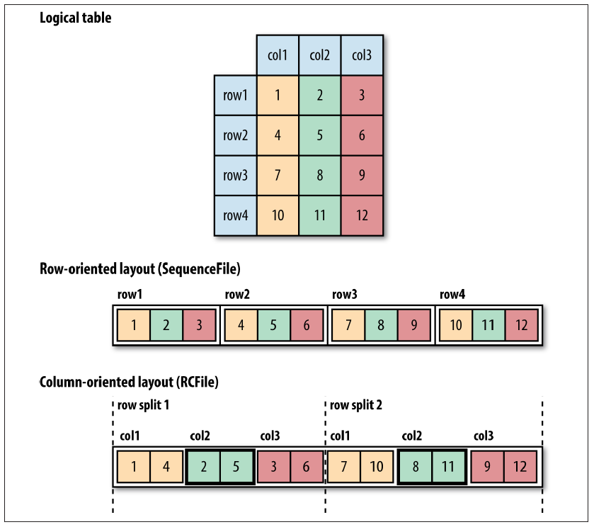
Row-oriented versus column-oriented storage
column-oriented formats work well when queries access only a small number of columns in the table.
Row-oriented formats are appropriate when a large number of columns of a single row are needed for processing at the same time.

Slide 26
Row-oriented versus column-oriented storage
Column-oriented formats need more memory for reading and writing
Column-oriented formats are not suited to streaming writes
Examples:
Column-oriented: Hive files, Parquet, Avro (Trevni)
Row-oriented: Flume, Avro, Map, SequenceFile

Slide 27
Key Points
Data Integrity (Using CRC-32C)
Input file Compression (Splitable)
Compress MapReduce output, and Map Output
Serialization and SequenceFiles
Backing Small Files
MapFile
Avro datafile

