Slide 1
How MapReduce Works
Elsayed Hemayed

Slide 2
Overview of Topics
Hadoop Configuration
Job, Task, and Task Attempt IDs
How Hadoop runs a MapReduce job
Uber Task
Task Assignment
Failures
Shuffle and Sort
Job/Configuration Tuning
Speculative Execution
Input Splits
MapReduce workflow
Notes:
The topics covered in this lesson are listed.

Slide 3
Hadoop Configuration
Configuration of Hadoop using XML files
Each property has name, value, final, and description
Site-specific properties (core-site.xml)
Yarn-specific properties (yarn-site.xml)
HDFS-specific properties (hdfs-site.xml)
Map Reduce specific properties (mapred-site.xml)
Latter configuration overrides earlier ones unless the property final flag is true
Configuration files are kept under etc/hadoop directory

Slide 4
Default Hadoop Configuration
Site-specific properties (core-default.xml)
Yarn-specific properties (yarn-default.xml)
HDFS-specific properties (hdfs-default.xml)
Map Reduce specific properties (mapred-default.xml)

Slide 5
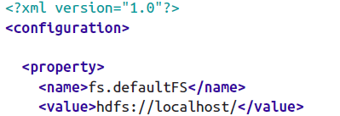
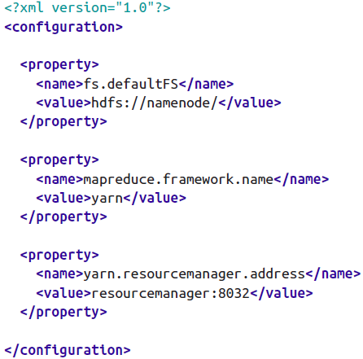
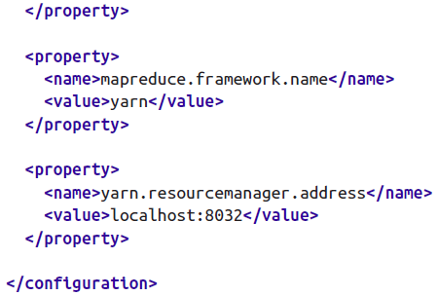
Configuration Examples
The namenode and YARN resource manager Are running on localhost
Specify the namenode and YARN resource manager address

Slide 6
Configuration Parameters Examples
Paramter | Value | Description
dfs.namenode.name.dir |  | Path on the local filesystem where the NameNode stores the namespace and transactions logs persistently.
dfs.block.size | 134217728 | HDFS blocksize of 128MB
mapreduce.framework.name | yarn | Execution framework set to Hadoop YARN
mapreduce.map.resource.memory-mb | 1024 | Sets the memory requested for the all map task containers to the value in MB. Defaults to 1024.
mapreduce.map.resource.vcores | 1 | Sets the CPU requested for the all map task containers to the value. Defaults to 1.
yarn.app.mapreduce.am.resource.memory-mb | 1536 | Sets the memory requested for the application master container to the value in MB. Defaults to 1536
yarn.app.mapreduce.am.resource.vcores | 1 | Sets the CPU requested for the application master container to the value. Defaults to 1.

Slide 7
Job, Task, and Task Attempt IDs
application_1410450250506_0003
The time that the resource manager (not the application) started.
Incrementing counter (1-based)
job_1410450250506_0003
appattempt_1410450250506_0003_000001
Containers
AM container_1410450250506_0003_01_000001
Others container_1410450250506_0003_01_000002
task_1410450250506_0003_m_000003
The fourth (0-based) map task to run
attempt_1410450250506_0003_m_000003_0
The first attempt (0-based)

Slide 8
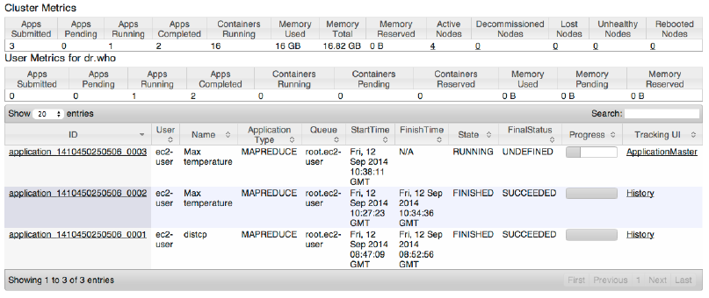
The MapReduce Web UI
http://resource-manager-host:8088/

Slide 9
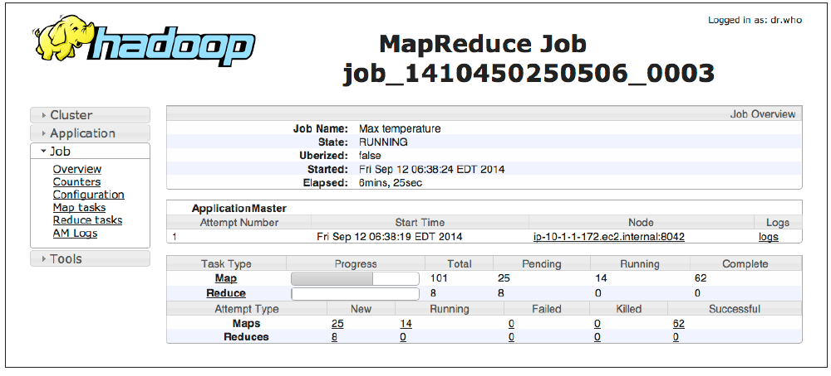
MapReduce Job Page

Slide 10
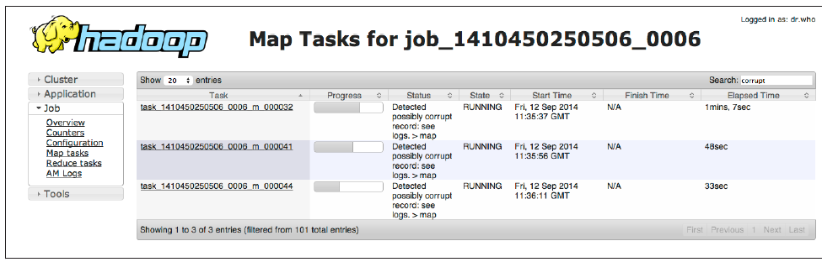
Map Tasks Page

Slide 11
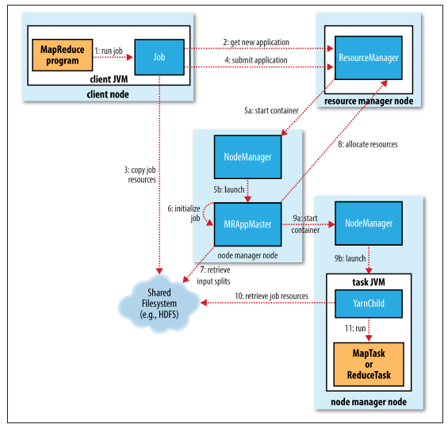
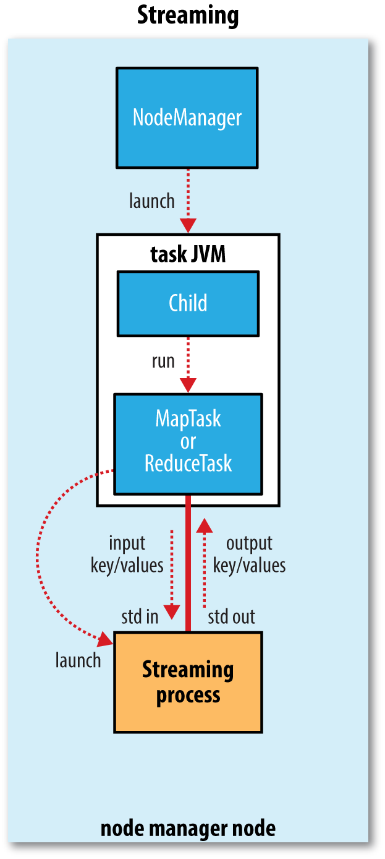
How Hadoop runs a MapReduce job

Slide 12
Step 3: Copy Job Resources
Copy the resources needed to run the job, including the job JAR file, the configuration file, and the computed input splits in a directory named after the job ID.
The job JAR is copied with a high replication factor (default=10)
mapreduce.client.submit.file.replication

Slide 13
Uber Task
If the job is small, the application master may choose to run the tasks in the same JVM as itself (uber task)
To enable uber tasks, set mapreduce.job.ubertask.enable to true
A small job is one that has less than 10 mappers, only one reducer, and an input size that is less than the size of one HDFS block. Or set
mapreduce.job.ubertask.maxmaps,
mapreduce.job.ubertask.maxreduces,
mapreduce.job.ubertask.maxbytes

Slide 14
Task Assignment
For non-small job, the application master requests containers for all the map and reduce tasks in the job from the resource manager (step 8)
Number of map tasks is the same as number of splits
Number of reduce task is 1 or set mapreduce.job.reduces
Request for reduce tasks are not made until 5% of map tasks have completed
Reduce tasks can run anywhere in the cluster, but requests for map tasks have data locality constraints that the scheduler tries to honor

Slide 15
Memory and CPU requirements for Tasks
Default is 1,024 MB of memory and one virtual core.
The values are configurable on a per-job basis (subject to minimum and maximum values)
mapreduce.map.memory.mb,
mapreduce.reduce.memory.mb,
mapreduce.map.cpu.vcores,
mapreduce.reduce.cpu.vcores

Slide 16
Task Failure
Task throws a runtime exception or sudden exit of the task JVM
The application master marks the task attempt as failed, and frees up the container
For Streaming tasks, if the Streaming process exits with a nonzero exit code, it is marked as failed. (stream.non.zero.exit.is.failure) (true).

Slide 17
Hanging Tasks
If no progress update for 10 minutes then
The task is marked as failed.
The task JVM process will be killed.
Application Master reschedules execution of the task.
If fails 4 times, the whole job fails
mapreduce.task.timeout (milliseconds)
mapreduce.map.maxattempts
mapreduce.reduce.maxattempts
mapreduce.map.failures.maxpercent
mapreduce.reduce.failures.maxpercent

Slide 18
Application Master Failure
If AM fails to run 2 times, the job fails
RM starts new AM
AM uses the job history to recover the state of the tasks that were already run by the failed AM.
mapreduce.am.max-attempts (job level)
yarn.resourcemanager.am.max-attempts (cluster)
yarn.app.mapreduce.am.job.recovery.enable (true)

Slide 19
Node Manager Failure
If RM notice a node manager that has stopped sending heartbeats for 10 minutes
It removes it from its pool of nodes
map tasks that were run and completed successfully on the failed node manager will be rerun if they belong to incomplete jobs
If more than three tasks fail on a node manager, it is blacklisted for that job only.
yarn.resourcemanager.nm.liveness-monitor.expiry-interval-ms
mapreduce.job.maxtaskfailures.per.tracker

Slide 20
Resource Manager Failure
RM is a single point of failure so for HA, we run a pair of RM in an active-standby configuration
Information about all the running applications is stored in a highly available state store (backed by ZooKeeper or HDFS), so that the standby can recover the core state of the failed RM.
Node manager information can be reconstructed by the new RM as the node managers send their first heartbeats.
The new RM restarts the application masters for all the applications running on the cluster
What about Tasks status?

Slide 21
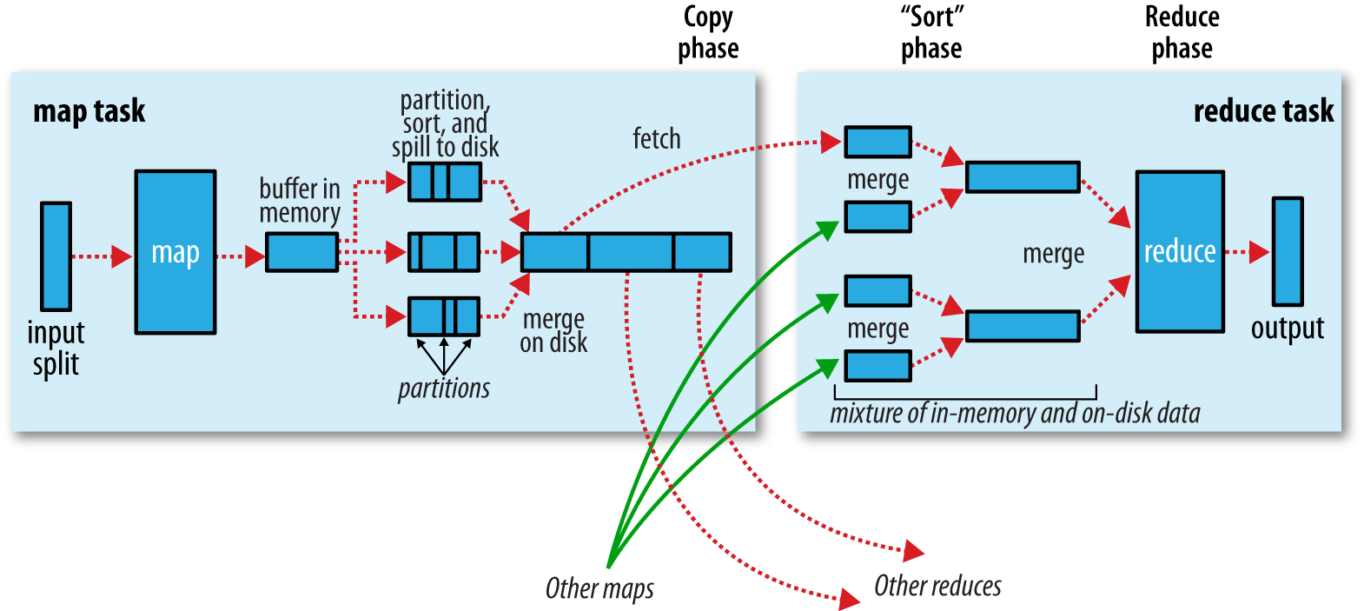
Shuffle and Sort

Slide 22
The Map Side
Each map task has a circular memory buffer (100 MB) that it writes the output to. mapreduce.task.io.sort.mb
When the contents of the buffer reach a certain threshold size (80%) mapreduce.map.sort.spill.percent
a background thread starts to spill the contents to disk.
Map outputs will continue to be written to the buffer while the spill takes place, but if the buffer fills up during this time, the map will block until the spill is complete
Before the task is finished, the spill files are merged into a single partitioned and sorted output file.

Slide 23
The Reduce Side
The reduce task has a small number of copier threads (default 5) so that it can fetch map outputs in parallel.
mapreduce.reduce.shuffle.parallelcopies
Map outputs are copied to the reduce task JVM’s memory if they are small enough
mapreduce.reduce.shuffle.input.buffer.percent (proportion of the heap).
Otherwise, they are copied to disk.
When the in-memory buffer reaches a threshold size (mapreduce.reduce.shuffle.merge.percent) or reaches a threshold number of map outputs (mapreduce.reduce.merge.inmem.threshold), it is merged and spilled to disk.
When all the map outputs have been copied, they get merged (into rounds of specific factor), maintaining their sort ordering.
mapreduce.task.io.sort.factor

Slide 24
Tuning A Job Guidelines
Number of mappers
Use less mappers
Mappers should run for a minutes
Number of reducers
Reducer should run for 5 minutes
Combiners
Intermediate compression
Map output compression
Custom serialization
Shuffle Tweaks

Slide 25
Configuration Tuning
The general principle is to give the shuffle as much memory as possible.
But make sure that your map and reduce functions get enough memory to operate.
This is why it is best to write your map and reduce functions to use as little memory as possible
The amount of memory given to the JVMs in which the map and reduce tasks run (mapred.child.java.opts) make this as large as possible for the amount of memory on your task nodes
On the map side, the best performance can be obtained by avoiding multiple spills to disk; one is optimal.
If you can estimate the size of your map outputs, you can set the mapreduce.task.io.sort.* properties appropriately to minimize the number of spills. (increase mapreduce.task.io.sort.mb)

Slide 26
Configuration Tuning
On the reduce side, the best performance is obtained when the intermediate data can reside entirely in memory.
Try setting mapreduce.reduce.merge.inmem.threshold → 0
mapreduce.reduce.input.buffer.percent → 1
More generally, Hadoop uses a buffer size of 4 KB by default, which is low, so you should increase this across the cluster (by setting io.file.buffer.size)

Slide 27
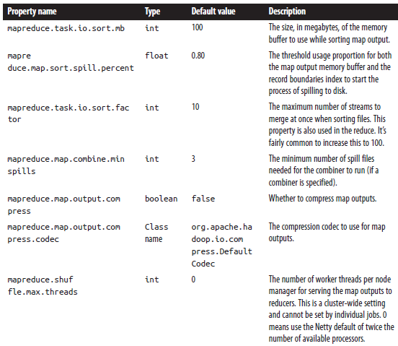
Map-side Tuning Parameters

Slide 28
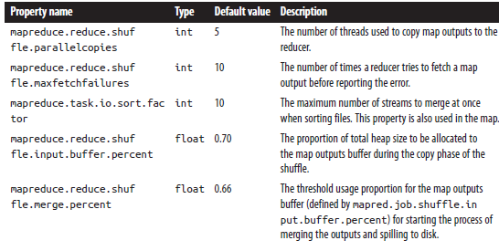
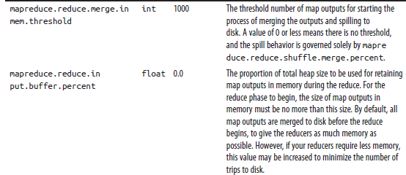
Reduce-side Tuning Parameters

Slide 29
Speculative Execution
Hadoop tries to detect when a task is running slower than expected and launches another equivalent task as a backup.
When a task completes successfully, any duplicate tasks that are running are killed
Speculative execution can reduce overall throughput
mapreduce.map.speculative
mapreduce.reduce.speculative

Slide 30
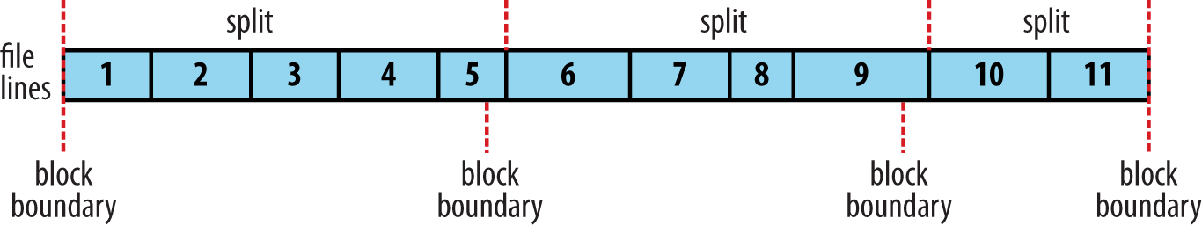
Input Splits
An input split is a chunk of the input that is processed by a single map
Each split is divided into records, and the map processes each record—a key-value pair
Splits and records are logical
Splits honor logical record boundaries
mapreduce.input.fileinputformat.split.minsize
mapreduce.input.fileinputformat.split.maxsize
dfs.blocksize
Split size = max(minSize, min(maxSize, blockSize))

Slide 31
MapReduce Workflows
For complex problem, use more MapReduce jobs, rather than having more complex map and reduce functions.
It is worth considering a higher-level language than MapReduce, such as Pig, Hive, Cascading, Crunch, or Spark.
Example:
Find the mean maximum temperature for every day of the year and every weather station.
Thus for station_ID, we need to calculate first the maximum daily temperatures for this station for January 1, 1901; January 1, 1902; and so on, up to January 1, 2000 then we calculate their mean.

Slide 32
Computation Decomposition
Compute the maximum daily temperature for every station-date pair. (Example: StationID-1 Jan 1901, Max Temp)
Compute the mean of the maximum daily temperatures for every station-day-month key. (Example: StationID-1 Jan, Mean of Max Temp across all years)
How to run them?

Slide 33
Apache Oozie
Apache Oozie is a system for running workflows of dependent jobs.
It is composed of two main parts:
a workflow engine that stores and runs workflows composed of different types of Hadoop jobs (MapReduce, Pig, Hive, and so on), and
a coordinator engine that runs workflow jobs based on predefined schedules and data availability.
Oozie can manage the timely execution of thousands of workflows in a Hadoop cluster, each composed of possibly dozens of constituent jobs.
Oozie reruns failed workflows and no time is wasted running successful parts of the workflow

Slide 34
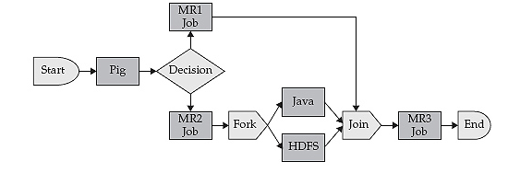
Apache Oozie
A workflow is a directed graph of action nodes and control-flow nodes.
An action node perform a workflow task:
moving files in HDFS;
running a MapReduce,
Streaming, Pig, or Hive job;
running an arbitrary shell script or Java program.
A control-flow node governs the workflow execution between actions by allowing such constructs as conditional logic

Slide 35
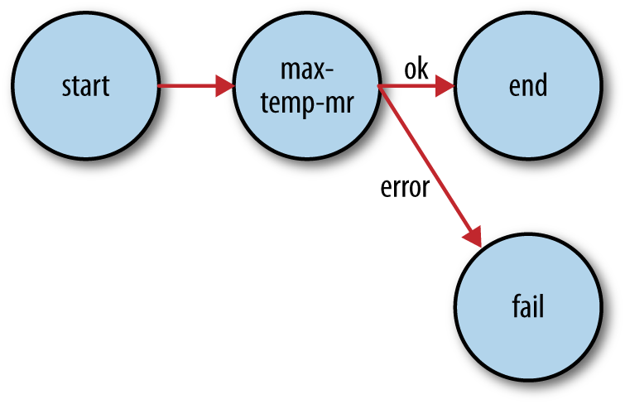
Simple Oozie Example
<workflow-app xmlns="uri:oozie:workflow:0.1" name="max-temp-workflow">
<start to="max-temp-mr"/>
<action name="max-temp-mr">
<map-reduce>
<job-tracker>${resourceManager}</job-tracker>
<name-node>${nameNode}</name-node>
<prepare>
<delete path="${nameNode}/user/${wf:user()}/output"/>
</prepare>
<configuration>
<property>
<name>mapred.mapper.new-api</name>
<value>true</value>
</property>
.
.
.

Slide 36
Packaging and deploying an Oozie workflow application
A workflow application is made up of the workflow definition plus all the associated resources (such as MapReduce JAR files, Pig scripts, and so on) needed to run it.
Applications must adhere to a simple directory structure, and are deployed to HDFS so that they can be accessed by Oozie.
The workflow definition file workflow.xml must appear in the top level of the base directory
JAR files containing the application’s MapReduce classes are placed in the lib directory.

Slide 37
Running an Oozie workflow job
Tell the oozie command which Oozie server to use
% export OOZIE_URL=http://localhost:11000/oozie
To run
% oozie job -config max-temp-workflow.properties –run
job: 0000001-140911033236814-oozie-oozi-W
To get info
% oozie job -info 0000001-140911033236814-oozie-oozi-W

