Slide 1

Elsayed Hemayed
Some of the slides are from Parallel Programming With Spark by Matei Zaharia, UC Berkeley
SWE 622 by David A. Wheeler, George Mason University
CS5412 by Kishore Pusukuri, Cornell

Slide 2
Overview
What is Spark?
History and Background
Spark Vs Hadoop
Anatomy of a Spark Application
Spark Programming
How to start?
Spark Context
Resilient Distributed Datasets (RDDs)
Transformations and Actions
Broadcasting and Accumulator
Sample Programs
Word Count
Max Temperature
PageRank

Slide 3
History of Hadoop and Spark

Slide 4
Recap
MapReduce
For easily writing applications to process vast amounts of data in-parallel on large clusters in a reliable, fault-tolerant manner
Takes care of scheduling tasks, monitoring them and re-executes the failed tasks
HDFS & MapReduce: Running on the same set of nodes → compute nodes and storage nodes same (keeping data close to the computation) → very high throughput
YARN & MapReduce: A single master resource manager, one slave node manager per node, and AppMaster per application

Slide 5
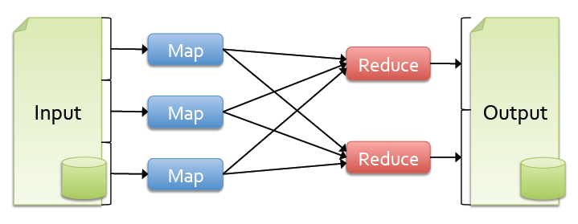
Background
Most current cluster programming models are based on directed acyclic data flow from stable storage to stable storage
Benefits of data flow: runtime can decide where to run tasks and can automatically recover from failures

Slide 6
Background
Acyclic data flow is inefficient for applications that repeatedly reuse a working set of data:
>> Iterative algorithms (machine learning, graphs)
>> Interactive data mining tools (R, Excel, Python)
With current frameworks, apps reload data from stable storage on each query

Slide 7
Overview
The Map-Reduce paradigm is fundamentally limited in expressiveness.
Hadoop implementation of Map-Reduce is designed for out-of-core data, not in-memory data.
Idea: Layer an in-memory system on top of Hadoop.
Achieve fault-tolerance by re-execution instead of replication.

Slide 8
Apache Hadoop & Apache Spark
Map Reduce
Hive
Pig
Other Applications
Spark Stream
Spark SQL
Processing
Resource manager
Yet Another Resource Negotiator (YARN)
Mesos etc.
Spark Core
Data Ingestion Systems
e.g., Apache Kafka, Flume, etc
Hadoop Database (HBase)
Cassandra etc., other storage systems
Data Storage
Hadoop Distributed File System (HDFS)
Hadoop
Spark
Notes:
Spark is not, despite the hype, a replacement for Hadoop. Nor mapreduce is dead. Spark can run on top of Hadoop, benefiting from yarn….. And underlying storage HDFS… spark can also run completely separately from Hadoop, integrating with alternative cluster managers like mesos, and alternative storage platforms such as cassandra

Slide 9
Apache Spark
** Spark can connect to several types of cluster managers (either Spark’s own standalone cluster manager, Mesos or YARN)
Processing
Spark Stream
Spark SQL
Spark ML
Other Applications
Resource manager
Spark Core
(Standalone Scheduler)
Mesos etc.
Yet Another Resource Negotiator (YARN)
Data Ingestion Systems
e.g., Apache Kafka, Flume, etc
Data Storage
S3, Cassandra etc., other storage systems
Hadoop NoSQL Database (HBase)
Hadoop Distributed File System (HDFS)
Hadoop
Spark

Slide 10
Apache Hadoop: No Unified Vision
Sparse Modules
Diversity of APIs
Higher Operational Costs

Slide 11
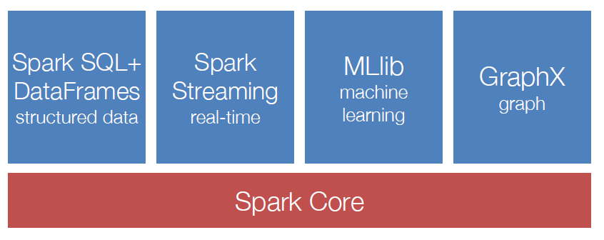
Spark Ecosystem: A Unified Pipeline

Slide 12
Spark vs MapReduce: Data Flow
ETL: Extract, Transform, Load

Slide 13
Spark: High Performance & Simple Data Flow
Notes:
We avoid materializing data on HDFS after each iteration

Slide 14
Data Access Rates
Within a node:
CPU to Memory: 10 GB/sec
CPU to HardDisk: 0.1 GB/sec
CPU to SSD: 0.6 GB/sec
Nodes between networks: 0.125 GB/sec to 1 GB/sec
Nodes in the same rack: 0.125 GB/sec to 1 GB/sec
Nodes between racks: 0.1 GB/sec

Slide 15
Performance: Spark vs MapReduce
Iterative algorithms
Spark is faster ← a simplified data flow
Avoids materializing data on HDFS after each iteration
Example: k-means algorithm, 1 iteration
HDFS Read
Map(Assign sample to closest centroid)
GroupBy(Centroid_ID)
NETWORK Shuffle
Reduce(Compute new centroids)
HDFS Write
Notes:
We avoid materializing data on HDFS after each iteration

Slide 16
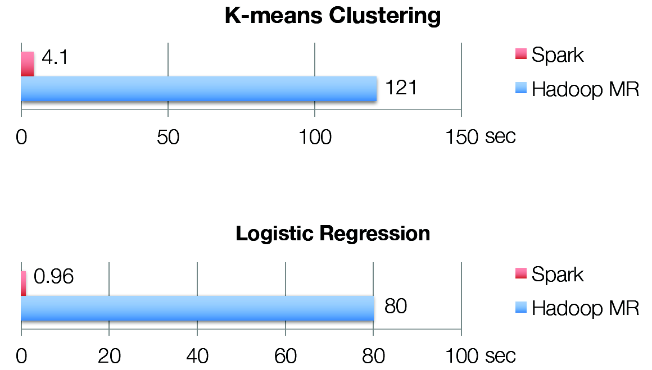
Performance: Spark vs MapReduce

Slide 17
The Working Set Idea
Peter Denning, “The Working Set Model for Program Behavior”, Communications of the ACM, May 1968.
http://dl.acm.org/citation.cfm?id=363141
Idea: conventional programs on one machine generally exhibit a high degree of locality, returning to the same data over and over again.
The entire operating system, virtual memory system, compiler, and micro architecture are designed around this assumption!
Exploiting this observation makes programs run 100X faster than simply using plain old main memory in the obvious way.
(But in Map-Reduce, access to all data is equally slow.)

Slide 18
The Working Set Idea in Spark
The user should identify which datasets they want to access.
Load those datasets into memory, and use them multiple times.
Keep newly created data in memory until explicitly told to store it.
Master-Worker architecture: Master (driver) contains the main algorithmic logic, and the workers simply keep data in memory and apply functions to the distributed data.
The master knows where data is located, so it can exploit locality.
The driver is written in a functional programming language (Scala).

Slide 19
What is Spark?
Fast, expressive cluster computing system compatible with Apache Hadoop
Works with any Hadoop-supported storage system (HDFS, Amazon S3, Avro, …)
Improves efficiency through:
In-memory computing primitives
General computation graphs
Improves usability through:
Rich APIs in Java, Scala, Python
Interactive shell
Up to 100× faster
Often 2-10× less code
Notes:
Put high-level distributed collection stuff here?

Slide 20
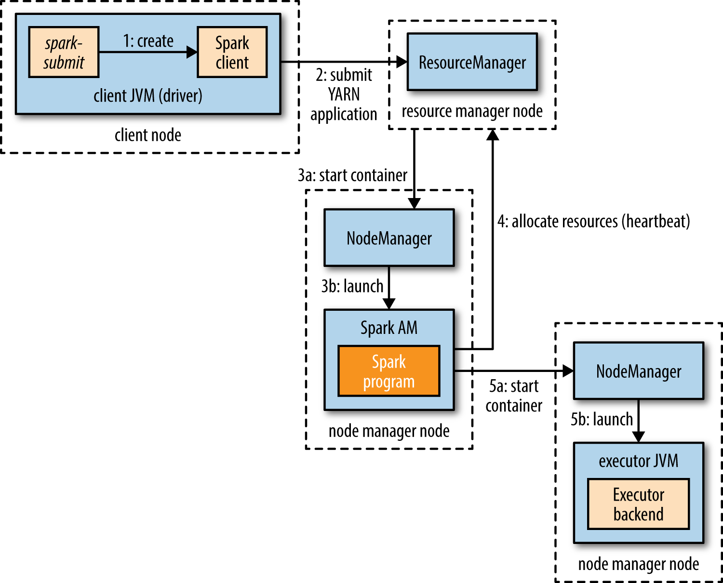
Spark on YARN

Slide 21
Anatomy of a Spark Application
Cluster Manager (YARN/Mesos)

Slide 22
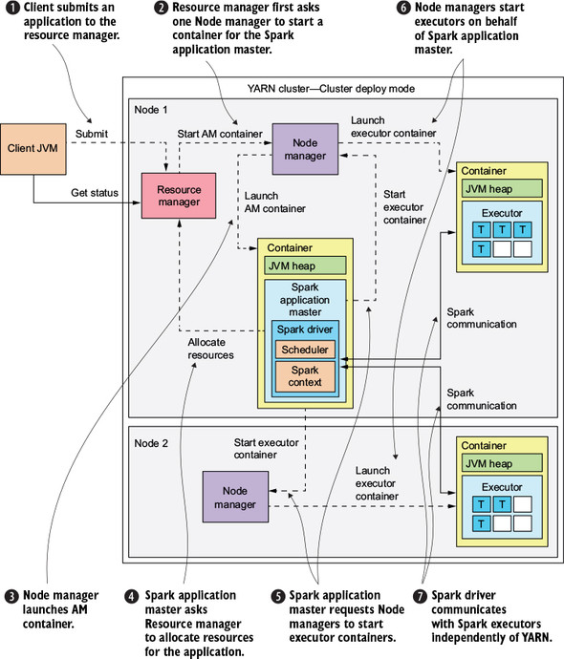

Slide 23
Driver
Responsible for executing the Spark application and returning the status/results to the user.
They are responsible for the translation of user code into actual Spark jobs executed on the cluster.
Responsible for converting a user application to smaller execution units called tasks
Schedules them to run with a cluster manager on executors.
Optimizes logical DAG transformations and, if possible, combines them in stages and determines the best location for execution of this DAG;

Slide 24
Driver – cont.
Spark Driver contains various components – DAGScheduler, TaskScheduler, BackendScheduler and BlockManager.
Stores metadata about all Resilient Distributed Databases and their partitions;
Creates Spark WebUI with detailed information about the application;

Slide 25
Spark Context
The main entry point into Spark functionality.
Allows Spark Driver to access the cluster through its Cluster Resource Manager
It can be used to create RDDs, accumulators and broadcast variables on the cluster.
Tracks executors in real-time by sending regular heartbeat messages.
Spark Context is created by Spark Driver for each Spark application when it is first submitted by the user.
It exists throughout the lifetime of the Spark application and stops working after the Spark application is finished.
For each JVM only one Spark Context can be active. You must stop() Spark Context before creating a new one.

Slide 26
Executors
The processes at the worker's nodes, whose job is to complete the assigned tasks.
These tasks are executed on the worker nodes and then return the result to the Spark Driver.
Executors are started once at the beginning of Spark Application and then work during all life of the application, But also can be dynamically allocated.
stores data in a cache in a JVM heap or on disk
reads data from external sources
writes data to external sources
performs all data processing

Slide 27
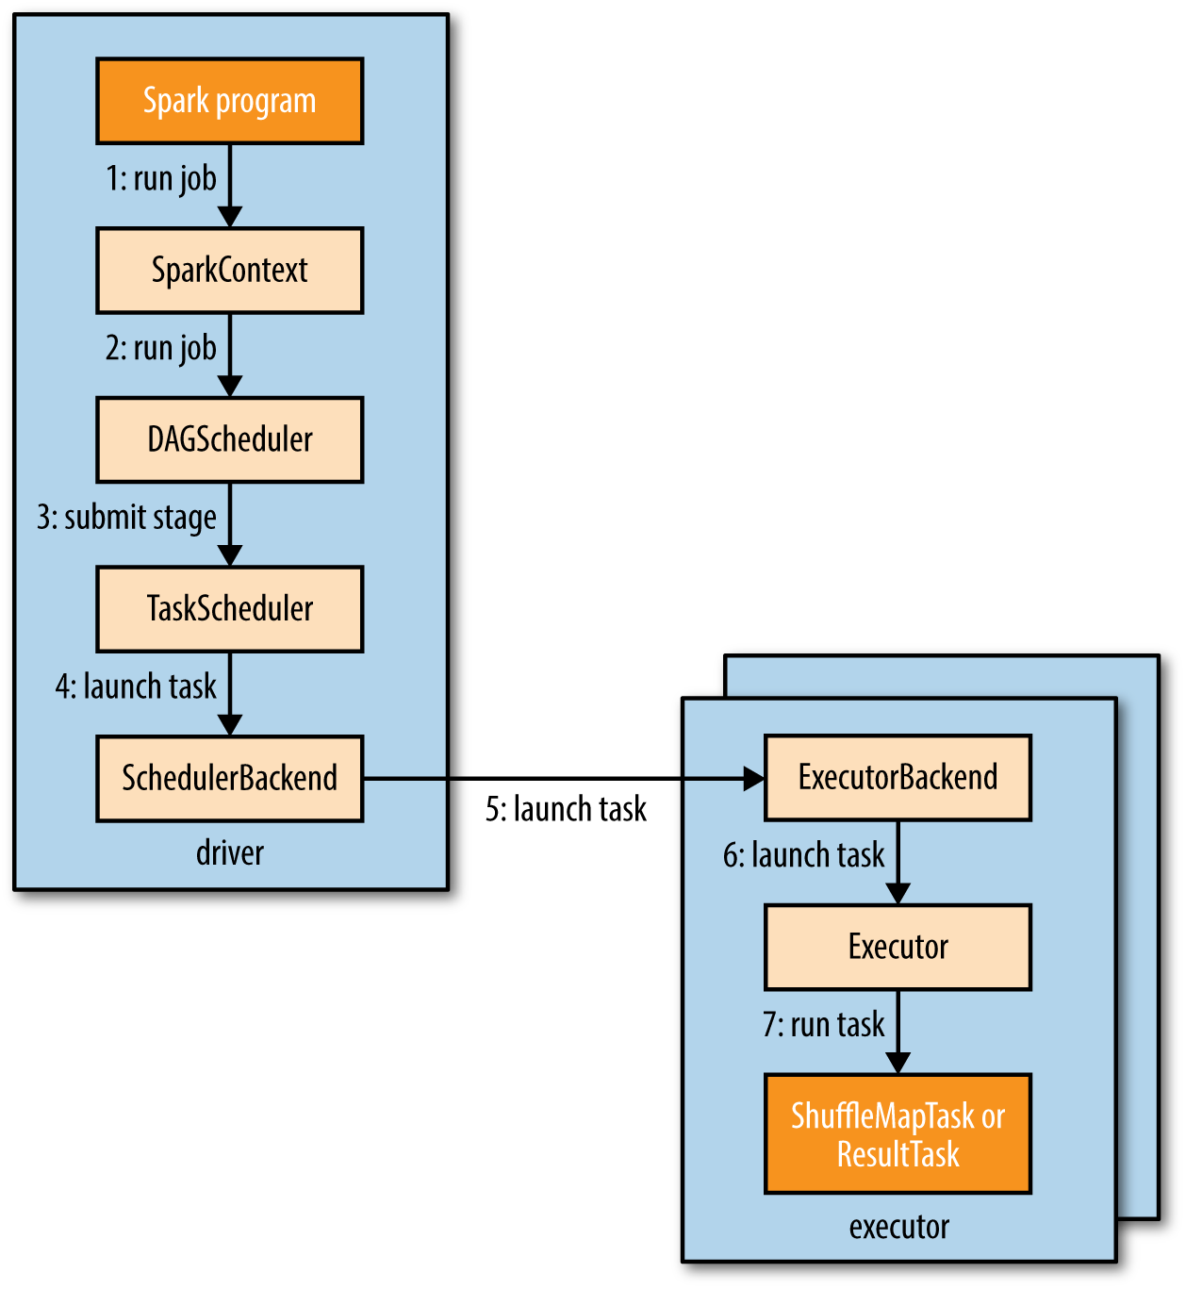
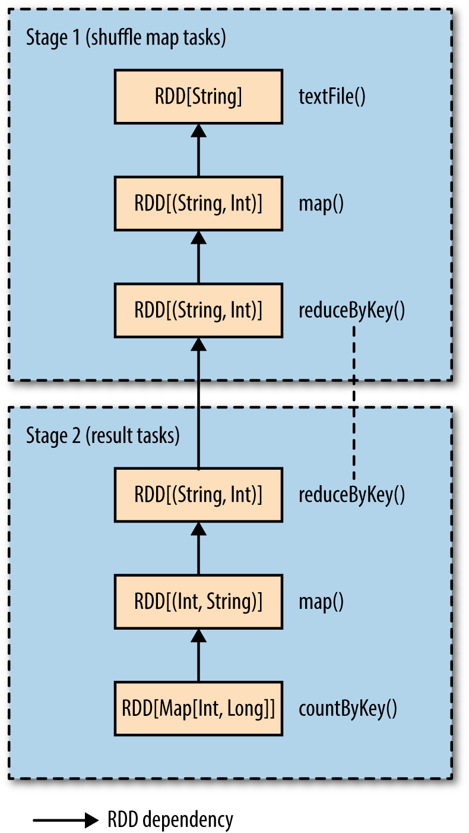
How Spark runs a job
calculating a histogram of word counts
val hist: Map[Int, Long] = sc.textFile(inputPath)
.map(word => (word.toLowerCase(), 1))
.reduceByKey((a, b) => a + b)
.map(_.swap)
.countByKey()

Slide 28
Task Scheduler
Supports general task graphs
Pipelines functions where possible
Cache-aware data reuse & locality
Partitioning-aware to avoid shuffles, (no shuffle inside the stage)
A:
B:
F:
Stage 1
groupBy
C:
D:
E:
join
Stage 2
map
filter
Stage 3
= RDD
= cached partition
Notes:
NOT a modified version of Hadoop

Slide 29
Controlling the Level of Parallelism
All the pair RDD operations take an optional second parameter for number of tasks
words.reduceByKey(lambda x, y: x + y, 5)
words.groupByKey(5)
visits.join(pageViews, 5)
Number of partitions determines number of tasks
Every RDD comes with a defined number of partitions.
For example, a file from HDFS will have number of splits as number of partitions.

Slide 30
Lifetime of a Job in Spark

Slide 31
Job Execution
Execution goes as follows:
Action → Job → Job Stages → Tasks
Task is a unit of work to be done
Tasks are created by a job scheduler for every job stage
Job is spawned in response to a Spark action
Job is divided in smaller sets of tasks called stages

Slide 32
Invoking an action spawns the Job
that gets divided into the stages by the job scheduler
and tasks are created for every job stage

Slide 33
Spark Programming

Slide 34
Spark Programming
How to start?
Spark Context
Resilient Distributed Datasets (RDDs)
Transformations
Actions

Slide 35
How to start?
APIs in Java, Scala and Python
Interactive shells in Scala and Python
Start Scala Shell
% spark-shell
Start Python shell
% pyspark
Run python script
% spark-submit wordcount.py [--master yarn]
Run PySpark in Jupyter
import findspark
findspark.init()

Slide 36
Spark Context (1)
Every Spark application requires a spark context: the main entry point to the Spark API
Spark Shell provides a preconfigured Spark Context called “sc”

Slide 37
Spark Context (2)
Spark context works as a client and represents connection to a Spark cluster
Notes:
Uses a directed acyclic graph of RDDs → create a schedule of spark tasks ..with the help of cluster manager assigns those tasks to worker nodes

Slide 38
Create a SparkContext
import spark.SparkContext
import spark.SparkContext._
val sc = new SparkContext(“masterUrl”,“name”,“sparkHome”,Seq(“app.jar”))
Scala
Cluster URL, or local / local[N]
App name
Spark install path on cluster
List of JARs with app code (to ship)
import spark.api.java.JavaSparkContext;
JavaSparkContext sc = new JavaSparkContext(
“masterUrl”, “name”, “sparkHome”, new String[] {“app.jar”}));
Java
from pyspark import SparkContext
sc = SparkContext(“masterUrl”, “name”, “sparkHome”, [“library.py”]))
Python
Notes:
Mention assembly JAR in Maven etc
Use the shell with your own JAR`

Slide 39
Spark Fundamentals
Example of an application:
Spark Context
Resilient Distributed Data
Transformations
Actions

Slide 40
Resilient Distributed Dataset
RDD (Resilient Distributed Dataset) is the fundamental unit of data in Spark: An Immutable collection of objects (or records, or elements) that can be operated on “in parallel” (spread across a cluster)
Resilient -- if data in memory is lost, it can be recreated
Recover from node failures
An RDD keeps its lineage information → it can be recreated from parent RDDs
Distributed -- processed across the cluster
Each RDD is composed of one or more partitions → (more partitions – more parallelism)
Dataset -- initial data can come from a file or be created

Slide 41
RDDs
Key Idea: Write applications in terms of transformations on distributed datasets
Collections of objects spread across a Memory caching layer(cluster) that stores data in a distributed, fault-tolerant cache
Can fall back to disk when dataset does not fit in memory
Built through parallel transformations (map, filter, group-by, join, etc)
Automatically rebuilt on failure
Controllable persistence (e.g. caching in RAM)

Slide 42
Creating a RDD
Three ways to create a RDD
From a file or set of files
From data in memory
From another RDD

Slide 43
Example: A File-based RDD
Notes:
mydata is a RDD… sc– the context.. Count is an action…

Slide 44
Creating RDDs
# Turn a local collection into an RDD
sc.parallelize([1, 2, 3])
# Load text file from local FS, HDFS, or Amazon S3
sc.textFile(“file.txt”)
sc.textFile(“directory/*.txt”)
sc.textFile(“hdfs://namenode:9000/path/file”)
# Use any existing Hadoop InputFormat
sc.hadoopFile(keyClass, valClass, inputFmt, conf)

Slide 45
Multiple Datasets
visits = sc.parallelize([(“index.html”, “1.2.3.4”), (“about.html”, “3.4.5.6”), (“index.html”, “1.3.3.1”)])
pageNames = sc.parallelize([(“index.html”, “Home”), (“about.html”, “About”)])
visits.join(pageNames) # (“index.html”, (“1.2.3.4”, “Home”)) # (“index.html”, (“1.3.3.1”, “Home”)) # (“about.html”, (“3.4.5.6”, “About”))
visits.cogroup(pageNames) # (“index.html”, (Seq(“1.2.3.4”, “1.3.3.1”), Seq(“Home”))) # (“about.html”, (Seq(“3.4.5.6”), Seq(“About”)))

Slide 46
Typical RDD pattern of use
Hadoop job uses RDD to transform some input object, like a “recipe” for generating a cooked version of the object.
The task might further transform the RDD with additional RDDs, in the style of a functional program.
Eventually, some task consumes the RDD output (or perhaps several of these RDDs) as part of a MapReduce-style computation.

Slide 47
Spark Fundamentals
Example of an application:
Spark Context
Resilient Distributed Data
Transformations
Actions

Slide 48
RDD Operations
Two types of operations
Transformations: Define a new RDD based on current RDD(s)
Actions: return values

Slide 49
RDD Transformations
Set of operations on a RDD that define how they should be transformed
As in relational algebra, the application of a transformation to an RDD yields a new RDD (because RDD are immutable)
Transformations are lazy, they don’t compute right away. Just remember the transformations applied to datasets(lineage). Only compute when an action require.
Examples: map(), filter(), groupByKey(), sortByKey(), etc.

Slide 50
Example: map and filter Transformations
python
Scala
Notes:
Talk about lineage here

Slide 51
RDD Actions
Apply transformation chains on RDDs, eventually performing some additional operations (e.g., counting)
Some actions only store data to an external data source (e.g. HDFS), others fetch data from the RDD (and its transformation chain) upon which the action is applied, and convey it to the driver
Some common actions
count() – return the number of elements
take(n) – return an array of the first n elements
collect()– return an array of all elements
saveAsTextFile(file) – save to text file(s)

Slide 52
Sample Spark transformations
map(func): Return a new distributed dataset formed by passing each element of the source through a function func.
filter(func): Return a new dataset formed by selecting those elements of the source on which func returns true
union(otherDataset): Return a new dataset that contains the union of the elements in the source dataset and the argument.
intersection(otherDataset): Return a new RDD that contains the intersection of elements in the source dataset and the argument.
distinct([numTasks])): Return a new dataset that contains the distinct elements of the source dataset
join(otherDataset, [numTasks]): When called on datasets of type (K, V) and (K, W), returns a dataset of (K, (V, W)) pairs with all pairs of elements for each key. Outer joins are supported through leftOuterJoin, rightOuterJoin, and fullOuterJoin.
Source: https://spark.apache.org/docs/latest/programming-guide.html

Slide 53
Sample Spark Actions
reduce(func): Aggregate the elements of the dataset using a function func (which takes two arguments and returns one). The function should be commutative and associative so that it can be computed correctly in parallel.
collect(): Return all the elements of the dataset as an array at the driver program. This is usually useful after a filter or other operation that returns a sufficiently small subset of the data.
count(): Return the number of elements in the dataset.
first() Return the first element of the dataset
saveAsTextFile(path) Write the elements of the dataset as text file (or set of text file) in a given dir in the local file system, HDFS or any other Hadoop-supported file system
Source: https://spark.apache.org/docs/latest/programming-guide.html

Slide 54
Lambda Functions Examples
General form:
lambda arguments: expression
Examples
lambda a: 2*a –doubles the argument a
lambda a, b: a+b –produces the sum of arguments a and b
lambda a: (a%2 == 0) –can be used to filter data, a is accepted only if a is divisible by 2
lambda a, b: a if (a%2 == 0) else b –another filtering example, returns a if divisible by 2, otherwise b

Slide 55
Basic Transformations (python)
nums = sc.parallelize([1, 2, 3])
# Pass each element through a function
squares = nums.map(lambda x: x*x) # => {1, 4, 9}
# Keep elements passing a predicate
even = squares.filter(lambda x: x % 2 == 0) # => {4}
# Map each element to zero or more others
nums.flatMap(lambda x: range(0, x)) # => {0, 0, 1, 0, 1, 2}
Range object (sequence of numbers 0, 1, …, x-1)
Notes:
All lazy

Slide 56
Basic Actions (python)
nums = sc.parallelize([1, 2, 3])
# Retrieve RDD contents as a local collection nums.collect() # => [1, 2, 3]
# Return first K elements nums.take(2) # => [1, 2]
# Count number of elements nums.count() # => 3
# Merge elements with an associative function nums.reduce(lambda x, y: x + y) # => 6
# Write elements to a text file nums.saveAsTextFile(“hdfs://file.txt”)
Notes:
Launch computations

Slide 57
Some Key-Value Operations (python)
pets = sc.parallelize([(“cat”, 1), (“dog”, 1), (“cat”, 2)])
pets.reduceByKey(lambda x, y: x + y) # => {(cat, 3), (dog, 1)}
pets.groupByKey() # => {(cat, Seq(1, 2)), (dog, Seq(1)}
pets.sortByKey() # => {(cat, 1), (cat, 2), (dog, 1)}
reduceByKey also automatically implements combiners on the map side

Slide 58
Lazy Execution of RDDs (1)
Data in RDDs is not processed until an action is performed

Slide 59
Lazy Execution of RDDs (2)
Data in RDDs is not processed until an action is performed

Slide 60
Lazy Execution of RDDs (3)
Data in RDDs is not processed until an action is performed

Slide 61
Lazy Execution of RDDs (4)
Data in RDDs is not processed until an action is performed

Slide 62
Lazy Execution of RDDs (5)
Data in RDDs is not processed until an action is performed

Slide 63
Spark – RDD Persistence
You can persist (cache) an RDD (tuples.cache())
When you persist an RDD, each node stores any partitions of it that it computes in memory and reuses them in other actions on that dataset (or datasets derived from it)
Allows future actions to be much faster (often >10x).
Mark RDD to be persisted using the persist() or cache() methods on it. The first time it is computed in an action, it will be kept in memory on the nodes.
Cache is fault-tolerant – if any partition of an RDD is lost, it will automatically be recomputed using the transformations that originally created it
Can choose storage level (MEMORY_ONLY, DISK_ONLY, MEMORY_AND_DISK, etc.)
Can manually call unpersist()

Slide 64
Example: Log Mining
Load error messages from a log into memory, then interactively search for various patterns:
lines = spark.textFile(“hdfs://...”) HadoopRDD
errors = lines.filter(lambda s: s.startswith(“ERROR”)) FilteredRDD
messages = errors.map(lambda s: s.split(“\t”)[2])
messages.cache()
messages.filter(lambda s: “foo” in s).count()

Slide 65

Example: Mining Console Logs (python)
Load error messages from a log into memory, then interactively search for patterns
Base RDD
Transformed RDD
Cache 1
Worker
lines = spark.textFile(“hdfs://...”)
errors = lines.filter(lambda s: s.startswith(“ERROR”))
messages = errors.map(lambda s: s.split(‘\t’)[2])
messages.cache()
tasks
Block 1
Driver
results
Action
messages.filter(lambda s: “foo” in s).count()
Cache 2
Worker
messages.filter(lambda s: “bar” in s).count()
. . .
Cache 3
Worker
Block 2
Result: full-text search of Wikipedia in <1 sec (vs 20 sec for on-disk data)
Result: scaled to 1 TB data in 5-7 sec (vs 170 sec for on-disk data)
Block 3
Notes:
Key idea: add “variables” to the “functions” in functional programming

Slide 66
Dependency Graph
Z = X.filter(lambda x: x % 2 == 0).filter(lambda y: y < 3)

Slide 67
RDD Fault Tolerance
RDDs track the transformations used to build them (their lineage) to recompute lost data
E.g:
messages = textFile(...).filter(lambda s: s.contains(“ERROR”))
.map(lambda s: s.split(‘\t’)[2])
HadoopRDD
path = hdfs://…
FilteredRDD
func = contains(...)
MappedRDD
func = split(…)
Notes:
Show recomputing

Slide 68
Broadcast Variables
Broadcast variable is a read-only variable that is efficiently shared among tasks
Distribution is done by a torrent-like protocol (extremely fast!)
Distributed efficiently compared to captured variables
BitTorrent is a peer-to-peer protocol, which means that the computers in a BitTorrent “swarm” transfer data between each other without the need for a central server.

Slide 69
Motivation
› Input:
1TB partitioned log, 1GB IP dictionary
› Task:
resolve IP addresses
› Idea:
distribute the dictionary
query it locally

Slide 70
Example
sc = SparkContext(conf=…)
# compute the dictionary
my_dict_rdd = sc.textFile(…).map(…).filter(…)
my_dict_data = my_dict_rdd.collect()
# distributed the dictionary via the broadcast variable
broadcast_var = sc.broadcast(my_dict_data)
# use the broadcast variable within the task
my_data_rdd = sc.textFile(…).filter(
lambda x: x in broadcast_var.value)

Slide 71
Accumulator Variables
› Accumulator variable is a read-write variable that is shared among tasks
d
›› Writes are restricted to increments!
› i. e.: var += delta
› addition may be replaced by any associate, commutative operation
›› Reads are allowed only by the driver program!
P.S. Personal Counters in Hadoop

Slide 72
Motivation Example and Use Cases
› Input:
1TB partitioned log
› Task:
resolve IP addresses AND collect metrics: # of valid records
Use cases
›› Performance counters
# of processed records, total elapsed time, total error, ..etc
›› Simple control flow
conditionals: stop on reaching a threshold for corrupted records
loops: decide whether to run the next iteration of an algorithm or not
››Monitoring
export values to the monitoring system
›› Profiling & debugging

Slide 74
Accumulator Example
accum=sc.accumulator(0)
rdd=spark.sparkContext.parallelize([1,2,3,4,5])
rdd.foreach(lambda x:accum.add(x))
print(accum.value) #Accessed by driver
What is the output?

Slide 75
Spark Program Samples

Slide 76
Overview
Word Count and Its Variations
Finding Maximum Temperature
PageRank

Slide 77
Word Count – Conceptual solution
We divide the text into a number of more manageable pieces –partitions
From each partition, we extract words from the text
Next, in each worker count the occurrences of each word in that partition and send your intermediate results to node(s) which sum up all intermediate results for each word

Slide 78
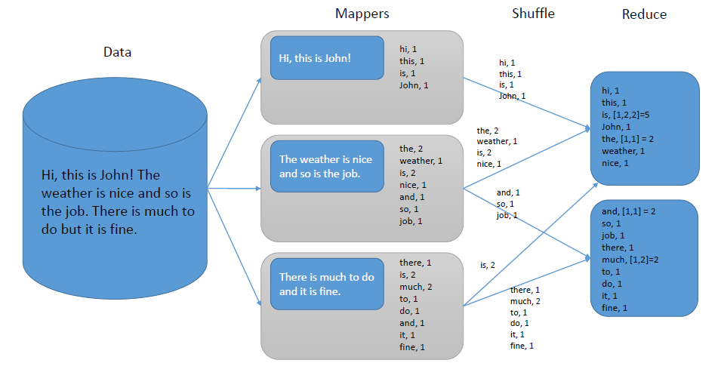
Word Count – Conceptual solution

Slide 79
Word Count - Algorithm
Pre-step 1: the text file first needs to be distributed. The simplest approach is to do this using hdfs commands:
Step 1: read the file from hdfs, Spark produces RDD
Step 2: write the code which extracts words from the text
Step 3: produce key-values pairs for each word -(word, 1)
Step 4: write the reducer code which sums up 1s for each key/word
Step 5: output the results

Slide 80
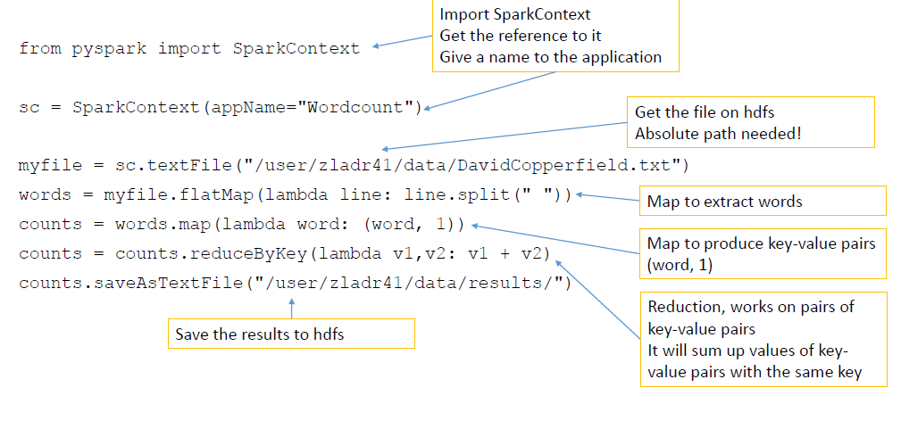
Word count – PySpark Code

Slide 81
Word Count - Variations
Modify the word count program by only considering words with at least 4 characters.
Sort the output

Slide 82
Word Count – PySpark Code (2)
from pysparkimport SparkContext
sc= SparkContext(appName="Wordcount")
myfile= sc.textFile("/user/zladr41/data/DavidCopperfield.txt")
words = myfile.flatMap(lambda line: line.split(" "))
words = words.filter(lambda w: len(w)==4)
counts = words.map(lambda word: (word, 1))
counts = counts.reduceByKey(lambda v1,v2: v1 + v2)
counts = counts.sortBy(ascending=False, keyfunc=lambda a: a[1])
counts.saveAsTextFile("/user/zladr41/data/results/").repartition(1)

Slide 83
Some Built-in
Count the total number of words
from pysparkimport SparkContext
sc= SparkContext(appName="Wordcount")
myfile= sc.textFile("/user/zladr41/data/DavidCopperfield.txt")
numberOfWords= myfile.flatMap(lambda line: line.split(" ")).count()
print numberOfWords
Count the total number of unique words
from pysparkimport SparkContext
sc= SparkContext(appName="Wordcount")
myfile= sc.textFile("/user/zladr41/data/DavidCopperfield.txt")
numberOfWords= myfile.flatMap(lambda line: line.split(" ")).distinct().count()
print numberOfWords

Slide 84
Finding Maximum Temperature
What is the highest temperatures measured each year for the period 1950-2014.
Provide the lists sorted in the descending order w.r.t. temperature.

Slide 85
Finding Max Temperatures – Conceptual Solution
Divide the input into more manageable parts
In each part, select only the necessary information, i.e. year and temperature
Filter out the data that is not in the interval 1950-2014
Find the maximum for each year in each partition
Send the intermediate results to node(s) which then find the maximum from the intermediate results

Slide 86
Finding Max Temperatures - Algorithm
Pre-Step 1: distribute the temperature-readings file using hdfs commands
Step 1: read the file, Spark produces an RDD
Step 2: select only relevant values in each row (year and temperature), produce key-value pairs
Step 3: filter out the years that are not relevant
Step 4: write the reducer code which finds the maximum value for each year
Step 5: output the results

Slide 87
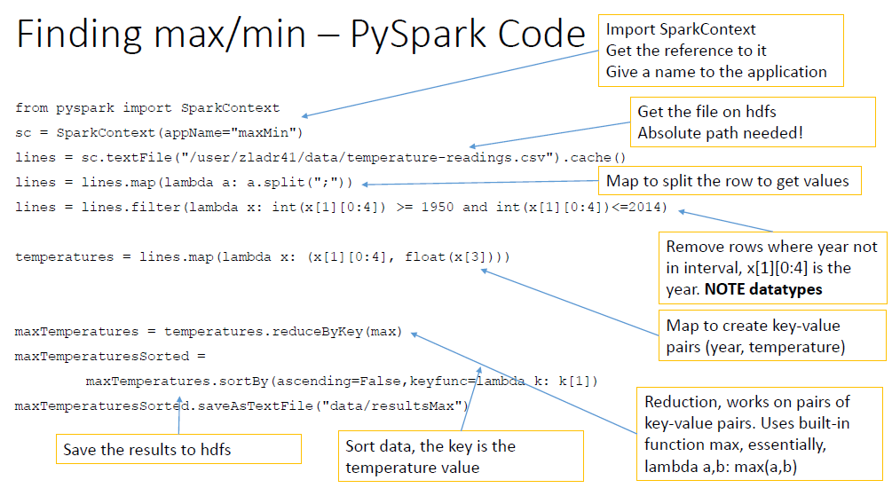
Finding max – PySpark Code

Slide 88
PageRank
Good example of a more complex algorithm
Multiple stages of map & reduce
Benefits from Spark’s in-memory caching
Multiple iterations over the same data

Slide 89
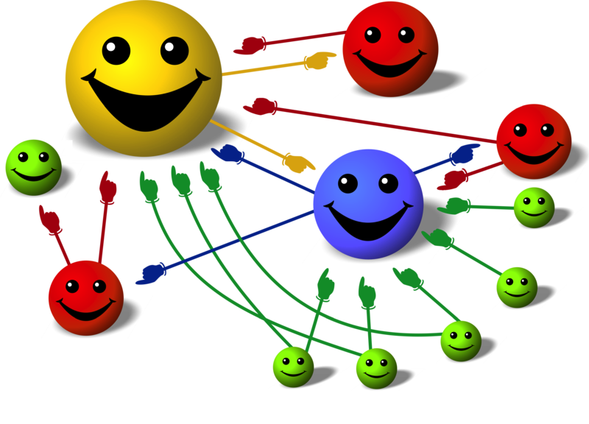
Basic Idea
Give pages ranks (scores) based on links to them
Links from many pages ➔ high rank
Link from a high-rank page ➔ high rank
Image: en.wikipedia.org/wiki/File:PageRank-hi-res-2.png

Slide 90
Algorithm
Start each page at a rank of 1
On each iteration, have page p contribute rank_{p} / |neighbors_{p}| to its neighbors
Set each page’s rank to 0.15 + 0.85 × contribs
1.0
1.0
1.0
1.0

Slide 91
Algorithm
Start each page at a rank of 1
On each iteration, have page p contribute rank_{p} / |neighbors_{p}| to its neighbors
Set each page’s rank to 0.15 + 0.85 × contribs
1.0
1
0.5
1
1.0
0.5
1.0
0.5
0.5
1.0

Slide 92
Algorithm
Start each page at a rank of 1
On each iteration, have page p contribute rank_{p} / |neighbors_{p}| to its neighbors
Set each page’s rank to 0.15 + 0.85 × contribs
1.85
0.58
1.0
0.58

Slide 93
Algorithm
Start each page at a rank of 1
On each iteration, have page p contribute rank_{p} / |neighbors_{p}| to its neighbors
Set each page’s rank to 0.15 + 0.85 × contribs
1.85
0.58
0.5
1.85
0.58
0.29
1.0
0.5
0.29
0.58

Slide 94
Algorithm
Start each page at a rank of 1
On each iteration, have page p contribute rank_{p} / |neighbors_{p}| to its neighbors
Set each page’s rank to 0.15 + 0.85 × contribs
1.31
0.39
. . .
1.72
0.58

Slide 95
Algorithm
Start each page at a rank of 1
On each iteration, have page p contribute rank_{p} / |neighbors_{p}| to its neighbors
Set each page’s rank to 0.15 + 0.85 × contribs
Final state:
1.44
0.46
1.37
0.73

Slide 96
Python Implementation
links = # RDD of (url, neighbors) pairs
ranks = # RDD of (url, rank) pairs
for i in range(NUM_ITERATIONS):
def compute_contribs(pair): [url, [links, rank]] = pair # split key-value pair
return [(dest, rank/len(links)) for dest in links]
contribs = links.join(ranks).flatMap(compute_contribs)
ranks = contribs.reduceByKey(lambda x, y: x + y) \ .mapValues(lambda x: 0.15 + 0.85 * x) ranks.saveAsTextFile(...)
For more implementation details see:
https://github.com/apache/spark/blob/master/examples/src/main/python/pagerank.py
https://github.com/abbas-taher/pagerank-example-spark2.0-deep-dive/blob/master/README.md

Slide 97
Conclusion
Spark is a powerful “manager” for big data computing.
Spark offers a rich API to make data analytics fast: both fast to write and fast to run
Achieves 100x speedups in real applications
It centers on a job scheduler for Hadoop (MapReduce) that is smart about where to run each task: co-locate task with data.
The data objects are “RDDs”: a kind of recipe for generating a file from an underlying data collection. RDD caching allows Spark to run mostly from memory-mapped data, for speed.

