Slide 1

Elsayed Hemayed
Some of the slides are from Spark Summit Talk by Joseph K. Bradley and Machine Learning with Spark by Jose Pena

Slide 2
Overview
About Spark Mllib
Example: Text Classification
Pain Points
Key Concepts
DataFrame
Pipeline
Hyper-parameter tuning

Slide 3
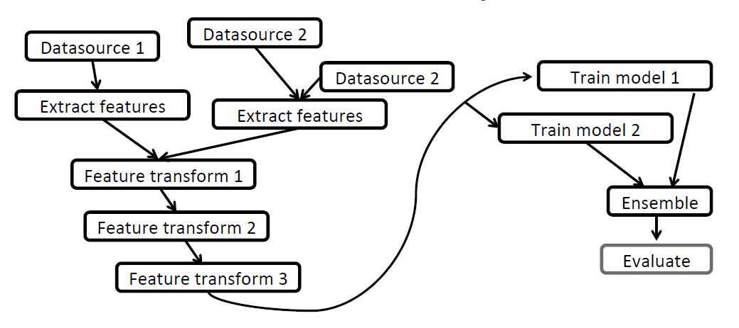
ML Workflows are Complex

Slide 4
About Spark MLlib
MLlib’s mission is to make practical machine learning easy and scalable.
Capable of learning from large-scale datasets
Easy to build machine learning applications
Started in UC Berkeley AMPLab
Shipped with Spark 0.8
SparkML (pipeline API) was introduced in Spark 1.2
Currently (Spark 3.0)
Contributions from 50+ orgs, 100+ individuals
Growing coverage of distributed algorithms
Notes:
Contributions estimated from github commit logs, with some effort to de-duplicate entities.

Slide 5
Algorithm Coverage (based on Spark 1.4)
Classification Logistic regression Naive Bayes Streaming logistic regression Linear SVMs Decision trees Random forests Gradient-boosted trees Regression Ordinary least squares Ridge regression Lasso Isotonic regression Decision trees Random forests Gradient-boosted trees Streaming linear methods Frequent itemsets FP-growth | Recommendation • Alternating Least Squares Feature extraction & selection • Word2Vec • Chi-Squared selection • Hashing term frequency • Inverse document frequency • Normalizer • Standard scaler • Tokenizer • One-Hot Encoder • StringIndexer • VectorIndexer • VectorAssembler • Binarizer • Bucketizer • ElementwiseProduct • PolynomialExpansion Model import/export Pipelines | Clustering • Gaussian mixture models • K-Means • Streaming K-Means • Latent Dirichlet Allocation • Power Iteration Clustering Statistics • Pearson correlation • Spearman correlation • Online summarization • Chi-squared test • Kernel density estimation Linear algebra • Local dense & sparse vectors & matrices • Distributed matrices • Block-partitioned matrix • Row matrix • Indexed row matrix • Coordinate matrix • Matrix decompositions

Slide 6
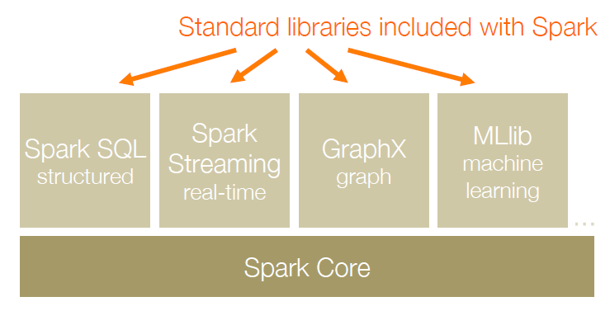
A General Platform
points = context.sql(“select latitude, longitude from tweets”)!
model = KMeans.train(points, 10)!

Slide 7
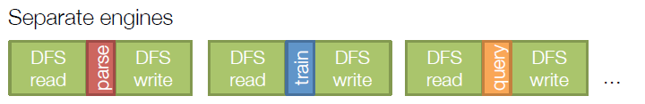
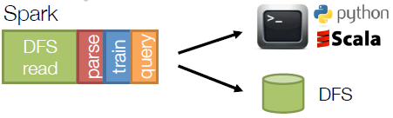
Same Engine
Same engine performs data extraction, model training and interactive queries

Slide 8
MLlib Sample Algorithms
Many machine learning methods are already implemented in MLlib, i.e. the user does not need to specify the map and reduce functions.
Logistic regression: lr = LogisticRegression(maxIter=10, regParam=0.3, elasticNetParam=0.8)
lrModel = lr.fit(training)
SVMs: model = SVMWithSGD.train(parsedData, iterations=100)
NNs: layers = [4, 5, 4, 3]
trainer = MultilayerPerceptronClassifier(maxIter=100, layers=layers,
blockSize=128, seed=1234)
model = trainer.fit(train)
MMs: gmm = GaussianMixture().setK(2)
model = gmm.fit(dataset)
K-Means: kmeans = KMeans().setK(2).setSeed(1)
model = kmeans.fit(dataset)

Slide 9
Example: Text Classification
Goal: Given a text document, predict its topic.
Features
Label
Subject: Re: Lexan Polish?
Suggest McQuires #1 plastic polish. It will help somewhat but nothing will remove deep scratches without making it worse than it already is.
McQuires will do something...
1: about science
0: not about science
Notes:
Dataset source: http://kdd.ics.uci.edu/databases/20newsgroups/20newsgroups.html
*Data from UCI KDD Archive, originally donated to archive by Tom Mitchell (CMU).

Slide 10
Training & Testing
Training
Testing/Production
Given labeled data:
RDD of (features, label)
Given new unlabeled data:
RDD of features
Subject: Re: Lexan Polish?
Suggest McQuires #1 plastic polish. It will help...
Subject: Apollo Training
The Apollo astronauts also trained at (in) Meteor...
Label 0
Label 1
Subject: RIPEM FAQ
RIPEM is a program which performs Privacy Enhanced...
Subject: A demo of Nonsense
How can you lie about something that no one...
Label 1
Label 0
...
Learn a model.
Use model to make predictions.

Slide 11
Example ML Workflow
Training
Pain point
Load data
Create many RDDs
labels + plain text
val labels: RDD[Double] =
data.map(_.label)
Extract features
labels + feature vectors
val features: RDD[Vector]
val predictions: RDD[Double]
Train model
Explicitly unzip & zip RDDs
labels + predictions
labels.zip(predictions).map {
if (_._1 == _._2) ...
}
Evaluate
Notes:
Handling multiple RDDs and data types
Split loaded data into featuresRDD, labelsRDD
Transform featuresRDD
→ words RDD
→ feature vector RDD
Zip labels with feature vector to create final RDD

Slide 12
Example ML Workflow
Training
Pain point
Write as a script
Load data
Not modular
Difficult to re-use workflow
labels + plain text
Extract features
labels + feature vectors
Train model
labels + predictions
Evaluate
Notes:
It is possible for programmers to abstract workflows by putting their workflows into methods or callable scripts. However, that makes it hard to do exploratory work or do rapid iterative tweaking-and-testing of workflows.

Slide 13
Example ML Workflow
Training
Testing/Production
Load data
Load new data
Almost identical workflow
labels + plain text
plain text
Extract features
Extract features
labels + feature vectors
feature vectors
Train model
Predict using model
labels + predictions
predictions
Evaluate
Act on predictions
Notes:
Feature extraction in particular can be long and complicated, and using the same workflow is vital.

Slide 14
Example ML Workflow
Training
Load data
Pain point
labels + plain text
Parameter tuning
Key part of ML
Involves training many models
For different splits of the data
For different sets of parameters
Extract features
labels + feature vectors
Train model
labels + predictions
Evaluate
Notes:
Parameter tuning is doable in essentially any ML library, but it is often done by hand and involves a lot of repetitive but difficult-to-abstract code.

Slide 15
Pain Points
Create & handle many RDDs and data types
DataFrame
Write as a script
Pipeline
Tune parameters
Hyper-parameter tuning
Notes:
This API shipped with Spark 1.2 and 1.3 but is still experimental.

Slide 16
Key Concepts
DataFrame: The ML Dataset
Abstractions: Transformers, Estimators, & Evaluators → Pipeline
Parameters: Hyper-parameter tuning

Slide 17
DataFrame: The ML Dataset
DataFrame: RDD + schema
Named columns with types
label: Double
text: String
words: Seq[String]
features: Vector
prediction: Double
label | text | words | features
0 | This is ... | [“This”, “is”, …] | [0.5, 1.2, …]
0 | When we ... | [“When”, ...] | [1.9, -0.8, …]
1 | Knuth was ... | [“Knuth”, …] | [0.0, 8.7, …]
0 | Or you ... | [“Or”, “you”, …] | [0.1, -0.6, …]
Notes:
SchemaRDD + DSL (SchemaRDD is now called DataFrame)
Introduced in Spark 1.3
Integrates with pandas dataframes
Catalyst optimizer handles column materialization
Other:
built-in data sources & 3rd-party extensions
optimizations & codegen
APIs for Python, Java & Scala (+R in dev)

Slide 18
DataFrame: The ML Dataset
DataFrame: RDD + schema
BIG data
Named columns with types
Shipped with Spark 1.3
Integration with Spark SQL
Data import/export
Internal optimizations
Pain point: Create & handle many RDDs and data types

Slide 19
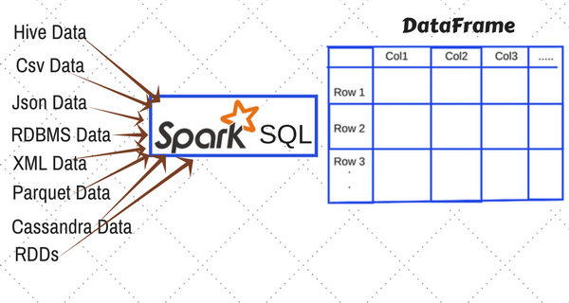
Creating DataFrame in Spark

Slide 20
Working with DataFrame (1)
from pyspark import SparkContext
sc = SparkContext()
sqlContext = SQLContext(sc)
train = sqlContext.load(source="com.databricks.spark.csv", path = 'PATH/train
.csv', header = True,inferSchema = True)
train.printSchema()
train.count()
train.describe('Product_ID’) #count, mean, stddev, min,max
train.select('User_ID','Age')
train.select('Product_ID').distinct().count()

Slide 21
Working with DataFrame (2)
train.crosstab('Age', 'Gender').show()
train.dropna()
train.fillna(-1)
train.filter(train.Purchase > 15000)
train.groupby('Age').count()
train.orderBy(train.Purchase.desc())
## Adding new column
train.withColumn('Purchase_new', train.Purchase /2.0).select('Purchase','Purchase_new')
#Apply SQL Query
sqlContext.sql('select Product_ID from train_table').show(5)
sqlContext.sql('select Age, max(Purchase) from train_table group by Age').show()
Output:
+----------------+------+-------+
|Age_Gender| F | M|
+----------------+-------+-------+
| 0-17 | 5083| 10019|
| 46-50 |13199| 32502|
| 18-25 |24628| 75032|

Slide 22
Abstractions
Training
Load data
Extract features
Train model
Evaluate

Slide 23
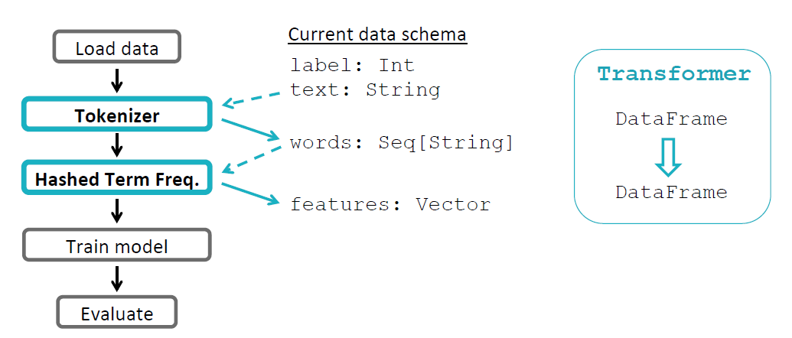
Abstractions: Transformer

Slide 24
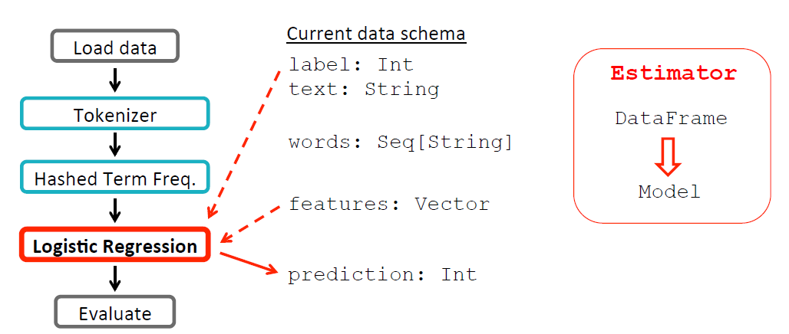
Abstraction: Estimator

Slide 25
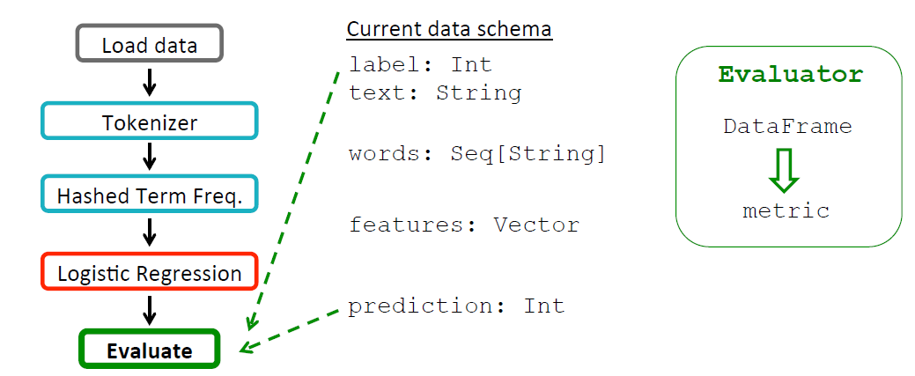
Abstraction: Evaluator

Slide 26
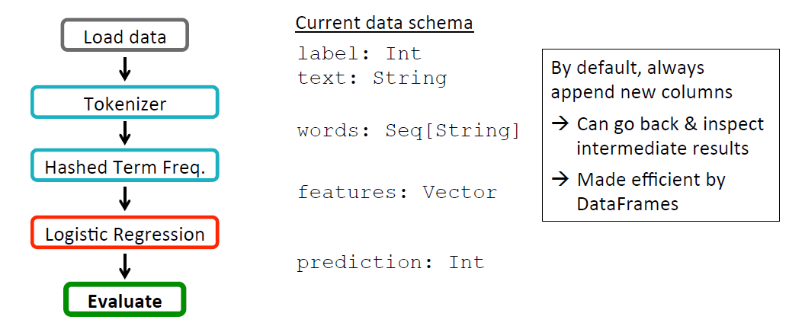
Data Flow

Slide 27
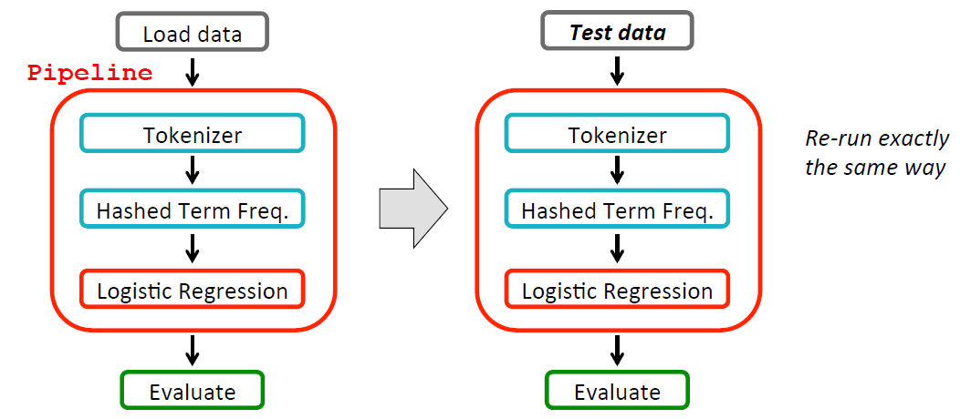
ML Pipelines

Slide 28
Abstractions: Summary
Training
Current data schema
DataFrame
Load data
label: Double
text: String
Transformer
Tokenizer
words: Seq[String]
Transformer
HashingTF
features: Vector
Estimator
LogisticRegression
prediction: Double
Evaluator
BinaryClassification
Evaluator

Slide 29
Abstractions: Summary
Training
DataFrame
Load data
Transformer
Tokenizer
Pain point: Write as a script
Transformer
HashingTF
Estimator
LogisticRegression
Evaluator
BinaryClassification
Evaluator

Slide 30
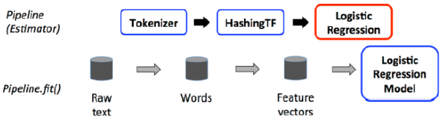
Pipelines
A pipeline is a sequence of stages, where each stage is of one of two types:
Transformer: It transforms a dataset into another dataset, e.g. tokenizing a dataset into words is a transformer.
Estimator: It fits a model to a dataset. The model becomes a transformer, since it transforms a dataset into predictions.

Slide 31
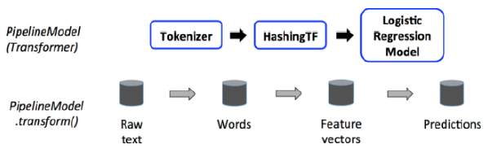
Pipeline Model
A pipeline typically contains estimators and, thus, the pipeline is an estimator itself.
By fitting the pipeline, the estimators in it become transformers. Then, the pipeline becomes a transformer itself (called pipeline model), which is ready to be used.

Slide 32
Pipeline Example
from pyspark.ml import Pipeline
from pyspark.ml.classification import LogisticRegression
from pyspark.ml.feature import HashingTF, Tokenizer
import pyspark
from pyspark.sql import SparkSession # using spark session starting SPARK 2.0
spark = SparkSession.builder.getOrCreate()
# Prepare training documents from a list of (id, text, label) tuples.
training = spark.createDataFrame([
(0, "a b c d e spark", 1.0),
(1, "b d", 0.0),
(2, "spark f g h", 1.0),
(3, "hadoop mapreduce", 0.0)
], ["id", "text", "label"])
# Configure an ML pipeline, which consists of three stages: tokenizer, hashingTF, and lr.
tokenizer = Tokenizer(inputCol="text", outputCol="words")
hashingTF = HashingTF(inputCol=tokenizer.getOutputCol(), outputCol="features")
lr = LogisticRegression(maxIter=10, regParam=0.001)
pipeline = Pipeline(stages=[tokenizer, hashingTF, lr])

Slide 33
Pipeline Example – cont.
# Fit the pipeline to training documents.
model = pipeline.fit(training)
# Prepare test documents, which are unlabeled (id, text) tuples.
test = spark.createDataFrame([
(4, "spark i j k"),
(5, "l m n"),
(6, "spark hadoop spark"),
(7, "apache hadoop")
], ["id", "text"])
# Make predictions on test documents and print columns of interest.
prediction = model.transform(test)
selected = prediction.select("id", "text", "probability", "prediction")
for row in selected.collect():
rid, text, prob, prediction = row
print("(%d, %s) --> prob=%s, prediction=%f" % (rid, text, str(prob), prediction))

Slide 34
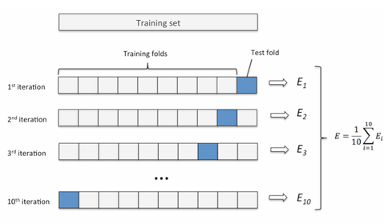
Cross-Validation & Hyper-parameter Tuning
Number of features
Regularization parameters

Slide 35
Parameter Tuning
Given:
Estimator
Parameter grid
Evaluator
Find best parameters
Tokenizer
hashingTF.numFeatures
{100, 1000, 10000}
HashingTF
LogisticRegression
CrossValidator
lr.regParam
{0.01, 0.1, 0.5}
BinaryClassification
Evaluator
Notes:
----- Meeting Notes (3/18/15 01:56) -----
bad animation

Slide 36
Parameter Tuning
Given:
Estimator
Parameter grid
Evaluator
Find best parameters
Tokenizer
Pain point: Tune parameters
HashingTF
LogisticRegression
CrossValidator
BinaryClassification
Evaluator

Slide 37
Hyper-parameter Tuning Example
from pyspark.ml import Pipeline
from pyspark.ml.classification import LogisticRegression
from pyspark.ml.evaluation import BinaryClassificationEvaluator
from pyspark.ml.feature import HashingTF, Tokenizer
from pyspark.ml.tuning import CrossValidator, ParamGridBuilder
# Prepare training documents, which are labeled.
training = spark.createDataFrame([
(0, "a b c d e spark", 1.0),
(1, "b d", 0.0),
(2, "spark f g h", 1.0),
…
(11, "hadoop software", 0.0)
], ["id", "text", "label"])
# Configure an ML pipeline, which consists of tree stages: tokenizer, hashingTF, and lr.
tokenizer = Tokenizer(inputCol="text", outputCol="words")
hashingTF = HashingTF(inputCol=tokenizer.getOutputCol(), outputCol="features")
lr = LogisticRegression(maxIter=10)
pipeline = Pipeline(stages=[tokenizer, hashingTF, lr])

Slide 38
Hyper-parameter Tuning Example – Cont.
# We now treat the Pipeline as an Estimator, wrapping it in a CrossValidator instance.
# This will allow us to jointly choose parameters for all Pipeline stages.
# A CrossValidator requires an Estimator, a set of Estimator ParamMaps, and an Evaluator.
# We use a ParamGridBuilder to construct a grid of parameters to search over.
# With 3 values for hashingTF.numFeatures and 2 values for lr.regParam,
# this grid will have 3 x 2 = 6 parameter settings for CrossValidator to choose from.
paramGrid = ParamGridBuilder() \
.addGrid(hashingTF.numFeatures, [10, 100, 1000]) \
.addGrid(lr.regParam, [0.1, 0.01]) \
.build()
crossval = CrossValidator(estimator=pipeline,
estimatorParamMaps=paramGrid,
evaluator=BinaryClassificationEvaluator(),
numFolds=2) # use 3+ folds in practice
# Run cross-validation, and choose the best set of parameters.
cvModel = crossval.fit(training)

Slide 39
Hyper-parameter Tuning Example – Cont.
# Prepare test documents, which are unlabeled.
test = spark.createDataFrame([
(4, "spark i j k"),
(5, "l m n"),
(6, "mapreduce spark"),
(7, "apache hadoop")
], ["id", "text"])
# Make predictions on test documents. cvModel uses the best model found (lrModel).
prediction = cvModel.transform(test)
selected = prediction.select("id", "text", "probability", "prediction")
for row in selected.collect():
print(row)

Slide 40





Abstracted Pipeline
Dataset
Dataset
Raw data
Transformer
Estimator
[parameters]
Cross Validator
Dataset
Dataset
Estimator
Dataset
[pipeline, evaluator, parameters]
Transformer
[parameters]
[parameters]
http://spark.apache.org/docs/latest/ml-pipeline.html

Slide 41
Clustering Example
df = sc.read.format('com.databricks.spark.csv').\
options(header='true', \
inferschema='true').\
load("../data/iris.csv",header=True);
+------------+-----------+------------+-----------+-------+
|sepallength|sepalwidth|petallength|petalwidth|species|
+------------+-----------+------------+-----------+-------+
| 5.1 | 3.5 | 1.4 | 0.2 | setosa|
| 4.9 | 3.0 | 1.4 | 0.2 | setosa|
| 4.7 | 3.2 | 1.3 | 0.2 | setosa|
| 4.6 | 3.1 | 1.5 | 0.2 | setosa|
| 5.0 | 3.6 | 1.4 | 0.2 | setosa|
+------------+-----------+------------+-----------+-------+

Slide 42
from pyspark.ml.feature import VectorAssembler
assembler = VectorAssembler(inputCols = ["sepal_length","sepal_width","petal_length","petal_width"], outputCol = "features")
transformed = assembler.transform(df).select(“features”)
+-----------------+
|features |
+-----------------+
|[5.1,3.5,1.4,0.2]|
|[4.9,3.0,1.4,0.2]|
|[4.7,3.2,1.3,0.2]|
|[4.6,3.1,1.5,0.2]|
|[5.0,3.6,1.4,0.2]|
+-----------------+

Slide 43
Deal With Categorical Variables
from pyspark.ml import Pipeline
from pyspark.ml.regression import LinearRegression
from pyspark.ml.feature import VectorIndexer
from pyspark.ml.evaluation import RegressionEvaluator
# Automatically identify categorical features, and index them.
# We specify maxCategories so features with > 4 distinct values are treated as continuous.
featureIndexer = VectorIndexer(inputCol="features", \
outputCol="indexedFeatures",\
maxCategories=4).fit(transformed)
# data = featureIndexer.transform(transformed)

Slide 44
K-Means Pipeline
from pyspark.ml.clustering import KMeans, KMeansModel
kmeans = KMeans() \
.setK(3) \
.setFeaturesCol("indexedFeatures")\
.setPredictionCol("cluster")
# Chain indexer and tree in a Pipeline
pipeline = Pipeline(stages=[featureIndexer, kmeans])
model = pipeline.fit(transformed)
cluster = model.transform(transformed)
cluster.show()
+-----------------+-----------------+-------+
| features| indexedFeatures|cluster|
+-----------------+-----------------+-------+
|[5.1,3.5,1.4,0.2]|[5.1,3.5,1.4,0.2]| 1|
|[4.9,3.0,1.4,0.2]|[4.9,3.0,1.4,0.2]| 1|
|[4.7,3.2,1.3,0.2]|[4.7,3.2,1.3,0.2]| 1|

Slide 45
Summary
Machine learning with Spark
Step 1) Getting data in DataFrame
Step 2) Data preprocessing
Step 3) Build the classifier (or other ML algorithm)
Step 4) Build a pipeline
Step 5) Train and evaluate the model
Step 6) Tune the hyperparameter

