Slide 1

Elsayed Hemayed
Some of the slides are from Spark Summer School (amplab- UC Berkeley) by Tathagata Das

Slide 2
Overview
Stream Computing
Motivation
Collecting Steaming Data (Flume, Kafka)
Spark Streaming
Discretized Stream Processing
DStream Transformation
Window based Transformation
Stateful Computation
Checkpoints
Fault Tolerance
Example
Spark Structured Streaming

Slide 3
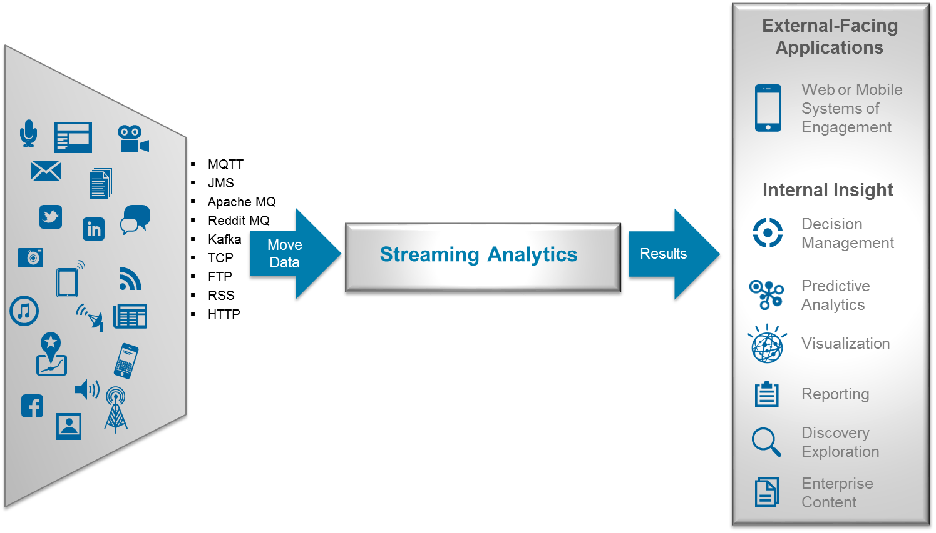
Stream Computing
https://www.ibmbigdatahub.com/blog/quick-reference-guide-technologies-and-applications-stream-computing

Slide 4
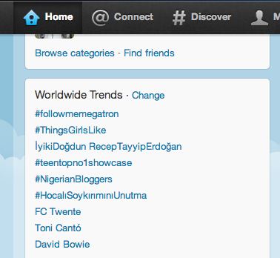
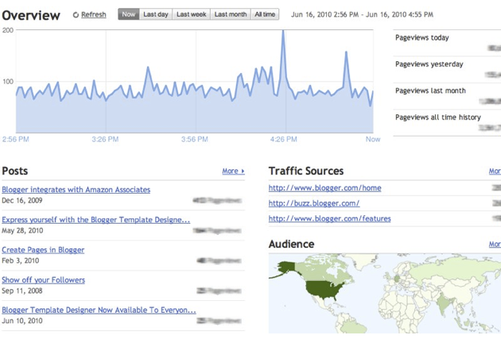
Motivation
Many important applications must process large streams of live data and provide results in near-real-time
Social network trends
Website statistics
Ad impressions
Sensor networks and IoT
Predictive Maintenance
Traffic Monitoring
…
Distributed stream processing framework is required to
Scale to large clusters (100s of machines)
Achieve low latency (few seconds)

Slide 5
How to collect the streaming data?
Flume: A service for collecting, aggregating, and moving large amounts of log data
Kafka: A distributed message queue with simple stream processing built on top

Slide 6

Flume Main Idea
1) Stage data into staging buffers
Making them immediately accessible to access
2) Flush buffers periodically to HDFS files (Hadoop) or other sink
Requires two access path to the data (buffers + HDFS)
Stream Source
Data Sink
Staging area
Events
Flush
HDFS
Big File

Slide 7
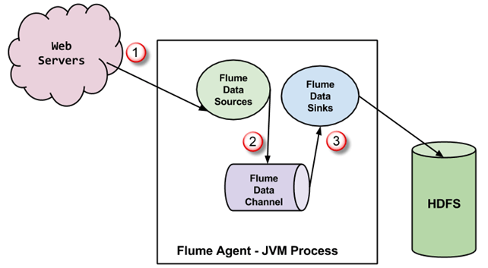
Apache Flume
Data transfer engine driven by events
Flume events
Headers
Body (byte array)
Data can be
Collected
Processed (interceptors)
Aggregated
Main features
Distributed
Agents can be placed on different machines
Reliable
Transactions

Slide 8
Flume agent
Agents has at least
A source
Files/Logs/Directories, Kafka, Twitter
STDOUT from a program
Custom (a.g. JDBCSource)
Note: could have interceptors
A channel
Memory
File
Kafka
JDBC
Custom
A sink
HDFS, HBase,
Kafka, ElasticSearch
Custom
flume-agent
Source
Sink
Channel

Slide 9


Flume data flow
Multiple agents can be deployed
On the same machine or in a distributed manner
flume-agent
Source
Sink
Consolidation/aggregation
Channel
flume-agent
flume-agent
Source
Sink
Source
Sink
Channel
Channel
flume-agent
Source
Sink
Channel

Slide 10
Flume data flow
Agents can have more than one data flow
Replication
Multiplexing
agent
Channel
Sink
Source
Channel
Sink
Channel
Sink

Slide 11


Flow Reliability
Normal Flow
Communication Failure between Agents
Communication Restored, Flow back to Normal
Flume agent machine is a single point of failure if it breaks we will lose data
We need to stage data in a reliable distributed event broker → Apache Kafka

Slide 12
Apache Kafka
Messages broker
Topics
Main features
Distributed
Instances can be deployed on different machines
Scalable
Topic could have many partitions
Reliable
Partitions are replicated
Messages can be acknowledged

Slide 13






How Kafka can improve data ingestion
As reliable big staging area
Stream Source
Events
Staging area
Real time stream processing
Stream Source
Stream Source
Events
Stream Source
Events
Flush periodically
Flush immediately
HDFS
Indexed data
Big Files
Batch processing
Fast data access

Slide 14
Important Aspects of Stream Processing
Delivery Guarantees : Atleast-once, Atmost-once, Exactly-once.
Fault Tolerance: Recover from failure
State Management: preserve and update state information
Performance: Latency, throughput, scalability
Advanced Features: Event Time Processing, Watermarks, Windowing

Slide 15
Stream Processing Types
Native Streaming:
record is processed as soon as it arrives, without waiting for others
there are some continuous running processes (operators/tasks/bolts)
Flink, Storm, Kafka streams
Micro-batching:
incoming records in every few seconds are batched together and then processed in a single mini batch with delay of few seconds
Spark Streaming, Storm-Trident

Slide 16
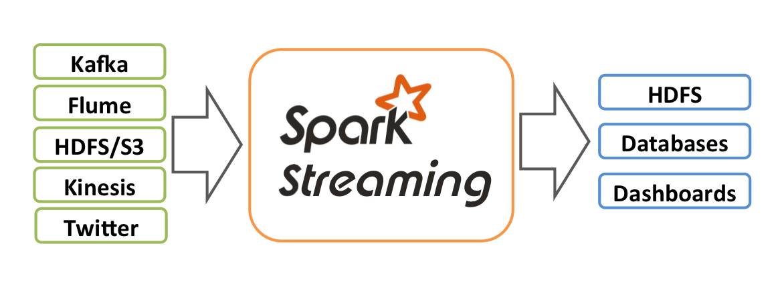
Spark Streaming Features
Scaling: Spark Streaming can easily scale to hundreds of nodes.
Speed: It achieves low latency (could be 1 sec).
Fault Tolerance: Spark has the ability to efficiently recover from failures.
Integration: Spark integrates with batch and real-time processing.
Simple batch-like API for implementing complex algorithms

Slide 17
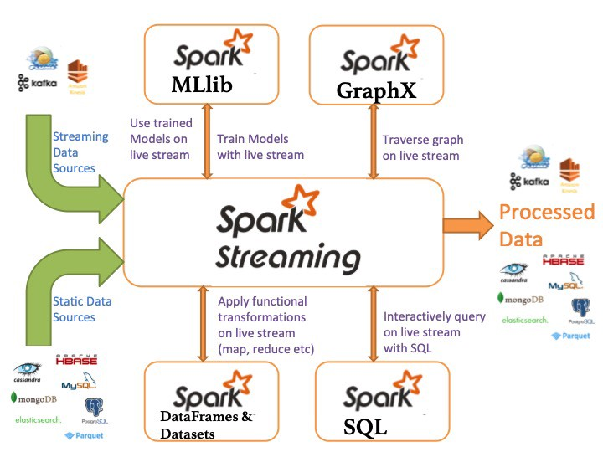
Integrated Environment

Slide 18

Integration with Batch Processing
Many environments require processing same data in live streaming as well as batch post processing
Existing framework cannot do both
Either do stream processing of 100s of MB/s with low latency
Or do batch processing of TBs / PBs of data with high latency
Extremely painful to maintain two different stacks
Different programming models
Double the implementation effort
Double the number of bugs

Slide 19
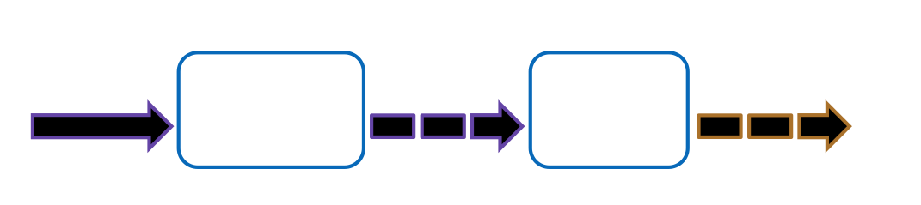
Spark Streaming
Spark Streaming is a Spark extension that receives live input data streams and divides the data into batches, called discretized stream or DStream, which can then be processed by the Spark engine.

Slide 20
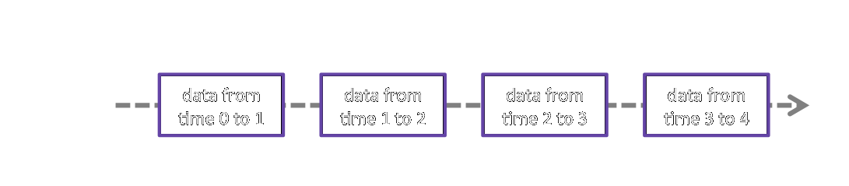
DStreams
A DStream is just a sequence of RDDs.
DStreams can be created from data sources, called input DStreams, or from applying transformations on other DStreams.

Slide 21
Input DStreams
Input DStream is created from data sources and served as the starting point of the application.
Sources can be,
File systems, socket connections.
Kafka, Flume, Twitter, HDFS, etc.
Custom sources user-defined sources.

Slide 22
Discretized Stream Processing
Run a streaming computation as a series of very small, deterministic batch jobs
live data stream
Spark
Streaming
Chop up the live stream into batches of X seconds
Spark treats each batch of data as RDDs and processes them using RDD operations
Finally, the processed results of the RDD operations are returned in batches
batches of X seconds
Spark
processed results

Slide 23
Discretized Stream Processing
Run a streaming computation as a series of very small, deterministic batch jobs
live data stream
Spark
Streaming
Batch sizes as low as ½ second, latency of about 1 second
Potential for combining batch processing and streaming processing in the same system
batches of X seconds
Spark
processed results

Slide 24
DStreams Transformations
DStreams expose most of the common RDD operations
Dstreams transformations applied to a DStream, results in a new DStream
map(func) | map(func) returns a new DStream by passing each element of the source DStream through a function func.
flatMap(func) | flatMap(func) is similar to map(func) but each input item can be mapped to 0 or more output items and returns a new DStream by passing each source element through a function func.
filter(func) | filter(func) returns a new DStream by selecting only the records of the source DStream on which func returns true.
reduce(func) | reduce(func) returns a new DStream of single-element RDDs by aggregating the elements in each RDD of the source DStream using a function func.
groupBy(func) | groupBy(func) returns the new RDD which basically is made up with a key and corresponding list of items of that group.

Slide 25
Stateless Vs Stateful Streaming
Stateful Streaming: The processing of the current data/batch is dependent on the data/batch that has been processed already
For word count example
(I, 1), (am, 1), (Engineer, 1)
What if you stream this data twice? What you get?
Will you get same output (count is 1) or you get double count?

Slide 26
DStreams Stateful Transformations
A particularly interesting DStream transformation is updateStateByKey which enables defining and updating a long-running state over all the RDDs in the DStream!
A state can be of any data type and it gets updated with new values in each batch.
For example, in a streaming variant of the word count example, the state can be defined as the count of each word so far, and it gets updated by each new batch by adding the number of occurrences of each word in the batch to its long-running count.

Slide 27
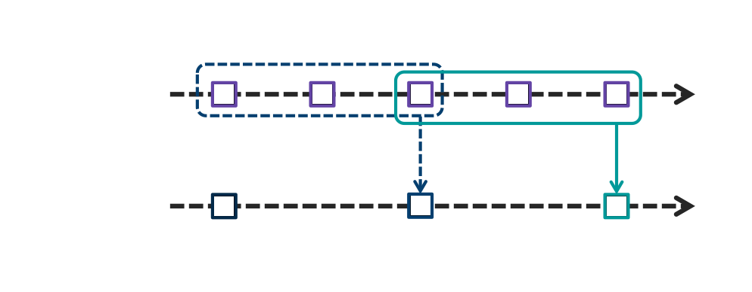
DStreams Windowed Transformations
Another interesting type of DStream transformations are windowed transformations which enables processing on multiple RDDs within a window.
A window is defined by two parameters; its length & sliding interval.

Slide 28

Windowing in Spark
Spark provides a set of transformations that apply to a sliding window of data.
A window is defined by two parameters: window length and slide interval.
First 8 sec. window
Second 8 sec. window
1
2
3
4
5
6
7
8
9
10
11
12
Secs.
Window operation is performed here.
Window operation is performed here, 4 seconds after the previous one.
“Tumbling window” effect can be achieved by making slide interval = window length
Notes:
Objective: This slide shows a set of transformations used in Apache Spark that encompasses windowing.
Talking points:
A window is defined by two parameters:
Window length: the duration of the window
Slide interval: the interval at which the window-based operation is performed
The figure shown displays a window with a length equaling 8 secs. and slide interval equaling 4 secs.

Slide 29
Spark: Window transformation operations
Transformation | Meaning
Window (windowLength, slideInterval) | Returns a new DStream that is computed based on windowed batches of the source DStream.
countByWindow (windowLength, slideInterval) | Returns a sliding window count of elements in the stream.
reduceByWindow (func, windowLength, slideInterval) | Returns a new single-element stream, created by aggregating elements in the stream over a sliding interval using func. The function should be associative so that it can be computed correctly in parallel.
reduceByKeyAndWindow (func, windowLength, slideInterval, [numTasks]) | When called on, a DStream of (K, V) pairs returns a new DStream of (K, V) pairs, where the values for each key are aggregated using the given reduce function (func) over batches in a sliding window.
reduceByKeyAndWindow (func, invFunc, windowLength, slideInterval, [numTasks]) | A more efficient version of the above reduceByKeyAndWindow(), where the reduce value of each window is calculated incrementally, using the reduce values of the previous window. This is done by reducing the new data that enters the sliding window, and "inverse reducing" the old data that leaves the window. An example would be that of "adding" and "subtracting" counts of keys as the window slides. However, it is applicable to only "invertible reduce functions”—that is, those reduce functions that have a corresponding "inverse reduce" function (taken as parameter invFunc).
countByValueAndWindow (windowLength, slideInterval, [numTasks]) | When called on, a DStream of (K, V) pairs returns a new DStream of (K, Long) pairs where the value of each key is its frequency within a sliding window.
Notes:
Objective: This slide displays the different type of transformations used to perform windowing.
Talking points:
Window (windowLength, slideInterval) – Returns a new DStream that is computed based on windowed batches of the source DStream.
countByWindow (windowLength,slideInterval) – Returns a sliding window count of elements in the stream.
reduceByWindow (func, windowLength,slideInterval) – Returns a new single-element stream, created by aggregating elements in the stream over a sliding interval using func. The function should be associative so that it can be computed correctly in parallel.
reduceByKeyAndWindow (func,windowLength, slideInterval, [numTasks]) – When called on, a DStream of (K, V) pairs returns a new DStream of (K, V) pairs, where the values for each key are aggregated using the given reduce function (func) over batches in a sliding window.
reduceByKeyAndWindow (func, invFunc,windowLength, slideInterval, [numTasks]) – A more efficient version of the above reduceByKeyAndWindow(), where the reduce value of each window is calculated incrementally, using the reduce values of the previous window. This is done by reducing the new data that enters the sliding window, and "inverse reducing" the old data that leaves the window. An example would be that of "adding" and "subtracting" counts of keys as the window slides. However, it is applicable to only "invertible reduce functions”—that is, those reduce functions that have a corresponding "inverse reduce" function (taken as parameter invFunc).
countByValueAndWindow (windowLength,slideInterval, [numTasks]) – When called on, a DStream of (K, V) pairs, returns a new DStream of (K, Long) pairs where the value of each key is its frequency within a sliding window.

Slide 30
DStreams Output Operations
DStreams flow usually ends with some sort of output operation!
Built-in output operations include printing to the terminal and saving to files.
A generic output operation, foreachRDD, is also exposed to enable more flexibility and customizations, e.g., pushing the output to another system.

Slide 31
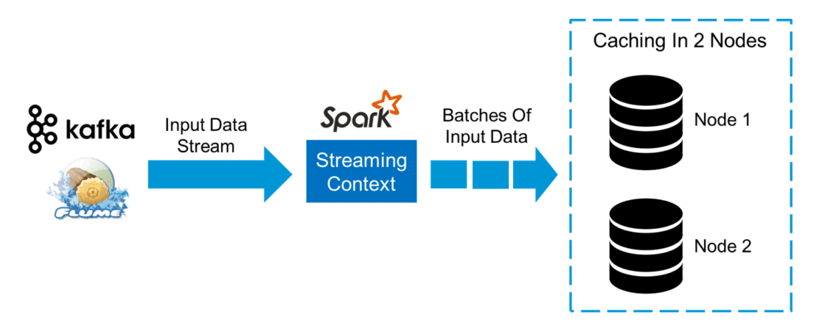
Caching
DStreams allow developers to cache/ persist the stream’s data in memory.
This is useful if the data in the DStream will be computed multiple times.
This can be done using the persist() method on a DStream.

Slide 32
DStreams Checkpoints
Since streaming applications are expected to operate 24/7, DStreams support the notion of checkpoints.
Periodically store information to a fault-tolerant storage system such that they can recover from failures.
Metadata checkpoints: Saving the information defining the streaming computation. This is used to recover from failure of the node running the driver of the streaming application.
Data checkpoints: Saving the generated RDDs to reliable storage. This is necessary in some stateful transformations that combine data across multiple batches.

Slide 33

Fault-tolerance: Worker
RDDs remember the operations that created them
Batches of input data are replicated in memory for fault-tolerance
Data lost due to worker failure, can be recomputed from replicated input data
tweets
RDD
input data replicated
in memory
flatMap
hashTags
RDD
lost partitions recomputed on other workers
All transformed data is fault-tolerant, and exactly-once transformations

Slide 34
Fault-tolerance: Master
Master saves the state of the DStreams to a checkpoint file
Checkpoint file saved to HDFS periodically
If master fails, it can be restarted using the checkpoint file

Slide 35

Example – Get hashtags from Twitter
val tweets = ssc.twitterStream()
DStream: a sequence of RDDs representing a stream of data
Twitter Streaming API
batch @ t+1
batch @ t
batch @ t+2
tweets DStream
stored in memory as an RDD (immutable, distributed)

Slide 36
Example – Get hashtags from Twitter
val tweets = ssc.twitterStream()
val hashTags = tweets.flatMap (status => getTags(status))
new DStream
transformation: modify data in one DStream to create another DStream
batch @ t
batch @ t+1
batch @ t+2
tweets DStream
flatMap
flatMap
flatMap
hashTags Dstream
[#cat, #dog, … ]
…
new RDDs created for every batch

Slide 37
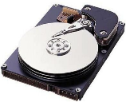
Example – Get hashtags from Twitter
val tweets = ssc.twitterStream()
val hashTags = tweets.flatMap (status => getTags(status))
hashTags.saveAsHadoopFiles("hdfs://...")
output operation: to push data to external storage
batch @ t
batch @ t+1
batch @ t+2
tweets DStream
flatMap
flatMap
flatMap
hashTags DStream
save
save
save
every batch saved to HDFS

Slide 38
Example – Get hashtags from Twitter
val tweets = ssc.twitterStream()
val hashTags = tweets.flatMap (status => getTags(status))
hashTags.foreach(hashTagRDD => { ... })
foreach: do whatever you want with the processed data
batch @ t
batch @ t+1
batch @ t+2
tweets DStream
flatMap
flatMap
flatMap
hashTags DStream
foreach
foreach
foreach
Write to database, update analytics UI, do whatever you want

Slide 39
Window-based Transformations
val tweets = ssc.twitterStream()
val hashTags = tweets.flatMap (status => getTags(status))
val tagCounts = hashTags.window(Minutes(1), Seconds(5)).countByValue()
sliding window operation
window length
sliding interval
countByValue() is invoked every 5 secs. All RDDs accumulated in the previous 1 minute are passed to the callback function.
window length
DStream of data
sliding interval

Slide 40
Arbitrary Stateful Computations
Specify function to generate new state based on previous state and new data
Example: Maintain per-user mood as state, and update it with their tweets
updateMood(newTweets, lastMood) => newMood
moods = tweets.updateStateByKey(updateMood _)

Slide 41
Arbitrary Combinations of Batch and Streaming Computations
Inter-mix RDD and DStream operations!
Example: Join incoming tweets with a spam HDFS file to filter out bad tweets
tweets.transform(tweetsRDD => { tweetsRDD.join(spamHDFSFile).filter(...)
})

Slide 42
Unifying Batch and Stream Processing Models
Spark program on Twitter log file using RDDs
val tweets = sc.hadoopFile("hdfs://...")
val hashTags = tweets.flatMap (status => getTags(status))
hashTags.saveAsHadoopFile("hdfs://...")
Spark Streaming program on Twitter stream using DStreams
val tweets = ssc.twitterStream()
val hashTags = tweets.flatMap (status => getTags(status))
hashTags.saveAsHadoopFiles("hdfs://...")

Slide 43
Vision - one stack to rule them all
Explore data interactively using Spark Shell to identify problems
Use same code in Spark stand-alone programs to identify problems in production logs
Use similar code in Spark Streaming to identify problems in live log streams
$ ./spark-shell
scala> val file = sc.hadoopFile(“smallLogs”)
...
scala> val filtered = file.filter(_.contains(“ERROR”))
...
scala> val mapped = filtered.map(...)
...
object ProcessProductionData {
def main(args: Array[String]) {
val sc = new SparkContext(...)
val file = sc.hadoopFile(“productionLogs”)
val filtered = file.filter(_.contains(“ERROR”))
val mapped = filtered.map(...)
...
}
}
object ProcessLiveStream {
def main(args: Array[String]) {
val sc = new StreamingContext(...)
val stream = sc.kafkaStream(...)
val filtered = file.filter(_.contains(“ERROR”))
val mapped = filtered.map(...)
...
}
}

Slide 44

Elsayed Hemayed
Some of the slides are from Apache Spark Website

Slide 45
Why Structured Streaming
The need arises for stateful streaming better than via “local” aggregations.
You should write simple queries & Spark should continuously update the answer
Spark 2.0 introduced Structured Streaming
Enables running continuous, incremental processes
Basically manages the state for you
Built on Spark SQL
DataFrame/Dataset API
Catalyst Optimizer
Many other features
Notes:
Talk about the benefits of Structured Streaming (e.g end-to-end exactly-once fault tolerance), and explain how is it different from Spark Streaming
DataFrame/Dataset - rather than DStream’s RDD
Catalyst Optimizer - extensible query optimizer which is “at the core of Spark SQL… designed with these key two purposes:
Easily add new optimization techniques and features to Spark SQL
Enable external developers to extend the optimizer (e.g. adding data source specific rules, support for new data types, etc.)” (see https://databricks.com/glossary/catalyst-optimizer)
Other features included :
Handling event-time and late data
End-to-end exactly-once fault-tolerance

Slide 46
Treat Streams as Unbounded Tables
Data stream
Unbounded Table
new data in the
data stream
=
new rows appended
to an unbounded table
Data stream as an unbounded table

Slide 47
Single API
static data =
bounded table
streaming data =
unbounded table

Slide 48
Programming Model for Structured Streaming
Trigger: every 1 sec
Time
1
2
3
Input
data up to t=1
data up to t=2
data up
to t=3
Query
Result
result up to t=1
result up to t=2
result up to t=3
Output
complete mode

Slide 49
cat dog
dog dog
owl cat
dog
owl
Time
1
2
3
Input
Unbounded table of all input
cat dog
dog dog
data up to t=1
cat dog
dog dog
owl cat
data up to t=2
cat dog
dog dog
owl cat
dog
owl
data up
to t=3
word count query
Result
Table of word counts
cat | 1
dog | 3
result up to t=1
cat | 2
dog | 3
owl | 1
result up to t=2
cat | 2
dog | 4
owl | 2
result up to t=3
Output
Complete Mode
print all the counts to console

Slide 50
Input Stream
12:02 | cat dog
12:03 | dog dog
12:07 | owl cat
12:11 | dog
12:13 | owl
12:00
12:05
12:10
12:15
Time
12:00 - 12:10 | cat | 1
12:00 - 12:10 | dog | 3
12:00 - 12:10 | cat | 2
12:00 - 12:10 | dog | 3
12:00 - 12:10 | owl | 1
12:05 - 12:15 | cat | 1
12:05 - 12:15 | owl | 1
12:00 - 12:10 | cat | 2
12:00 - 12:10 | dog | 3
12:00 - 12:10 | owl | 1
12:05 - 12:15 | cat | 1
12:05 - 12:15 | owl | 2
12:05 - 12:15 | dog | 1
12:10 - 12:20 | dog | 1
12:10 - 12:20 | owl | 1
Result Tables
after 5 minute triggers
counts incremented for windows
12:00 - 12:10 and 12:05 - 12:15
counts incremented for windows
12:05 - 12:15 and 12:10 - 12:20
Windowed Grouped Aggregation
with 10 min windows, sliding every 5 mins

Slide 51
late data that was generated at 12:04 but arrived at 12:11
Input Stream
12:02 | cat dog
12:03 | dog dog
12:04 | dog
12:13 | owl
12:07 | owl cat
12:00
12:05
12:10
12:15
Time
12:00 - 12:10 | cat | 1
12:00 - 12:10 | dog | 3
12:00 - 12:10 | cat | 2
12:00 - 12:10 | dog | 3
12:00 - 12:10 | owl | 1
12:05 - 12:15 | cat | 1
12:05 - 12:15 | owl | 1
12:00 - 12:10 | cat | 2
12:00 - 12:10 | dog | 4
12:00 - 12:10 | owl | 1
12:05 - 12:15 | cat | 1
12:05 - 12:15 | owl | 2
12:10 - 12:20 | owl | 1
Result Tables
after 5 minute triggers
counts updated for
window 12:00 - 12:10
Late data handling in
Windowed Grouped Aggregation

Slide 52
Watermarking
Keeping state allows late data to update counts of old windows
But size of the state increases indefinitely if old windows are not dropped
So we need to drop the state of very late data
Watermark - moving threshold of how late data is expected to be and when to drop old state

Slide 53
Summary
Spark Streaming has near real time latency
Integrated with Spark as an extension
Unifies Batch and Stream Processing Models
Spark Structured Streaming is a better solution for Streaming
Programming Guides:
http://spark.apache.org/docs/latest/streaming-programming-guide.html
http://spark.apache.org/docs/latest/structured-streaming-programming-guide.html

