Slide 1
Hadoop Echo System –
Apache Sqoop
Elsayed Hemayed
Some of the slides are from Hadoop Tutorial by Daniel Lanza and Zbigniew Baranowski and from ApacheCon Tutorial

Slide 2
Overview
Data Ingestion to Hadoop
Batch Ingestion
Sqoop (Why and What)
Sqoop Connectors
Sqoop Import and Export Job
Sqoop 2 Architecture

Slide 3




Data Ingestion to Hadoop and Challenges
Variety of data sources
Databases
Web
REST
Logs
Whatever…
Not all of them are necessary producing files…
HDFS is a file system, not a database
You need to store files
Extraction-Tranformation-Loading tools needed
Streaming data
Files in batch

Slide 4
Data ingestion types
Batch ingestion
Data are already produced and available to store on Hadoop (archive logs, files produced by external systems, RDBMS)
Typically big chunks of data
Real time ingestion
Data are continuously produced
Streaming sources

Slide 5
Batch ingestion
hdfs dfs –put
sends file from local system to HDFS
file is sent sequentially
Custom programs with using HDFS API
Apache Sqoop – loading data from external relational databases

Slide 6
Why Sqoop?
In traditional application management system, the interaction of applications with relational database using RDBMS, is one of the sources that generate Big Data.
Such Big Data, generated by RDBMS, is stored in Relational Database Servers in the relational database structure.
When Big Data storages and analyzers such as MapReduce, Hive, Hbase, Pig, etc. of the Hadoop ecosystem came into picture, they required a tool to interact with the relational database servers for importing and exporting the Big Data residing in them.
Here, Sqoop occupies a place in the Hadoop ecosystem to provide feasible interaction between relational database server and Hadoop’s HDFS.

Slide 7
What is Sqoop?
Sqoop: “SQL to Hadoop and Hadoop to SQL” Sqoop is a tool designed to transfer data between Hadoop and relational database servers.
It is used to import data from relational databases such as MySQL, Oracle to Hadoop HDFS, and export from Hadoop file system to relational databases.
It is provided by the Apache Software Foundation.

Slide 8

About Apache Sqoop
Tool to transfer data between structured databases and Hadoop
Sqoop tasks are implemented as map reduce jobs – can scale on the cluster
Database
(MySQL, Oracle, PostgreSQL, DB2
HDFS
(Files, Hive, HBase)
Sqoop Import
JDBC
Sqoop Export

Slide 9
Sqoop Import and Export
The import tool imports individual tables from RDBMS to HDFS. Each row in a table is treated as a record in HDFS.
All records are stored as text data in text files or as binary data in Avro (data serialization system)and Sequence files.
The export tool exports a set of files from HDFS back to an RDBMS.
The files given as input to Sqoop contain records, which are called as rows in table.
Those are read and parsed into a set of records and delimited with user-specified delimiter.

Slide 10
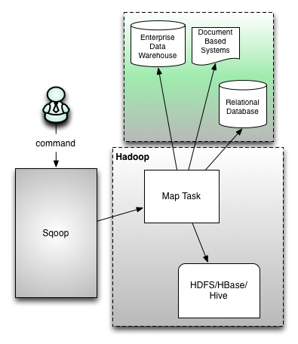
Sqoop Connectors
Sqoop provides optimized MySQL, PostgreSQL, Oracle, and Netezza connectors that use database-specific APIs to perform bulk transfers more efficiently.
There is also a generic JDBC connector for connecting to any database that supports Java’s JDBC protocol.

Slide 11
Connection vs Job Metadata
There are two distinct sets of options to pass in to Sqoop:
Connection (distinct per database)
Connect, username, password
Job (distinct per table)
Table, query, where, compress, target-dir

Slide 12
A Sqoop Import Job
Example (Source Oracle):
% sqoop import \ #impoting from DB to HDFS
--direct \ # using direct oracle connector (efficient)
--connect jdbc:oracle://localhost/myDBname \
--username myDBusername \
--table myTableName #table name to be imported
--m 2 \ #number of parallel sessions (
--target-dir my_target_dir \ #target HDFS directory
OR
--hive-import #import to Hive and not HDFS
--as-sequencefile #Optional: default is text file

Slide 13
A Sqoop Import Job – Cont.
Controlling the import:
--where
--query
Incremental Imports:
--incremental append
--incremental lastmodified
Inspect the file contents:
% hadoop fs -cat my_target_dir/part-m-00000
% hadoop fs -cat my_target_dir/part-m-00001

Slide 14
A Sqoop Export Job
% sqoop export --connect jdbc:mysql://localhost/myDBname --m 1 \
--table myTableName --export-dir /user/hive/warehouse/myHiveTable \
--input-fields-terminated-by '\0001‘
--stagingtable myStagingTable #Optional: a temporary staging table
--clear-staging-table #If the staging table in not empty
The staging table must already exist and have the same schema as the destination.
Do not use too many mappers/sessions
Excessive number of concurrent sessions can kill a database
max 10 mappers/sessions

Slide 15
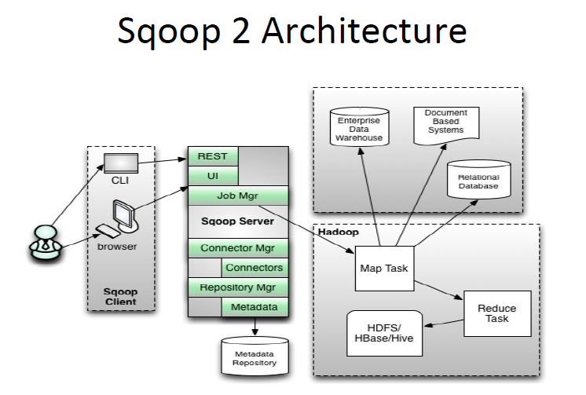
Sqoop 2 Architecture

Slide 16
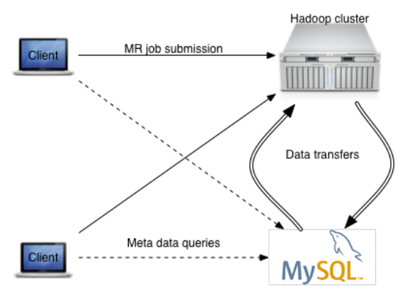
Sqoop 1 Operation

Slide 17
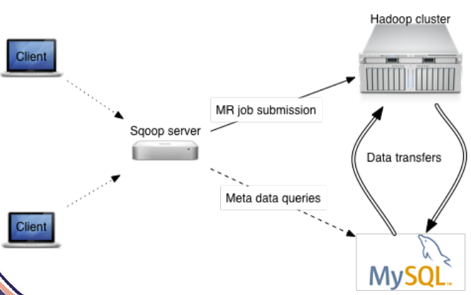
Sqoop 2 Operation

Slide 18
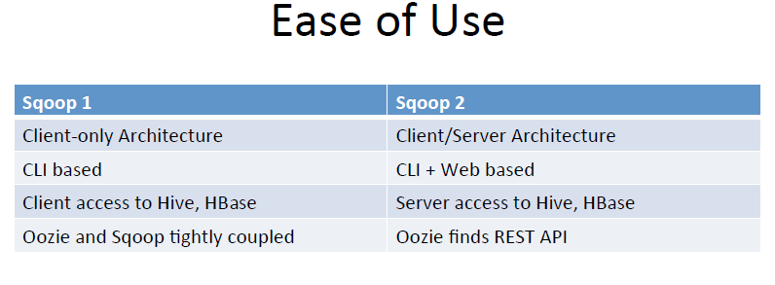
Sqoop 1 vs 2

Slide 19
Summary – when to use what
Apache Sqoop
NameNode
DataNode
DataNode
+
Streaming data
DataNode
Remote copy
Pre-processing
DataNode
Files in batch

