Slide 1

Hadoop Echo System - Hive
Elsayed Hemayed
Some of the slides are from CMSC 491 by Adam Shook

Slide 2
Overview of Topics
Hadoop Echo System
What is Hive?
Hive architecture, shell and configuration
Hive metastore
Data Model
HiveQL
Notes:
The topics covered in this lesson are listed.

Slide 3
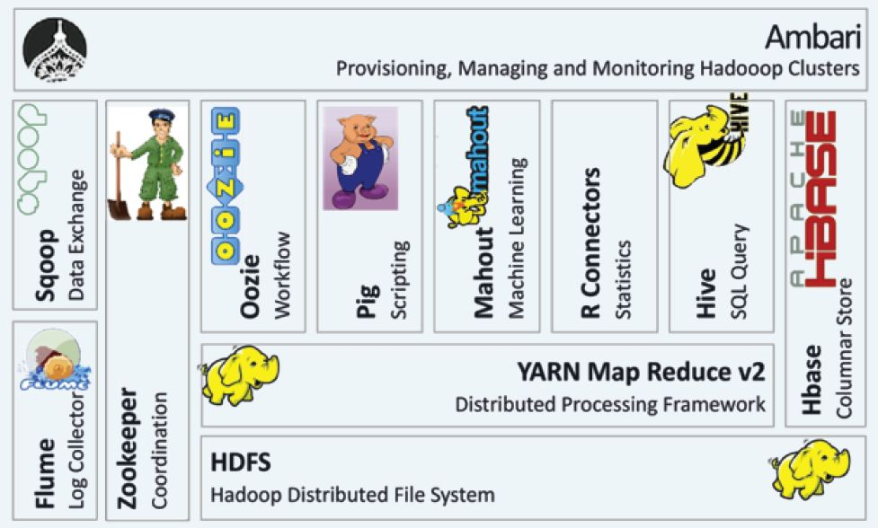
Hadoop Echo System

Slide 4
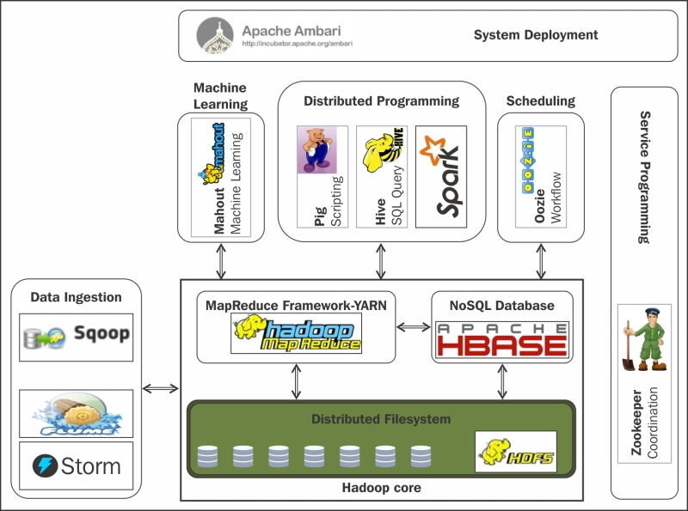
Hadoop Echo System

Slide 5
Query Languages for Hadoop
Builds on core Hadoop (MapReduce and HDFS) to enhance the development and manipulation of Hadoop clusters
Pig --- Data flow language and execution environment
Hive (and HiveQL) --- Query language based on SQL for building MapReduce jobs
HBase --- Column oriented database built on HDFS supporting MapReduce and point queries
Notes:
These interfaces build on core Hadoop to support different styles of interaction with the data stored in HDFS. All are layered over HDFS and MapReduce.
Pig is a data flow language and execution environment on top of Hadoop.
Hive (HiveQL) is an SQL-like query language for building MapReduce jobs.
HBase is a column-oriented database running over HDFS and supporting MapReduce and point queries.
HBase depends on Zookeeper, a coordination service for building distributed applications. We won’t be discussion Zookeeper in this course except to say that it exists.
Mahout is a project to build scalable, machine learning systems by packaging machine learning algorithms as an executable library. You can specify input and output sources in HDFS to the algorithms, for example: each algorithm can take different parameters.
Mahout is still in early development (0.7 is the latest release). More information is available at http://mahout.apache.org/

Slide 6
Levels of Abstraction
As you move from Pig to Hive to HBase, you are increasingly moving away from the mechanics of Hadoop and creating an RDBMS view of the world
DBMS View
HBase
Queries against defined tables
Hive
Data flow language
Pig
SQL-based language
Less Hadoop Visible
More Hadoop
Visible
Mechanics of Hadoop
Notes:
In Pig and Hive, the presence of HDFS is very noticeable.
Pig, for example, directly supports most of the Hadoop file system commands.
Likewise, Hive can access data whether it’s local or stored in an HDFS.
In either case, data can usually be specified via an HDFS URL (hdfs://<namenode>/path>). In the case of HBase, however, Hadoop is mostly hidden in the HBase framework, and HBase provides data to the client via a programmatic interface (usually Java).
Via these interfaces, a Data Scientist can focus on manipulating large datasets without concerning themselves with the inner working of Hadoop. Of course, a Data Scientist must be aware of the constraints associated with using Hadoop for data storage, but doesn’t need to know the exact Hadoop command to check the file system.

Slide 7
What Is Hive?
Developed by Facebook and a top-level Apache project
A data warehousing infrastructure based on Hadoop
Immediately makes data on a cluster available to non-Java programmers via SQL like queries (HiveQL-HQL)
Interprets HiveQL and generates MapReduce jobs that run on the cluster
Enables easy data summarization, ad-hoc reporting and querying, and analysis of large volumes of data
Metadata—such as table schemas—is stored in a database called the metastore.

Slide 8
Hive Usage @ Facebook
Statistics per day:
4 TB of compressed new data added per day
135TB of compressed data scanned per day
7500+ Hive jobs per day
Hive simplifies Hadoop:
~200 people/month run jobs on Hadoop/Hive
Analysts (non-engineers) use Hadoop through Hive
95% of jobs are Hive Jobs
http://www.slideshare.net/cloudera/hw09-hadoop-development-at-facebook-hive-and-hdfs

Slide 9
What Hive Is Not
Hive, like Hadoop, is designed for batch processing of large datasets
Not an OLTP or real-time system
Latency and throughput are both high compared to a traditional RDBMS
Even when dealing with relatively small data ( <100 MB )

Slide 10


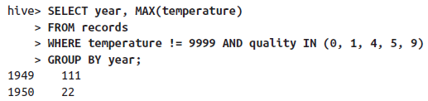
An Example
hive.metastore.warehouse.dir

Slide 11
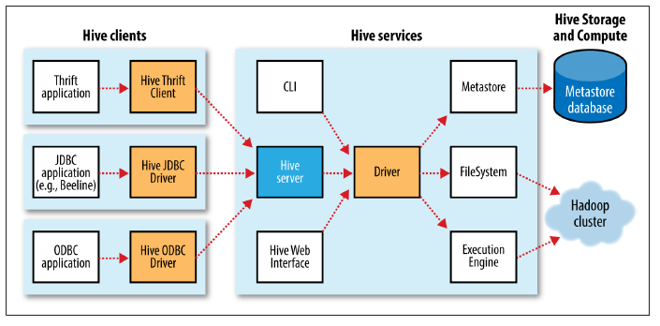
Hive Architecture

Slide 12
Hive Shell
Shell
%hive
hive> SHOW TABLES;
OK
Time taken: 0.473 seconds
Script
% hive -f script.q
Statement
% hive -e 'SELECT * FROM dummy'
OK
X
Time taken: 1.22 seconds, Fetched: 1 row(s)
You can run commands on the host operating system by using a ! prefix to the command and the ability to access Hadoop filesystems using the dfs command.

Slide 13
Configuring Hive
Properties Precedence Hierarchy:
The Hive SET command
The command-line -hiveconf option
hive-site.xml and the Hadoop site files (core-site.xml, hdfs-site.xml, mapredsite.xml, and yarn-site.xml)
The Hive defaults and the Hadoop default files (core-default.xml, hdfs-default.xml, mapred-default.xml, and yarn-default.xml)

Slide 14
Hive Metastore
Stores Hive metadata
Default metastore database uses Apache Derby
Various configurations:
Embedded (in-process metastore, in-process database)
Mainly for unit tests
Local (in-process metastore, out-of-process database)
Each Hive client connects to the metastore directly
Remote (out-of-process metastore, out-of-process database)
Each Hive client connects to a metastore server, which connects to the metadata database itself

Slide 15
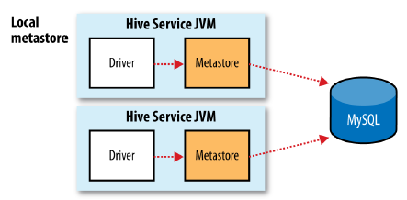
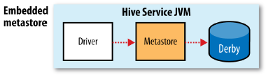
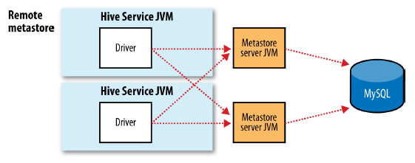
The Metastore
hive.metastore.warehouse.dir
The directory relative to fs.defaultFS where managed tables are stored.
Ex: /user/hive/ warehouse
hive.metastore.uris
Comma separated URIs in the form of thrift://host:port

Slide 16
Hive Comparison with a SQL
Hive | Database
“Schema on Read” | “Schema on Write”
Incomplete SQL-92 (never a design goal) | Full SQL-92
No updates, transactions. Indexes available in v0. 7 Summer 2011. | Updates, transactions and indexes.
Notes:
In most traditional DBMS, the database description (or schema) is read and applied when the data is loaded. If the data doesn’t match the schema (specifically, the table into which it is read), then the load fails. This is often called “Schema on Write.”
Hive, on the other hand, doesn’t attempt to apply the schema until the data is actually read when someone issues a query. This results in fast loads as well as supporting multiple schemas for the same data (only defining as many variables as needed for your particular analysis). In addition, the actual format of the data may not be known because queries against the data haven’t been defined.
Updates and transactions aren’t supplied with Hive. Indexes are available as of Summer 2011 in Hive 0.7. If concurrent access to tables is desired, then the application must roll its own. That said, the Hive project is working towards integration with the HBase project that does provide row updates. See the Hive project page at <http://hive.apache.org/> for further details.

Slide 17
Execution Engine/SQL Alternatives
Execution engines
SQL-on-Hadoop Alternatives
Hive on MapReduce
Hive on Tez
Hive on Spark?
hive> SET hive.execution.engine=tez;
Cloudera Impala
Spark SQL
Apache Drill
Presto
Apache Phoenix (on HBase)

Slide 18
Hive Warehouse
Hive tables are stored in the Hive “warehouse”
Default HDFS location: /user/hive/warehouse
Tables are stored as sub-directories in the warehouse directory
Partitions are subdirectories of tables
External tables are supported in Hive
The actual data is stored in flat files

Slide 19
Data Model
Tables
Basic type columns (int, float, boolean)
Complex type: List / Map ( associate array)
Partitions
Buckets
CREATE TABLE sales( id INT, items ARRAY<STRUCT<id:INT,name:STRING>
) PARITIONED BY (ds STRING)
CLUSTERED BY (id) INTO 32 BUCKETS;
SELECT id FROM sales TABLESAMPLE (BUCKET 1 OUT OF 32)
12/19/2020

Slide 20
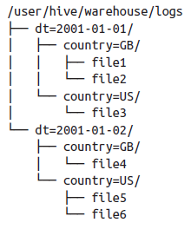
Partitions
CREATE TABLE logs (ts BIGINT, line STRING)
PARTITIONED BY (dt STRING, country STRING);
LOAD DATA LOCAL INPATH 'input/hive/partitions/file1‘ INTO TABLE logs
PARTITION (dt='2001-01-01', country='GB');
hive> SHOW PARTITIONS logs;
dt=2001-01-01/country=GB
dt=2001-01-01/country=US
dt=2001-01-02/country=GB
dt=2001-01-02/country=US
SELECT ts, dt, line
FROM logs
WHERE country='GB';
Will scan only file 1, 2 and 4.

Slide 21
Bucketing
Can speed up queries that involve sampling the data
Sampling works without bucketing, but Hive has to scan the entire dataset
Use CLUSTERED BY when creating table
For sorted buckets, add SORTED BY
To query a sample of your data, use TABLESAMPLE

Slide 22
Managed Tables and External Tables
CREATE TABLE managed_table (dummy STRING);
LOAD DATA INPATH '/user/tom/data.txt' INTO table managed_table;
Hive will move the file hdfs://user/tom/data.txt into Hive’s warehouse directory for the managed_table table, which is hdfs://user/hive/warehouse/managed_table
DROP TABLE managed_table;
Thus the table, including its metadata and its data, is deleted.
CREATE EXTERNAL TABLE external_table (dummy STRING)
LOCATION '/user/tom/external_table';
LOAD DATA INPATH '/user/tom/data.txt' INTO TABLE external_table;
Hive doesn’t move it to its warehouse directory.
When you drop an external table, Hive will leave the data untouched and only delete the metadata.
When to use what?

Slide 23
HiveQL
HiveQL / HQL provides the basic SQL-like operations:
Select columns using SELECT
Filter rows using WHERE
JOIN between tables
Evaluate aggregates using GROUP BY
Store query results into another table
Download results to a local directory (i.e., export from HDFS)
Manage tables and queries with CREATE, DROP, and ALTER

Slide 24
Primitive Data Types
Type | Comments
Tinyint, smallint, int, bigint | 1, 2, 4 and 8-byte integers
Boolean | TRUE/FALSE
Float, double | Single and double precision real numbers
String | Character string
Timestamp | Unix-epoch offset or datetime string
DECIMAL | Arbitrary-precision decimal
BINARY | Opaque; ignore these bytes

Slide 25
Complex Data Types
Type | Comments
Struct | A collection of elements If S is of type STRUCT {a INT, b INT}: S.a returns element a
MAP | Key-value tuple If M is a map from 'group' to GID: M['group'] returns value of GID
Array | Indexed list If A is an array of elements ['a','b','c']: A[0] returns 'a'

Slide 26
HiveQL Limitations
HQL only supports equi-joins, outer joins, left semi-joins
Because it is only a shell for mapreduce, complex queries can be hard to optimise
Missing large parts of full SQL specification:
HAVING clause in SELECT
Correlated sub-queries
Sub-queries outside FROM clauses
Updatable or materialized views
Stored procedures

Slide 27
Create Complex Table
CREATE TABLE employees (
(name STRING,
salary FLOAT,
subordinates ARRAY<STRING>,
deductions MAP<STRING, FLOAT>,
address STRUCT<street:STRING,
city:STRING,
state:STRING,
zip:INT>)
ROW FORMAT DELIMITED
FIELDS TERMINATED BY '\t'
STORED AS TEXTFILE;

Slide 28
Browsing Tables And Partitions
Command | Comments
SHOW TABLES; | Show all the tables in the database
SHOW TABLES 'page.*'; | Show tables matching the specification ( uses regex syntax )
SHOW PARTITIONS page_view; | Show the partitions of the page_view table
DESCRIBE page_view; | List columns of the table
DESCRIBE EXTENDED page_view; | More information on columns (useful only for debugging )
DESCRIBE page_view PARTITION (ds='2008-10-31'); | List information about a partition

Slide 29
Loading Data
Use LOAD DATA to load data from a file or directory
Will read from HDFS unless LOCAL keyword is specified
Will append data unless OVERWRITE specified
PARTITION required if destination table is partitioned
LOAD DATA LOCAL INPATH '/tmp/pv_2008-06-8_us.txt'
OVERWRITE INTO TABLE page_view
PARTITION (date='2008-06-08', country='US')

Slide 30
Inserting Data
Use INSERT to load data from a Hive query
Will append data unless OVERWRITE specified
PARTITION required if destination table is partitioned
FROM page_view_stg pvs
INSERT OVERWRITE TABLE page_view
PARTITION (dt='2008-06-08', country='US')
SELECT pvs.viewTime, pvs.userid, pvs.page_url, pvs.referrer_url
WHERE pvs.country = 'US';

Slide 31
Inserting Data
Normally only one partition can be inserted into with a single INSERT
A multi-insert lets you insert into multiple partitions
FROM page_view_stg pvs
INSERT OVERWRITE TABLE page_view
PARTITION ( dt='2008-06-08', country='US‘ )
SELECT pvs.viewTime, pvs.userid, pvs.page_url, pvs.referrer_url WHERE pvs.country = 'US'
INSERT OVERWRITE TABLE page_view
PARTITION ( dt='2008-06-08', country='CA' )
SELECT pvs.viewTime, pvs.userid, pvs.page_url, pvs.referrer_url WHERE pvs.country = 'CA'
INSERT OVERWRITE TABLE page_view
PARTITION ( dt='2008-06-08', country='UK' )
SELECT pvs.viewTime, pvs.userid, pvs.page_url, pvs.referrer_url WHERE pvs.country = 'UK';

Slide 32
Inserting Data During Table Creation
Use AS SELECT in the CREATE TABLE statement to populate a table as it is created
CREATE TABLE page_view AS
SELECT pvs.viewTime, pvs.userid, pvs.page_url, pvs.referrer_url
FROM page_view_stg pvs
WHERE pvs.country = 'US';

Slide 33
Loading And Inserting Data: Summary
Use this | For this purpose
LOAD | Load data from a file or directory
INSERT | Load data from a query One partition at a time Use multiple INSERTs to insert into multiple partitions in the one query
CREATE TABLE AS (CTAS) | Insert data while creating a table
Add/modify external file | Load new data into external table

Slide 34
Sample Select Clauses
Select from a single table
SELECT *
FROM sales
WHERE amount > 10 AND
region = "US";
Select from a partitioned table
SELECT page_views.*
FROM page_views
WHERE page_views.date >= '2008-03-01' AND
page_views.date <= '2008-03-31'

Slide 35
Relational Operators
ALL and DISTINCT
Specify whether duplicate rows should be returned
ALL is the default (all matching rows are returned)
DISTINCT removes duplicate rows from the result set
WHERE
Filters by expression
Does not support IN, EXISTS or sub-queries in the WHERE clause
LIMIT
Indicates the number of rows to be returned

Slide 36
Relational Operators
GROUP BY
Group data by column values
Select statement can only include columns included in the GROUP BY clause
ORDER BY / SORT BY
ORDER BY performs total ordering
Slow, poor performance
SORT BY performs partial ordering
Sorts output from each reducer

Slide 37
Advanced Hive Operations
JOIN
If only one column in each table is used in the join, then only one MapReduce job will run
This results in 1 MapReduce job:
SELECT * FROM a JOIN b ON a.key = b.key JOIN c ON b.key = c.key
This results in 2 MapReduce jobs:
SELECT * FROM a JOIN b ON a.key = b.key JOIN c ON b.key2 = c.key
If multiple tables are joined, put the biggest table last and the reducer will stream the last table, buffer the others
Use left semi-joins to take the place of IN/EXISTS
SELECT a.key, a.val FROM a LEFT SEMI JOIN b on a.key = b.key;

Slide 38
Advanced Hive Operations
JOIN
Do not specify join conditions in the WHERE clause
Hive does not know how to optimise such queries
Will compute a full Cartesian product before filtering it
Join Example
SELECT
a.ymd, a.price_close, b.price_close
FROM stocks a
JOIN stocks b ON a.ymd = b.ymd
WHERE a.symbol = 'AAPL' AND
b.symbol = 'IBM' AND
a.ymd > '2010-01-01';

