Slide 1
Hadoop Operation and Administration & Spark Performance Tuning
Elsayed Hemayed

Slide 2
Overview of Topics
Hadoop Echo System
Hadoop Cluster Operation and Administration
HDFS Quota
Trash facility
Checkpointing
HDFS health
Balancer
Spark Echo System
Spark Performance Tuning
Notes:
The topics covered in this lesson are listed.

Slide 3
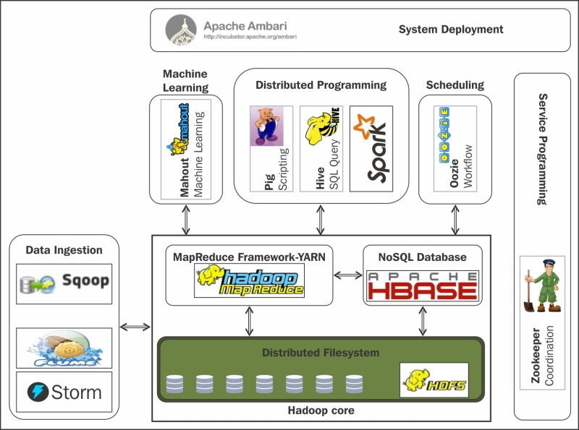
Hadoop Echo System

Slide 4
Hadoop Echo System
YARN: Yet Another Resource Negotiator aka MapReduce V2. Its a framework for job scheduling and managing resources on cluster.
Flume: Its a tool or service that is used for aggregating, collecting and moving large amount of log data in and out of Hadoop.
Zookeeper: Its a framework that enables highly reliable distributed coordination of nodes in the cluster.
Sqoop: “SQL-to-Hadoop” or Sqoop is a tool for efficient transfer between Hadoop and structured data sources i.e Relational Database or other Hadoop data stores, e.g. Hive or HBase.
Oozie: Workflow scheduler system to manage Hadoop jobs. The jobs may include non MapReduce jobs.
Amabri/Cloudera Manager: This component of Hadoop ecosystem is used for provisioning, managing and monitoring the hadoop cluster.

Slide 5
Hadoop Echo System
Hive: Hive is an open-source data warehouse system for querying and analyzing large datasets stored in Hadoop files.
HBase: Its a column-oriented non-relational database management system that runs on top of HDFS.
Pig: Initially developed at Yahoo!, Pig is a framework consisting of high-level scripting language i.e Pig Latin along with a run time environment to which allows user to run MapReduce on hadoop cluster.
Mahout: Mahout is a scalable machine learning and data mining library.

Slide 6
Managing HDFS
RAID should not be used with Hadoop HDFS (Why?)
Creating User (Home) Directories
% hadoop fs -mkdir /user/username
Setting ownership permissions
% hadoop fs -chown username:username /user/username
Set Space Limit
Number of files and directories
Contents Size

Slide 7
Configuring the HDFS Quota
Name Quota
hdfs dfsadmin -setQuota <N><directory>...<directory>
hdfs dfsadmin -setQuota 20 /usr/hduser
Space Quota
hdfs dfsadmin -setSpaceQuota <N> <directory>...<directory>
hdfs dfsadmin -setSpaceQuota 100000000 /user/hduser
Remove Quota
hdfs dfsadmin -clrQuota <directory>...<directory>
hdfs dfsadmin -clrSpaceQuota <directory>...<directory>

Slide 8
Reporting Quota
hdfs dfs -count [-h] –q <directory>...<directory>
hdfs dfs -count -q /user/hduser
NameQuota remaining SpaceQuota remaining
DirCount FileCount ContentSize Filename.
Before setting quota
none inf none inf
13 27 10000000 hdfs://master:54310/user/ hduser
After setting quota
100 60 100000000 90000000
13 27 10000000 hdfs:// master:54310/user/hduser

Slide 9
Trash Facility in Hadoop
Set the time delay (in minutes) for the trash removal
fs.trash.interval property in core-site.xml
fs.trash.interval of 1440
means users have 24 hours (1,440 minutes) to restore a deleted file
When you remove something from HDFS by using the rm command, files or directories will not be wiped out immediately instead, they will be moved to a trash directory
/user/{username}/.Trash/SomeDirectory
hadoop fs –expunge
immediately removes expired checkpoints from the file system

Slide 10
Checkpointing in HDFS
reconciling fsimage with edits to produce a new version of fsimage.
Secondary namenode job (Why?)
dfs.namenode.checkpoint.dir
dfs.namenode.checkpoint.period
dfs.namenode.checkpoint.size

Slide 11
The checkpointing process

Slide 12
Checking the health of files in HDFS
% hdfs fsck /
......................Status: HEALTHY
Total size: 511799225 B
Total dirs: 10
Total files: 22
Total blocks (validated): 22 (avg. block size 23263601 B)
Minimally replicated blocks: 22 (100.0 %)
Over-replicated blocks: 0 (0.0 %)
Under-replicated blocks: 0 (0.0 %)
Mis-replicated blocks: 0 (0.0 %)
Default replication factor: 3
Average block replication: 3.0
Corrupt blocks: 0
Missing replicas: 0 (0.0 %)
Number of data-nodes: 4
Number of racks: 1
The filesystem under path '/' is HEALTHY

Slide 13
Checking the health of files in HDFS (cont.)
fsck recursively walks the filesystem namespace, starting at the given path and checks the files it finds.
It prints a dot for every file it checks.
fsck retrieves the metadata for the file’s blocks and looks for problems or inconsistencies.
It does not communicate with any datanodes to actually retrieve any block data.
Over-replicated blocks
Under-replicated blocks
Misreplicated blocks (ex: all replica in same rack)
Corrupt blocks (blocks whose replicas are all corrupt)
Missing replicas (blocks with no replicas anywhere in the cluster.)

Slide 14
Finding the blocks for a file
% hdfs fsck /user/tom/part-00007 -files -blocks -racks
/user/tom/part-00007 25582428 bytes, 1 block(s): OK
0. blk_-3724870485760122836_1035 len=25582428 repl=3
[/default-rack/10.251.43.2:50010,/default-rack/10.251.27.178:50010, /default-rack/10.251.123.163:50010]
The -files option shows the line with the filename, size, number of blocks, and its health (whether there are any missing blocks).
The -blocks option shows information about each block in the file, one line per block.
The -racks option displays the rack location and the datanode addresses for each block.

Slide 15
Datanode block scanner
Every datanode runs a block scanner, which periodically verifies all the blocks stored on the datanode. (detect and report bad blocks)
Blocks are verified every three weeks to guard against disk errors over time dfs.datanode.scan.period.hours = 504 hours
To see block verification report
http://localhost:9864/blockScannerReport
Block scanner information for volume DS-3019657d-ba18-4602-bbe0-a7e1368490b5 with base path C:\Hadoop\hadoop-3.1.0\data\datanode
Bytes verified in last hour : 13000000
Blocks scanned in current period : 1
Blocks scanned since restart : 0
Block pool scans since restart : 0
Block scan errors since restart : 0
Hours until next block pool scan : 499.000
Last block scanned : none
More blocks to scan in period : false

Slide 16
Balancer % start-balancer.sh
The balancer program redistributes blocks by moving them from overutilized datanodes to underutilized datanodes, while adhering to the block replica placement
It moves blocks until the cluster is deemed to be balanced
The utilization of every datanode differs from the utilization of the cluster by no more than a given threshold percentage (default 10%).
Notes:
The utilization of every datanode (ratio of used space on the node to total capacity of the node) differs from the utilization of the cluster (ratio of used space on the cluster to total capacity of the cluster) by no more than a given threshold percentage.

Slide 17
Routine Administration Procedures
Metadata backups
% hdfs dfsadmin -fetchImage fsimage.backup
Important data Backup (distcp)
Filesystem check (fsck)
Filesystem balancer
Commissioning and Decommissioning Nodes
Upgrades

Slide 18
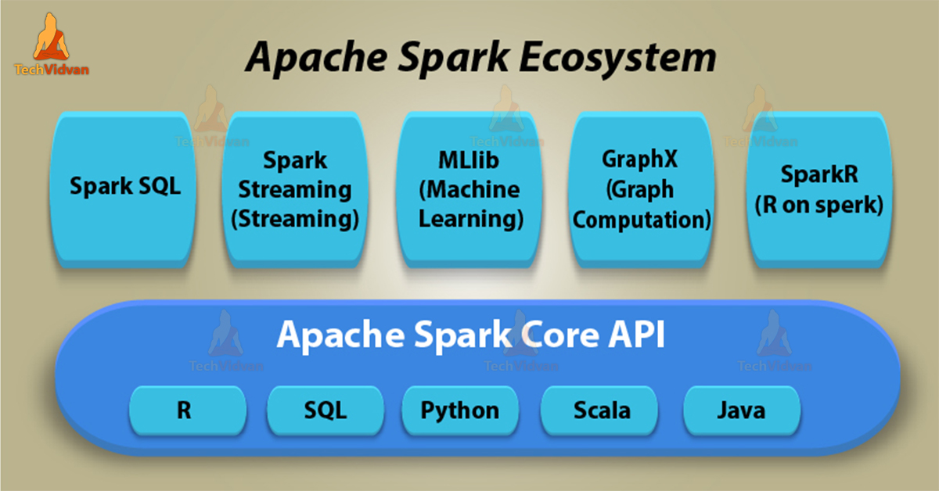
Spark Eco system

Slide 19
Deep Learning with Apache Spark
Elephas: Distributed Deep Learning with Keras & Spark (http://maxpumperla.com/elephas/)
Yahoo: TensorFlowOnSpark (https://github.com/yahoo/TensorFlowOnSpark)
CERN: Distributed Keras (Keras + Spark) (https://github.com/cerndb/dist-keras)
Qubole:Distributed Deep Learning on Apache Spark with Keras (https://www.qubole.com/blog/distributed-deep-learning-keras-apache-spark/)
Intel: BigDL (Distributed Deep Learning Library for Apache Spark) (https://github.com/intel-analytics/BigDL)
Databricks: Deep Learning Pipeline (https://github.com/databricks/spark-deep-learning)
https://towardsdatascience.com/deep-learning-with-apache-spark-part-1-6d397c16abd

Slide 20
Spark Tuning
Memory Management
Out of Memory (Driver, Executor)
Skewed Data
reduceByKey Vs groupByKey
treeReduce and treeAggregate

Slide 21
SPARK Memory Management
How to solve out of memory problem
At the driver level
The driver should only be considered as an orchestrator. In typical deployments, a driver is provisioned less memory than executors.

Slide 22
Out of Memory (Driver)
Common causes which result in driver OOM are:
rdd.collect()
sparkContext.broadcast
Low driver memory configured as per the application requirements.
Misconfiguration of spark.sql.autoBroadcastJoinThreshold
Spark uses this limit to broadcast a relation to all the nodes in case of a join operation.

Slide 23
Collect Modification
Avoid explicit result collection at the driver level.
Delegate this task to one of the executors.
// Inefficient code
val result = dataFrame.collect() // Will cause driver to collect the results
saveToFile(result)
// Better code
dataFrame.repartition(1).write.csv("/file/path") // Will assign an executor to do the task

Slide 24
Out of Memory (Executor)
High Concurrency
too many partitions such as Hive partitioned table
many tasks are executed in parallel on each executor (spark.executor.cores) without due consideration of the memory required
Inefficient queries
Getting all columns in a table
Try to use filter, drop NA, use partition column(s)
Incorrect configuration
Driver and Executor memory
Cashing memory

Slide 25
Skewed (non-uniform) Data
Consider a degenerate case where you have allocated 100 partitions to process a batch of data, and all the keys in that batch are from the same customer.
Then, if we are using a hash or range partitioner, all records would be processed in one partition, while the other 99 would be idle
Solution: Adding Salt

Slide 26
Adding Salt
Map each key to a pair whose first element is the original key, and whose second element is a random integer in some range.
For very frequently occurring keys the range would be larger than for keys which occur with average or lower frequency.

Slide 27
Adding Salt (Join Example)
Order Table
customerId itemOrdered Quantity
1001 a-1 10
1001 a-2 44
1001 a-5 553
101 a-1 2
101 a-1 4
103 a-1 2
1001 a-5 553
102 a-5 1
Order Table (added salt)
customerId salt itemOrdered Quantity
1001 1 a-1 10
1001 2 a-2 44
1001 3 a-5 553
101 1 a-1 2
101 1 a-1 4
103 1 a-1 2
1001 3 a-5 553
102 1 a-5 1
Discount Table (added salt)
customerId salt discountPercent
1 .010
2 .010
3 .010
101 1 .001
102 1 .001
103 1 .002
Discount Table
customerId discountPercent
1001 .010
101 .001
102 .001
103 .002

Slide 28
Adding Salt (groupBy-aggregate)
Order Table
Id itemOrdered qty
1001 a-1 10
1001 a-2 44
1001 a-5 553
101 a-1 2
101 a-1 4
103 a-1 2
1001 a-5 553
102 a-5 1
import pyspark.sql.functions as func
groupByFields="id"
aggFields="qty"
n=3
#Without Salt
df.groupBy(groupByFields)
.agg(func.sum(aggFields))
.show()
Sum the quantity for each customer
#With Salt
df.withColumn("salt", (func.rand() * n).cast("int"))
.groupBy("salt", groupByFields)
.agg(func.sum(aggFields).alias('qty’))
.groupBy(groupByFields)
.agg(func.sum(aggFields))
.show()

Slide 29
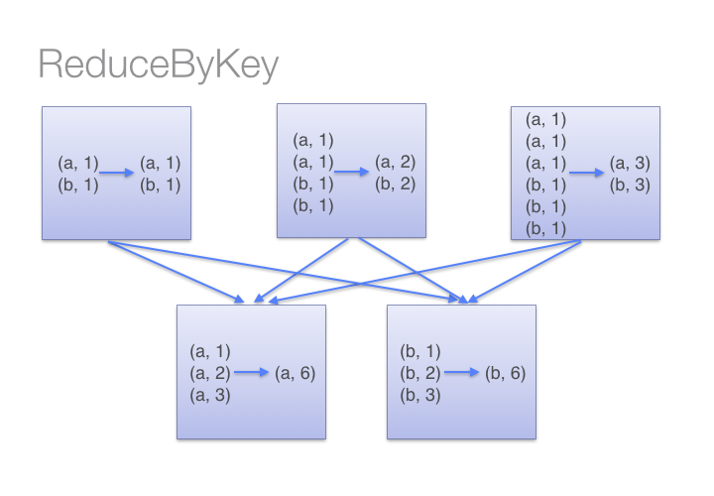
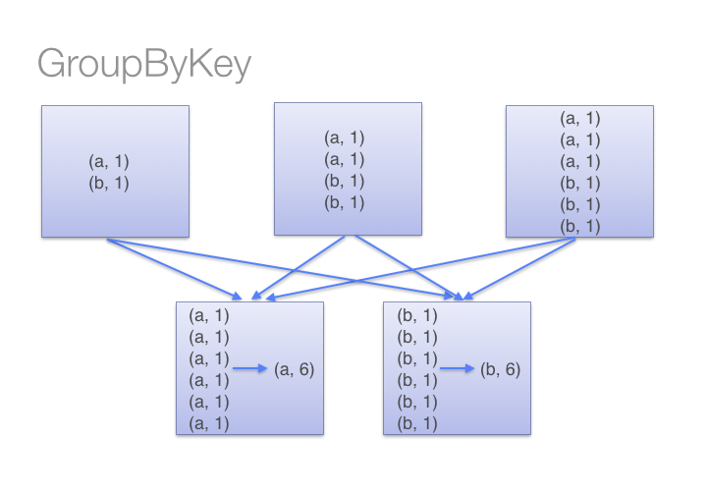
reduceByKey vs groupByKey

Slide 30
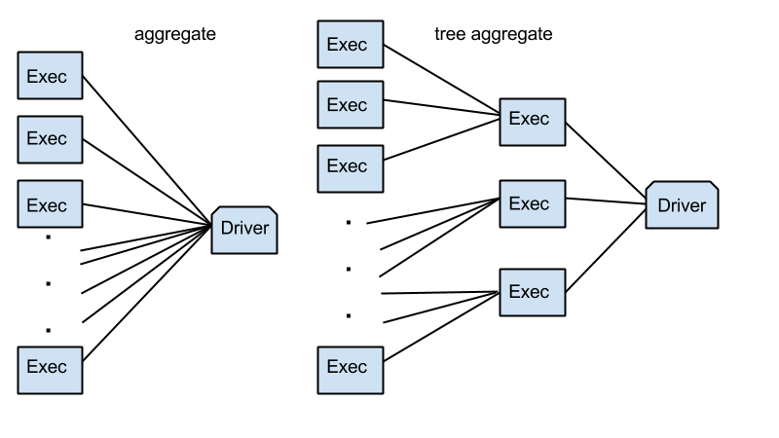
treeReduce and treeAggregate

Slide 31
Summary
Hadoop
HDFS
YARN
Hive
Sqoop
HBase
Spark
Core/RDD
Dataframe
MLlib
Spark Streaming

