Slide 1
HFT using DRL For Limit Order Book Data
Amr Mohamed Abd Albadee 201500358
Abdelmoez Elsaadany 201500438

Slide 2
Introduction
What is Limit Order Book(LOB)?
What is HFT?
HFT’s volume in the market.

Slide 3
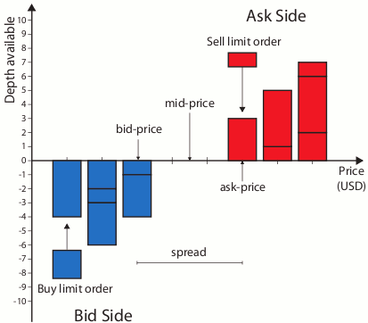
What is Limit Order Book(LOB)?
A limit order book is a record of outstanding limit orders kept by the exchange's security specialist. A limit order is a form of order that allows you to purchase or sell a securities at a certain price or a higher price. A buy limit order is an order to purchase an asset at a given price or lower, whereas a sell limit order is an order to sell a security at a specific price or higher.

Slide 4
What is HFT?
HFT, or high-frequency trading, is a type of trading that involves the use of sophisticated computer programmes to execute a huge number of orders in fractions of a second. It analyses several markets and executes orders based on market conditions using complicated algorithms.

Slide 5
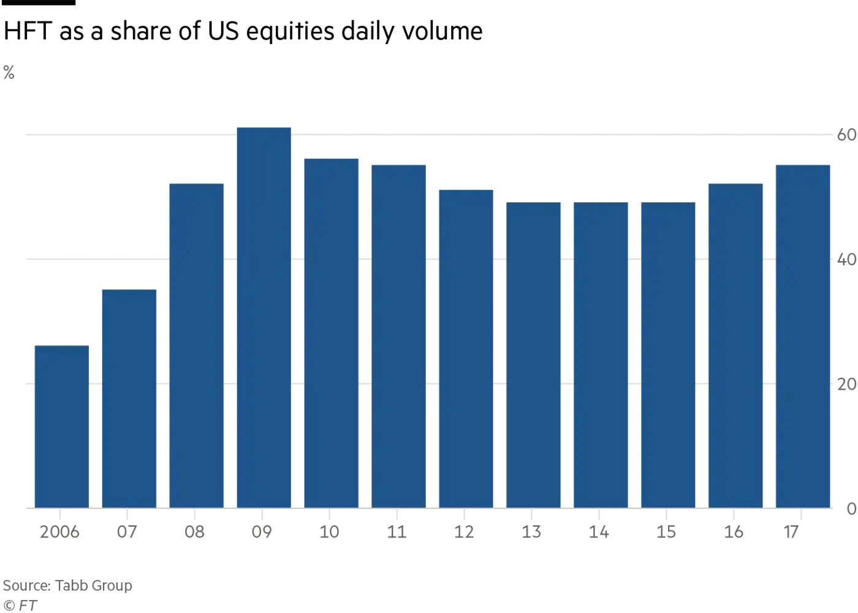
HFT’s volume in the market

Slide 6
ENVIRONMENT SETUP
Our project uses FinRL library for simulating the trading environment, training the model, comparing results with backtesting, configuring and trying models with plenty of schemes.
We begin by installing all the required libraries such as FinRL , Stable-baselines, GYM, Tensorflow for Reinforcement Learning (RL) algorithms.
We used the sample data from https://lobsterdata.com.

Slide 7
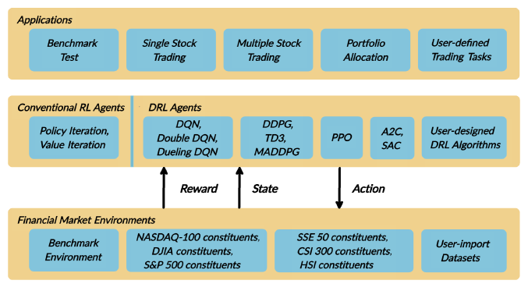
FinRL

Slide 8
Our Specifications
We used one of the example codes from the FinRL framework for the basic environment for our agent and made a lot of changes to the environment to match our specifications which includes:
Using Limit Order Book data.
Being able to do long and short trading.
Implementing complete portfolio allocation.
Letting users limit the number of shares owned, the maximum time of every position.

Slide 9
Reinforcement Learning
The reinforcement learning approach used is modeled with the Markov Decision Process scheme for learning and it is implemented as shown below:
State s = [p, h, b] where p is the stock price, h is the shares, b is the balance.
Action a which is the set of allowable actions for given number of stocks. The actions are Buy, Hold, and Sell.
Reward r(s, a,s′) which is the reward of taking an action a to move from a state s to a new state s′.
Policy π(s) which denotes the probability distribution of the set of actions a at a state s.
Q-function Q_{π}(s, a) which is the reward of taking an action a under a policy π at a state s.

Slide 10
Action scheme
The mentioned actions are start a long or short position, end these positions, or hold them and the number of shares over stocks in a portfolio. At each time step, an action is taken to transform the portfolio value.

Slide 11
Reward Scheme
We define the reward scheme as maximizing the portfolio balance when moving from a state to a new state when an action is performed. So the change of portfolio should be maximized with the trading strategy given the set of actions mentioned before.

Slide 12
The Model
The model used for training is known as the actor-critic model (A2C), and it updates both the actor scheme — the policy — and the critical scheme — the Q-function — at the same time. The critic is used to estimate the Q-function, while the actor updates the policy probability distribution, and they iterate in a feedback process to update the policy and the Q-function. This method enables the actor to learn to do better acts while also assisting the critic in criticizing those behaviors.

Slide 13
Challenges Faced
The FinRL framework does not support Limit Order Book data as an input.
We wanted the agent to choose 2 independent actions for each stock given to the model.
The agent used to keep on adding shares to the same position with no limits which may make it hold an unrealistic number of shares in each position indefinitely.

Slide 14
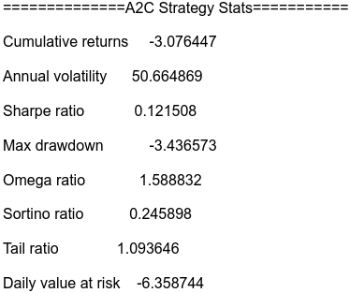
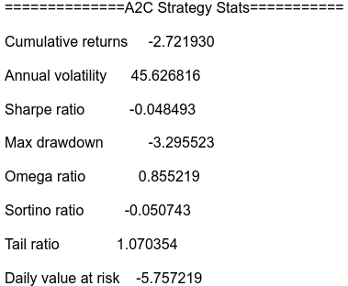
Results
Without Limits With limit of 1000 shares amax time of
250 secs

Slide 15
Future Work
Adding history to the observation of agent and letting the user to limit the size of the history.
Parallelizing the model better so it can be able tp run on fast GPUs.

Slide 16
Thank you

