Slide 1
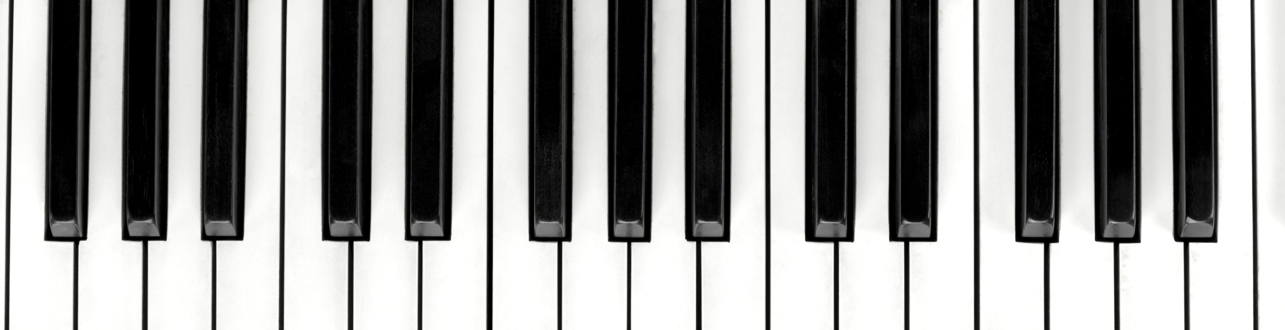
SHAI MUSIC GENRE

Slide 2
Discover and visualize the data
The Shape of the Data is 14396 Sample and 18 features.
It has 2 categorical features and all other features are numerical.
The target is the class of the song and it between 0-10 the mean about 6.

Slide 3
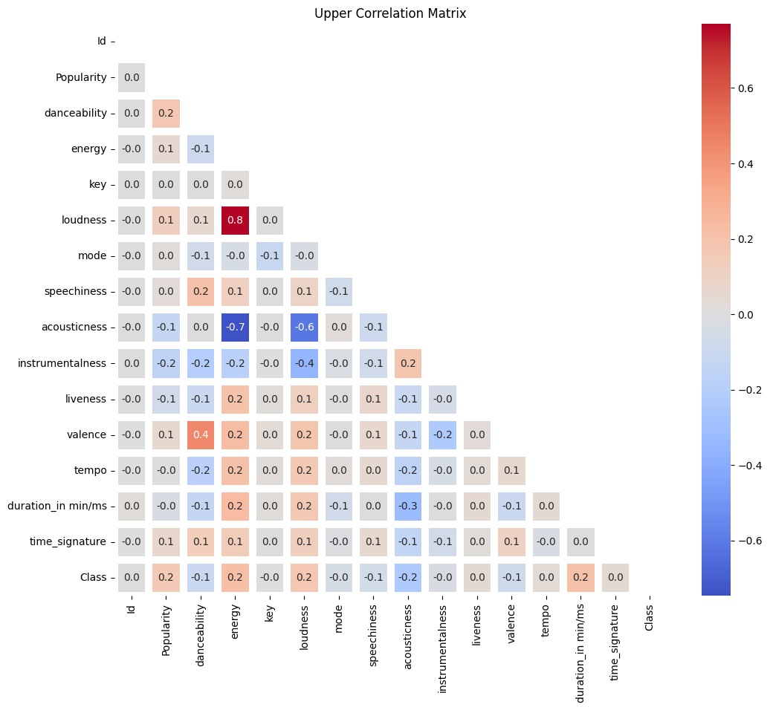
Discover and visualize the data
Correlation Matrix

Slide 4
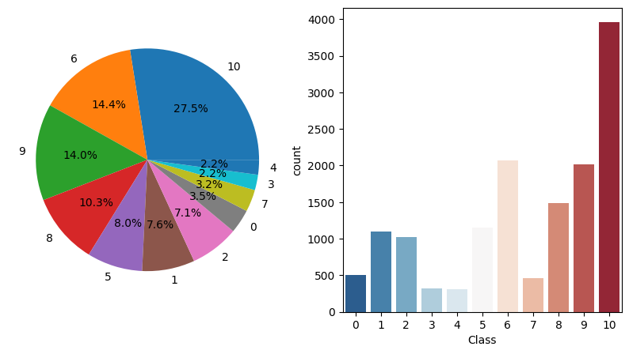
Discover and visualize the data
Plot the class

Slide 5
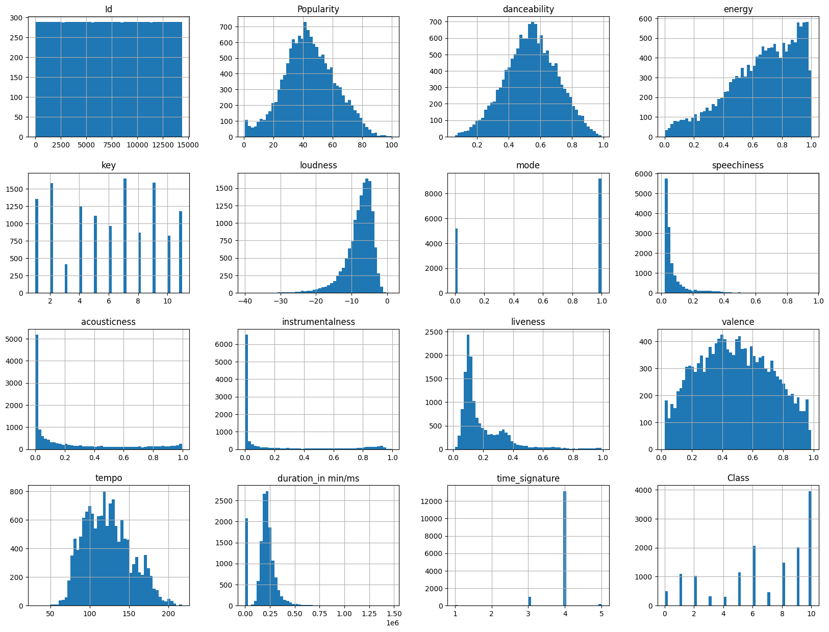
Discover and visualize the data
Hist plot

Slide 6
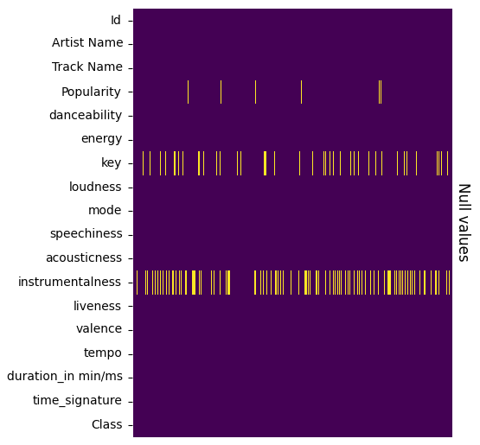
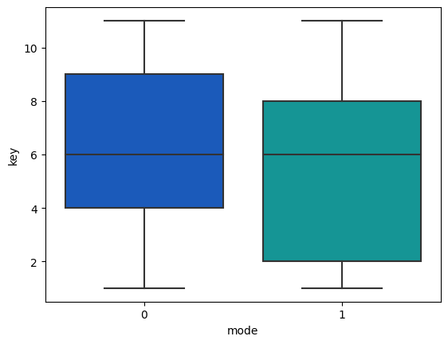
Discover and visualize the data

Slide 7
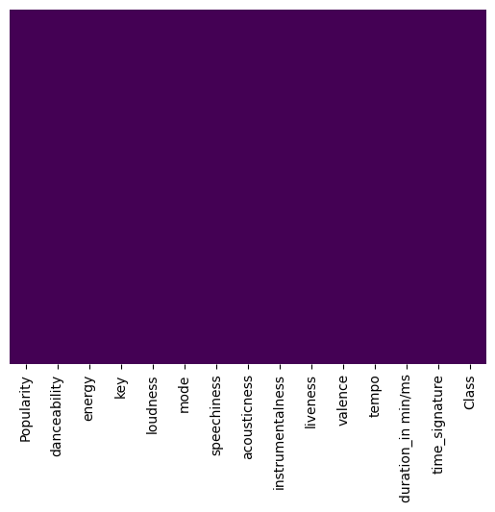
Prepare the data
Start by drop unnecessary columns ('Artist Name’,'Track Name',’Id’)
Fill NAN value in (popularity, instrumentalness) with median
Fill NAN in the Key using impute function
Notes:
I think the impute function make the null value of key using the mode value and fill it with the number (8 and 9)

Slide 8
Features Engineering
music['new1']=music['danceability'] - music['energy']
music['new2']=music['liveness'] - music['energy']
music['new3']=music['tempo']-music['energy']
Notes:
I think the impute function make the null value of key using the mode value and fill it with the number (8 and 9)

Slide 9
Train and Test split
Scaling the Data using StanderdScaler

Slide 10
Modeling
Name | Precision | Recall | F1-Score | Accuracy
SGDClassifier | 0.46 | 0.58 | 0.51 | 0.42
OneVsOneClassifier | 0.44 | 0.67 | 0.53 | 0.48
KNeighborsClassifier | 0.62 | 0.62 | 0.62 | 0.60
Voting Classifier Score: 45%

Slide 11
Modeling
Bagging Classifier
Name | Accuracy
Bagging Tree Classifier | 0.464
RandomForestClassifier | 0.513

Slide 12
Modeling
Boosting Classifier
Name | Accuracy
AdaBoostClassifier | 0.396
GradientBoostingClassifier | 0.538
XGBClassifier | 0.539
CatBoostClassifier | 0.637

Slide 13
Modeling
hyperparameter tuning for XGB model:
The best score across ALL searched params:
0.5474992989216962
The best parameters across ALL searched params:
{'subsample': 0.8, 'n_estimators': 200, 'max_depth': 4, 'learning_rate': 0.1, 'gamma': 0, 'colsample_bytree': 1.0}

Slide 14
Modeling
hyperparameter tuning for CatBoost model:
The best score across ALL searched params:
0.658
The best parameters across ALL searched params:
{'n_estimators': 1000, 'learning_rate': 0.05, 'depth': 4}

Slide 15
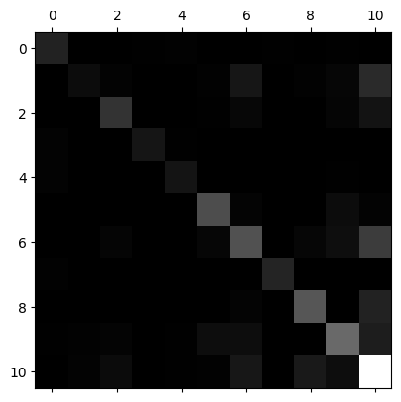
Confusion Matrix for the final Model

Slide 16
Evaluation
Evaluation on Validation data
Precision: 0.46
Recall: 0.66
F1-score: 0.55
Accuracy: 0.54

Slide 17
Thank you
Amro abdelqader
Rama Amairy

