Slide 1

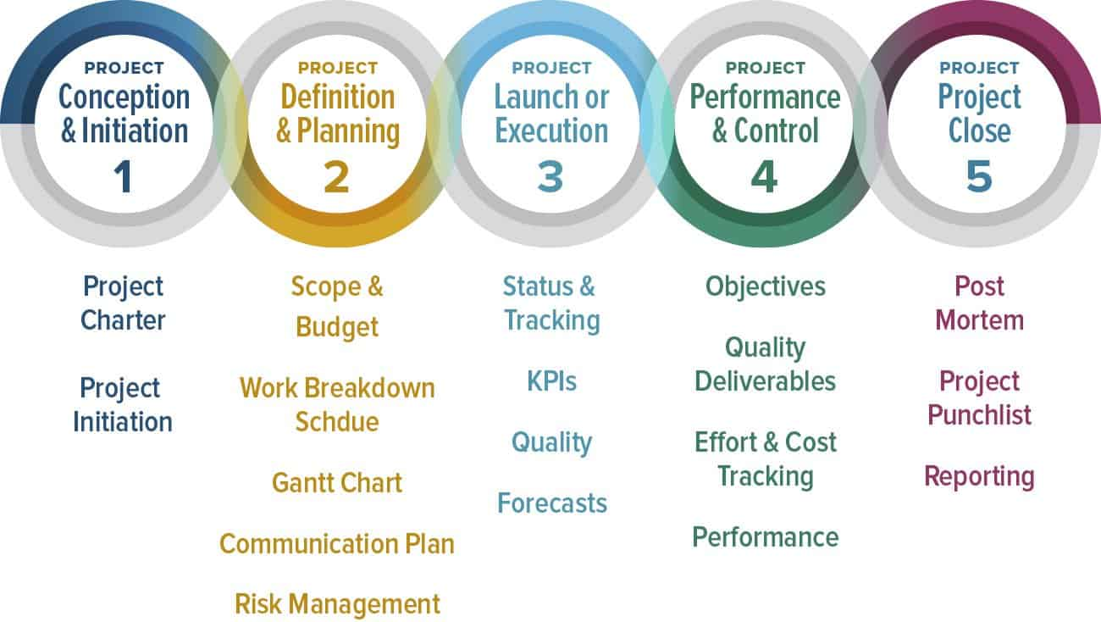
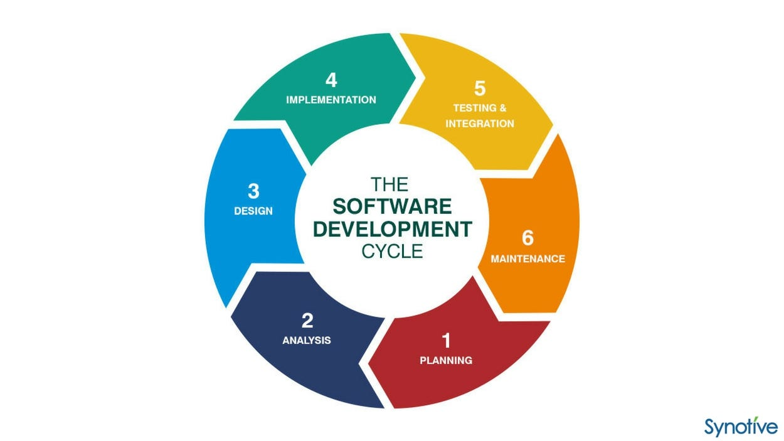
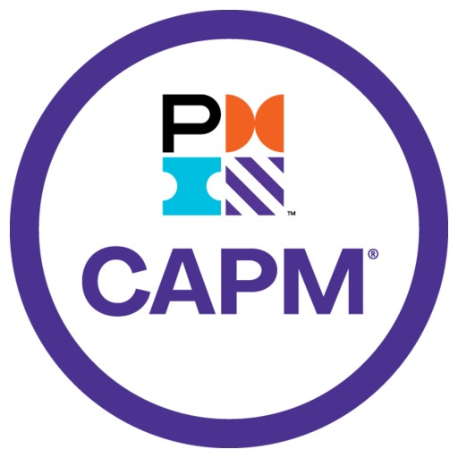


Little Experience in Software Project Management
Amro Elbahrawy - 40221760
Gina Cody School of Engineering and Computer Science. Concordia University
Abstract
Theoretical & Practical Inexperience
How to Deal with Little Experience
Inexperienced software project managers are managers who lack theoretical & practical knowledge in software engineering.
Theoretical knowledge consists of the concepts studied in both the managerial and the technical field, such as software project management life-cycle & the software development life-cycle.
Practical knowledge is all the concepts related to communication, decision making, leadership, time management, and stress management.
Learning the theoretical knowledge first forms a very good fundamental layer to learn all the other skills and facilitates learning them.
Guidance seeking, constant learning, continuous focus, and good mental health are essential in making a successful software project manager.
Certified Associate in Project Management (CAPM) and internships are very good starting points for inexperienced software project managers to grow their careers.
Project Management Professional (PMP) certification is a certificate coveted by many companies in the industries currently and forms a very good goal for software project managers to pursue.
The theoretical aspects of a software project manager are the definitions and principles for both the business and the technical side of any software project.
While some parts of these concepts might be practiced in different manners in the work industry, these concepts behave as the initial and most important steps in making a successful software project manager.
The most crucial concepts that inexperienced software project managers struggle with the most are:
Inadequate understanding of any of the software project management life cycle phases, especially inexperience in scope, budget, and timeline management.
Not knowing the difference between project scope and project charter.
Not having full information on what should and should not be included in project management deliverables, such as feasibility study, budget, or risk management documents.
Not being in touch with the recent technology changes and new research findings on project management, as these two drastically change or revolutionize concepts.
Inability to differentiate realize the importance of knowing the technical concepts related to projects, such as the Software Engineering Life Cycle (SDLC) phases and what tasks fall under each one.
Lack of proper communication skills that lead to misunderstandings with stakeholders, or conflicts within the project team.
Inadequate understanding of the different software methodologies, especially the Agile process.
Practical skills consist of properly applying the theoretical skills, in addition to having good communication, leadership, and mental health management.
Resorting to trial-and-error methods instead of consulting experts and previously similar tasks and projects.
Neglecting stakeholder communication and not providing constant feedback.
Not having enough experience with project management tools.
Allowing scope creep without taking countermeasures to handle it.
Failing to provide an accurate budget estimation of the project.
Planning overly ambitious plans for the project that are unrealistic in terms of time or budget.
Providing unrealistic and vague goals that cannot be met within the given time or would exceed the given budget.
Pretending to know more than you actually do and acting based on that instead of seeking advice or consulting experts.
Be mentally prepared to ask tough questions when unexpected things happen.
Make sure you are in a good state of mind. Bad mental health will always reflect negatively on the work environment, especially when unexpected or bad things occur.
Relying on re-usable projects and processes on all types of projects even though the contexts and scopes are very different.
Not paying attention to all possible problems and risks that might occur within the project, or completely ignoring some of them.
Gold-plating deliverables to impress the customers at the expense of the project’s quality and budget.
Failing to see the overall project dependencies. Some decisions within the project might be beneficial for the project only, but not for the company or the stakeholders.
Seek Guidance: Have a Senior PM to be your mentor, don't be afraid to ask for help or guidance, this is how you grow and learn.
Stay Focused: Focus on the project objectives and don't let other factors distract you, like the customer keep expanding the scope of the project, use PM tools and techniques to stay on top of tasks, deadlines, and progress.
Keep Learning: Learning doesn't stop after leaving school, stay up-to-date with industry trends, best practices, and new technologies to improve your project management skills.
Have a Deep Understanding of the Project’s Scope: Everything else in the project will be affected by its scope. Budget, timeline, risk, and required effort all depend on it. Having a clearly defined scope will make it so that all other phases that rely on it easy to manage.
Learn and Master the Agile Methodology: This is the software methodology that is the most popular right now. The best parts about it are getting constant feedback from the stakeholders & progress updates with the project team. So, communication and constant feedback are key concepts when it comes to managing project that use the Agile methodology.
Build Relationships: Forming strong relationships with your team results to effective communication, which is the most important aspect of a team. Connecting with other project managers is also valuable to learn from them.
Have a Good Mental State: Good mentality is the environment where everybody works at their best. Is it normal for some parts of projects to be stressful, so make sure you are mentally prepared to provide harsh information or ask difficult questions when the time comes.
Why Little Experience is a Problem
49% of the software projects fail, and the main reasons are all tied to inexperience in either theoretical or technical concepts.
Nobody wants to work under a project manager who is uncertain, doesn’t know how to manage schedules & time, and uses trial & error on life-changing projects.
Lacking proper software project management principles is one of the main reasons why projects fail. Inexperience in software project management is something that no company wants.
Inexperience in software project management can be divided into two main parts: theoretical and practical inexperience.
Theoretical inexperience involves all ideas pertaining to managerial principles such as software project management life-cycle, and technical principles such as the software development life-cycle.
Practical knowledge includes the capability to apply the theoretical principles, in addition to communication, leadership, time & stress management.
An experienced software project manager must not only be good at the business or managerial side of the project, knowledge about the technical aspects is also essential.
Conclusion & Helpful Resources
Software project managers with little experience will have a rough start when it comes to working in the industry because the consequences of inexperience are too high for a project.
Nobody wishes to hire or work under an inexperienced software project manager because it’s too risky for their project.
Little experience mainly consists of theoretical skills, and how to apply them practically in addition to having communication, leadership, and a good mentality.
Seeking for internships to train under the supervision of a senior project manager is a very solid head-start for inexperienced project managers to get hands-on experience on how software project management is practiced in the industry.
Additionally, the Project Management Institute (PMI) offers a very valuable certificate called Certificate Associate in Project Management (CAPM) that inexperienced software project managers can strive to achieve. CAPM is coveted by many companies and would provide a great advantage to software managers because of the skills required to get it.

