Slide 1
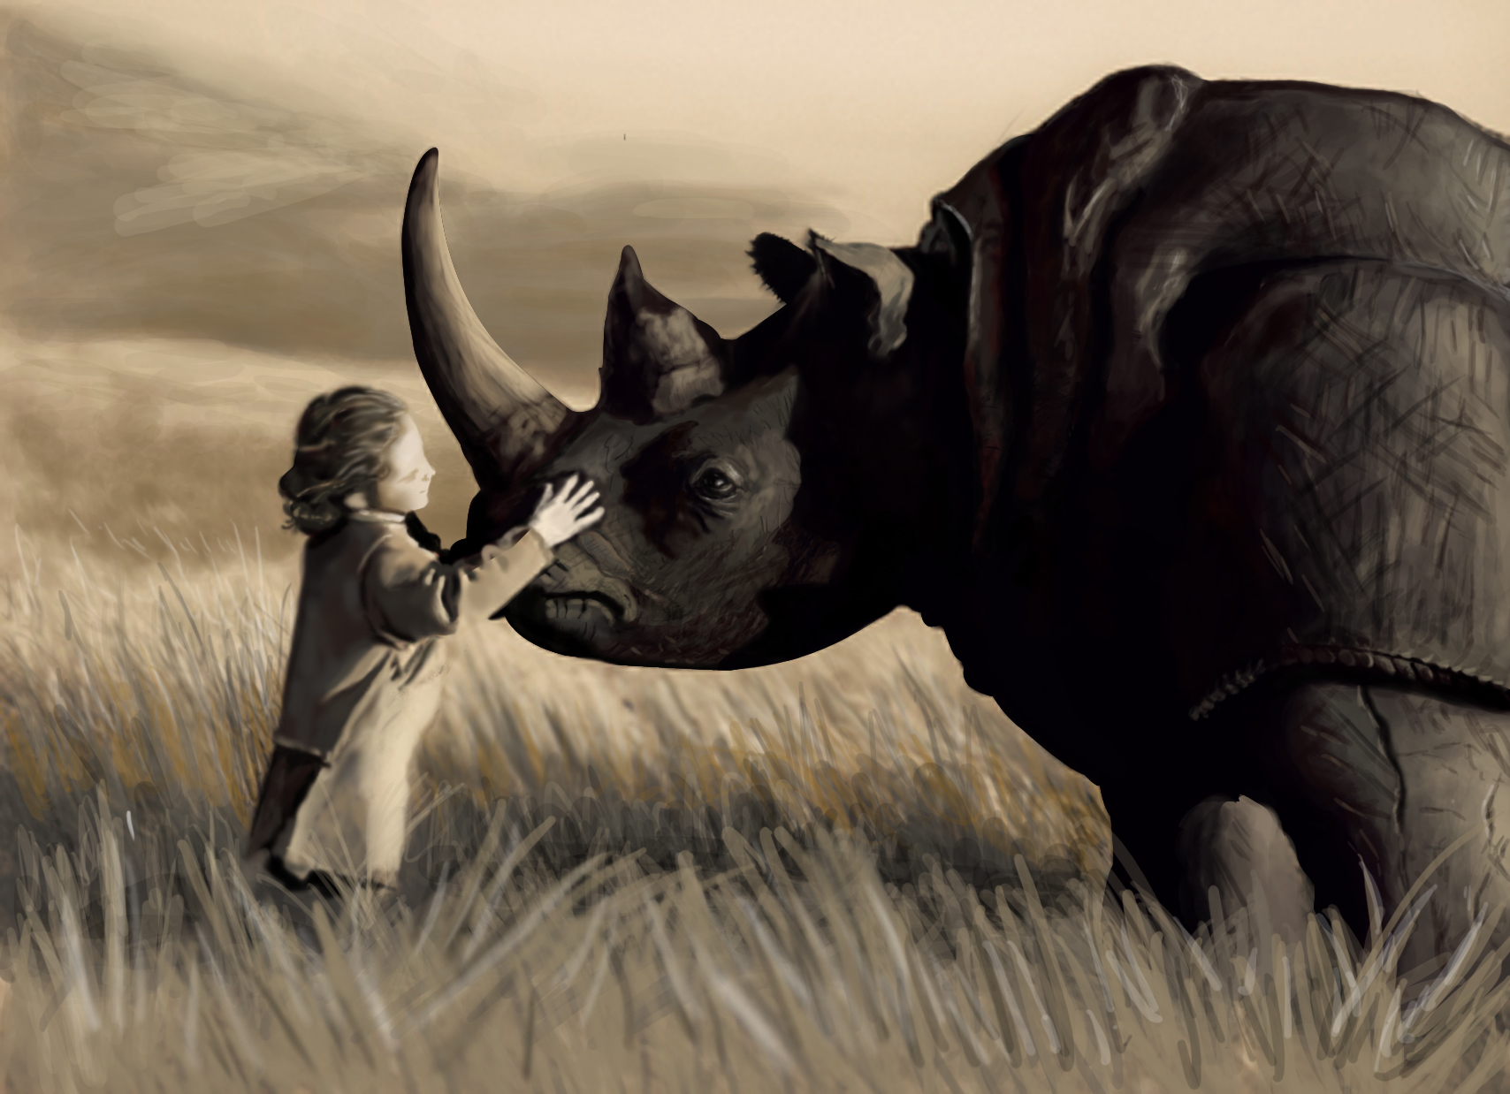
SESSION 2
Data Taming in R with dplyr
Prepared by Daniel Pinedo

Slide 2
materials
01
02
03
Data-wrangling-cheatsheet.pdf and dplyr.pdf.
These files are great resources. We will not cover the ‘tidyr’ library, but the cheat sheet has useful tips for both it and ‘dplyr’
Session_2.Rmd
We will be spending most of our time here. Best if opened in RStudio
Session_2.xls
This is our datafile.
Finally, make sure you have downloaded the files onto your own computer, and did not make changes to the shared drive.

Slide 3
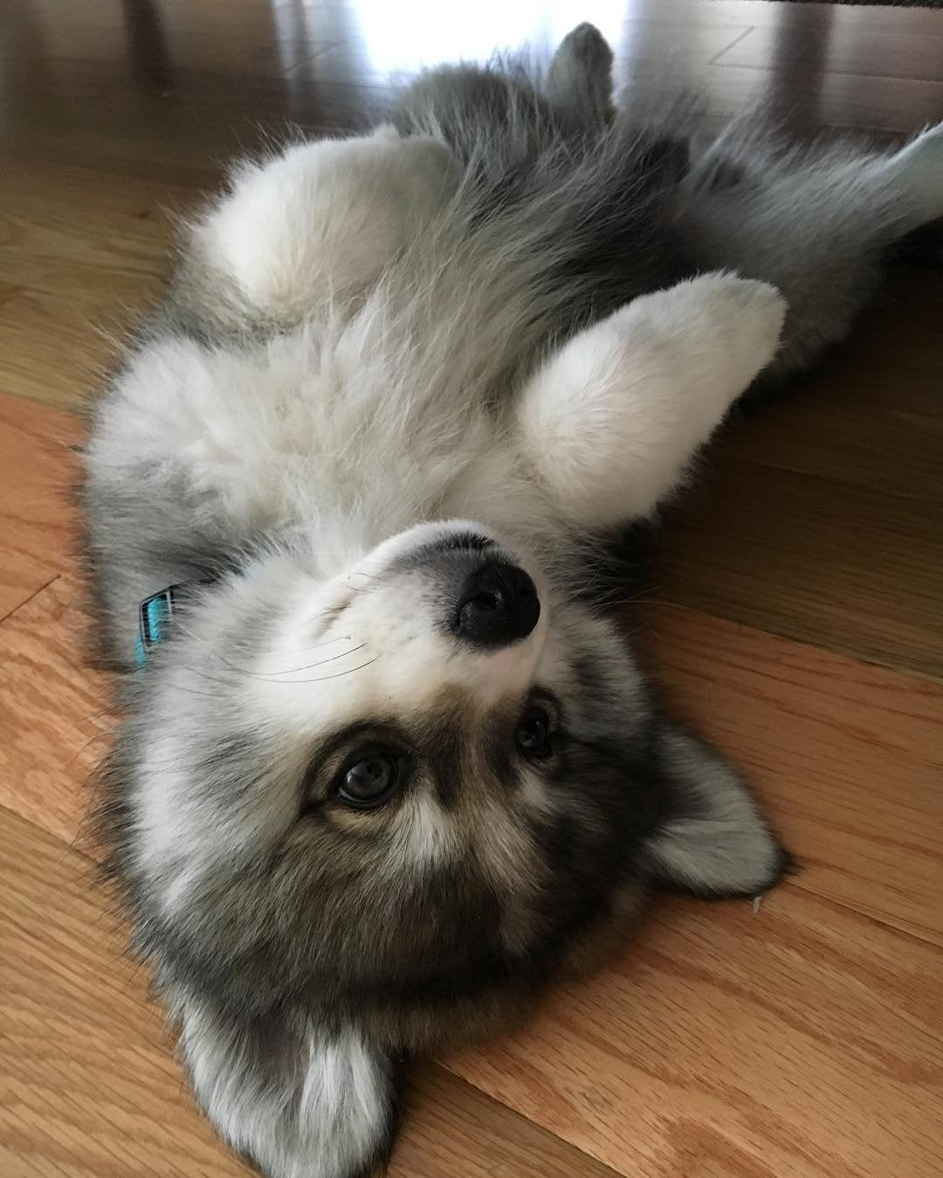
let’s go!
The first part with dplyr should take 20-30 minutes. Interrupt and engage! These workshops work best if you have prepared in advance and have questions. Think about your own data taming you need to do!!
After the first part, I will hand it off to Adrian to cover DataExplorer and plotting things in 3d! This entire session will be all wrapped up in 90 minutes.
Photo credits:
Cover: Taming the Beast by Taylor Patterson
Here: https://i.imgur.com/KvQ5DUM.jpg

