Slide 1
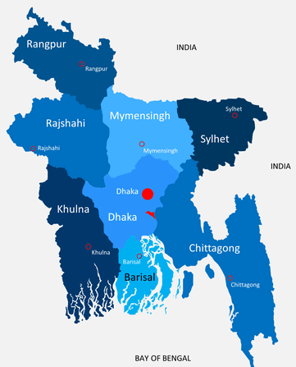


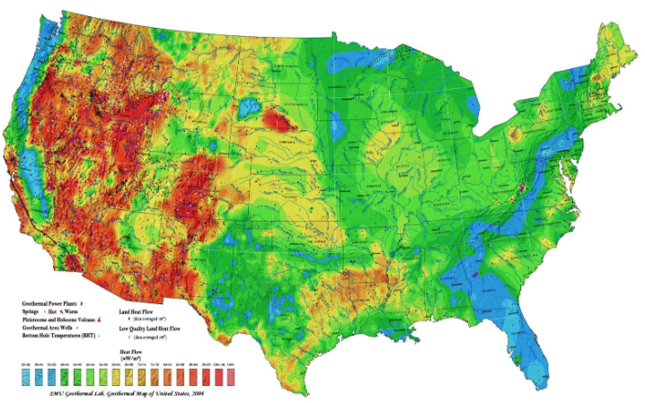
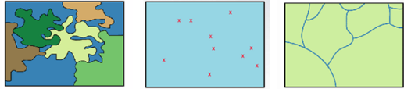

Read and Write Spatial Data in Python
Zia U Ahmed, University at Buffalo

Slide 2

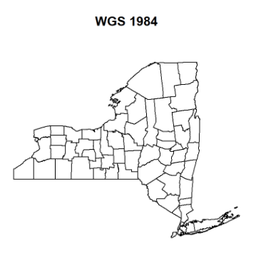
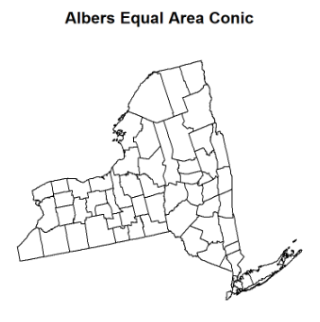
Map Projection and Coordinate Reference Systems
Zia U Ahmed, University at Buffalo

Slide 3
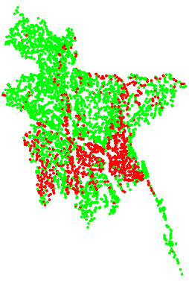
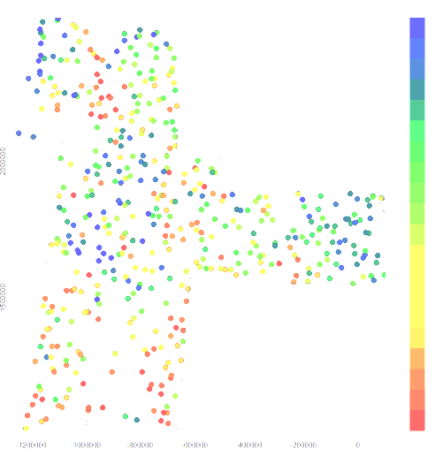
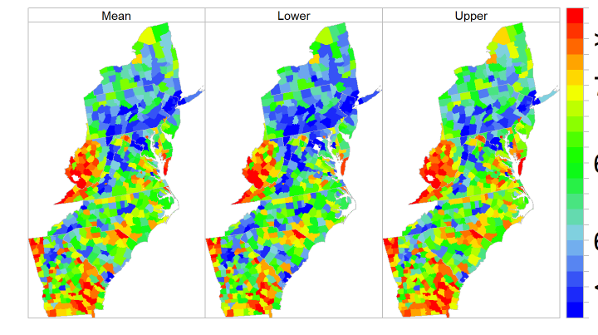
Working With Spatial Vector Data
Zia U Ahmed, University at Buffalo

Slide 4


Read and Write Spatial Data in R
Zia U Ahmed

Slide 6
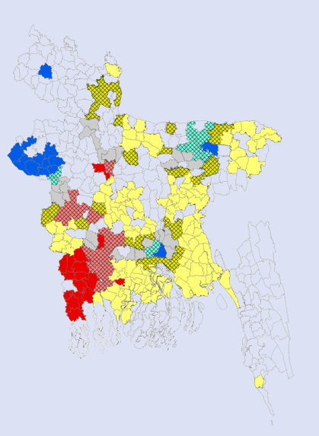
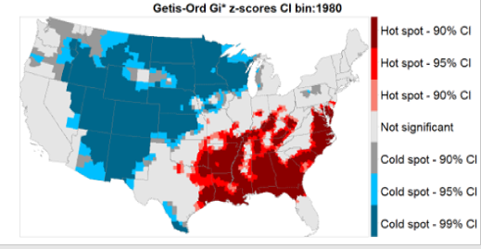
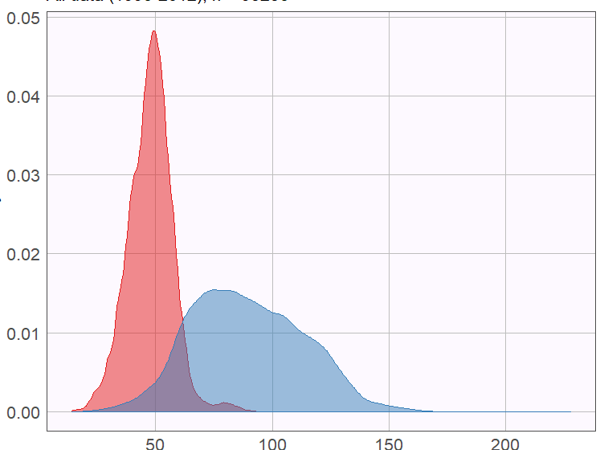
Spatial Statistics
Zia U Ahmed

