Slide 1
Stronger visualizations with ggplot
Patrick Mathias

Slide 2
Default plotting functions in a nutshell
plot() and hist() can be helpful for generating simple plots quickly
Syntax for different functions can very
Adding multiple elements can be labor- and thinking-intensive

Slide 3
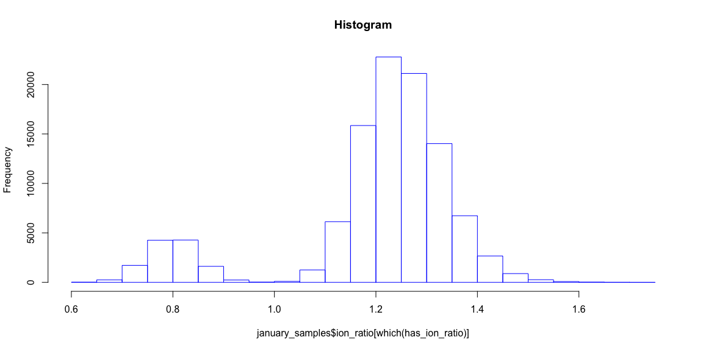
Default plotting example
january_samples <- read_csv("data/2017-01-06_s.csv") %>% clean_names() january_samples$idx <- c(1:nrow(january_samples)) has_ion_ratio <- january_samples$ion_ratio > 0 hist(january_samples$ion_ratio[which(has_ion_ratio)], border='blue', main='Histogram')

Slide 4
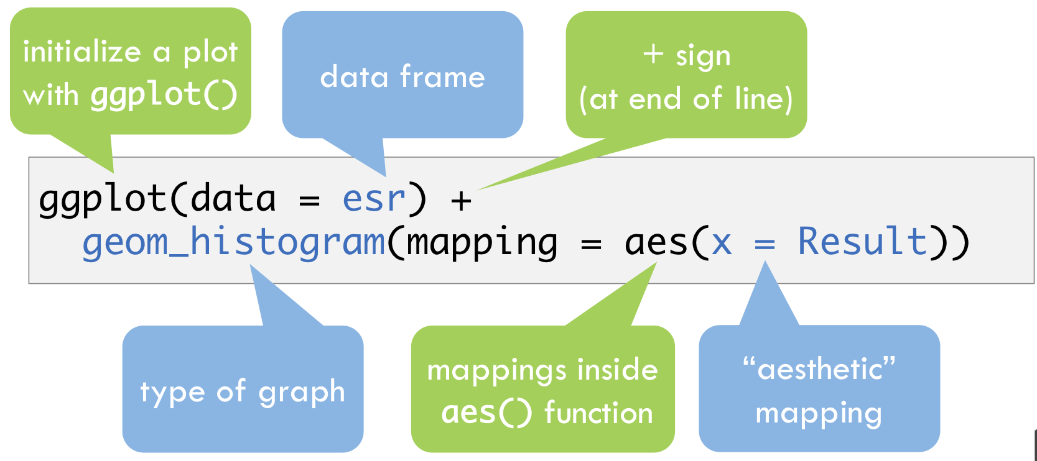
General ggplot syntax
Syntax for ggplot

Slide 5
Filter data set
january_pos_ir <- january_samples %>% filter(ion_ratio > 0) glimpse(january_pos_ir)
## Observations: 104,302 ## Variables: 11 ## $ batch_name <chr> "b802253", "b802253", "b802253", "b802253… ## $ sample_name <chr> "s253003", "s253003", "s253003", "s253003… ## $ compound_name <chr> "morphine", "hydromorphone", "oxymorphone… ## $ ion_ratio <dbl> 0.7348524, 0.8113200, 0.7158790, 0.811440… ## $ response <dbl> 0.1470282, 0.1359978, 0.1460046, 0.178825… ## $ concentration <dbl> 18.97167, 17.71769, 18.30703, 21.82945, 2… ## $ sample_type <chr> "standard", "standard", "standard", "stan… ## $ expected_concentration <dbl> 20, 20, 20, 20, 20, 20, 50, 50, 50, 50, 5… ## $ used_for_curve <lgl> TRUE, TRUE, TRUE, TRUE, TRUE, TRUE, TRUE,… ## $ sample_passed <lgl> TRUE, TRUE, TRUE, TRUE, TRUE, TRUE, TRUE,… ## $ idx <int> 13, 14, 15, 16, 17, 18, 19, 20, 21, 22, 2…

Slide 6
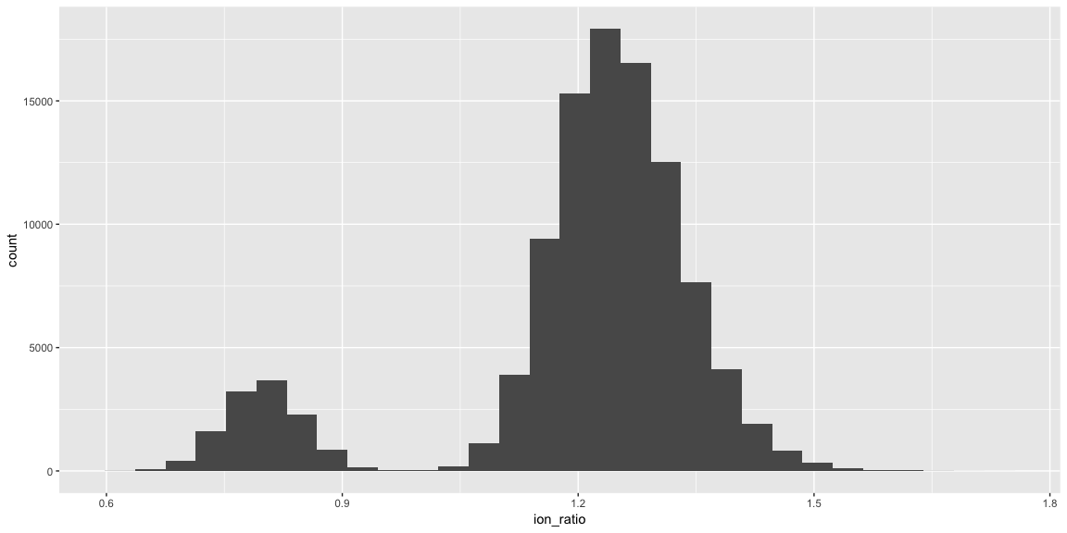
Default histogram
ggplot(january_pos_ir) + geom_histogram(mapping = aes(x = ion_ratio))
## `stat_bin()` using `bins = 30`. Pick better value with `binwidth`.

Slide 7
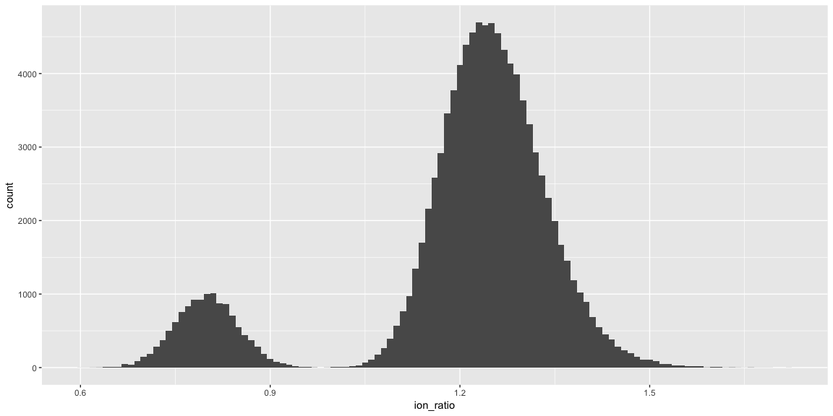
Define binwidth
ggplot(january_pos_ir) + geom_histogram(mapping = aes(x = ion_ratio), binwidth = 0.01)

Slide 8
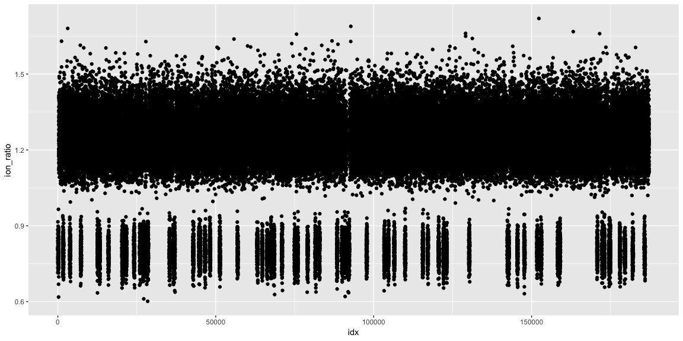
Plot x vs. y
ggplot(data = january_pos_ir) + geom_point(mapping = aes(x = idx, y = ion_ratio))

Slide 9
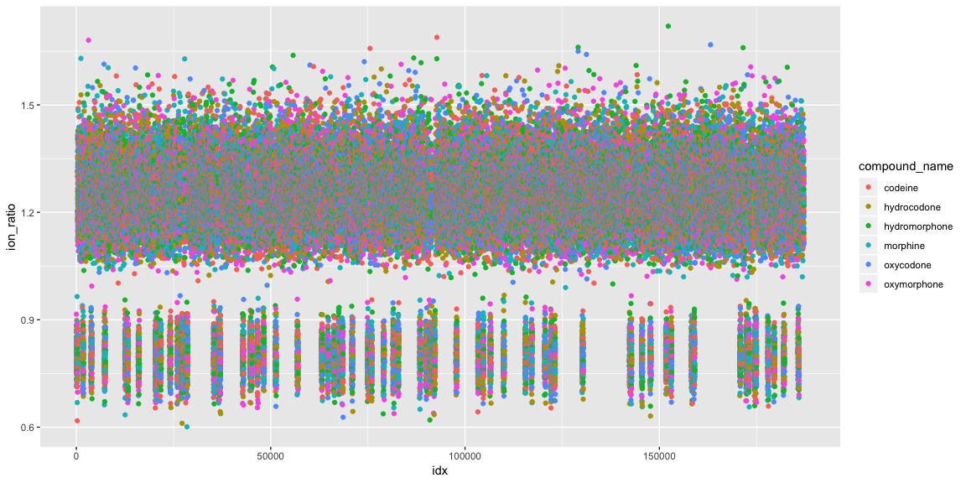
Add another variable
ggplot(data = january_pos_ir) + geom_point(mapping = aes(x = idx, y = ion_ratio, col = compound_name))

Slide 10
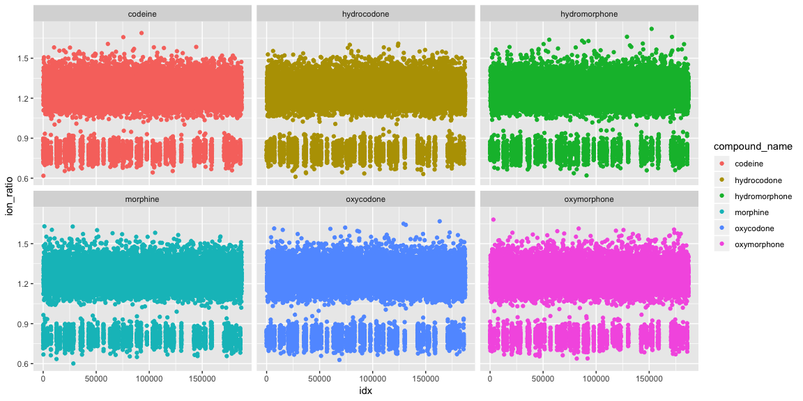
Facet to generate separate plots
g <- ggplot(data = january_pos_ir) + geom_point(mapping = aes(x = idx, y = ion_ratio, col = compound_name)) g + facet_wrap(~compound_name)

Slide 11
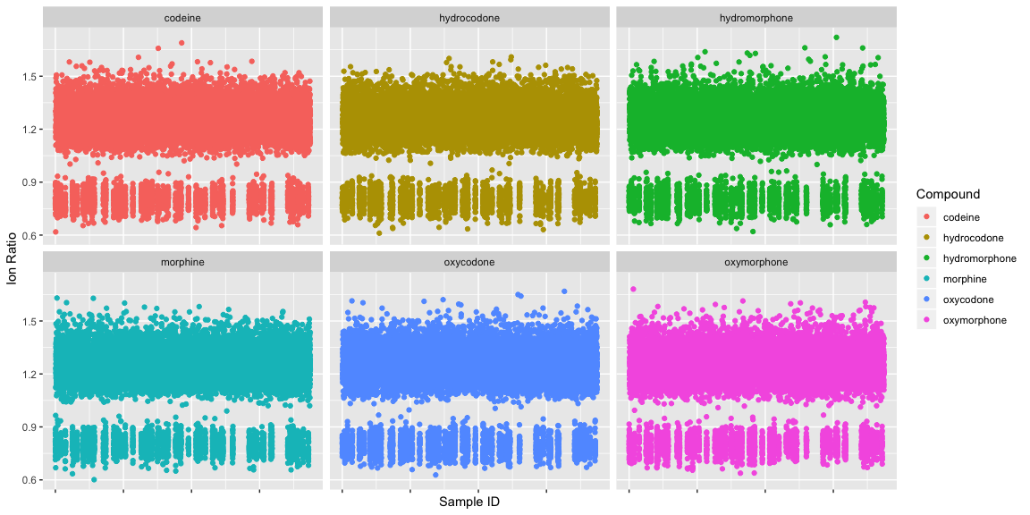
Modify labels
g + facet_wrap(~compound_name) + scale_x_continuous(labels = NULL) + xlab("Sample ID") + ylab("Ion Ratio") + scale_color_discrete(name = "Compound")

Slide 12
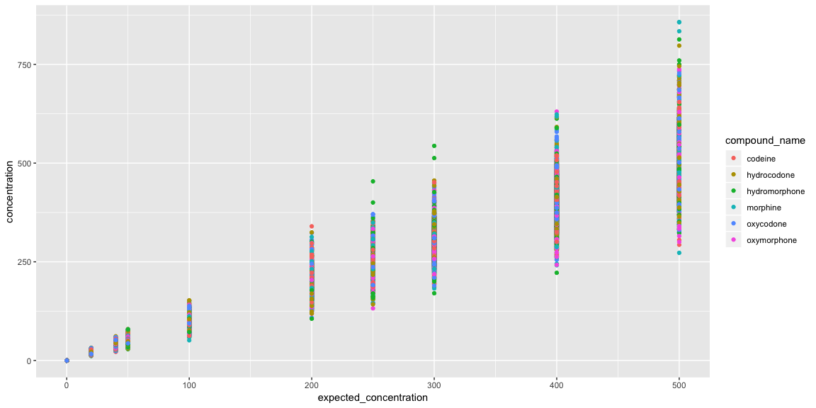
Another multiple variable example
known_samples <- january_samples %>% filter(sample_type != "unknown") ggplot(data = known_samples) + geom_point(mapping = aes(x = expected_concentration, y = concentration, col = compound_name))

Slide 13
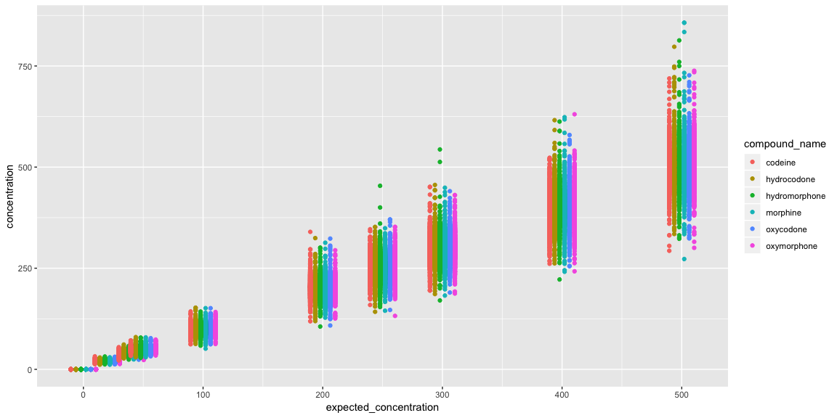
Get out of dodge
ggplot(data = known_samples) + geom_point(mapping = aes(x = expected_concentration, y = concentration, col = compound_name), position = position_dodge(width = 25))
## Warning: position_dodge requires non-overlapping x intervals

Slide 14
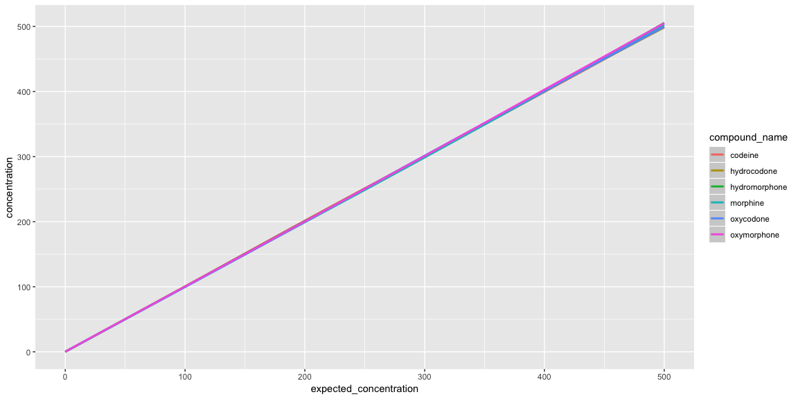
Smooth it out
ggplot(data = known_samples) + geom_smooth(mapping = aes(x = expected_concentration, y = concentration, col = compound_name))
## `geom_smooth()` using method = 'gam' and formula 'y ~ s(x, bs = "cs")'

Slide 15
Multiple geoms in one plot
ggplot(data = known_samples, mapping = aes(x = expected_concentration, y = concentration, col = compound_name)) + geom_smooth() + geom_point(position = position_dodge(width = 25))
## `geom_smooth()` using method = 'gam' and formula 'y ~ s(x, bs = "cs")'
## Warning: position_dodge requires non-overlapping x intervals

Slide 16
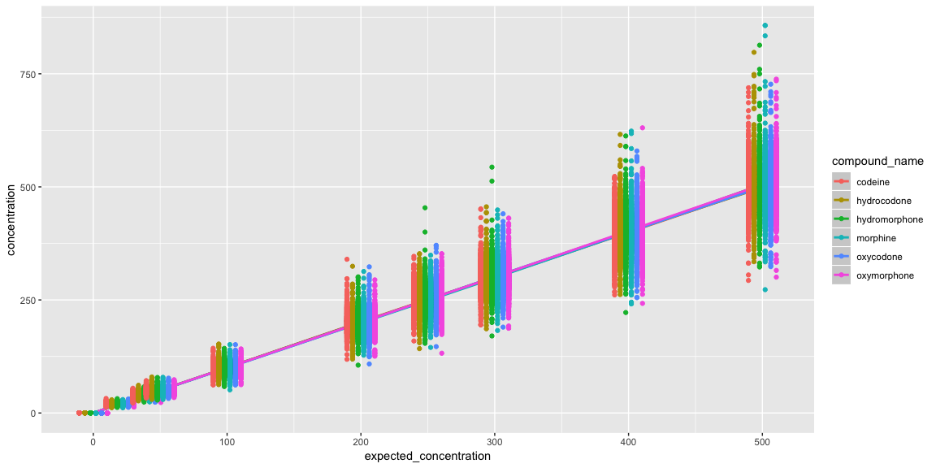

Slide 17
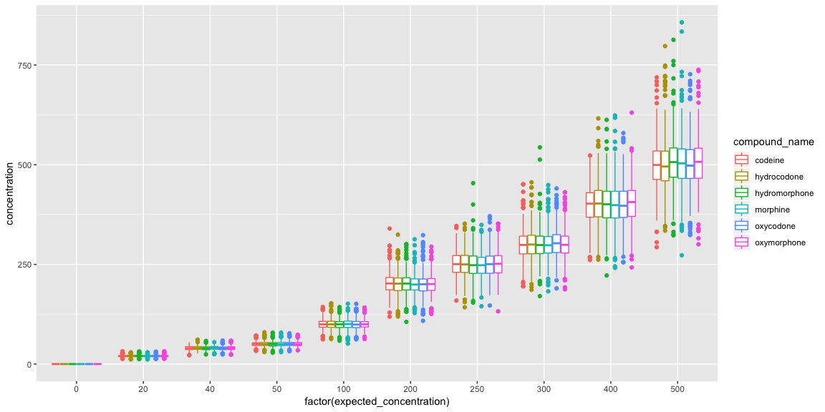
Boxplots might be better
ggplot(data = known_samples) + geom_boxplot(mapping = aes(x = factor(expected_concentration), y = concentration, col = compound_name))

Slide 18
Exercise
Compare the distributions of ion ratio for different sample types and compounds

Slide 19
Summary
Plotting with ggplot has a unique but consistent syntax
Data set is defined first (similar to other tidyverse functions)
Aesthetics map variables to plot characteristics, like axes or colors
Geoms are geometric objects representing data
Facets can be helpful to separate plots by one or two variables

Slide 20
Summary
The ggplot2 cheatsheat is a valuable quick reference to help identify the best plot

