Slide 1
Version Control
Patrick Mathias

Slide 2
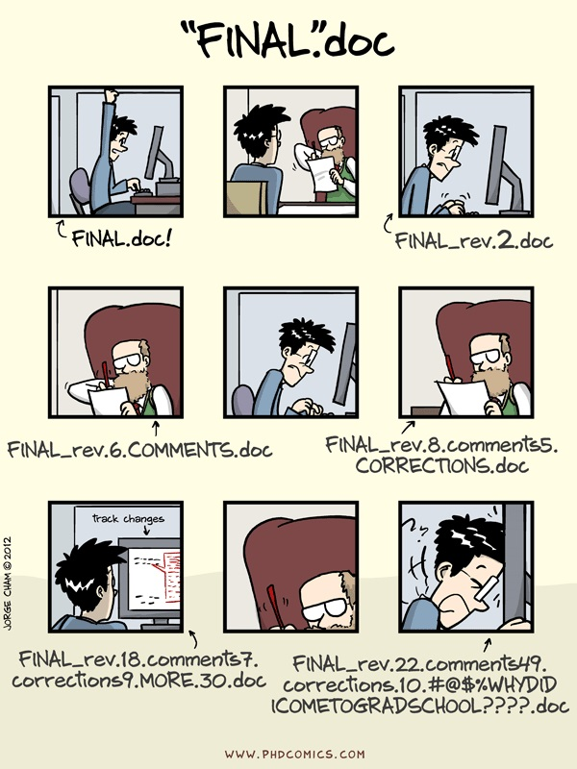
Why use version control?
One of many justifications for using version control. Source: phdcomics.com

Slide 3
Git principles
Git works by taking snapshots of a set of files over time
Most operations are performed on your local machine
Every change is captured
Git generally adds data and does not remove it (which means it is hard to lose data)

Slide 4
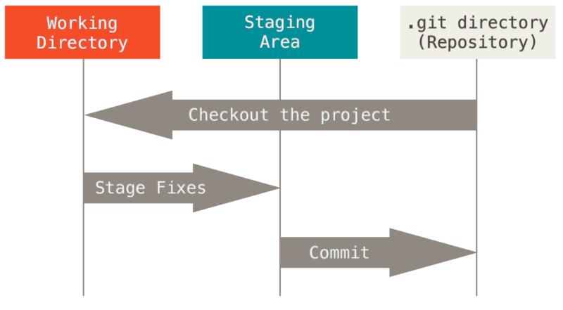
Git workflow
Git basic workflow. Source: https://git-scm.com/book/en/v2/Getting-Started-Git-Basics

Slide 5
Git setup
If you have not set up Git per the pre-course instructions (https://git-scm.com/book/en/v2/Getting-Started-Installing-Git) and signed up for an account on Github.com (https://github.com/join), you will need to do so before you can complete the next exercise.

Slide 6
Exercise 1
Walk through a local Git workflow to commit a file in your msacl-201-project

Slide 7
Exercise 1 Comments
Local Git workflow addresses versioning issues
You decide when to stage and commit a version
Commit messages can help trace your work
Provides ability to roll back to a previous version (not covered but quick access through History button)

Slide 8
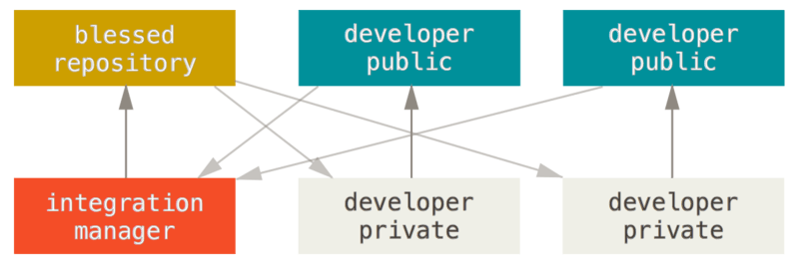
Distributed workflows: central management
Integration manager workflow with Git. Credit: https://git-scm.com/book/en/v2/Distributed-Git-Distributed-Workflows

Slide 9
Exercise 2
Fork course repository and open as new project in RStudio

Slide 10
Exercise 3
Push your changes to your remote repository

Slide 11
Exericise 2 & 3 comments
Github (or other hosted Git solution) allows a remote repository to be synced and worked on at multiple locations/computers
More importantly, a remote repository provides a mechanism for collaboration

Slide 12
Optional exercise
Open a pull request and have your edits come back into the base repository

Slide 13
Additional Git wisdom
Use branches and couple to features/issues
Set up ssh to transfer data
Consider what should and shouldn’t go into version control
Happy Git and GitHub for the useR online book - Git in RStudio
Pro Git - general Git info

