Slide 1
Lesson 7
Data Exploration

Slide 2
Exploratory Data Analysis (EDA) is a concept championed by John Tukey in the 1970s. There are no hard-and-fast rules. Instead, EDA is described as a philosophy with a recognized level of art in how one conducts EDA.
The objective is to explore data and develop insight that makes downstream analyses more robust and enables formulation of hypotheses that may lead to new data collection and experiments.
Notes:
what do you have, how can you best use that data, and what other data may you need?

Slide 3
What is exploratory data analysis?
First step in your data analysis process
Make sense of your data (aka, initial data analysis)
What data do you have? Is it what you need?
Are there any mistakes, anomalies, or issues to be handled?
Do your assumptions about the data hold?
How do the variables relate to each other?

Slide 4
What is exploratory data analysis?
Figure out what to do next with your data
What questions do you want to ask/test and how to frame them?
How to best manipulate data for downstream analyses?
Is there other data that should be collected??

Slide 5
How do we explore our data?
Non-graphical
Univariate
Multivariate
Graphical
Univariate
Multivariate
Use different approaches based on the role (outcome or explanatory) and type (categorical or quantitative) of the variable(s).
Notes:
Univariate methods look at one variable (data column) at a time,
while multivariate methods look at two or more variables at a time to explore
relationships.

Slide 6
Non-graphical EDA
Quantitative
univariate
range of values, central tendency (mean, median, mode), spread, and outliers
tabulation of values, summary statistics
multivariate
correlation matrix
Categorical
univariate
range of values, frequency (counts, percent)
tabulation of values
multivariate
cross-tabulations

Slide 7
Graphical EDA
Quantitative
univariate
histograms, boxplots, QQ plots, barplots, frequency polygons, line graph
multivariate
scatterplots, boxplots, correlation matrix plots
Categorical
univariate
barplots
multivariate
barplots, contingency plots, boxplots

Slide 8
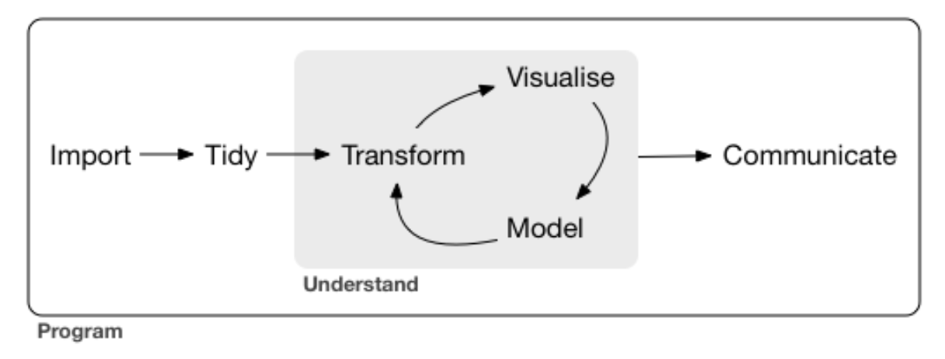
Next steps that we didn’t cover (this time)…
Data preparation
Missing data
Handling outliers
Transformations
R for Data Science by Garrett Grolemund and Hadley Wickham

