Slide 1
Lesson 8
Linear Regression Modeling

Slide 2
Intro to predictive modeling
Supervised machine learning
Linear regression
Apply linear models to make quantitative predictions

Slide 3
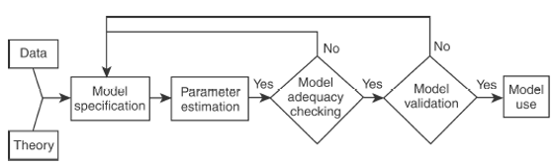
Predictive modeling process
Model tuning
Feature selection
Model fit
Coefficient table
Model summary
Interpretation
ANOVA
Fit diagnostics
Outliers
Multicollinearity
Performance metrics
Method of validation
Stat vs ops validation
Study design
Data collection
EDA
Data prep

Slide 4
Model specification
Simple linear regression
y = β₀ + β₁x + ε
y = response variable
x = predictor variable
Multiple linear regression (multiple predictor variables)
y = β₀ + β₁x₁ + β₂x₂ + … β_{n}x_{n} + ε
Parameter selection via minimizing least squared error

Slide 5
Assumptions
Linear regression relies on several assumptions (though it can be pretty robust even if some assumptions are violated to some degree).
These assumptions include:
The relationship between the response and predictors is linear and additive
The errors are independent (i.e., not serially correlated)
The errors have constant variance (i.e., have homoscedasticity)
The errors are normally distributed

Slide 6
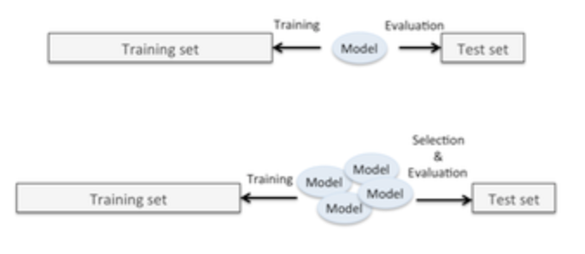
Internal validation
Split data into train and test sets, commonly 70/30 or 75/25

Slide 7
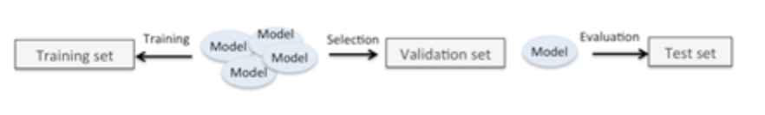
External validation
Test model on entirely new (independent) data set

Slide 8
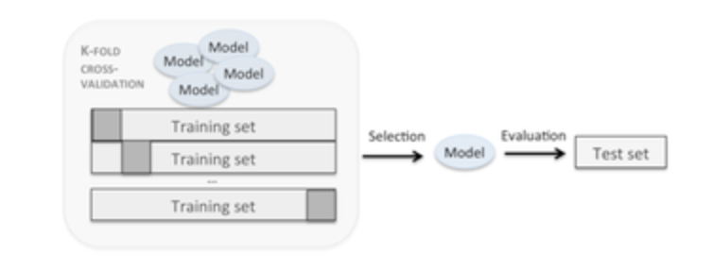
Cross validation
More sophisticated approach to internal validation, using resampling to make use of all data without training on validation set

