Slide 1
Lesson 9
Logistic Regression Modeling

Slide 2
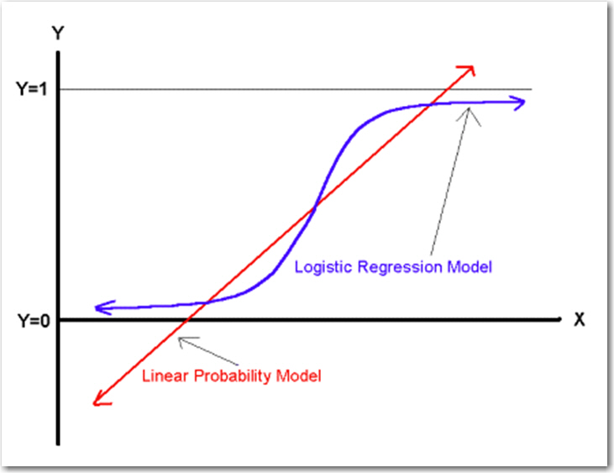
Why not use least squares regression for classification?
Errors won’t be normally distributed
Probability value from linear regression can take on values > 100% or < 0%
Even if the Predicted value is truncated, the predictions are usually not good

Slide 3
Logistic regression
Uses Maximum Likelihood algorithm
Predicts LOG-ODDS (“LOGIT”) of target (value can range from +/- Infinity)
Logit can be converted to a Probability Score ranging from 0% to 100%
Logit = log odds
Odds = exp(log odds)
Prob = odds/(1+odds)

Slide 4
Assumptions
The outcome is a binary or dichotomous variable
There is a linear relationship between the logit of the outcome and each predictor variables
There are no influential values (extreme values or outliers) in the continuous predictors
There is no multicollinearity among the predictors

