Slide 1
API Introduction to R Workshop
Amrom Obstfeld MD PhD
Notes:
Hello everyone and welcome to this years Introducton to R workshop. I am Amrom Obstfeld the organizer of the course representing the presenters. We are so excited you have made the decision to take the time to join us and learn about R and how it can be used to power reproducible high quality data analysis and data science.
This workshop is designed for beginners who are brand new to R and new to coding in general. If you have some experience we're here to help you build up some R muscle memory, in addition to completely newbs we often see those looking for a refresher come back to take the workshop again, so welcome all.

Slide 2
Course Introduction
Notes:
I'm here just to give you a quick introduction after which we'll dive right into the meat of the workshop.

Slide 3
Goals and Objectives
Advocate for the use of R as a means of improving reproducibility in clinical data analysis
Demonstrate how R is used to perform analyses of laboratory operational data
Establish a basis of understanding in the 'tidy' approach to data analysis within the framework of R
Notes:
Obviously we would love for those who are here today to all walk away and just start coding but the reality is that while that would be great we also have a set of more modest if more important goals
We're here to Advocate for the use of R as a means of improving reproducibility in clinical data analysis and I cannot emphasize enough how strongly we feel about this point
As we review this we will demonstrate how we can use R perform analyses of laboratory operational data
And we also hope to establish a baseline understanding of what tidy data is and how to implement a 'tidy' approach to data analysis within the framework of R

Slide 4
Session | Instructor
Introduction | Amrom Obstfeld
Introduction to R and RStudio | Joe Rudolf
Data Transformation | Amrom Obstfeld
Data Visualization | Sarah Dudgeon
Dashboards | Patrick Mathias

Slide 5
Who are we?

Slide 6
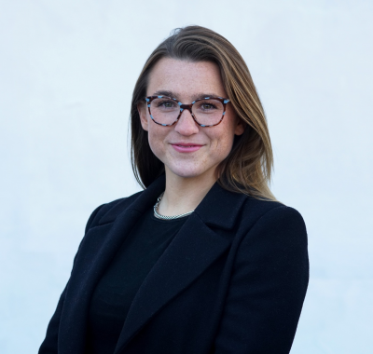
Sarah Dudgeon
PhD Candidate, Department of Laboratory Medicine, Yale University School of Medicine
Notes:
Sarah Dudgeon is a PhD Candidate at Yale University where she studies graph analytics and other advanced mechanisms of multi-modal healthcare data analysis. She additionally has experience in medical device regulation with the FDA, a Master of Public Health in Epidemiology and Biostatistics from Johns Hopkins Bloomberg School of Public Health, and a Bachelor of Science from University of Michigan in Kinesiology minoring in Engineering.

Slide 7
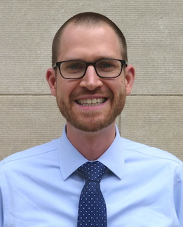
Joseph Rudolf
Assistant Professor, Department of Pathology, University of Utah Medical School
Medical Director, Automated Core Laboratory, ARUP Laboratories
Notes:
Joseph Rudolf, MD is the medical director for the automated core laboratory at ARUP Laboratories in Salt Lake City, Utah. His clinical and research interests focus on the intersection of informatics and clinical operations including clinical decision support, utilization management, and reporting and analytics. He is also passionate about clinical process improvement and initiatives to support quality and safety.

Slide 8
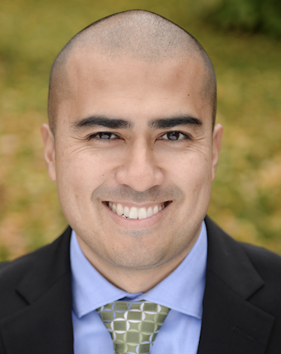
Patrick Mathias
Assistant Professor, Department of Laboratory Medicine and Pathology
University of Washington School of Medicine
Associate Medical Director, Laboratory Medicine and Pathology Informatics
Notes:
Patrick Mathias, MD, PhD, is the Associate Medical Director of the Informatics Division in the Department of Laboratory Medicine at the University of Washington School of Medicine. His interests include developing data science and analytics as a core competency to improve clinical lab operations and laboratory stewardship, and applying clinical informatics approaches to mitigate laboratory-associated diagnostic errors. He is interested in developing and improving programming and data science education across all levels of pathology practice.

Slide 9
Amrom Obstfeld
Associate Professor of Clinical Pathology and Laboratory Medicine
Director of Pathology Informatics
Children's Hospital of Philadelphia
Notes:
And this is me, Amrom Obstfeld MD, PhD, I am the Medical Director of the Division of Pathology Informatics at Children’s Hospital of Philadelphia. In this role I lead the development of analytic tools to aid in quality management and operations, interfaces with other groups throughout the hospital on informatics initiatives and I also in design and implement informatics educational experiences for pathology trainees and faculty at the University of Pennsylvania.

Slide 10
Workshop Workflow
Notes:
So now that you've met us let's discuss for a moment how this workshop is going to work

Slide 11

Your Turn
Introduce yourself to your breakout roommates
Who are you?
What institution are you from?
Why are you here?
Notes:
Great now that we are all acclimated I thought it would be nice if we could all drop our info into the chat so that we can all get a sense for who is in the workshop, just type in your name, and briefly why are you attending the workshop.

Slide 12
Final Tips
The best way to learn to code is by doing!
Google is your friend
Notes:
And just some final words before we begin, no matter what you're learning but particularly coding, the best way to learn is by doing:
Find a project, make a goal for yourself, push yourself to use R, it's OK to lean on some excel, we all do when we're starting out, but try to get that activation energy to get your hands typing code. We would not be teaching this course if we didn't strongly believe that R is accessible to all of you. So keep practicing and you'll get there.
With that let's get started with the workshop. Up next Joe will provide us with the basics of R and get us up and running with Rstudio Cloud.

