Slide 1
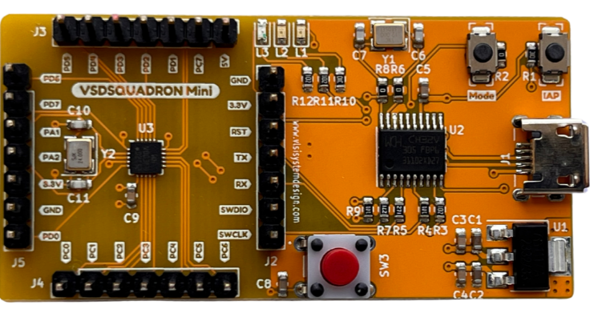
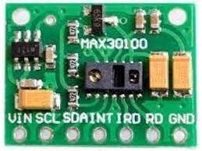
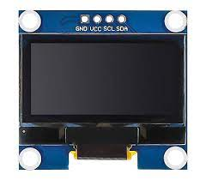
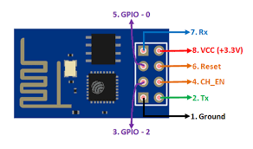
Amrit Raj – Aditya Manjunatha __ HighRiders
Max30100 SPo2 module
VSDSquadron Mini RISC-V
Oled display
ESP8266 WIFI Module

