Slide 1

E-COMMERCE DATA ANALYSIS USING SQL
Presented by: Amartya Prasad

Slide 2
OBJECTIVE:-
To explore and analyze an e-commerce dataset using SQL.
To extract insights such as pricing trends, stock levels, product performance, and customer behavior.
To extract meaningful business insights such as top-selling products, sales trends by city, and category-wise performance.

Slide 3
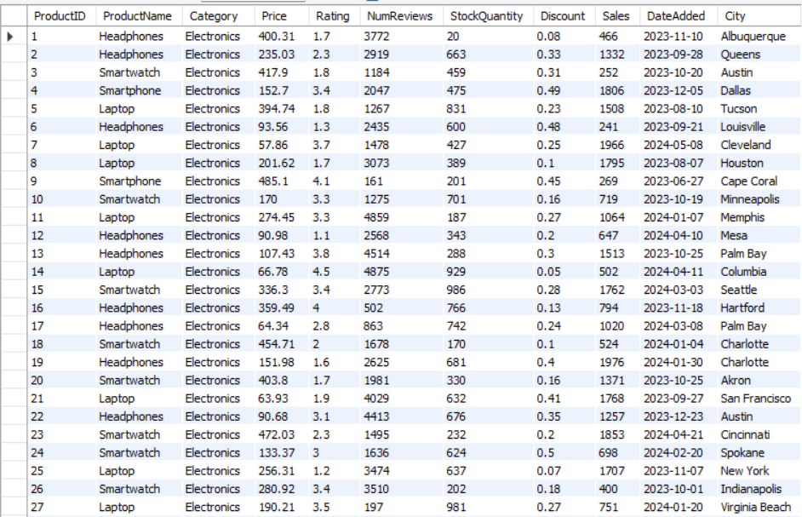
THE DATABASE :- The Database shown below contains data about products that have been bought from a particular e-commerce website .

Slide 4
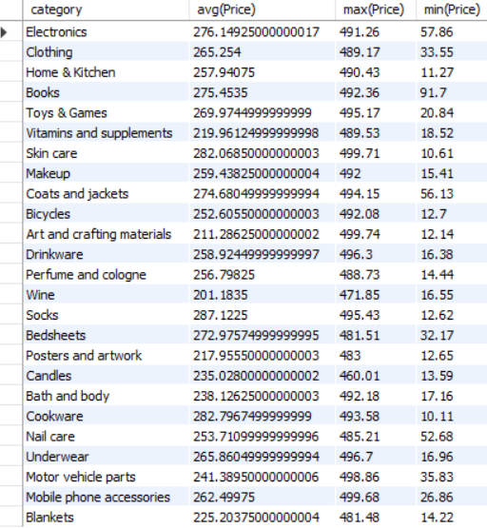
QUERY 1) WRITE A SQL QUERY TO FIND AVERAGE PRICE,MAXIMUM PRICE AND MINIMUM PRICE OF EACH PRODUCT ON THE BASIS OF IT’S CATEGORY

Slide 5
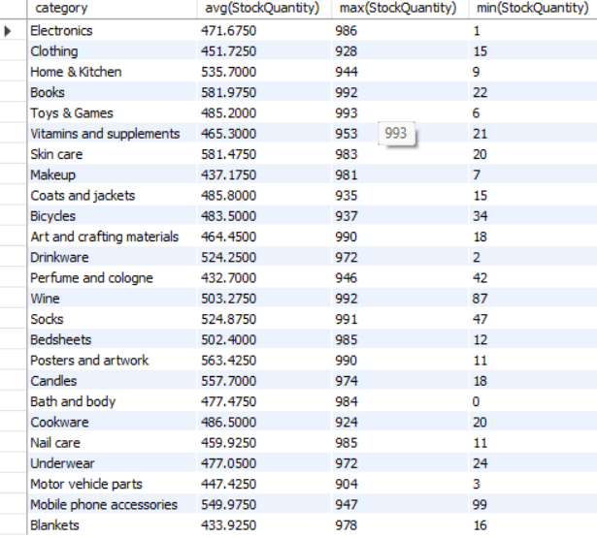
QUERY 2) WRITE A SQL QUERY TO FIND AVERAGE,MAXIMUM,MINIMUM STOCK QUANTITY OF ALL THE PRODUCTS BASED ON THE CATEGORY.

Slide 6
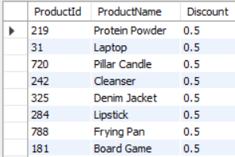
QUERY 3) WRITE A SQL QUERY TO FIND PRODUCTS WITH HIGHEST DISCOUNTS.

Slide 7
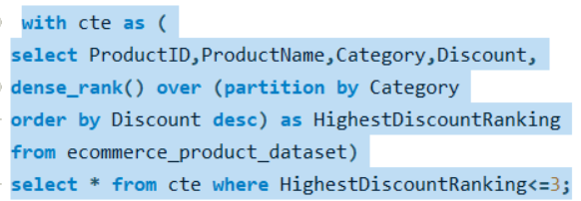
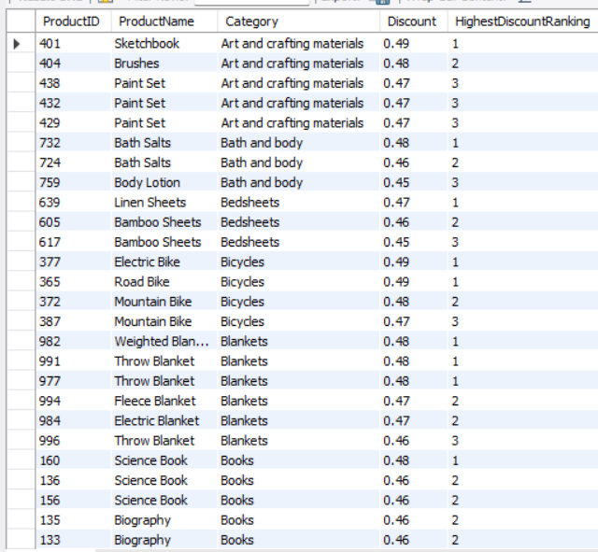
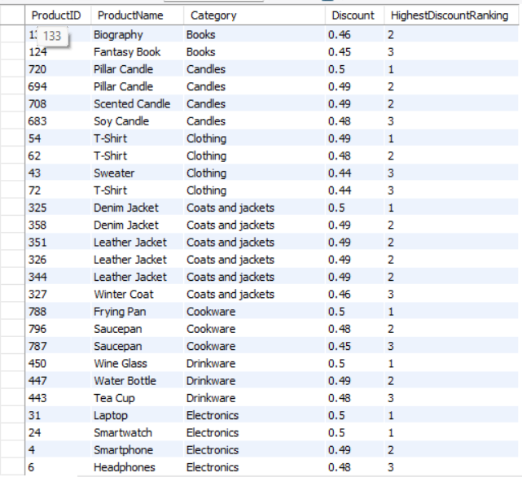
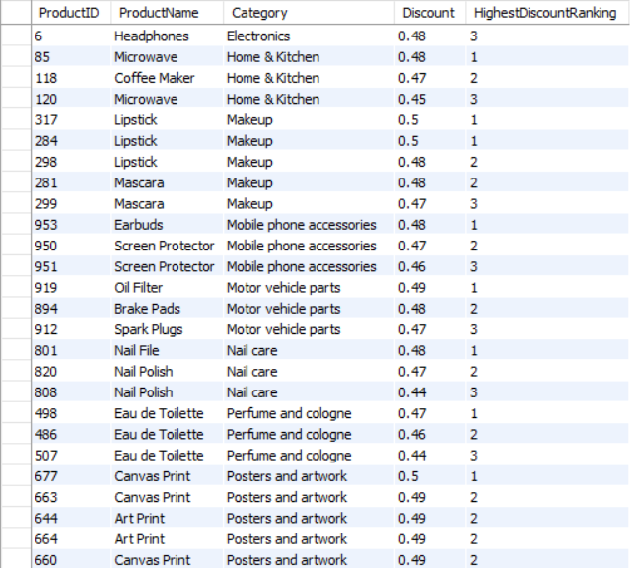
QUERY 4) WRITE A SQL QUERY TO FIND PRODUCTS OFFERING HIGHEST DISCOUNT BASED ON IT’S CATEGORY

Slide 8
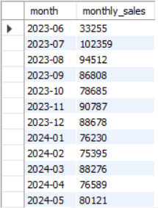
QUERY 5) WRITE A SQL QUERY TO FIND MONTHLY SALES TREND.

Slide 9
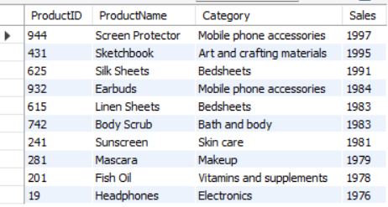
QUERY 6) WRITE A SQL QUERY TO FIND TOP SELLING PRODUCTS

Slide 10
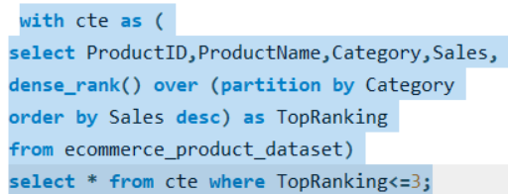
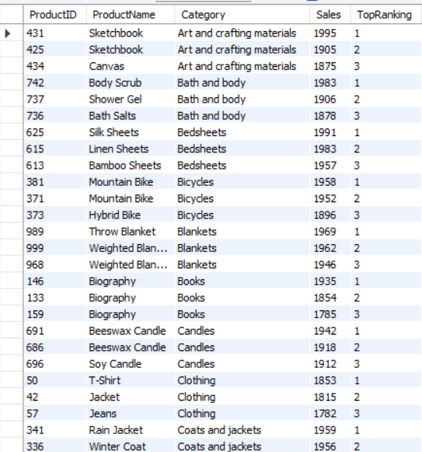
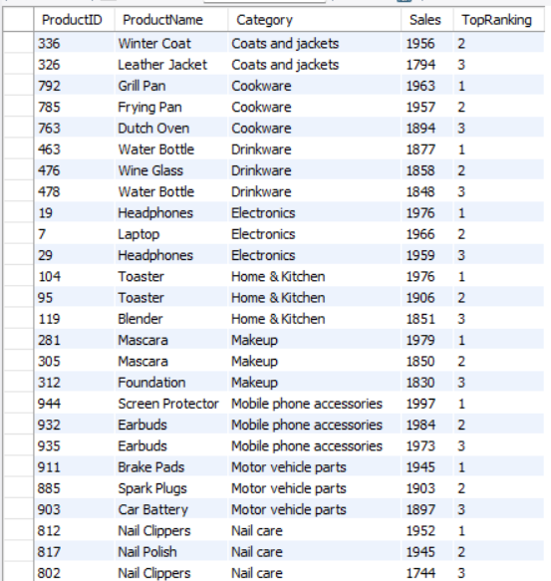
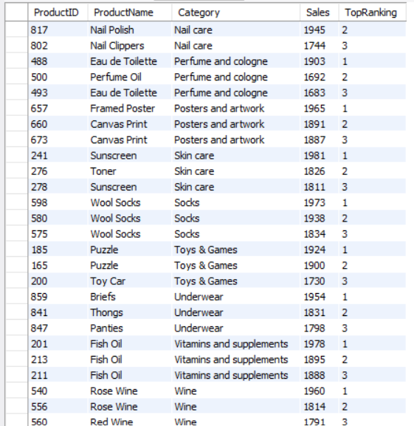
QUERY 7)WRITE A SQL QUERY TO FIND TOP SELLING PRODUCTS BASED ON CATEGORY.

Slide 11
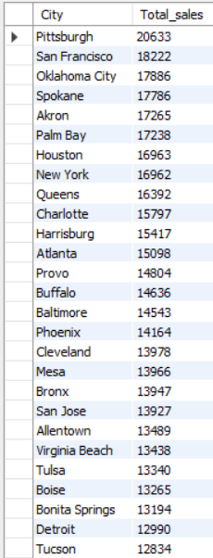
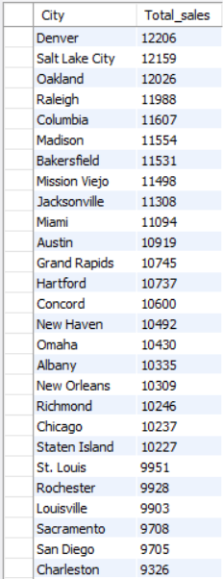
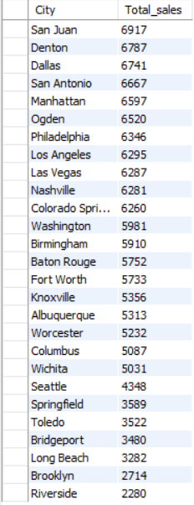
QUERY 8)WRITE A SQL QUERY TO FIND TREND IN SALES BY CITY.

Slide 12
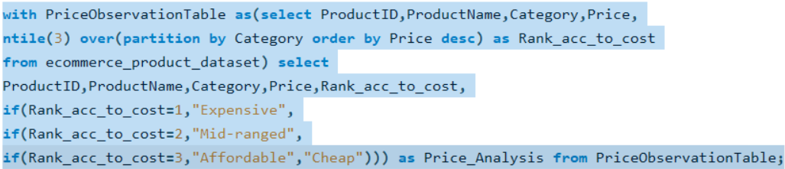
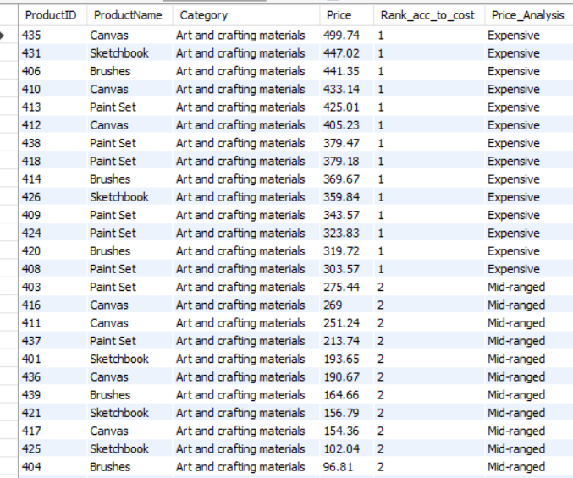
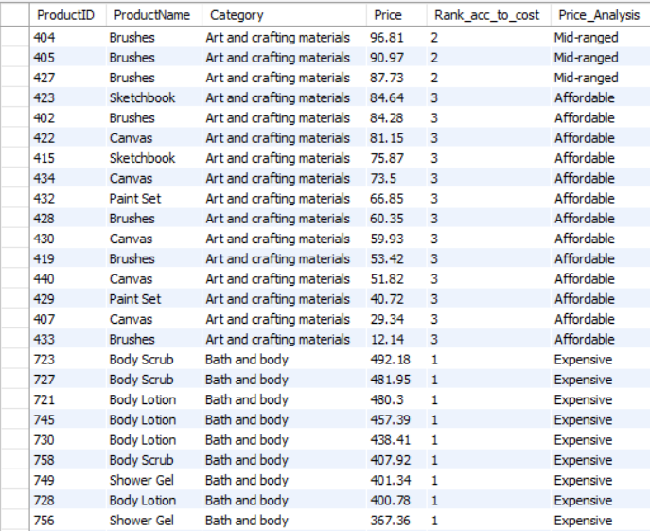
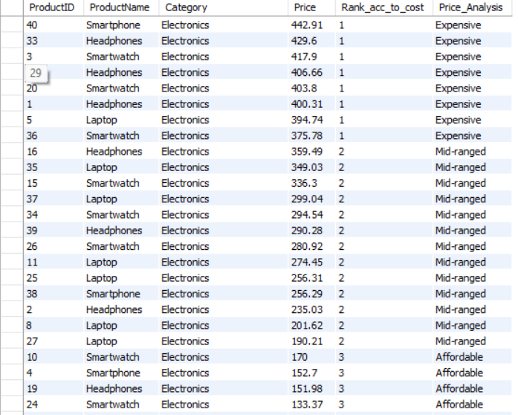
QUERY 9) WRITE A SQL QUERY TO CATEGORIZE PRODUCTS BASED ON THEIR PRICE AS EXPENSIVE ,MID-RANGED OR CHEAP.

Slide 13
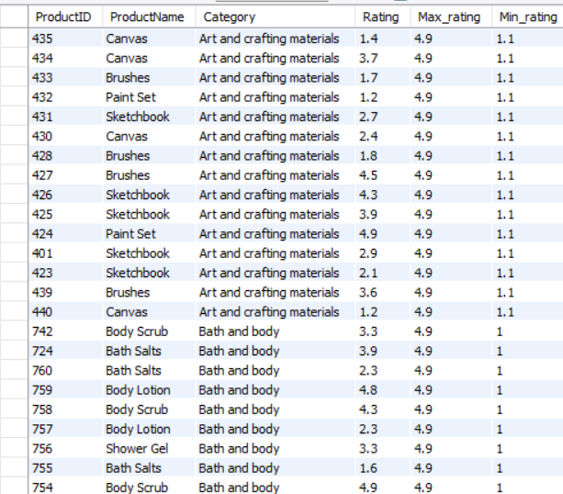
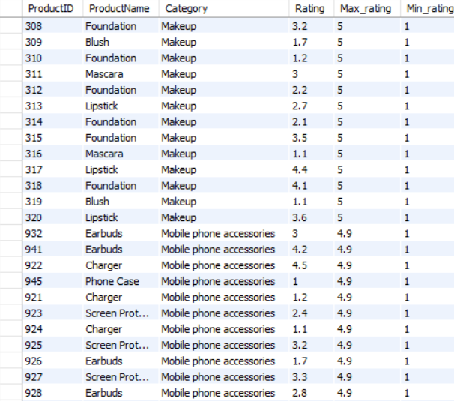
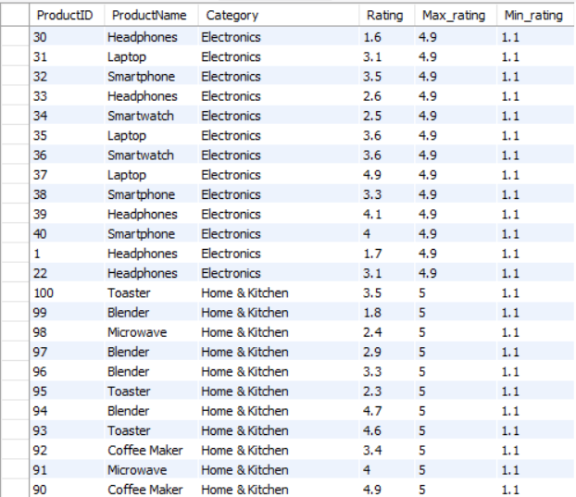
QUERY 10)WRITE A SQL QUERY TO FIND MAX AND MIN RATING OF EACH PRODUCTS BASED ON IT’S CATEGORY.

Slide 14
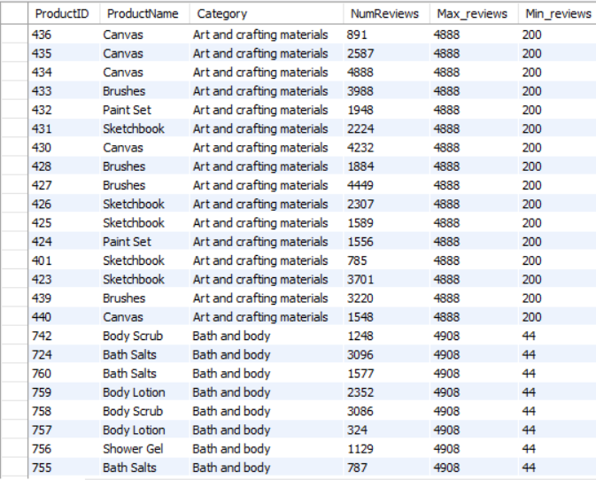
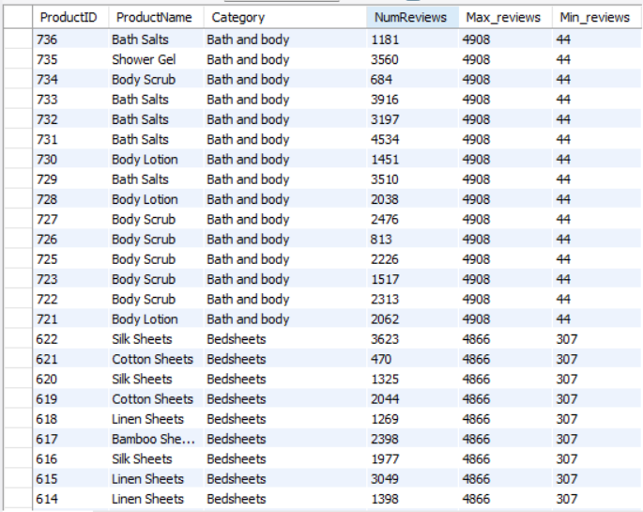
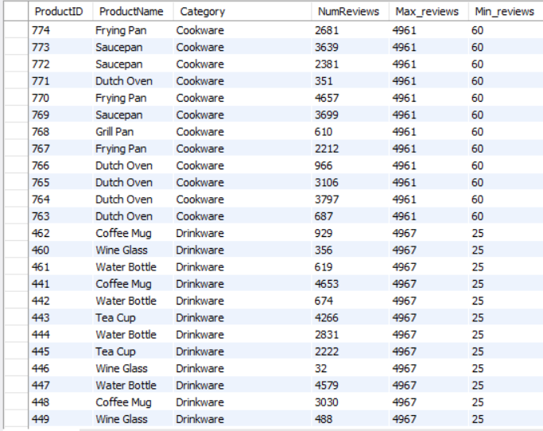
QUERY 11)WRITE A SQL QUERY TO FIND MAX AND MIN NUMBER OF REVIEWS EACH PRODUCTS BASED ON IT’S CATEGORY.

Slide 15
ACKNOWLEDGEMENT:-
Ankit sir-For his invaluable advice and support.
Ashish sir-For his mentorship and encouragement.
Cybrom Technology Pvt. Ltd.-For providing the necessary resource and support.

