Slide 1
Testing Of an E-commerce
Website
Presented by Team 2
Team Leader: Amr Ashraf
Submitted to Eng. Abdelrhman Osama
1

Slide 2
Table of contents
01
02
03
04
06
05
Introduction
Why Automation
Exercise
Project Objectives
Testing scopes
07
08
Tools Used
Challenges & What We Learned
Teamwork
Distribution
Conclusion
2

Slide 3
Introduction
4

Slide 4
Introduction
Our goal is to apply Manual ,Automation, Api Testing on a real E-commerce Website
We choose “Automation Exercise” to fully test
We wanted to follow the complete QA process from planning and writing test cases, to executing tests and documenting results
In this presentation, I will introduce the project, explain why we chose this website, and show our objectives before the team presents their individual work
3

Slide 5
Why Automation Exercise
4

Slide 6
Why Automation Exercise
Free and easy to test website
Offers many UI features suitable for manual ,automation and Api testing
Includes Apis that are free and public that allow GET/POST/PUT/DELETE testing
No authentication required (keys & tokens) so it’s easy to Practice on
5

Slide 7
Project Objectives
9

Slide 8
Project Objectives
Practice the complete software testing lifecycle
Write clear test scenarios and test cases
Execute manual testing to find defects
Automate main user flows using Selenium
Validate API responses using Postman
Improve teamwork, task planning, and documentation skills
10

Slide 9
Testing Scope
9

Slide 10
Testing Scope
1-Manual Testing
Signup, Login, Contact Us
Navigation and UI elements
Functional & negative testing
Form validation and error messages
11

Slide 11
Testing Scope
2-Automation Testing
Automating sign-in, sign-up, and contact form flows
Validating elements using locators
Running regression test scripts
11

Slide 12
Testing Scope
3-Api Testing
GET all products, categories, brands
POST to verify login and user operations
Handling negative cases like PUT → 405 Not Supported
Checking response codes, time, and structure
11

Slide 13
Tools Used
9

Slide 14

Tools Used
Selenium WebDriver – UI automation
TestNG – test execution & reporting
Postman – API testing
Java – automation scripting language
12

Slide 15
Tools Used
Excel/Google Sheets – test cases documentation
GitHub – team collaboration & version control
IDE (VS Code /Eclipse) – writing automation scripts
12

Slide 16
Challenges & What We Learned
9

Slide 17
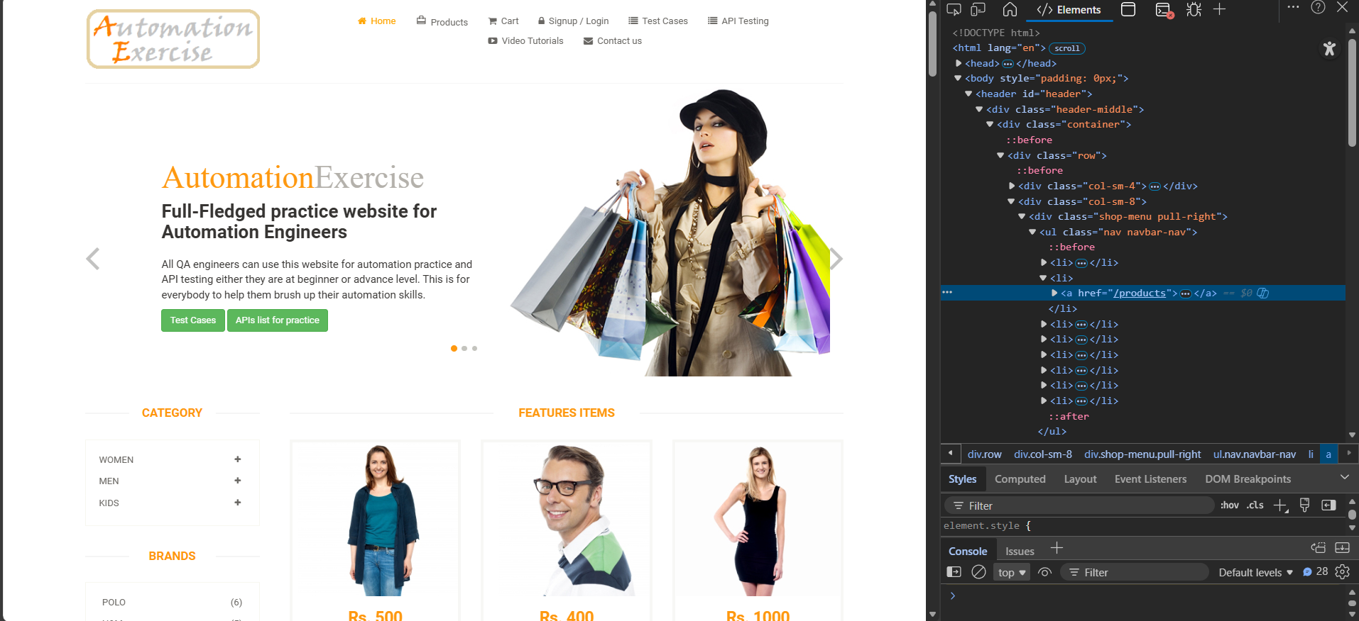
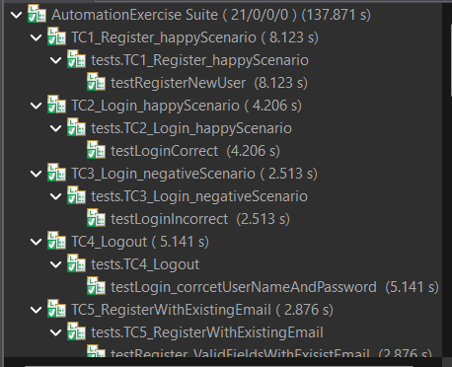
Challenges & What We Learned
Locating dynamic elements during automation
Handling failing/unstable scripts
Writing proper assertions in TestNG
13

Slide 18
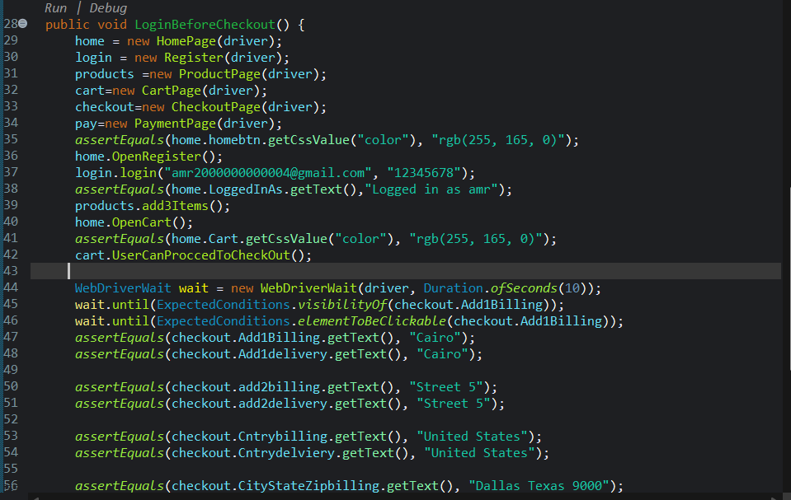
Challenges & What We Learned
Understanding API errors like 405, 404
Improved problem-solving and debugging skills
Better time management and communication
Learning how to divide tasks and coordinate as a team
13

Slide 19
Team Work Distribution
9

Slide 20
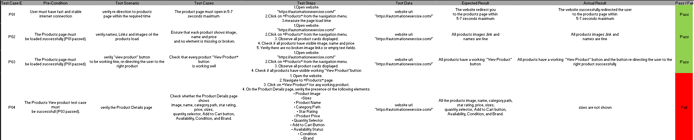
Team Work Distribution
SRS & Writing Manual Test Cases
Ammar: Checkout & Payments
Rana: Cart
Amr: Products & Search
Madonna: User Management
Shahd: Orders & Accounts
Jomana: Navigation & static pages & Cross Browser Testing
15

Slide 21
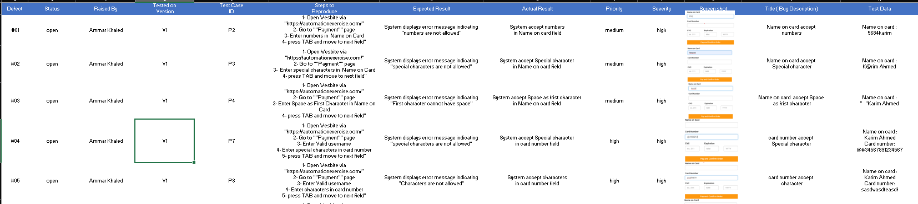
Team Work Distribution
Test Cases Execution & Bug Reports
Ammar: Cart
Rana: Checkout & Payments
Amr: User Management
Madonna: Products & Search
Shahd: Navigation & static pages & Cross Browser Testing
Jomana: Orders & Accounts
15

Slide 22
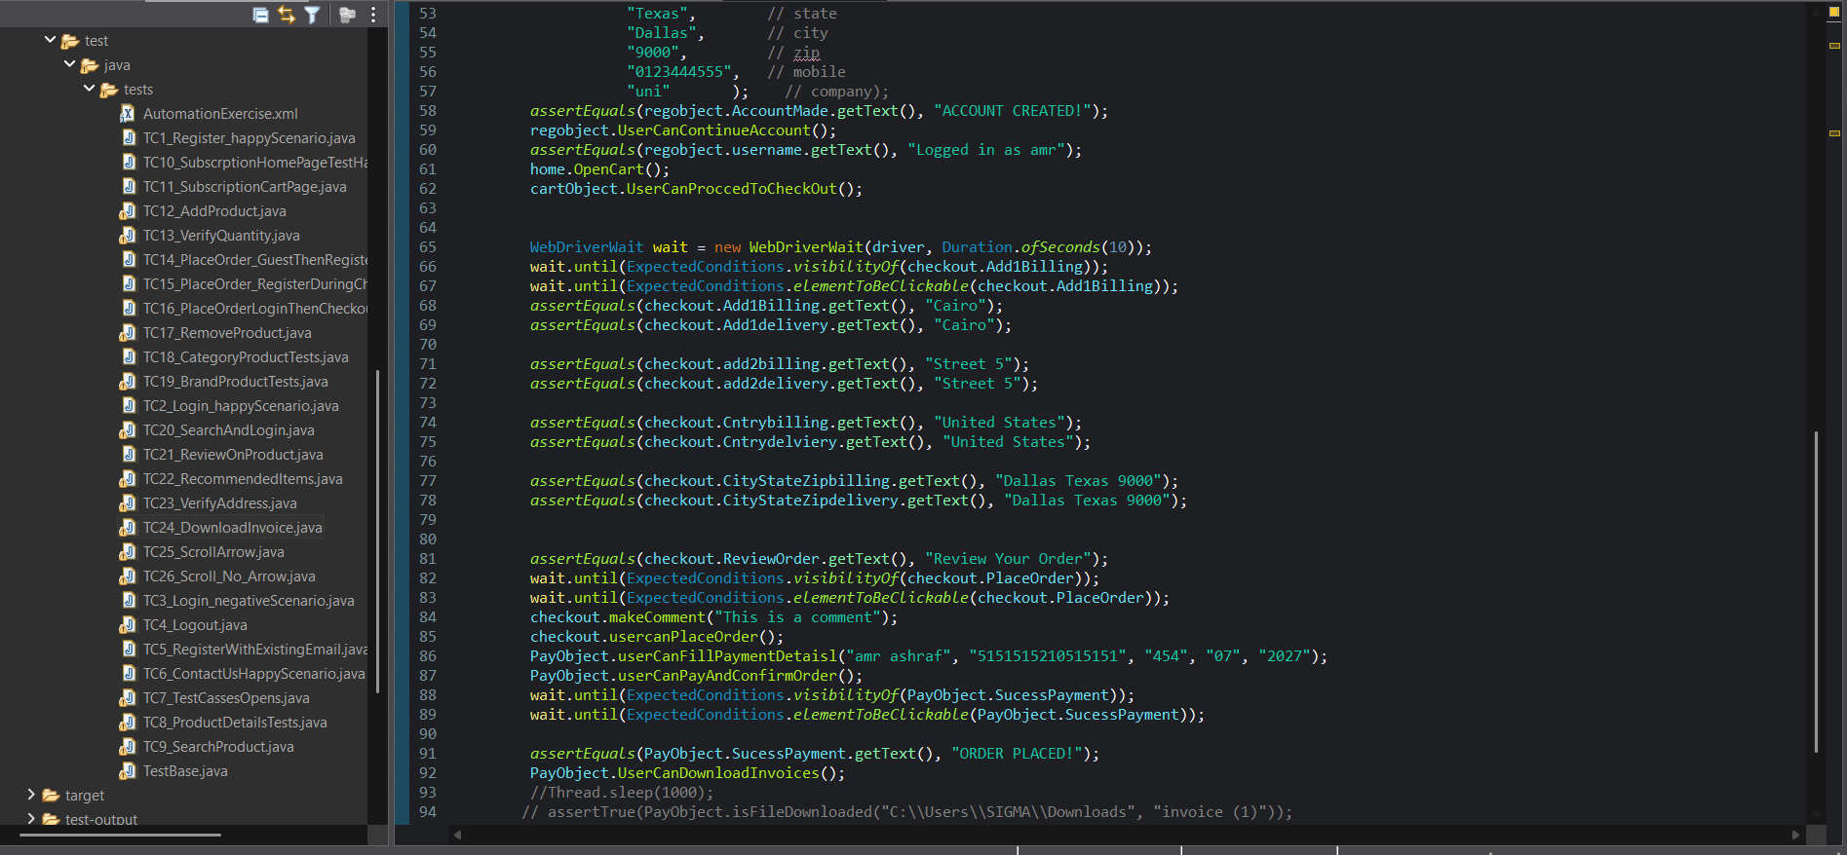
Team Work Distribution
Automation Testing
Ammar: TC(25,26)
Rana: TC(4,5,7,9)
Amr: TC(6,10,11,21)
Madonna: TC(8,18,19,20,22)
Shahd: TC(12,13,17,23,24)
Jomana: TC(1,2,3,14,15,15)
15

Slide 23
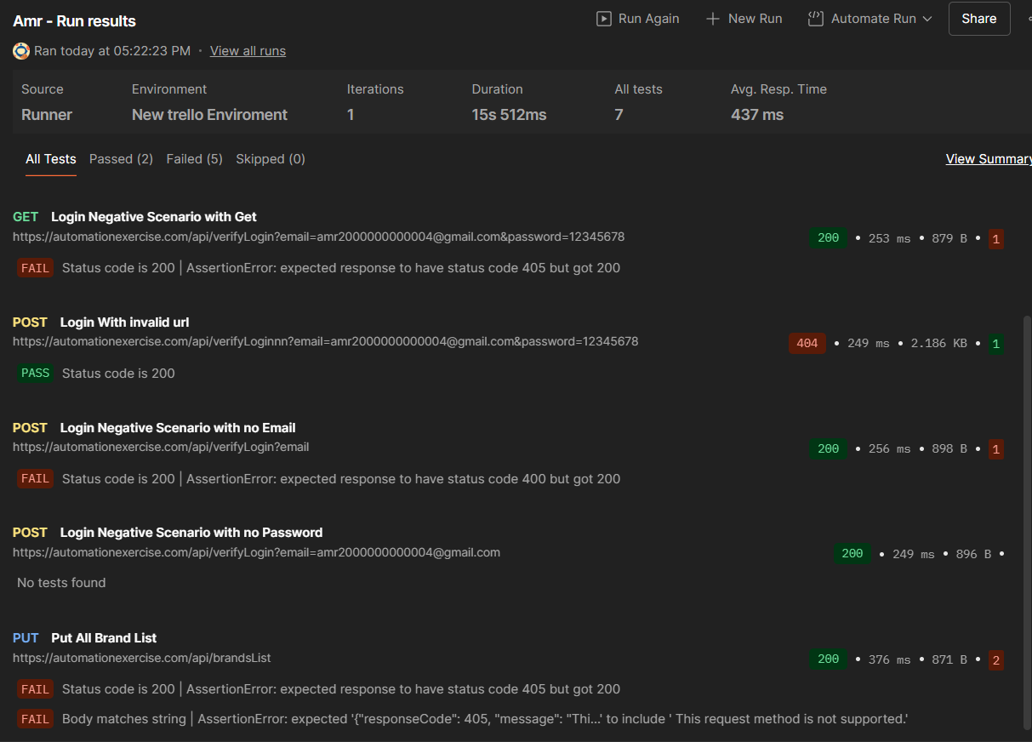

Team Work Distribution
Api Testing
Ammar: TC(2,12)
Rana: TC(5,10)
Amr: TC(4,7)
Madonna: TC(1,6,11)
Shahd: TC(9,14)
Jomana: TC(3,8,13)
15

Slide 24
Conclusion
9

Slide 25

Conclusion
Achieved full manual, automation, and API testing workflow
Gained real project experience similar to industry QA teams
Understood how tools like Selenium and Postman
work in real cases
Improved collaboration and documentation skills
Successfully delivered a complete testing project
24

Slide 26
Thanks!
💻 Github
📁 Drive
26

