Slide 1
AI – ML – DS ECOSYSTEM & Execution
AbdulMajedRaja RS

Slide 2
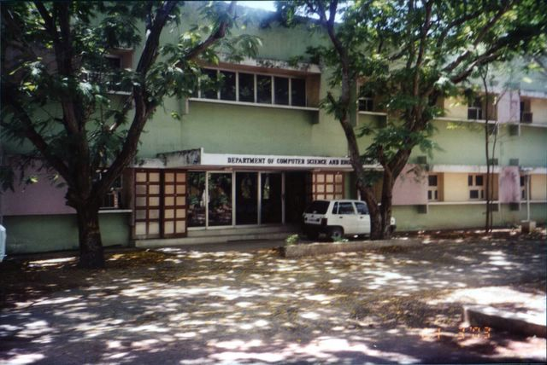
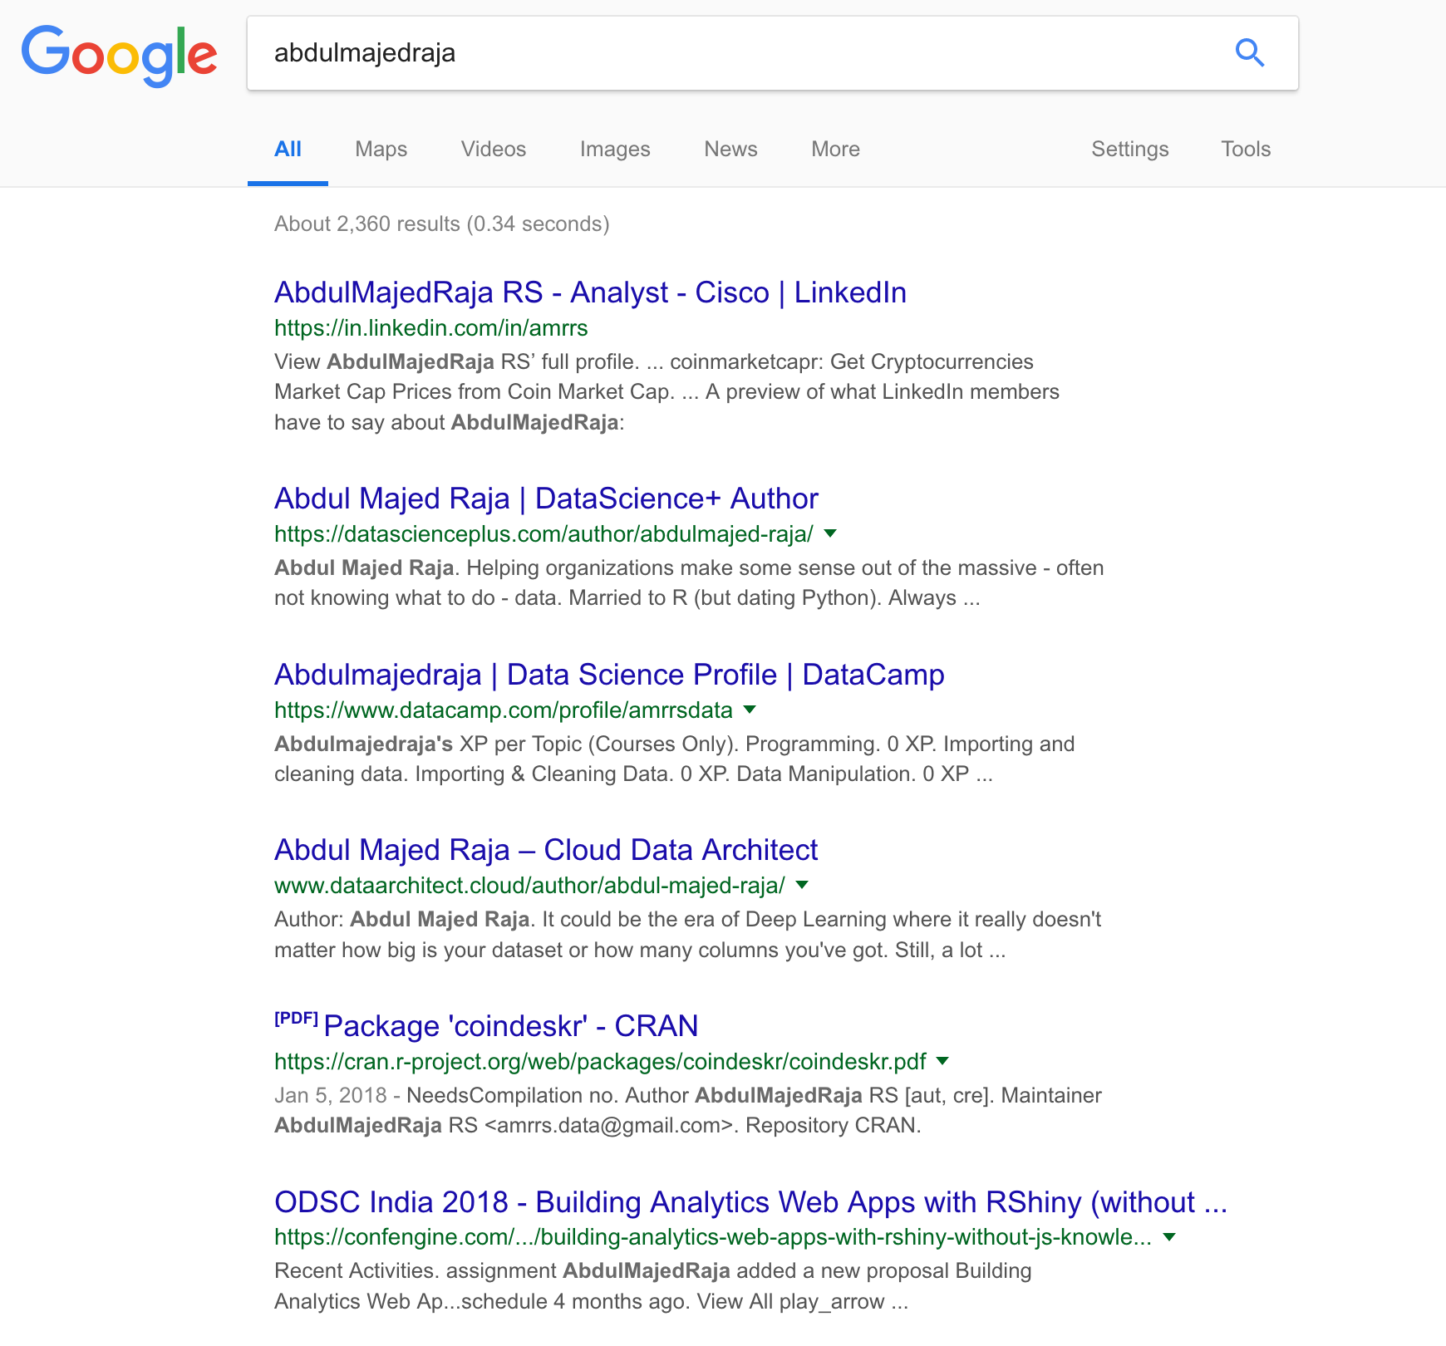
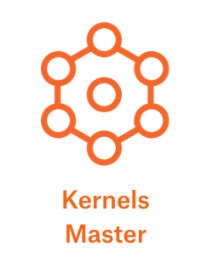
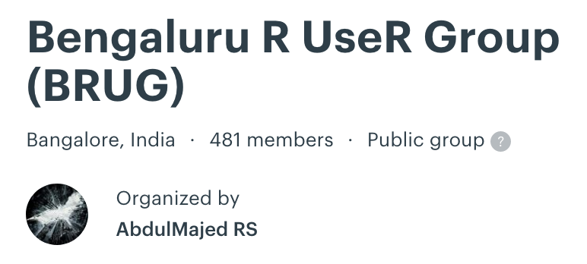
ABOUT ME

Slide 3
DEFINITION
Data science produces insights
Machine learning produces predictions
Artificial intelligence produces actions
http://varianceexplained.org/r/ds-ml-ai/
David Robinson, Chief Data Scientist, Datacamp

Slide 4
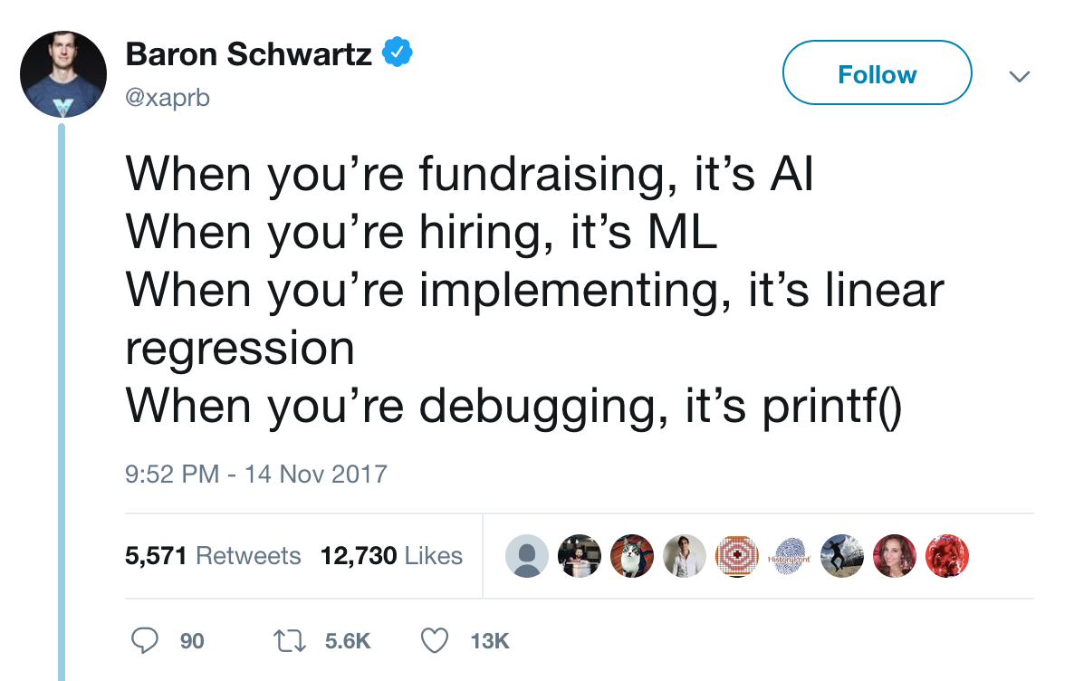
KindA-DEFINITION

Slide 5
TOOLCHAIN
Programming Languages
Self-serve Tools / Platforms
Analytics Tools
Auto ML / Studio Tools
Data Visualization Tools
Deep Learning Frameworks

Slide 6

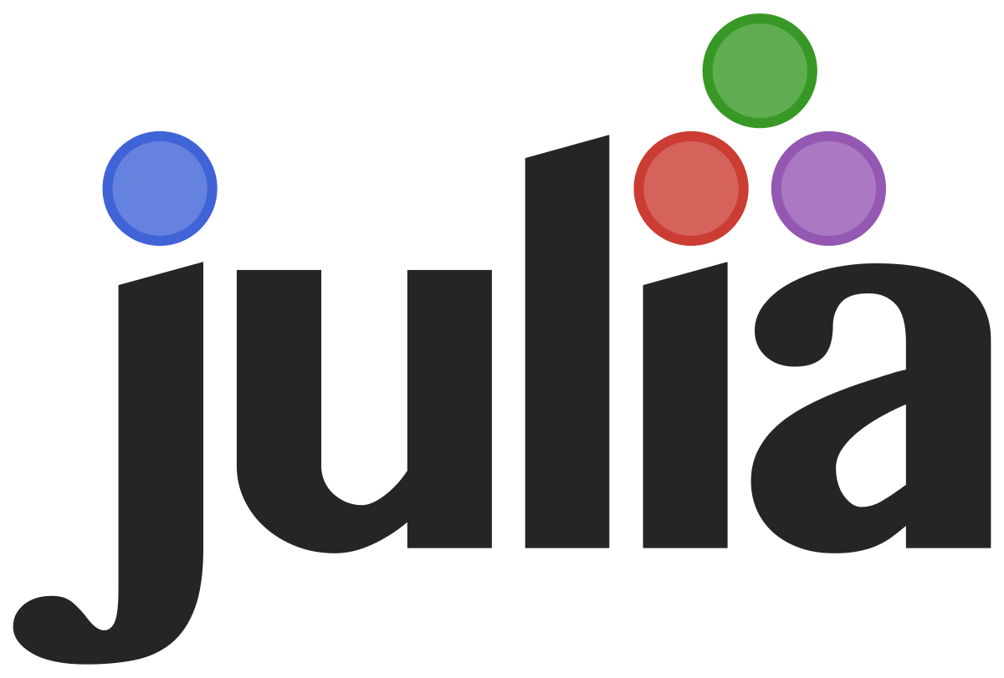


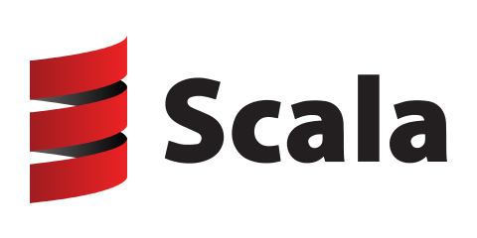

Programming languages

Slide 7



Analytics - SELF-SERVE TOOLS / PLATFORMS

Slide 8

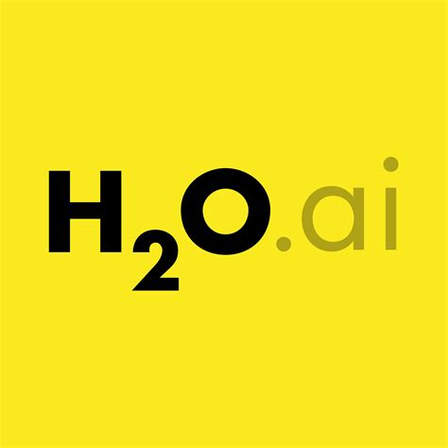
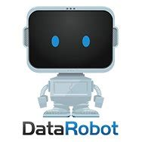

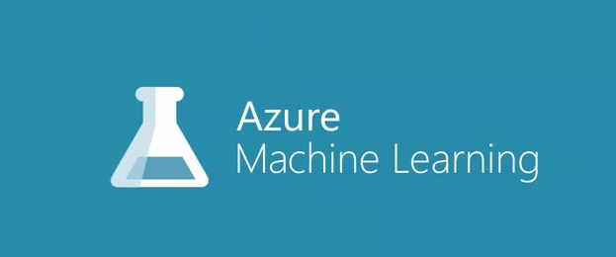

AUTO ML / STUDIO - SELF-SERVE TOOLS / PLATFORMS

Slide 9

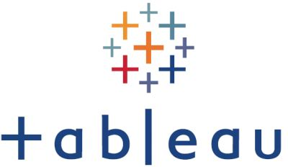

Visualization - SELF-SERVE TOOLS / PLATFORMS

Slide 10



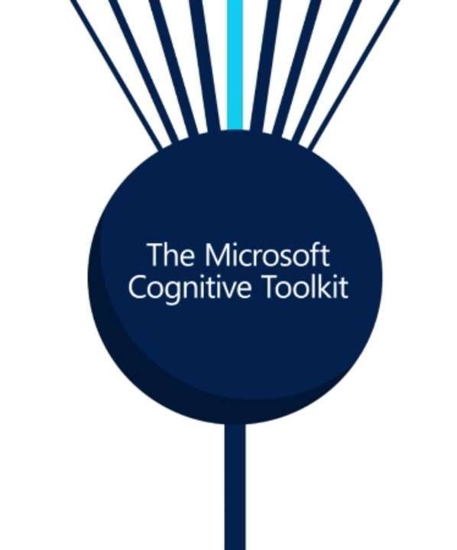


Deep learning frameworks

Slide 11

Data science FRAMEWORK #1
https://en.wikipedia.org/wiki/Cross_Industry_Standard_Process_for_Data_Mining

Slide 12
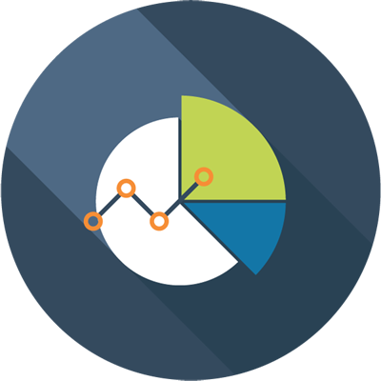
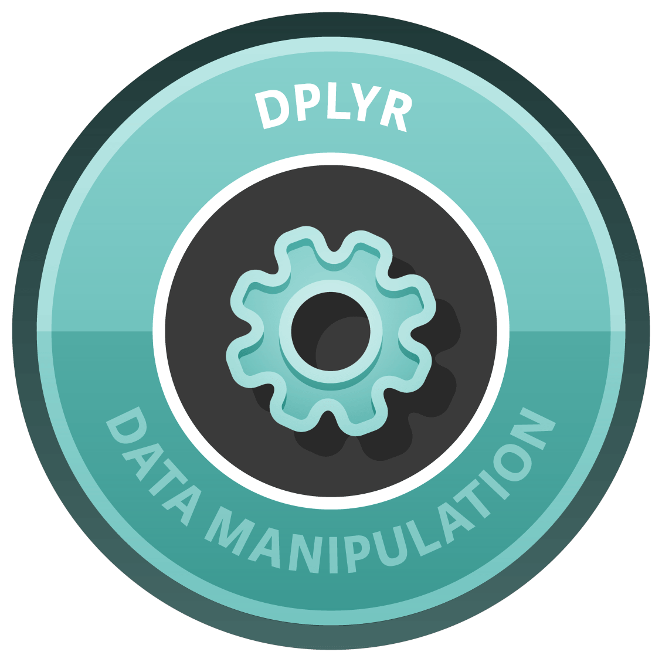




Data science FRAMEWORK #2
4
Data Visualization
Insights
Data-driven Recommendations
3
Data Manipulation
2
Data Cleaning
1
Data Collection

Slide 13
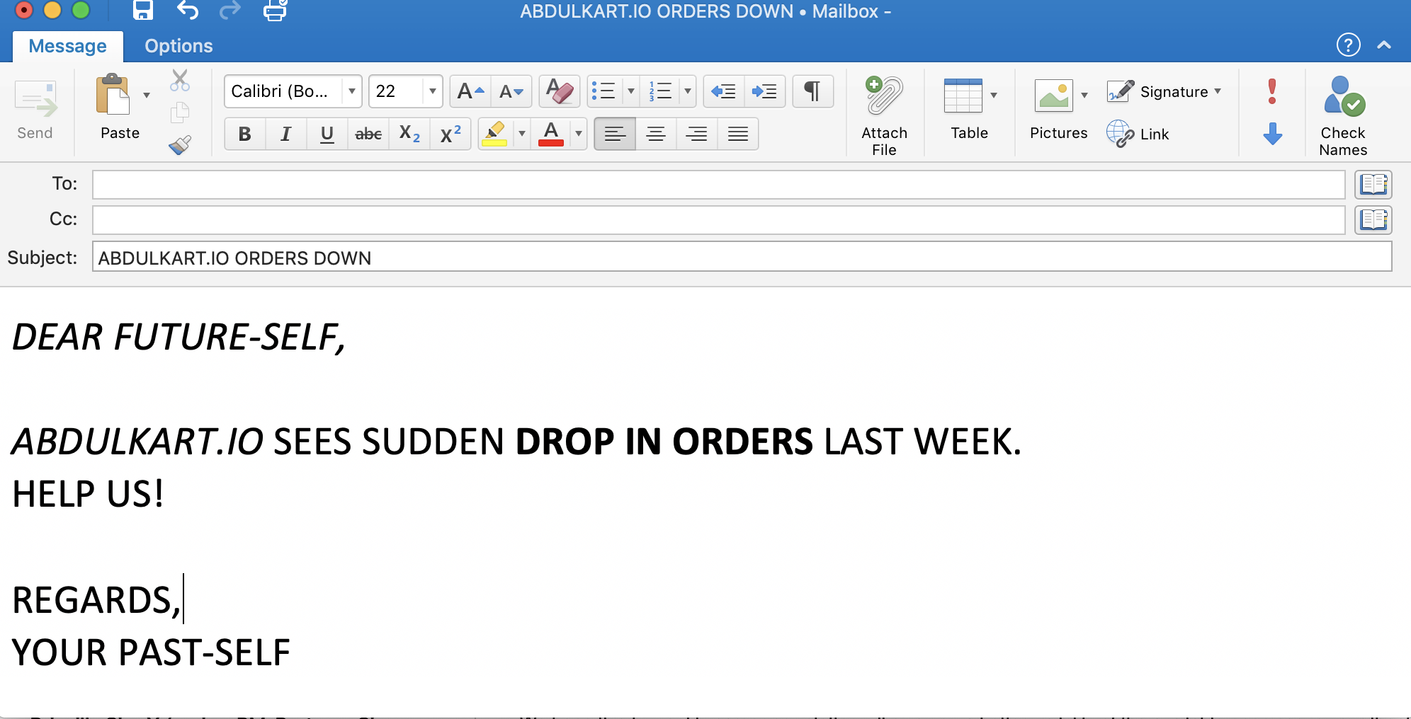
Use-case #1

Slide 14
Solving use-case #1
Business Understanding
Hypothesising some potential causes:
Could be due to failure in the site
Could be due to data flow between Site & Accounting System
Could be due to reduced Market Demand
Could be seasonal
Data Collection
Digital – Clickstream Data
ERP/CRM Bookings Data

Slide 15
Solving use-case #1
Data Science
Narrowing down between CRM & Digital
Comparison with Similar Previous Time Period
Stage-wise Funnel / Conversion
At each stage of Digital Journey to see fall out
Recommendations
Minify Checkout Page weight to reduce load time
Change Payment gateway
A/B Test to improve the UX of Check-out page

Slide 16
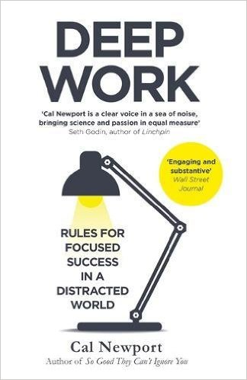
SHOWCASE
“If you don’t produce, you won’t thrive—no matter how skilled or talented you are.”
Deep Work, Cal Newport

Slide 17
showcase
Github/Gitlab – Own Repos, Contributions, Hobby Projects
Competitions/Hackathons – Kaggle, Crowdanalytix, Analytics Vidhya
Blog posts – Medium, Wordpress, Github
Meetups/Conferences

Slide 18
Emerging concerns – please KEEP In MIND
Model Bias and Fairness
Reproducibility
Interpretable Machine Learning
Data Ethics

