Slide 1
Introduction to Python
AbdulMajedRaja RS

Slide 2
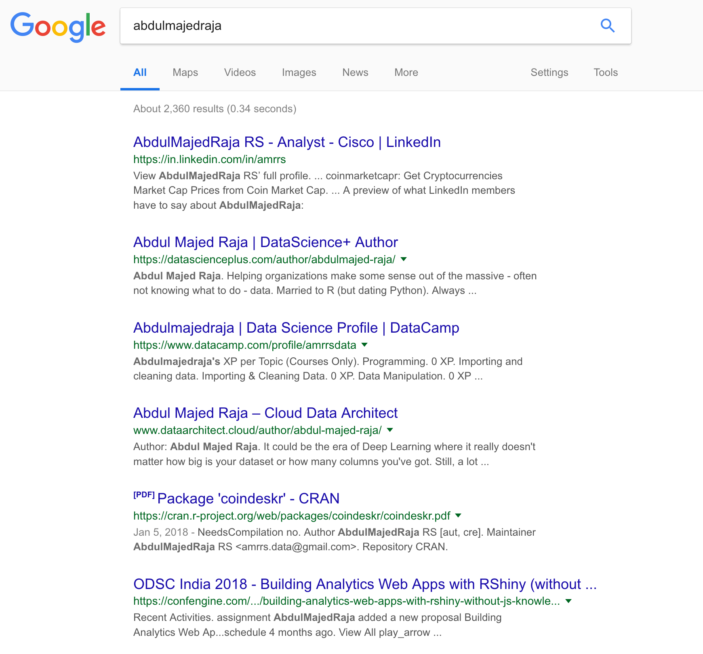
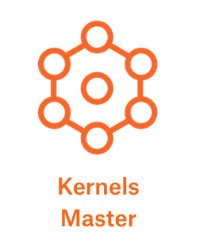
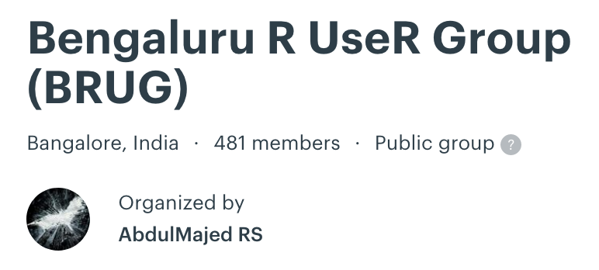
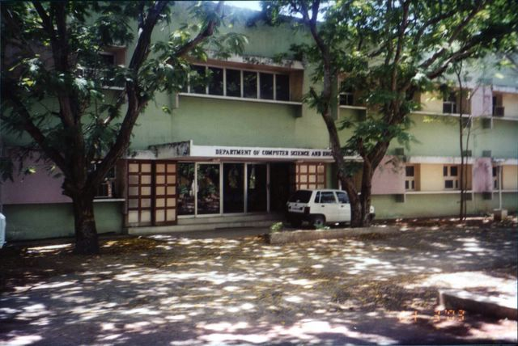


About Me!

Slide 3
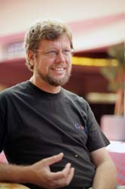

history
Guido van Rossum (Dutch Programmer)
1991
Source: Wikipedia

Slide 4
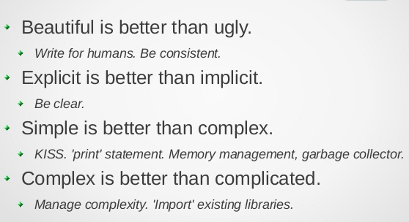
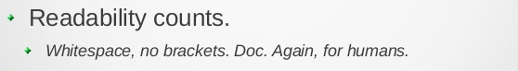
ZEN of Python - Philosophy
https://www.slideshare.net/DZPM/the-zen-ofpython
David Arcos

Slide 5
APPLICATIONS
Web Development: Django, Pyramid, Bottle, Tornado, Flask, web2py
GUI Development: tkInter, PyGObject, PyQt, PySide, Kivy, wxPython
Scientific and Numeric: SciPy, Pandas, IPython
Software Development: Buildbot, Trac, Roundup
System Administration: Ansible, Salt, OpenStack
https://www.python.org/

Slide 6
Some words
Expressions
Github/Gitlab
Terminal
Notebook
Packages
Stackoverflow

Slide 7
CODE INTRO

Slide 8
PROJECTS

Slide 9
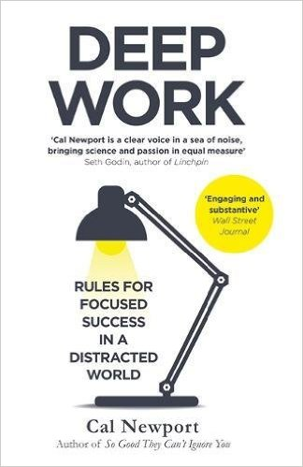
SHOWCASE
“If you don’t produce, you won’t thrive—no matter how skilled or talented you are.”
Deep Work, Cal Newport

Slide 10







Code {Projects}
Showcase
Write
{Blog/Books}
Design
{UI, UX, Art, Logo}
Publish
{Podcast/Videos}
Build & Sell
{Kits/Products}

Slide 11




Get in Touch!
@amrrs
@amrwrites
amr.rs.contact@gmail.com
https://in.linkedin.com/in/amrrs

