Slide 1
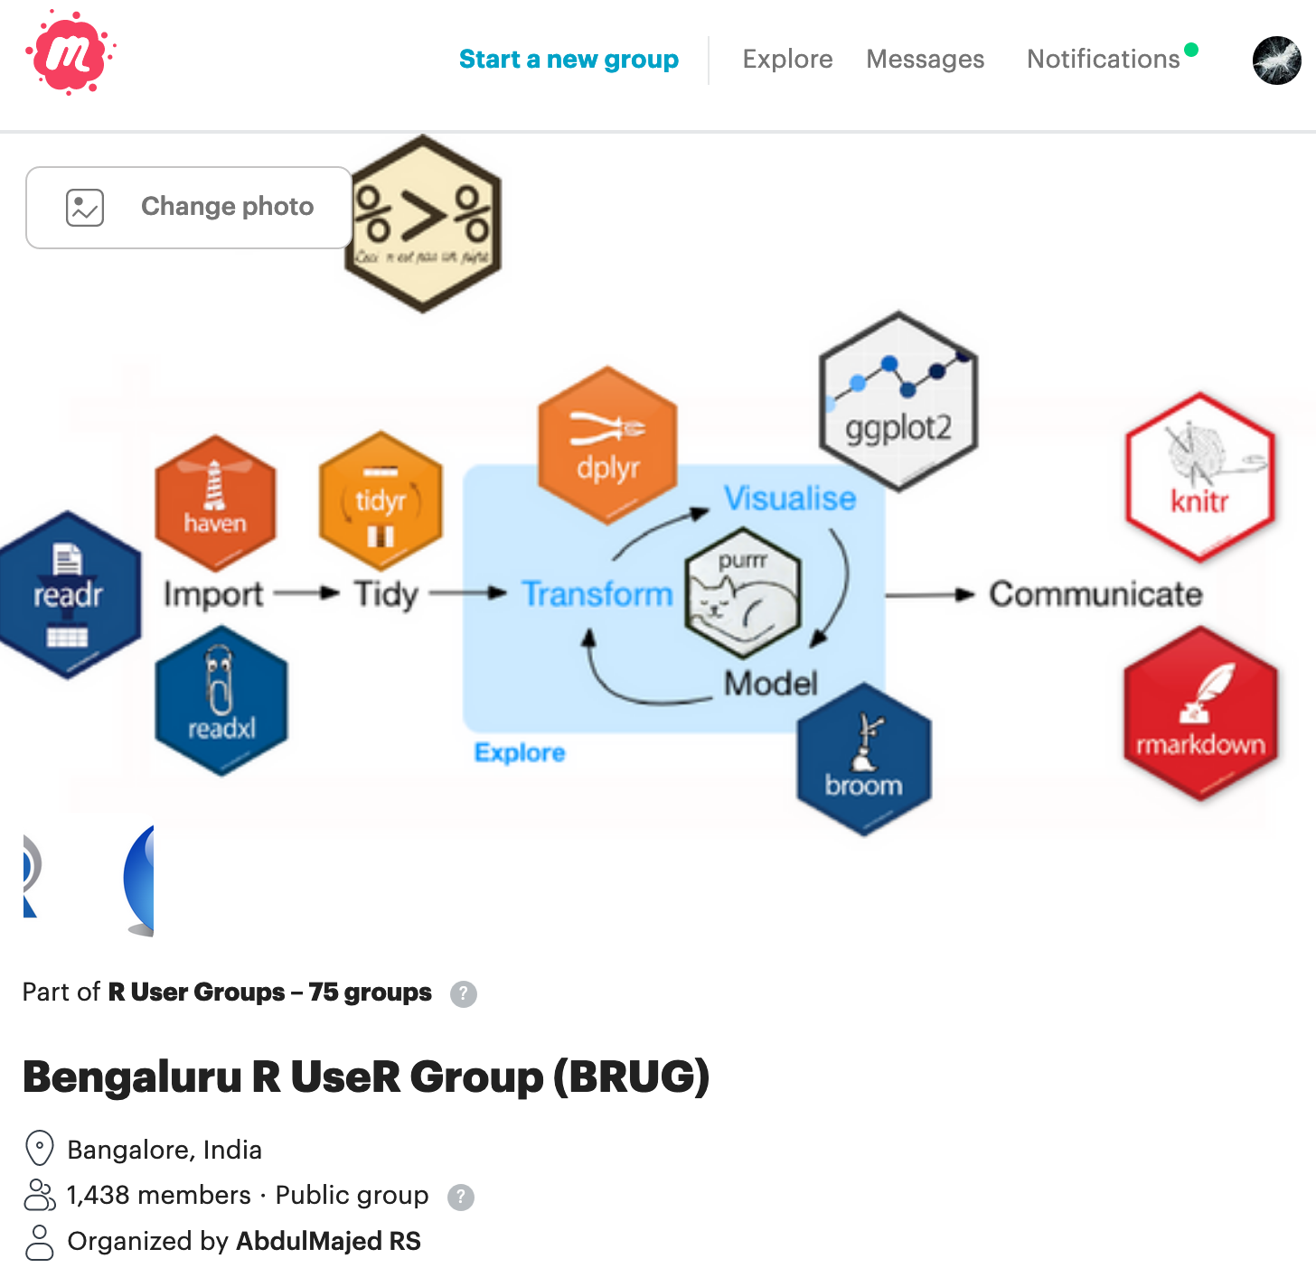

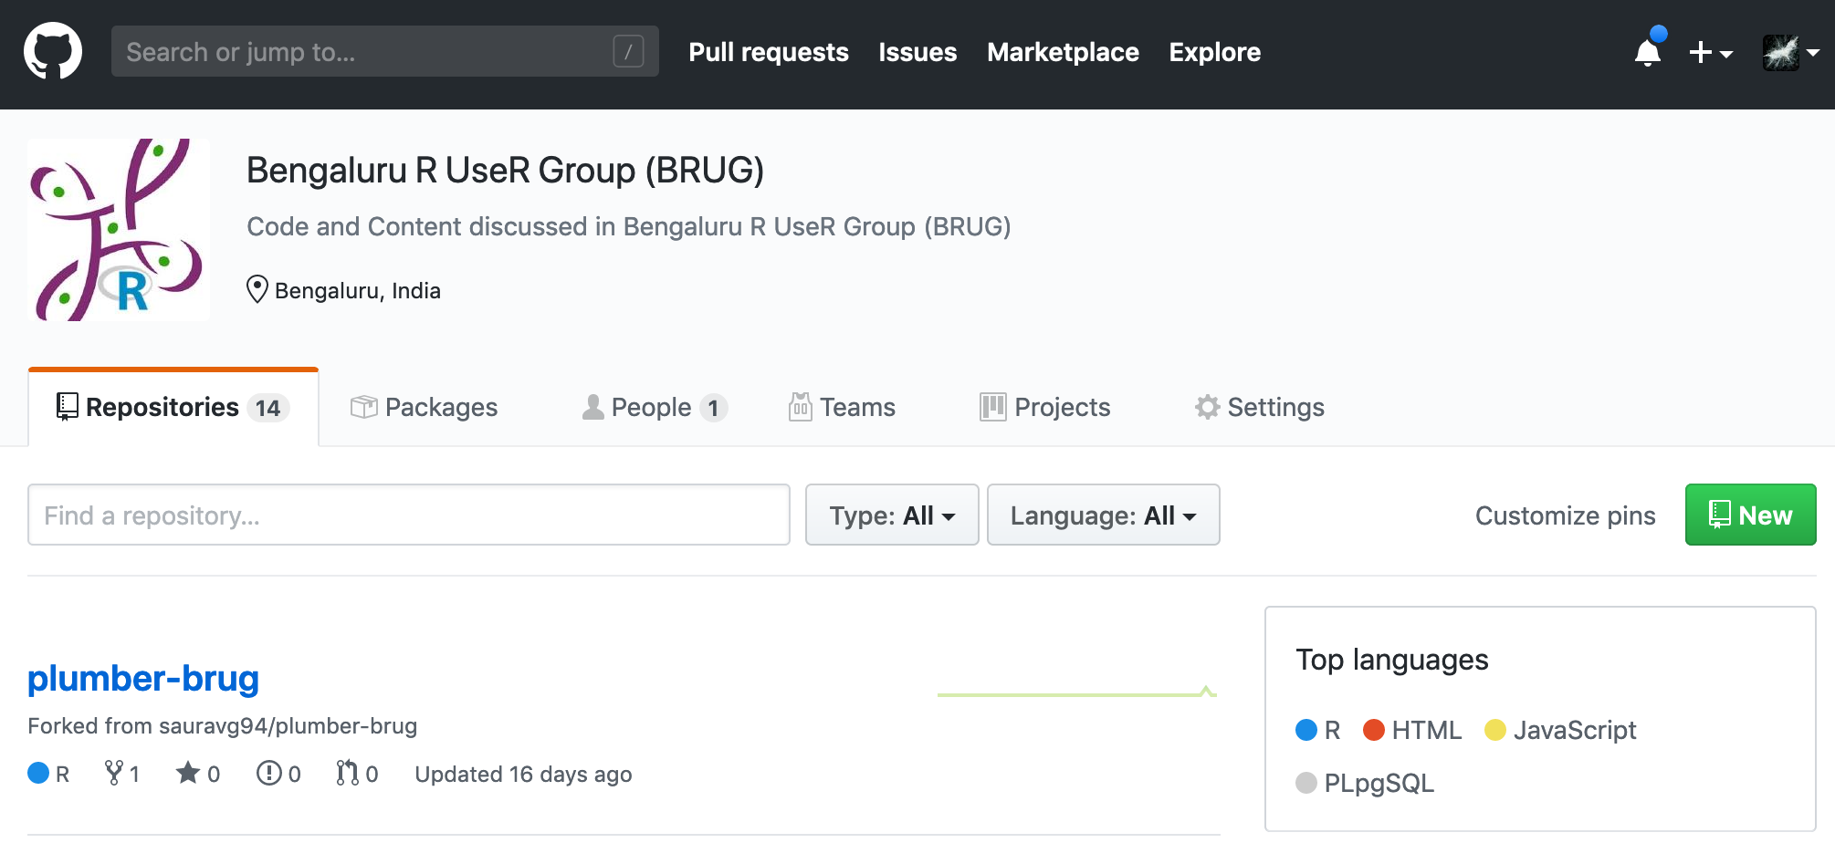


Bengaluru R useR Group (BRUG)
Sponsors
Activities
Monthly Meetups
Community Building
Mentorship and Guidance
Beginners Assistance
Open Source Contribution
Open Source Programming
Data Science
Machine Learning
Analytics

