Slide 1
Human Activity Recognition
Project Mentor:
Dr.A.Meena Kowshalya M.E.,Ph.D
Project Team:
R.S.Ahamed Musthafa(1517103)
M.Elavarasan(1517L02)
A.V.Mervin(1517125)
M.Ragul(1517138)

Slide 2
Abstract
Recognizing human activities from temporal streams of sensory data observations is a very important task on a wide variety of applications in context recognition. Especially for time- series sensory data, a method that takes into account the inherent sequential characteristics of the data is needed.
Moreover, activities are hierarchical in nature, in as much that complex activities can be decomposed to a number of simpler ones.
In this paper, we propose a two-stage continuous hidden Markov model (CHMM) approach for the task of activity recognition using accelerometer and gyroscope sensory data gathered from a smartphone.

Slide 3
The proposed method consists of first-level CHMMs for coarse classification, which separates stationary and moving activities, and second-level CHMMs for fine classification, which classifies the data into their corresponding activity classes.
Random Forests (RF) variable importance measures are exploited to determine the optimal feature subsets for both coarse and fine classification.

Slide 4
Introduction
Random Forest is a classifier consisting of a collection of tree- structured classifiers, h(x, Θ_{k}), k=1, … , where {Θ_{k}} are independent, identically-distributed random vectors, and each tree casts a unit vote for the most popular class at input x.
The random subspace selection method has been proven to perform better than bagging alone when there are many redundant features present .
The method also gives useful internal estimates of error, strength, correlation, and variable importance.

Slide 5
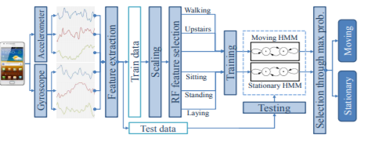
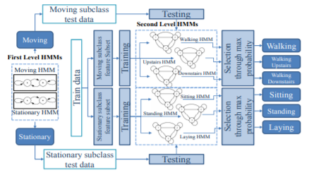

Slide 6

Formulae
RF variable importance:
Using the Variable importance values, the less important features are removed from the dataset before fitting it to the CHMM model.
The variable importance is calculated using Out-of-Bag error (errOOB) of Random Forest which makes the accuracy of this algorithm more similar for both train and test dataset.

Slide 7
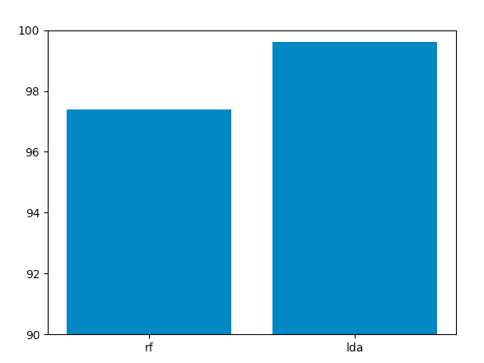
Visualization
RF vs LDA

Slide 8
Application
To monitor sedentary lifestyle of humans in today's world.
To be health conscious for healthy life. And it can be helpful for physicians.
Integrated with web application and are used in hospitals.

Slide 9
Literature Survey
Title | Author | Advantages | Disadvantages | Techniques
Towards Physical Activity Recognition Using Smartphone Sensors | M. Shoaib, H. Scholten, and P. J. M. Havinga | Only 50 samples per second is enough to recognize human activities | Magnetometer’s raw data does not help the recognition process. | Sliding window Naive Bayes, KNN(Weka)
A Public Domain Dataset for Human Activity Recognition Using Smartphones | D. Anguita, A. Ghio, L. Oneto, X. Parra, and J. L. Reyes-Ortiz | Only 20hz Frequency is enough for getting 99% energy. | Misclassification overlaps for non-dynamic actions | Support Vector Machines

Slide 10
Literature Survey
Title | Author | Advantages | Disadvantages | Techniques
Human Activity Recognition Using Accelerometer and Gyroscope Sensors | Warren Triston D’souza1, Kavitha R | RF classifier gives higher Accuracy | Take more time to recognise the activity. | RF, KNN, SVM
Human activity recognition using smartphone sensors with two-stage continuous hidden Markov models | Charissa Ann Ronao, Sung-Bae Cho | CHMM of two stages performs subclass (stationary and moving) classification | Improvement of accuracy required for the model. | RF, CHMM

Slide 11
Implementation

Slide 12
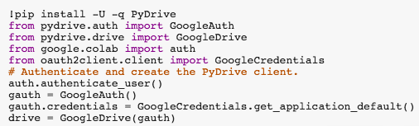
IMPORTING PACKAGES AND AUTHENTICATI0N
The above code snippet is to create authenticated connection with google drive. Using the google drive credentials only this connection can be established.

Slide 13
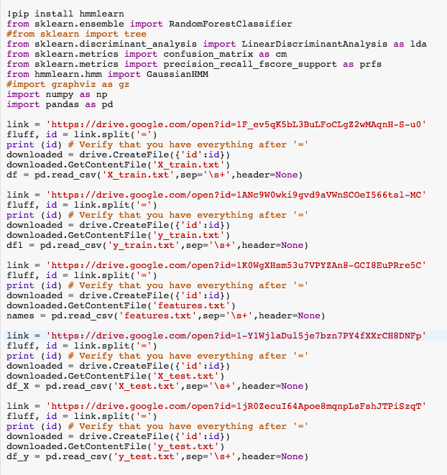
LOADING PACKAGES AND DATASET
Importing python libraries necessary for performing machine learning model predictions
Loading the Train and Test dataset from the google drive using the authenticated connection established

Slide 14
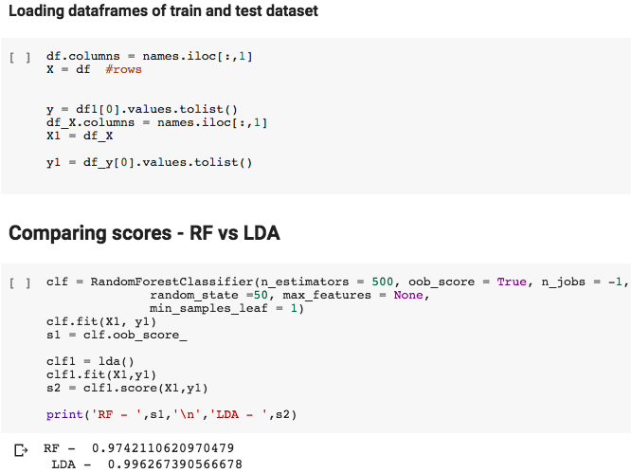

Slide 15
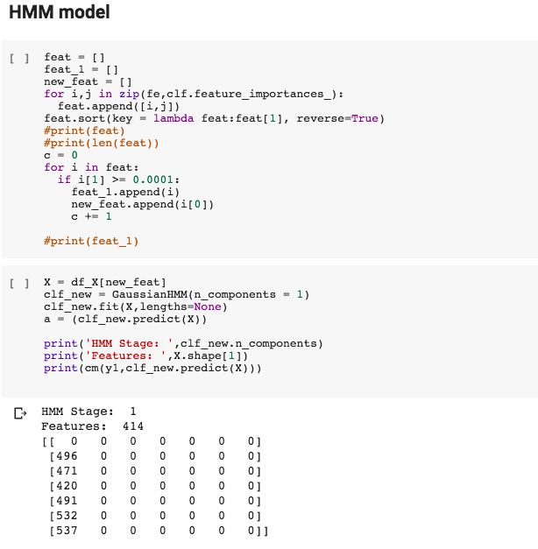
Obtain the variable importance values and then match it with the corresponding feature names
Select the features that have feature importance value more than 0.0001
Create a dataframe with new set of features and then fit it to the Gaussian HMM one-stage model

Slide 16
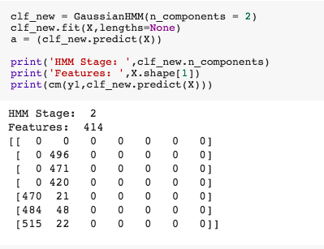
Fit the dataframe into the two-stage Gaussian HMM model and then print the respective confusion matrix
Overall accuracy is above 95% using this two-stage HMM model

Slide 17
Thank You
Queries?

