Slide 1
Final Project Bluetooth Based Smart Home
Group: F20
Name: Amr Hatem Semeda

Slide 2
Introduction
Project consists of 2 microcontrollers, the first MC receives data from a Bluetooth device using a Bluetooth module by means of UART communication, and transfers the data to another MC using SPI communication. According to the data being sent actuators behave accordingly.

Slide 3
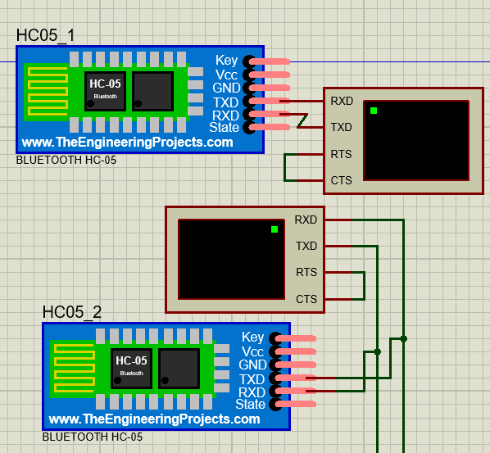
Bluetooth Modules Communication
We have 2 virtual terminals each terminal is connected to a Bluetooth module. Bluetooth module 1 “HC05_1” sends the data from its virtual terminal to Bluetooth module 2 “HC05_2”

Slide 4
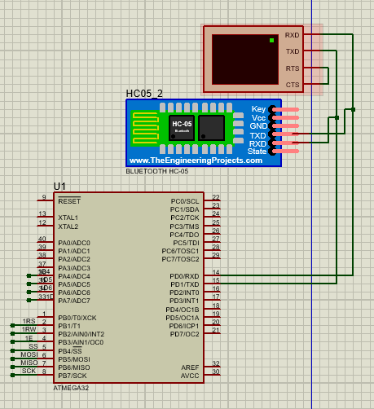
UART
Bluetooth module 2 “HC05_2” passes the data to the first ATMEGA32 microcontroller through UART peripheral.

Slide 5
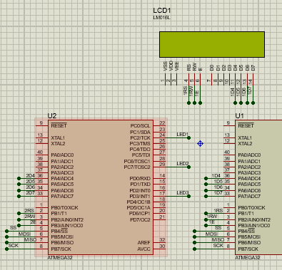
SPI
The first microcontroller sends the data to the second microcontroller through SPI protocol, and the data being sent is also displayed on LCD1

Slide 6
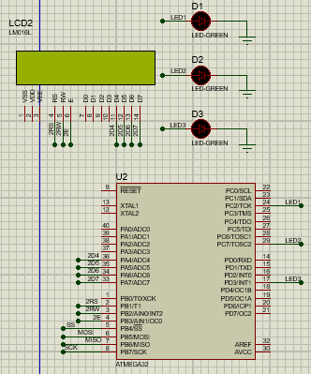
Actuators
Microcontroller 2, processes the data, and according to the programmed logic, activates the LEDs ➔ LED0, LED1, LED2.
If data sent is equal to 0, then LED0 toggles and LCD displays “LED 0”
If data sent is equal to 1, then LED1 toggles and LCD displays “LED 1”
If data sent is equal to 2, then LED2 toggles and LCD displays “LED 2”
If any other data is sent, the LCD displays: “Enter valid LED”

Slide 7
Thank You

