Slide 1


Medical Report Generation with Multi-Attention for Abnormal Keyword Description and History Report
(Maggie) Mei Wang Haihan Yao Yanxia Qin∗
Donghua University, Shanghai, China

Slide 2
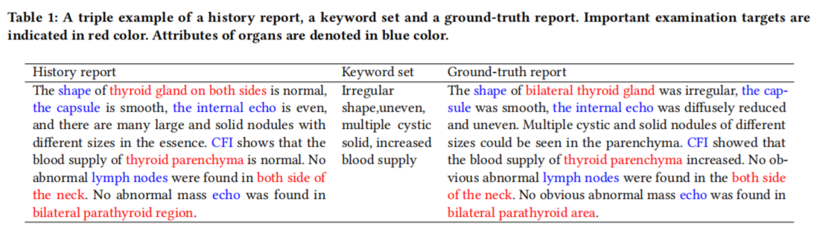
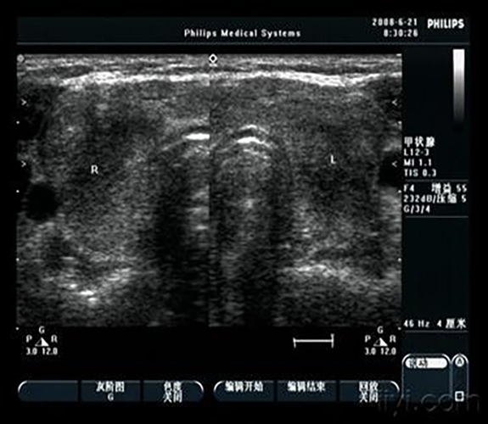
Motivation

Slide 3
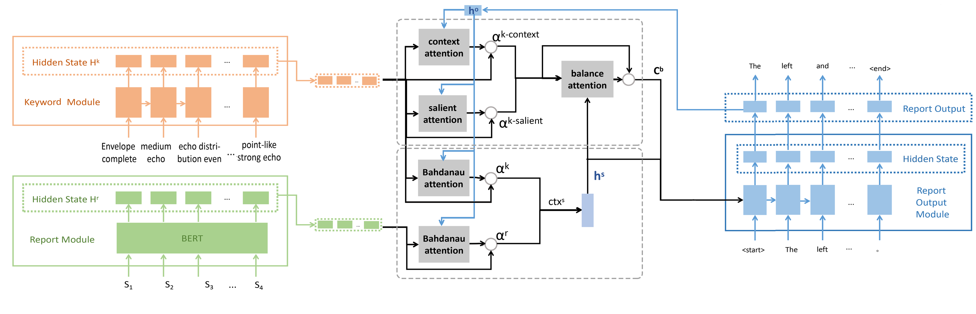
Our framework
Encoder layer
Attention layer
Decoder layer

Slide 4
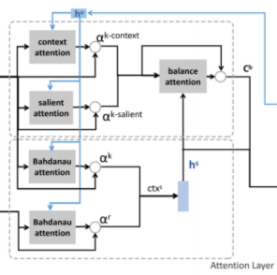


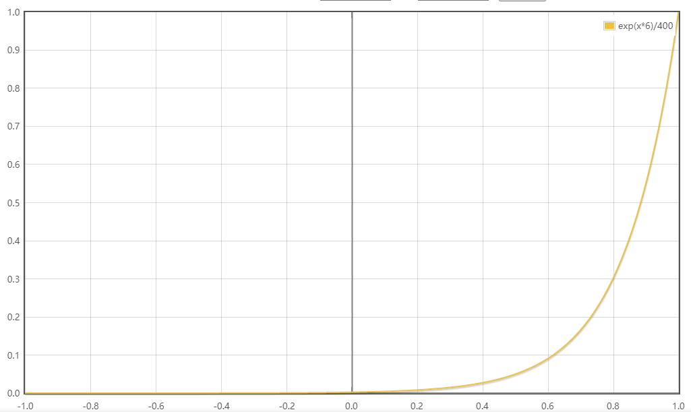
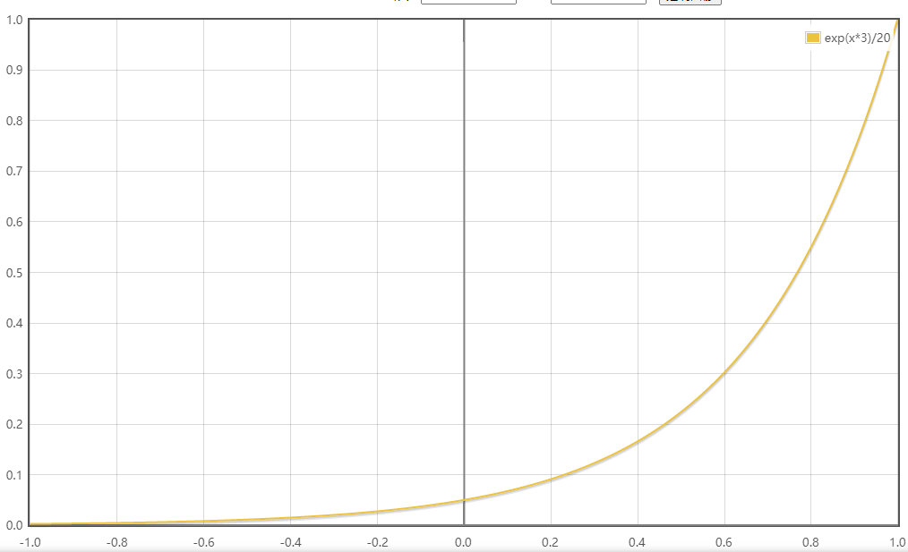
Attention layer
contextual information in the keyword list
balance the contextual and salient information
increase the salience of the keywords
sentence level information among history report
h^{k} : the hidden state of the keyword module
hº : the hidden state of the output report module
n=3 m=20
n=6 m=500

Slide 5

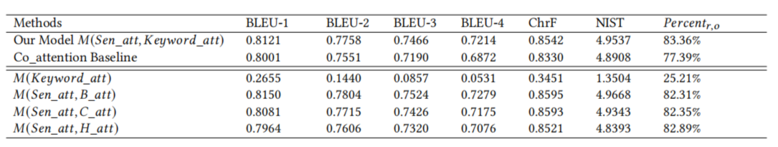
Experiment
Dataset: Practical ultrasound text dataset with 3000 samples.
Training set: 80%; test set: 20%.
Evaluation Metrics：the percentage of appeared keywords in target report to measure the accuracy of the generated report.
Baseline:
Co_attention: two simple attentions for the keyword list and word level history report.
M(Keyword_att) : without the attention for sentence-level embedding
M(Sen_att, B_att) : replace the proposed keyword attention component with single Bahdanau Attention
M(Sen_att, C_att) : replace the proposed keyword attention component with single Content base Attention
M(Sen_att, H_att) : replace the proposed keyword attention component with single Highlight Attention

Slide 6
Experiment
Dataset: Practical ultrasound text dataset with 3000 samples.
Training set: 80%; test set: 20%.
Evaluation Metrics：the percentage of appeared keywords in target report to measure the accuracy of the generated report.
Baseline:
Co_attention: two simple attentions for the keyword list and word level history report.
M(Keyword_att) : without the attention for sentence-level embedding
M(Sen_att, B_att) : replace the proposed keyword attention component with single Bahdanau Attention
M(Sen_att, C_att) : replace the proposed keyword attention component with single Content base Attention
M(Sen_att, H_att) : replace the proposed keyword attention component with single Highlight Attention

Slide 7
Experiment
Dataset: Practical ultrasound text dataset with 3000 samples.
Training set: 80%; test set: 20%.
Evaluation Metrics：the percentage of appeared keywords in target report to measure the accuracy of the generated report.
Baseline:
Co_attention: two simple attentions for the keyword list and word level history report.
M(Keyword_att) : without the attention for sentence-level embedding
M(Sen_att, B_att) : replace the proposed keyword attention component with single Bahdanau Attention
M(Sen_att, C_att) : replace the proposed keyword attention component with single Content base Attention
M(Sen_att, H_att) : replace the proposed keyword attention component with single Highlight Attention

Slide 8
Thanks for your listening
Mei Wang Haihan Yao Yanxia Qin∗
Donghua University, Shanghai, China

