Slide 1
Text Analysis via Binomial Tails
Omid Madani, Cisco
omadani@cisco.com

Slide 2

Motivation
Tfidf term weighting (importance of terms to documents, and vice versa) and cosine similarity (among documents) are simple and very useful..
But lack probabilistic semantics
There is research on justifying tfidf, e.g. based on information theoretic grounds
It would be great to get well-understood probabilities (pvalues, confidences), but also efficiently!
Avoid expensive simulations and counting
Ideally as simple and efficient as computing say tfidf!
This talk: binomial tails are a good candidate for providing probabilities/confidences!
on tfidf: K. S. Jones. 1972. A Statistical Interpretation of Term Specificity and Its Application in Retrieval. Journal of Documentation (1972).
justification: A. Aizawa. 2003. An information-theoretic perspective of tfidf measures. Information Processing and Management (2003).
Notes:
tfidf: K. S. Jones. 1972. A Statistical Interpretation of Term Specificity and Its Application in Retrieval. Journal of Documentation (1972).
A. Aizawa. 2003. An information-theoretic perspective of tfidf measures. Information Processing and Management (2003).
Take the case of cosine: although the values are in 0 and 1 (or -1 and 1 when we have negative vector values), there is no interpretation to
these scores or their spread. It’s hard to pick a threshold: corpus dependent
and more trial and error is (probably) required (compared to having probabilities) ….

Slide 3
Potential Benefits of Probabilities
Well understood/uniform semantics, automatically adjusting to corpus (size) characteristics (eg we’ll see application to co-occurrence discovery)
Easier thresholding (filtering), or ranking
For human in the loop computing, eg. ranking and color coding results, in terms of confidence, in the UI (eg ranking candidate communities in social network analysis)
Decision theoretic actions: probabilities required for computing expectations, utilities, etc.
Improved downstream tasks (e.g. better representations or improved topological similarity spaces for clustering and supervised learning, improved embedding/dimensionality reduction)
O.Madani, T.Ngo, W.Zeng, S.Averin,S.Evuru,V.Malhotra, S.Gandham, and N. Yadav. 2020. Binomial Tails for Community Analysis.
Notes:
On the application to community mining in social graph, in particular ranking and confidence assignment to returned results:
O.Madani, T.Ngo, W.Zeng, S.Averin,S.Evuru,V.Malhotra, S.Gandham, and N. Yadav. 2020. Binomial Tails for Community Analysis.
- For term weighting, we can easier pick a threshold eg for dropping insignificant terms..
- Take the case of cosine: although the values are in 0 and 1 (or -1 and 1 when we have negative vector values), there is no interpretation to
these scores or their spread. It’s hard to pick a threshold: corpus dependent
and more trial and error is (probably) required (compared to having probabilities) ….

Slide 4
This Talk
The binomial tail:
Formulation
Approximation & properties
We reduce several text analysis tasks to the tail:
Phrase discovery or significance of co-occurrences
Document representation or term weighting in documents
And a slide on probabilistic similarity (stretching the use of binomial tail!)
Binomial tail belongs to the analyst’s (or dataminer’s) toolbox!

Slide 5
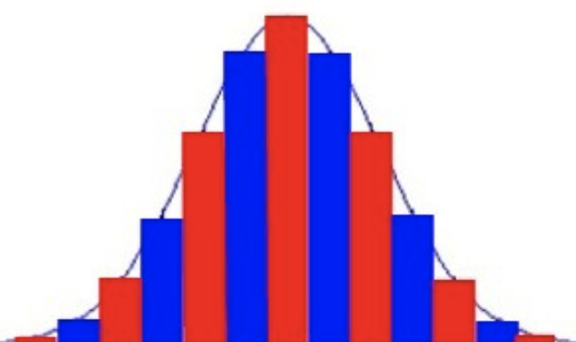
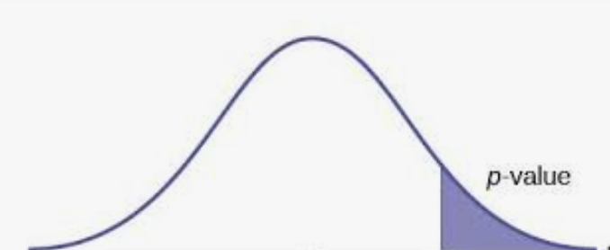
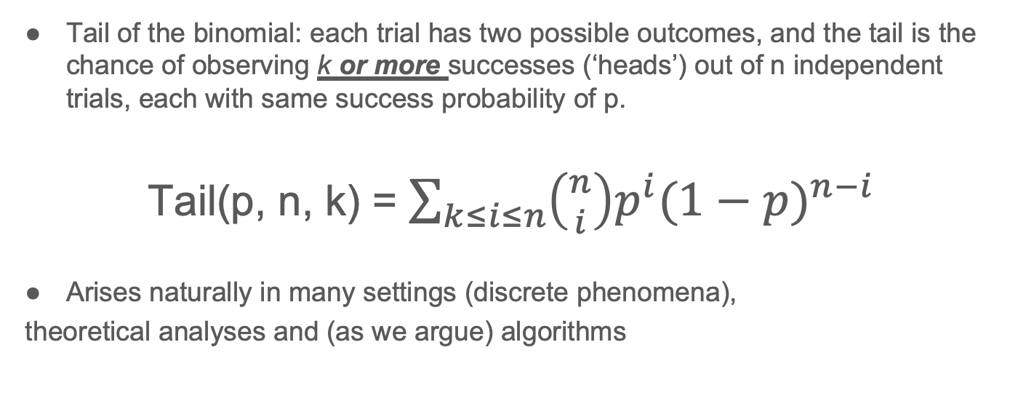
The Binomial Tail
Tail of the binomial: each trial has two possible outcomes, and the tail is the chance of observing k or more successes (‘heads’) out of n independent trials, each with same success probability of p.
Tail(p, n, k) = $\sum_{k≤i≤n}{\left({n \atop i}\right)p^{i}{(1−p)}^{n−i} }$
Arises naturally in many settings (discrete phenomena),
theoretical analyses and (as we argue) algorithms
tail

Slide 6
Semantics and Scoring Options
Semantics:
Why use tail: conservative (point-estimate or a sub-range would be arbitrary)
Tail score relatives we use (e.g. as feature weights):
Tail (probabilities or pvalues), eg: 0.1, 0.05, 0.01, 0.001, … (the lower the ‘better’ or more significant)
Confidences (significances): 90%, 95%, 99%, 99.9%, 99.99%, ….
Binomial significance score, ie negative log(tail): 0, 1, 2, 3, … (log base 10, or 2, etc,) (higher is ‘better’)
The lower the tail (0.01, 0.001..), the higher the significance score or our confidence (99%, 99.9%) that the observed phenomena (e.g. term co-occurrence, density of a subgraph, etc.) is not generated by chance (by the given random binomial model).
Notes:
- in ‘not generated by chance’, to be precise, ‘chance’ means a specific (‘background’) binomial model. Another binomial model (with a higher p) could have
generated the observation! (eg. in the co-occurrence application, we are looking for pairs whose ‘binomial model’ has a much higher
‘p’ than the the prior)
- Why use a ‘tail’ ? (vs a point-estimate, or a sub-interval, etc) A point estimate or subinterval could be arbitrary. The tail is
a good conservative measure for deriving confidence and a basis for p-values.
- note: For ranking, whether we take log or make percentage, etc. doesn’t matter, but for embedding, vector representation, etc., the actual
values matter

Slide 7
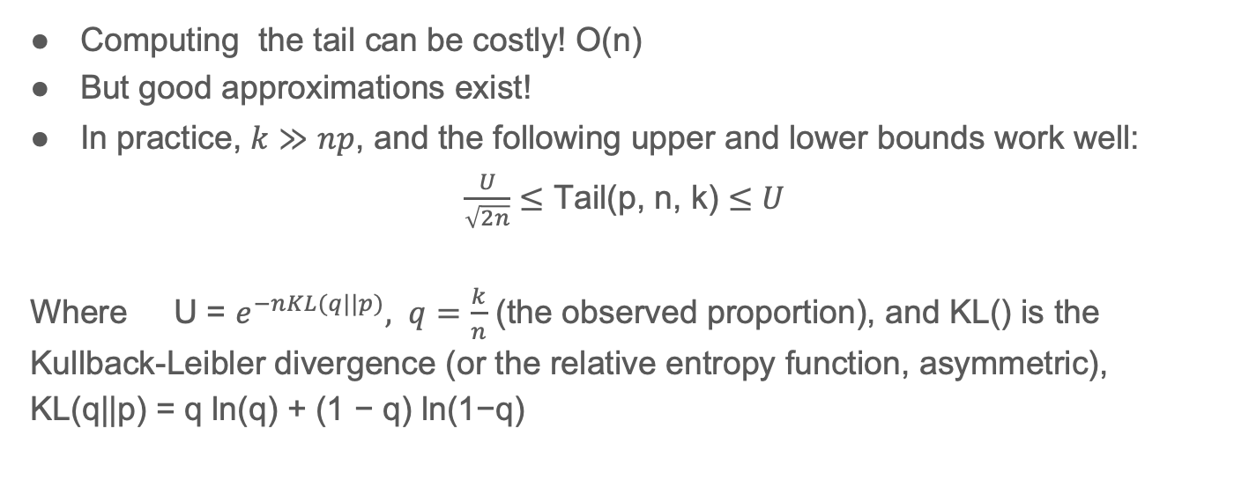
Approximating the Tail
Computing the tail can be costly! O(n)
But good approximations exist!
In practice, $k≫np$, and the following upper and lower bounds work well:
$\frac{U}{\sqrt{2n}}≤$ Tail(p, n, k) $≤U$
Where U = $e^{−nKL(q||p)}, q=\frac{k}{n}$ (the observed proportion), and KL() is the Kullback-Leibler divergence (or the relative entropy function, asymmetric), KL(q||p) = q ln(q) + (1 − q) ln(1−q)
k … n
Notes:
- We may need to compute the tail for many items, and n can be in the 1000s to millions and beyond, k can be relatively small, k << n, p can be tiny, numeric (floating point) and efficiency issues …
- note q=k/n is the observed proportion and the log ratio q/p we call
intensity. and that measure is also useful: it appears in the KL
divergence and is useful for direct use (scoring or weighting) in some
applications too.
- we also note that in a few special cases (eg when n is small, say below 20), we can and should use the
exact formulation and/or use Sterling's approximation.
Other approximations, eg normal (binomial can look like normal) , exist, but for tiny probabilities p this is best (note: in special cases, we can compute exact or use Sterling’s for factorial, etc ) (see below for several citations)
KL(q||p ) is how much the observed q diverges from our expectation or model, p
Approximation accuracies within 10% and rapidly gets better with n, etc…
From wikipedia: The Kullback–Leibler divergence is then interpreted as the average difference of the number of bits required for encoding samples of {\displaystyle P} using a code optimized for {\displaystyle Q} rather than one optimized for {\displaystyle P}.
R. Arratia and L. Gordon. 1989. Tutorial on large deviations for the binomial distribution. Bulletin of Mathematical Biology 51 (1989), 125–131.
R. B. Ash. 1990. Information Theory. Dover Publications. 115 pages.
The lower bound multiplier could also be $\frac{1}{\sqrt{8k(1−\frac{k}{n})}}$ (which is better), np < k < n, instead of 1/$\sqrt{2n}$ (we can take the max, but this lower bound is always better)
The two below provide an upper and lower bound of a different kind (no KL divergence, binomial coefficients):
J.P. Schmidt, A. Siegel, A. Srinivasan, Chernoff-Hoeffding bounds for applications with limited independence,
SIAM Journal on Discrete Mathematics 8 (2) (1995) 223–250.
Lower bounds on binomial and Poisson tails, Christos Pelekis, 2017
(has a lower bound in terms of binomial coefficients ( ie ‘n choose k’, vs KL), and the
upper bound of similar form was derived before by Schmidt, Siegel above:
Tail(p, n, k) $≤p^{l}\left({n \atop l}\right)\left({l \atop k}\right)$, where $l=\left\lceil \frac{k−np}{1−p}\right\rceil$ and assuming k>np (or q>p) ( ”factorial moment” approach )
${0.5p}^{2(l+1)}\left({n \atop l+1}\right)/\left({k \atop l+1}\right)$ $≤$Tail(p, n, k), where $l=$ $\left\lfloor \frac{k−np}{1−p}\right\rfloor$ (we assume, n > k > np) ( proof via tail conditional expectation by Pelekis )

Slide 8
Notes on the Tail and Approximation
We use average of the upper and lower bounds (or scores)
Approximation quality improves with increasing n and intensity log(q / p)
Relative error in score, (upper-lower) / lower, is below 10% for n > 50 and KL > 0.5 (more details in Madani et. al. 2020)
Although intensity is a component of the (approximate) tail, in some applications we may want to use intensity directly (after thresholding on the tail, ie significance) (ie use the tail in combination with intensity)
Options: We can query the tail formula with different p (not just the prior/expected p, but with, say, multiples of the prior)
Notes:
For more details: O.Madani,T.Ngo,W.Zeng,S.Averin,S.Evuru,V.Malhotra,S.Gandham, and N. Yadav. 2020. Binomial
Tails for Community Analysis.
The approximation quality (the gap or relative error) improves with (increasing) n as long as KL is fixed, and with increasing KL as long as n is fixed.
(note: assuming q > p). (note: for a fixed intensity q/p, as p goes down, KL goes down too, so approximation quality can go down as p goes
down… )
Note: since we have both upper and a lower bound (and they are pretty good!), we can also assess how far we are from the exact tail (we have a bound on how far we are)
At some point, if we have sufficient confidence, eg 99.9% and higher, binomial tail may lose additional utility, and intensity maybe more
useful depending on the task.

Slide 9
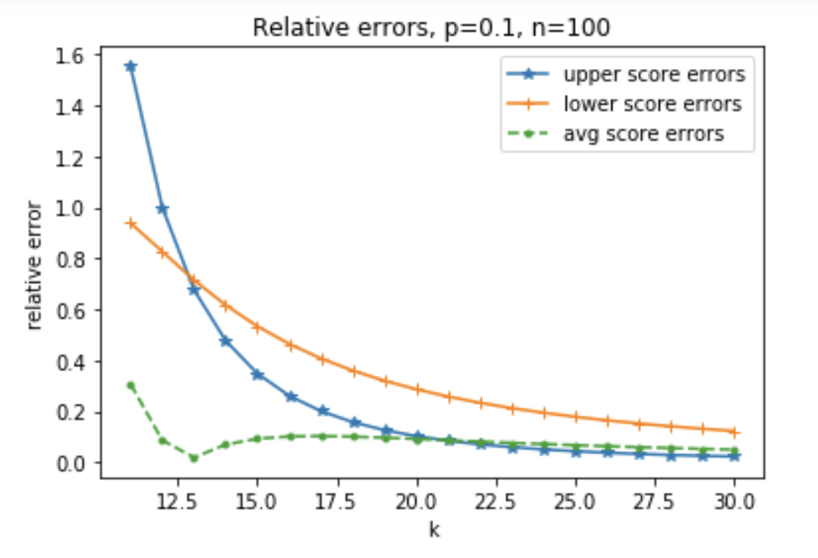
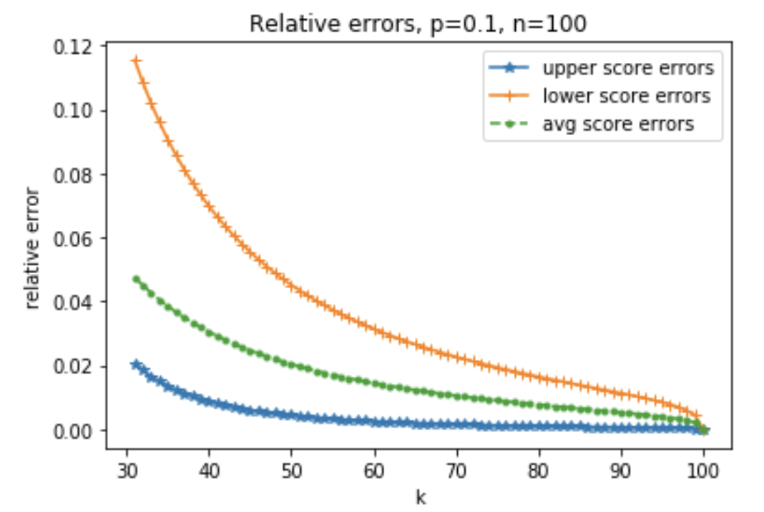
Relative Errors of Upper and Lower Scores
Relative error := | exact tail – approx. | / exact tail
For n=100, p=0.1, k > np. As k increases, error reduces, and the average of upper
and lower bound can be better (e.g., relative error below 5% for k > 30).

Slide 10
Applications (to Text)
Notes:
Now for a couple of applications in text!

Slide 11
Co-Occurrence Analysis
There is a variety of co-occurrences, eg context window can be the whole document, or one paragraph, or one word, one-sided or both sides, etc.
We explore one-sided immediate co-locations here: “word1 word2” ( “w1 w2”, eg “new york”)
co-occurrence analysis has applications in phrase or concept discovery (in text and beyond), term expansion (IR), sparse sense representations, discovery of relations among terms, topic discovery, ...
Existing techniques: variants of pointwise mutual information (PMI), chi-squared test, ..
PMI, P(w2|w1)/P(w2), very sensitive to low counts (does not incorporate statistical support)
C. D. Manning and H. Schutze. 1999. Foundations of statistical natural language processing. Cambridge University Press.
F. Role and M. Nadif. 2011. Handling the Impact of Low Frequency Events on Co-occurrence based Measures of Word Similarity - A Case Study of Pointwise Mutual Information. In International Conference on Knowledge Discovery and Information Retrieval (KDIR).
A recent application: S. Mittal A.t A. Mahabal, D. Roth. 2018. Robust Handling of Polysemy via Sparse Representations. In Seventh Joint Conference on Lexical and Computational Semantics.
Notes:
For this task, the pointwise mutual information and its variants are popular. But that's sensitive to low counts.
C. D. Manning and H. Schutze. 1999. Foundations of statistical natural language processing. Cambridge University Press.
F. Role and M. Nadif. 2011. Handling the Impact of Low Frequency Events on Co-occurrence based Measures of Word Similarity - A Case Study of Pointwise Mutual Information. In International Conference on Knowledge Discovery and Information Retrieval (KDIR).
Recent application: S. Mittal A.t A. Mahabal, D. Roth. 2018. Robust Handling of Polysemy via Sparse Representations. In Seventh Joint Conference on Lexical and Computational
Semantics.

Slide 12
Binomials for Phrase Discovery
Binomial tail, incorporates statistical support.. rank terms by:
how confident that (in the corpus) word w2 occurs after w1 higher than prior(w2), or
Tail( prior(w2), F(w1), F(w2, w1) )
We look at statistics of top terms ranked by pmi and its variants, as well as the binomial, and how similar the top ranked are
p is the prior of w2
n or count of times w1 occurs in corpus
k or count of times w2 occurs after w1 in corpus

Slide 13
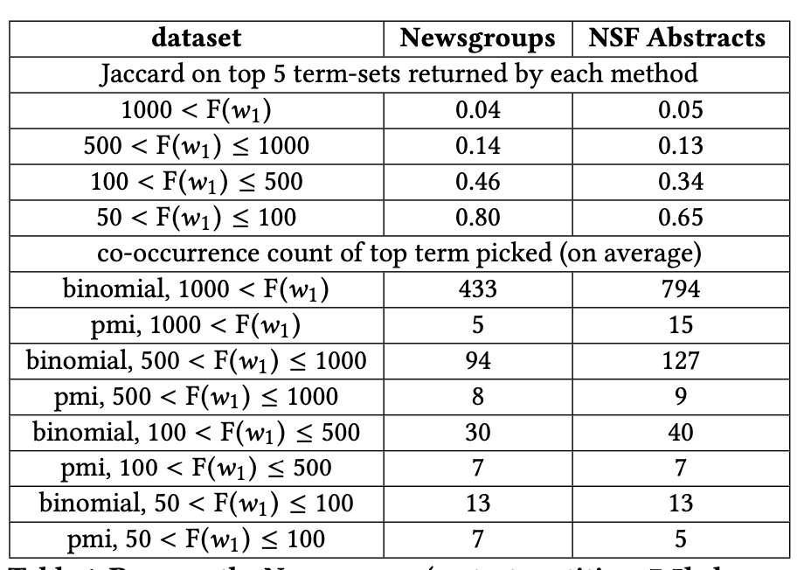
The similarity between pmi and binomial tail ranking decreases as freq. of w1 goes up
Binomial tail ranking diverges from pmi as F(w1) increases. Much more robust against low counts and finds good co-terms for frequent terms as well.
Jacard between top 5 term-sets returned by binomial tail and pmi
co-counts of top returned much higher for binomial than pmi
Notes:
Other issues:
Burstiness of text …
NSF abstracts from: D. Dua and C. Graff. 2017. UCI Machine Learning Repository. http://archive.ics.uci.edu/ml

Slide 14
Examples for “role”
Top ranked by binomial tail:
tail score | pmi | phrase | F(w2,w1) | F(w2)
5304 | 1.0 | role of | 7455 | 115572
3518 | 1.1 | role in | 4518 | 527997
397 | 2.5 | role played | 195 | 1035
211 | 1.2 | role models | 273 | 28343
136 | 0.6 | role that | 454 | 166174
Top ranked by pmi^2:
pmi^2 | pmi | phrase | F(w2,w1) | F(w2)
-2.5 | 1.0 | role of | 7455 | 115572
-2.6 | 1.1 | role in | 4518 | 527997
-2.6 | 2.5 | role played | 195 | 1035
-3.8 | 1.2 | role models | 273 | 28343
-3.9 | 3.2 | role misocyclone | 2 | 2
Top ranked by pmi:
tail score | pmi | phrase | F(w2,w1) | F(w2)
6.6 | 3.2 | role misocyclone | 2 | 2
6.6 | 3.2 | role Dike | 2 | 2
6.3 | 3.0 | role Tough | 2 | 3
6.0 | 1.2 | role MDN | 2 | 4
9.7 | 0.6 | role inthe | 4 | 16
pmi^3 on "role": "of"(-6),"in"(-6.3),"played","models","that"
Notes:
Examples from NSF abstracts
pmi^k, raise numerator to power k: p(w1, w2)^k / (p(w1) p(w2)) to make it more biased toward higher frequency co-occurrences..
pmi^2 and pmi^3 seem to do better, but scores not interprettable, and still there can be issues with low counts..

Slide 15
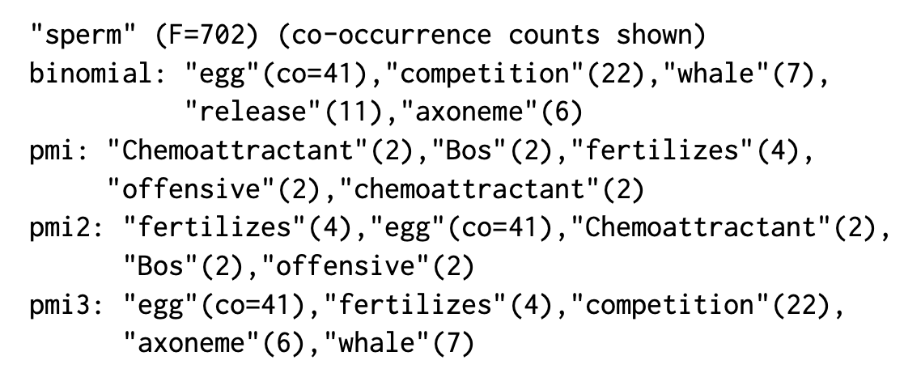
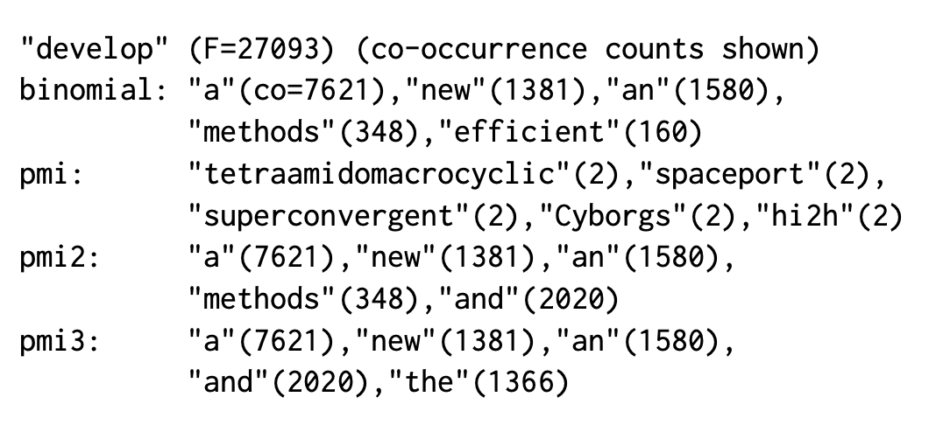
Other Co-Occur Examples
Notes:
After a certain high confidence (tail score), perhaps the tail is not informative any more (‘intensity’ or measures like it could be better)?

Slide 16
Summary Observations
As the frequency of w1 goes up (100s to 1000s in our datasets), the binomial tail grows more different from pmi and its variants
And it ranks better terms (with higher co-occurrences) on top to discover common phrases such as ‘what if’ and “as soon as”
Binomial is more robust
Note: the binomial can be ‘queried’ with any prior/probability
Notes:
Similarity of binomial to pmi variants:
With j = 2 or 3, the top-ranked get closer to binomial, but still significantly different: average Jaccard similarities on most frequent (> 1000) to less frequent
terms (100 to 500) range go from 0.3, to 0.5 between binomial and pmi2, and from 0.7 to 0.6 between binomial and pmi3, and the pmi variants
continue to rank somewhat smaller co-occurrences on top.

Slide 17
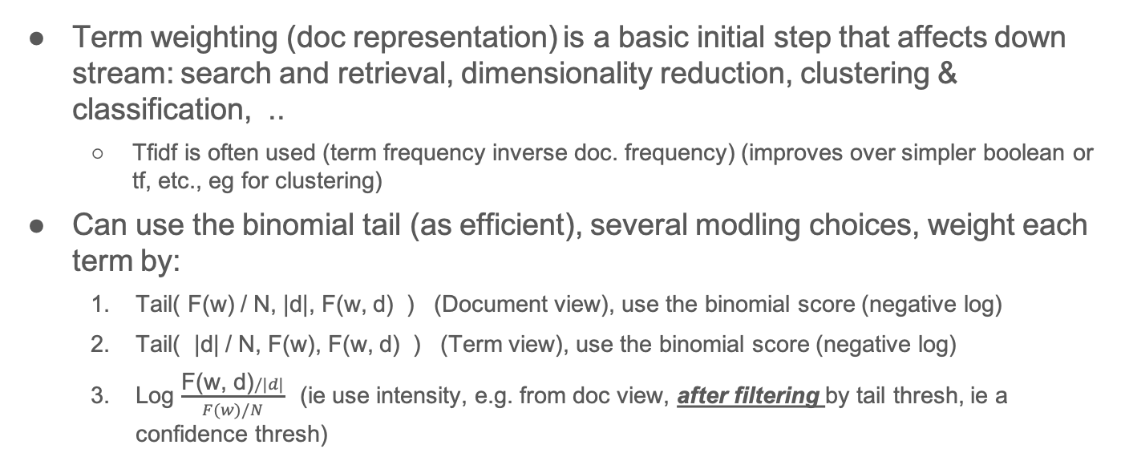
Term Weighting (Document Representation)
Term weighting (doc representation) is a basic initial step that affects down stream: search and retrieval, dimensionality reduction, clustering & classification, ..
Tfidf is often used (term frequency inverse doc. frequency) (improves over simpler boolean or tf, etc., eg for clustering)
Can use the binomial tail (as efficient), several modling choices, weight each term by:
Tail( F(w) / N, |d|, F(w, d) ) (Document view), use the binomial score (negative log)
Tail( |d| / N, F(w), F(w, d) ) (Term view), use the binomial score (negative log)
Log $\frac{\text{F}\text{(}\text{w}\text{, }\text{d}\text{)}/|d|}{F(w)/N}$(ie use intensity, e.g. from doc view, after filtering by tail thresh, ie a confidence thresh)
Notes:
These work best when terms frequencies, inside a document, are more than 1 (long documents).. Still, they (the weights) do take document size and the term’s corpus freq. into account. ….

Slide 18
Term Weighting Observations
Average number of unique terms left per document after thresholding the
binomial significance scores (0=no threshold, 1 = 90% confidence, 2 = 99%, 3 = 99.9%)
Term weight (or binomial score) threshold → | 0 | 1 | 2 | 3
NSF Abstracts | 77 | 73 | 43 | 16
Newsgroups | 144 | 128 | 54 | 22
Above: a reasonable fraction of terms, per document, get dropped at ~99% confidence (~30% to 40% in above)
Another finding: Ranking terms in a document by tfidf or binomial are highly correlated (above Spearman Rank Corr. 0.95), less so with intensity (~0.90) (above datasets)..
Notes:
A reasonable fraction of terms, per document, actually get dropped at ~99% confidence interval. These are the terms
that are too frequent (‘stop’ words). (note the negative logs here are based 10, so pvalues of 0.1, 0.01, 0.001, …)

Slide 19
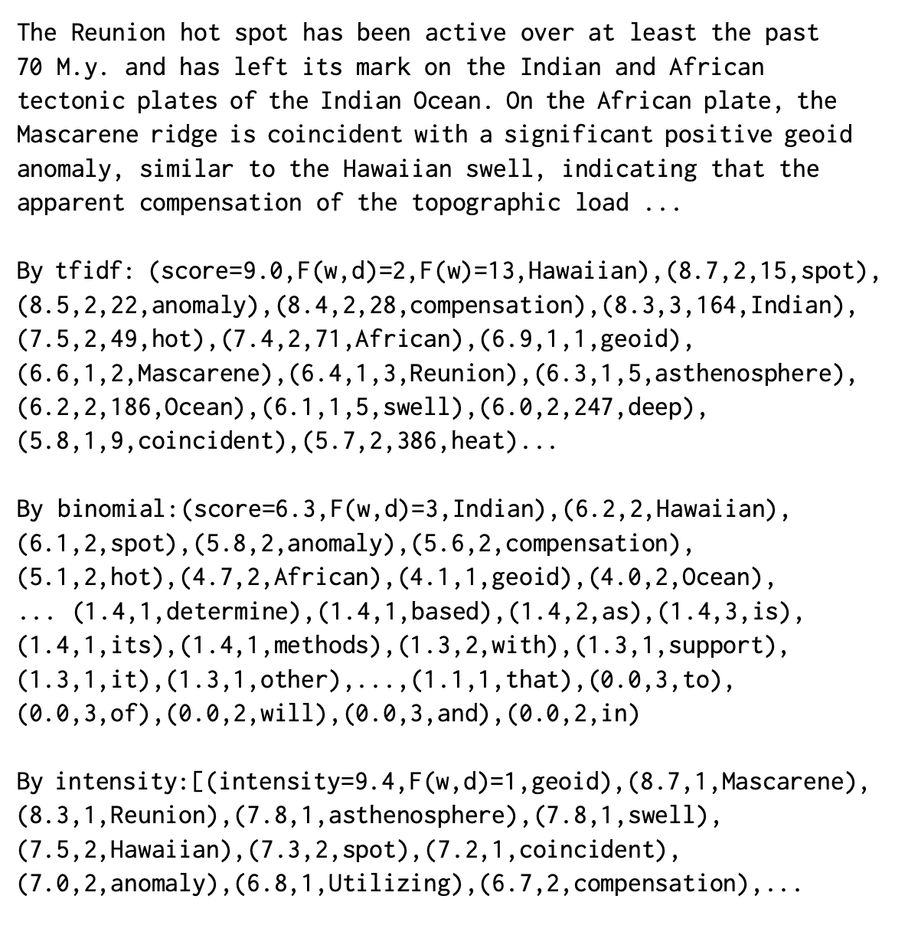
Example Paragraph (an NSF Abstract)

Slide 20
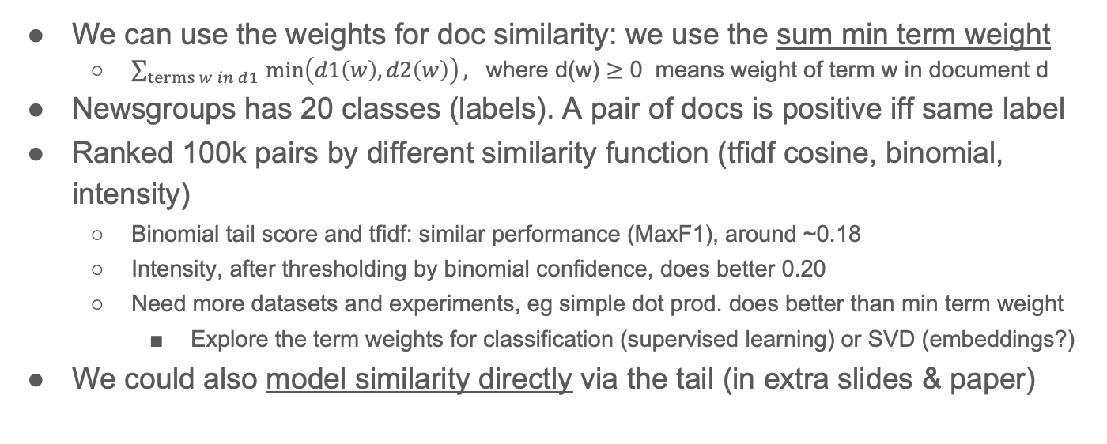
Document Similarity via Weights
We can use the weights for doc similarity: we use the sum min term weight
$\sum_{terms w in d1 }{\min\left(d1\left(w\right), d2\left(w\right)\right), }$ where d(w) $≥$ 0 means weight of term w in document d
Newsgroups has 20 classes (labels). A pair of docs is positive iff same label
Ranked 100k pairs by different similarity function (tfidf cosine, binomial, intensity)
Binomial tail score and tfidf: similar performance (MaxF1), around ~0.18
Intensity, after thresholding by binomial confidence, does better 0.20
Need more datasets and experiments, eg simple dot prod. does better than min term weight
Explore the term weights for classification (supervised learning) or SVD (embeddings?)
We could also model similarity directly via the tail (in extra slides & paper)
Notes:
Note there are of course limits to this evaluation: two docs can
be similar but have different labels and vice versa…
Another experiment would be to explore the representation for supervised learning experiments.

Slide 21
Three Main Takeaways!
Binomial tail arises in a lot of places (versatility)
Efficiently computable (well approximated)
The probabilities are beneficial! ( so the tail could replace or augment existing techniques)
➔ belongs to the toolbox
Applications: Filtering, Ranking, Labeling (confidence assignments), Representation, …
Future: develop further understanding (e.g. support vs intensity), variants (Poisson, multinomial,...), and, of course, applications
Notes:
In community analysis: We have used binomial tail in several (user-facing or front-end) tasks in community analysis (in computer/social networks): ranking discovered groups and assigning confidence, ranking/confidence for individual nodes’ memberships (‘binomial centrality’), prior work did it for the whole network partitioning, etc.
Here we showed some ‘backend’ tasks (co-location analysis for phrase discovery and term weighting in document representation) could also benefit by using the tail.
Future todo: develop applications further with more extensive experiments/comparisons, understand for example the intensity
vs. support tradeoff, explore tail variants for other models such as Poisson, multinomial (for doc similarity), etc..

Slide 22
Extra Slides

Slide 23
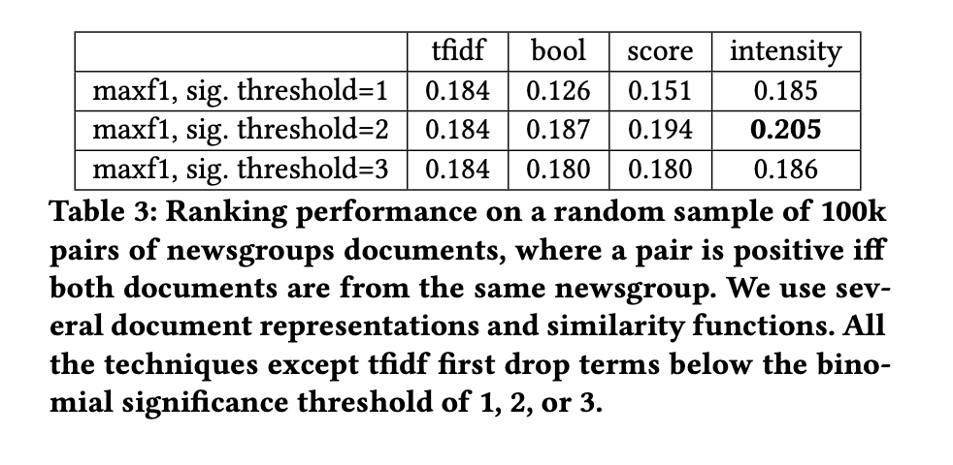
Document Similarity Performance
For the doc pair similarity respectively boolean (bool), binomial score (score), and intensity, we used the min of the two feature values. See paper.
Notes:
Doc pair similarity = Sum over the features of min(value1, value2), where feature value is 0 if it doesn’t appear in the document (for boolean, the feature value is 0 or 1)

Slide 24
Modeling (Doc.) Similarity via the Tail Directly
Rough semantics: given a document d1, what’s the likelihood that another document sampled randomly would match a few terms with such (low) priors
So we can get probabilities or confidences, or negative log such, as similarity score
We need to stretch binomial modeling somewhat! (could other better efficient probabilistic models exist for this?)
Idea: for terms in d1, make a target region around such, and assess the tail where we have |d2| trials
See paper!
Still efficient, and does well on previous newsgroups ranking task (some promising results for clustering too)

