Slide 1
Position Masking for Improved Layout-Aware Document Understanding
Anik Saha¹, Catherine Finegan-Dollak², Ashish Verma²
Document Intelligence Workshop @ KDD 2021
¹Rensselaer Polytechnic Institute
²IBM Research
Notes:
Anik Saha, PhD student at RPI
Work done during internship in IBM Research last summer.

Slide 2
Visually Rich Documents

Slide 3
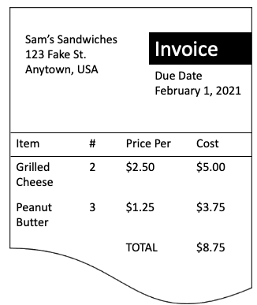
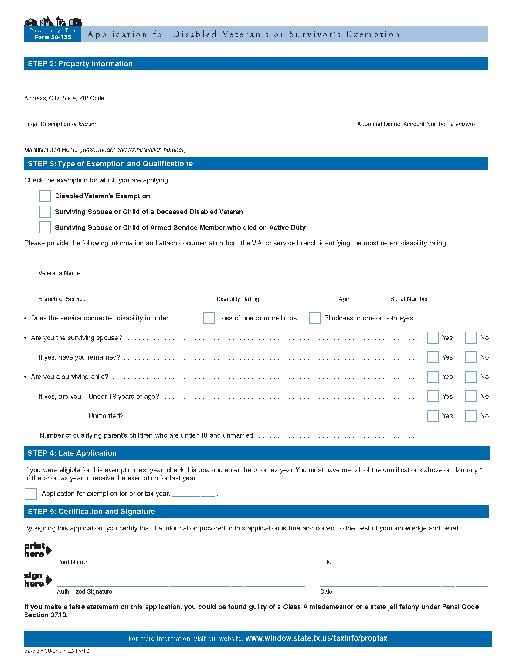
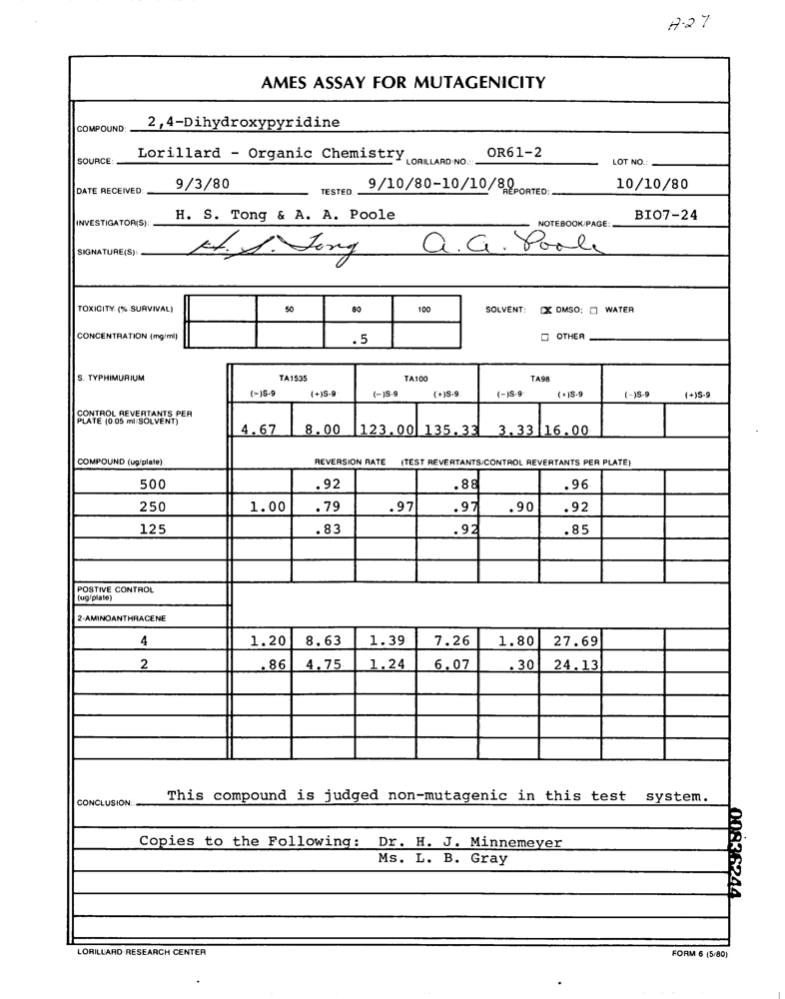
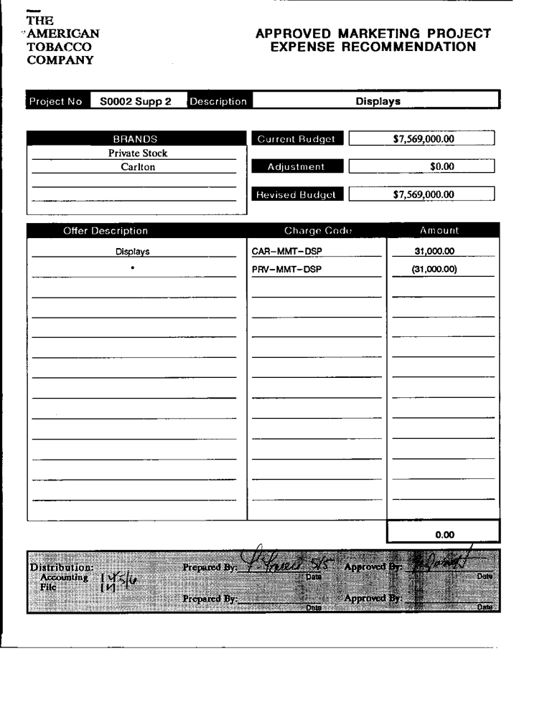
Visually rich documents are everywhere in daily business processes
Some examples of formatted documents
Invoices
Purchase orders
Receipts
Resumes
Tax forms
Notes:
Many, many of the documents that businesses need to process are visually rich.
Some examples include forms, invoices, and purchase orders.
To understand these documents, both the text and the layout of the page is important.

Slide 4
The format of these documents are widely varied
Sam’s Sandwiches
123 Fake St.
Anytown, USA
Invoice
Due Date
February 1, 2021
Key information may be presented in different ways
Table
Form
Figure
Item | # | Price Per | Cost
Grilled Cheese | 2 | $2.50 | $5.00
Peanut Butter | 3 | $1.25 | $3.75
 |  | TOTAL | $8.75
Use machine learning to automate information extraction
Notes:
Template based methods don’t generalize and there is no single format. It is not realistic to create custom rules for all types of documents.
We can use machine learning as a general solution to the information extraction problem.

Slide 5
Background:
LayoutLM

Slide 6
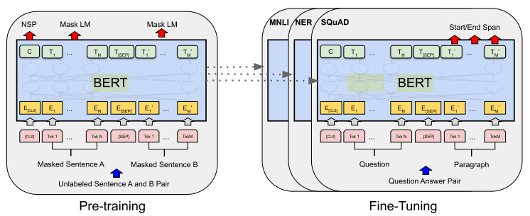
Language models like BERT work extremely well for text
Sam’s Sandwiches
123 Fake St.
Anytown, USA
Invoice
Due Date
February 1, 2021
Item | # | Price Per | Cost
Grilled Cheese | 2 | $2.50 | $5.00
Peanut Butter | 3 | $1.25 | $3.75
 |  | TOTAL | $8.75
Devlin et al. 2018
But we need to look at the position of the text to understand this invoice
Notes:
That suggests that we want an NLP model, since those are pretty good at text.
But if you look at this invoice, pure text isn't going to be enough to understand it. A model that can do amazing things on sentence won't capture information that's conveyed by the layout of the document.

Slide 7
Transformer Layers
token
E(grilled)
E(2)
E($2.50)
E($5.00)
E(cheese)
E(peanut)
+
+
+
+
+
+
1-D
E(18)
E(19)
E(20)
E(21)
E(22)
E(23)
+
+
+
+
+
+
segment
E(A)
E(A)
E(A)
E(A)
E(A)
E(A)
The BERT Model
Notes:
Here's the basic BERT model. For each word in the input, it combines a token embedding, a 1-D position embedding for where the word is in the sentence, and a segment embedding.

Slide 8
No prediction
Predict token
No prediction
Predict token
No prediction
No prediction
Transformer Layers
token
E(grilled)
E($2.50)
E(cheese)
E(peanut)
+
+
+
+
+
+
1-D
E(18)
E(19)
E(20)
E(21)
E(22)
E(23)
Masked Language Model Pretraining
Notes:
What the MLM does is randomly hide a subset of the token embeddings that are passed to the transformer layers. The pretraining task is to predict what the masked token originally was, based on the context. By paying attention to the surrounding words, the model learns to make these predictions.
And the great thing is, masking is completely automated. No human is involved in annotating this data for pretraining. But by completing this task, the model encodes enough information about language that it is ready for fine-tuning on all sorts of downstream tasks.

Slide 9
Tokens on our invoice have bounding boxes that define where they are on the page.
Sam’s Sandwiches
123 Fake St.
Anytown, USA
Invoice
Due Date
February 1, 2021
Item | # | Price Per | Cost
Grilled Cheese | 2 | $2.50 | $5.00
Peanut Butter | 3 | $1.25 | $3.75
 |  | TOTAL | $8.75
(x₁, y₁)
(x₂, y₂)
Notes:
A key insight that the authors of LayoutLM had was that visually rich documents like our invoice aren't a sequence of tokens, like BERT usually works with. They have a 2-D layout, which can be expressed by the bounding boxes around words. Two pairs of (x,y) coordinates tell us where "TOTAL" appears on this page.

Slide 10
No prediction
Predict token
No prediction
Predict token
No prediction
No prediction
Transformer Layers
token
E(grilled)
E($2.50)
E(cheese)
E(peanut)
+
+
+
+
+
+
1-D
E(18)
E(19)
E(20)
E(21)
E(22)
E(23)
+
+
+
+
+
+
x₁
E(5)
E(138)
E(203)
E(328)
E(1)
E(1)
+
+
+
+
+
+
y₁
E(481)
E(476)
E(479)
E(481)
E(452)
E(413)
+
+
+
+
+
+
x₂
E(75)
E(151)
E(257)
E(382)
E(69)
E(72)
+
+
+
+
+
+
y₂
E(456)
E(455)
E(455)
E(457)
E(429)
E(390)
LayoutLM (Xu et al. 2020)
Notes:
LayoutLM therefore added 2-D position embeddings along with the 1-D position embeddings that BERT used. And this one step allowed them to outperform SOTA.

Slide 11
No prediction
Predict token
Predict x₁, y₁, x₂, y₂
Predict token, x₁, y₁
Predict x₂, y₂
Predict x₁
Transformer Layers
token
E(grilled)
E($2.50)
E(cheese)
E(peanut)
+
+
+
+
+
+
1-D
E(18)
E(19)
E(20)
E(21)
E(22)
E(23)
+
+
+
+
+
+
x₁
E(5)
E(138)
E(1)
+
+
+
+
+
+
y₁
E(481)
E(476)
E(452)
E(413)
+
+
+
+
+
+
x₂
E(75)
E(151)
E(382)
E(72)
+
+
+
+
+
+
y₂
E(456)
E(455)
E(457)
E(390)
We mask positions as well as words.
Notes:
Where BERT and LayoutLM masked only words, we ALSO mask positions for pretraining.
Just like a masked language model predicts masked words, our model must also predict the 2-D position of the word on the page.
This forces the model to learn about the relationship between words and layout.

Slide 12
No prediction
Predict token
Predict x₁, y₁, x₂, y₂
Predict token, x₁, y₁
Predict x₂, y₂
Predict x₁
Transformer Layers
token
E(grilled)
E($2.50)
E(cheese)
E(peanut)
+
+
+
+
+
+
1-D
E(18)
E(19)
E(20)
E(21)
E(22)
E(23)
+
+
+
+
+
+
x₁
E(5)
E(138)
E(1)
+
+
+
+
+
+
y₁
E(481)
E(476)
E(452)
E(413)
+
+
+
+
+
+
x₂
E(75)
E(151)
E(382)
E(72)
+
+
+
+
+
+
y₂
E(456)
E(455)
E(457)
E(390)
Full position masking
Notes:
We can do this in a few different ways, and I want to explain them so they'll make sense when you see the result slide.
Full position masking means that we mask all the 2-D position embeddings for a given word.

Slide 13
No prediction
Predict token
Predict x₁, y₁, x₂, y₂
Predict token, x₁, y₁
Predict x₂, y₂
Predict x₁
Transformer Layers
token
E(grilled)
E($2.50)
E(cheese)
E(peanut)
+
+
+
+
+
+
1-D
E(18)
E(19)
E(20)
E(21)
E(22)
E(23)
+
+
+
+
+
+
x₁
E(5)
E(138)
E(1)
+
+
+
+
+
+
y₁
E(481)
E(476)
E(452)
E(413)
+
+
+
+
+
+
x₂
E(75)
E(151)
E(382)
E(72)
+
+
+
+
+
+
y₂
E(456)
E(455)
E(457)
E(390)
Partial position masking
Notes:
Partial position masking allows the model to see some of the position embeddings.

Slide 14
No prediction
Predict token
Predict x₁, y₁, x₂, y₂
Predict token, x₁, y₁
Predict x₂, y₂
Predict x₁
Transformer Layers
token
E(grilled)
E($2.50)
E(cheese)
E(peanut)
+
+
+
+
+
+
1-D
E(18)
E(19)
E(20)
E(21)
E(22)
E(23)
+
+
+
+
+
+
x₁
E(5)
E(138)
E(1)
+
+
+
+
+
+
y₁
E(481)
E(476)
E(452)
E(413)
+
+
+
+
+
+
x₂
E(75)
E(151)
E(382)
E(72)
+
+
+
+
+
+
y₂
E(456)
E(455)
E(457)
E(390)
x₁ position masking
Notes:
x1 position masking is one kind of partial position masking where only the first x-coordinate is masked.

Slide 15
Experiments

Slide 16
Pretraining
Baseline: Masked language model
Ours: Masked language model + position masking
Notes:
I want to emphasize that all the pre-training for these experiments was self-supervised. No human had to label any documents for pre-training. The baseline used masked language modeling only, and our system used masked language modeling plus our new position masking task.

Slide 17
Pretraining Dataset
500,000 tobacco litigation documents
Letters, forms, advertisements, memos, articles…
Entirely unlabeled
Notes:
We used a half million publicly released tobacco litigation documents for pretraining. They include letters, forms, advertisements, memos, articles and much more. And these don't have labels.

Slide 18
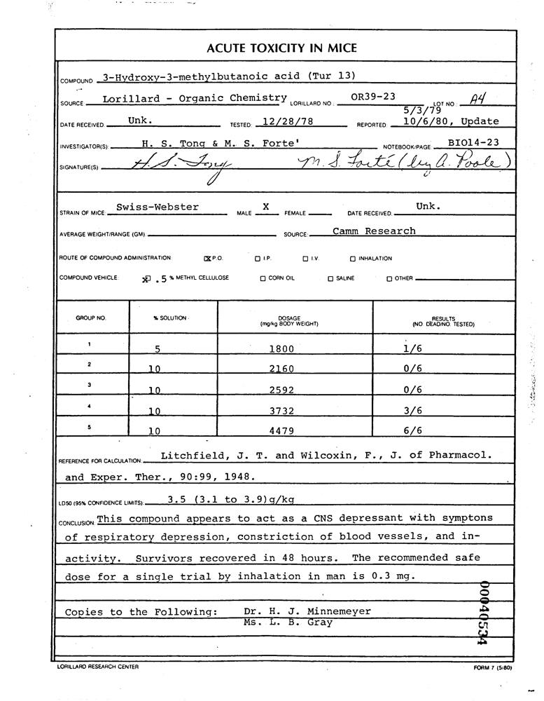
Fine-Tuning for Key-Value Pair Extraction
Task: Given a document, identify keys and values
Modeled as token labeling problem
Each token is annotated as key, value, header, or “other” entity type
Notes:
Once we had our pre-trained model, we needed to fine-tune it. The task we focused on is key-value pair extraction. As an example, we'd like to be able to identify that the "Source" on this document was "Lorillard Organic Chemistry."
Following LayoutLM, we treat this as a token-labeling problem, where each word in the document gets labeled as a key, value, header, or "other" entity type.

Slide 19
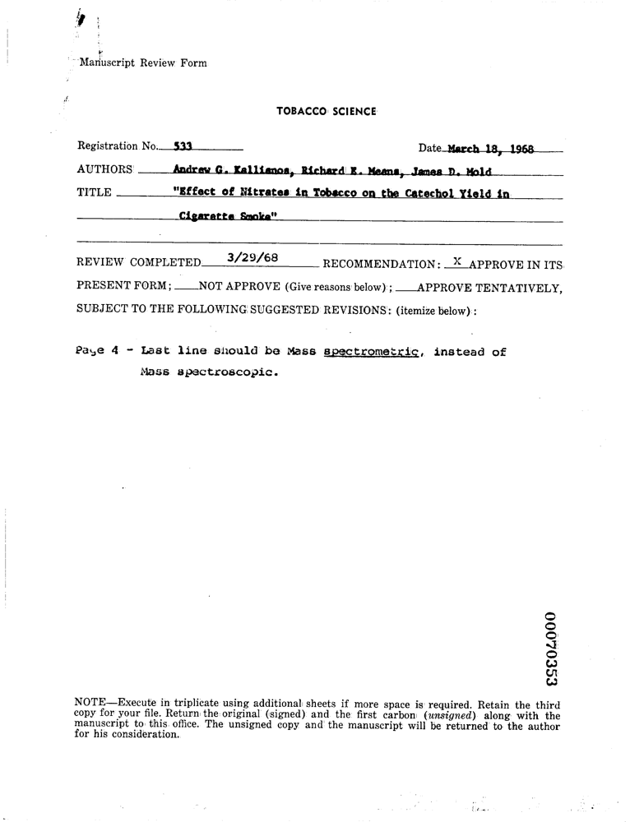
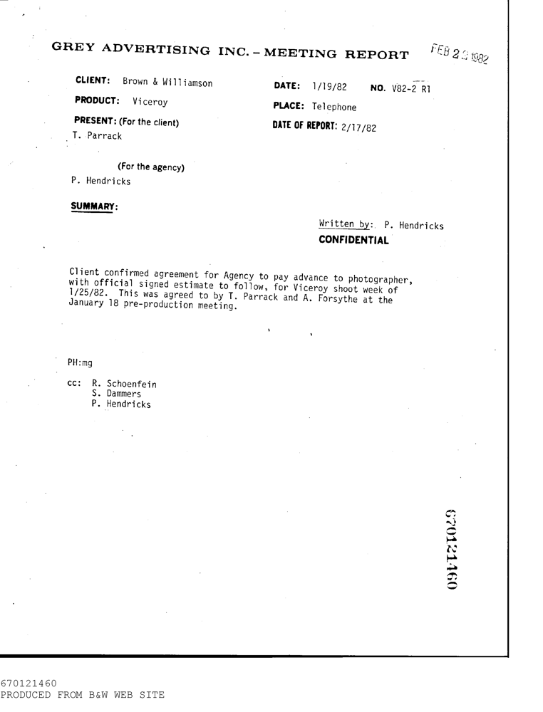
Fine-tuning Dataset
FUNSD dataset
﻿9,707 semantic entities total
Fine tune on 149 train documents
Evaluate on 50 test documents
Notes:
The dataset for fine-tuning and evaluation is FUNSD. All the key-value pairs are annotated. Notice how small our train set is, with only 149 documents. And then we evaluate on 50 test documents.

Slide 20
Results

Slide 21
Models trained using classification method of position masking improved over baseline by more than 5%.
 | Precision | Recall | F1
Baseline LayoutLM | 61.1 (0.8) | 69.2 (0.2) | 64.9 (0.5)
x1-position masking
Using Classification Pretraining | 66.8 (0.6) | 74.0 (0.5) | 70.2 (0.4)
Using Regression Pretraining | 65.5 (1.0) | 73.6 (0.6) | 69.3 (0.8)
Full position masking
Using Classification Pretraining | 67.1 (1.0) | 73.6 (0.6) | 70.2 (0.8)
Using Regression Pretraining | 64.9 (1.0) | 72.9 (1.0) | 68.7 (0.9)
Mean (standard deviation) over 5 runs
All models with position masking outperformed the baseline
(𝑝 < 0.001).
Notes:
We found that models trained with the classification method of position masking improved over the baseline by more than 5%.
Moreover, all of the models using position masking outperformed the baseline, and the differences were statistically significant.

Slide 22
Conclusion & Future Directions
Adding a position-masking pretraining task to LayoutLM improved performance on form understanding by 5%.
Next:
Understand its effect on other tasks
Combine with newer systems like LayoutLMv2 and Text-Image-Layout Transformer (TILT)
Explore additional pretraining tasks for visually-rich document understanding
Key-value linking

Slide 23
Thank You!
Questions?

