Slide 1
AMBA AHB-Lite
AHB-Lite is a simplified version of the AMBA AHB bus used to connect a master to one or more slaves.
The bus uses address and control signals, then a separate data phase follows.
The design is pipelined: while one transfer is in the data phase, the next transfer can be in the address phase.
Main blocks: Master, Decoder, Mux, and Slaves.
Master
Decoder
Mux
Slave

Slide 2
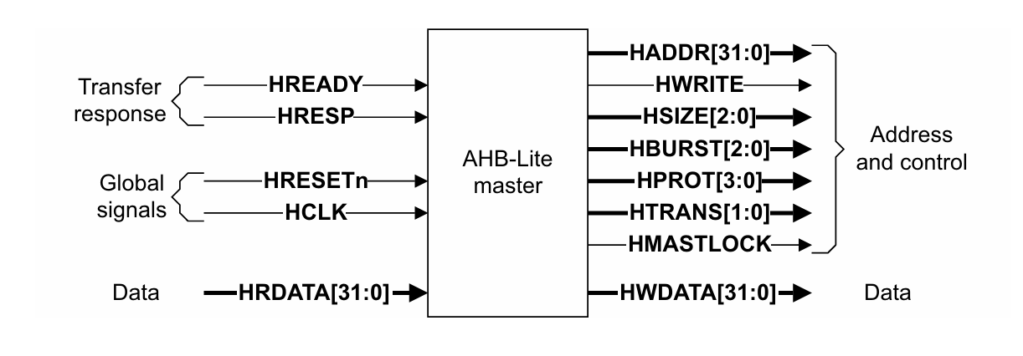
AHB-Lite Architecture and Signal Groups
Handshake and data signals:
  HREADY - global bus ready
  HREADYOUT - slave ready output
  HRESP[1:0] - response (OKAY/ERROR)
  HRDATA[31:0] - read data
  HWDATA[31:0] - write data
  HSELx - slave select from the decoder
Address and control signals:
  HADDR[31:0] - address bus
  HWRITE - read/write control
  HTRANS[1:0] - transfer type
  HBURST[2:0] - burst type
  HSIZE[2:0] - transfer size

Slide 3
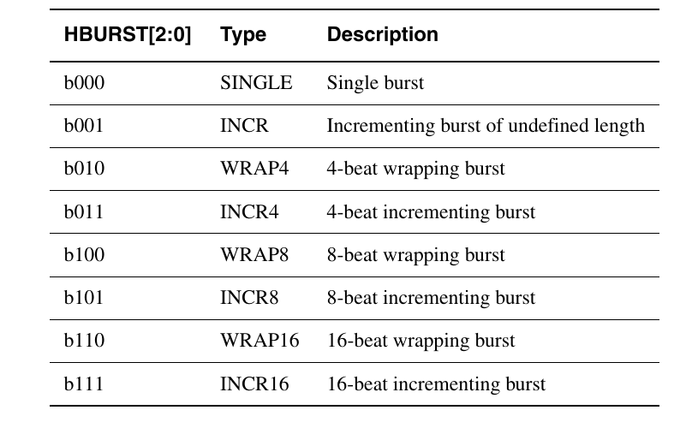
Burst Types and Address Behavior
What is a Burst?
A burst transfer is a sequence of consecutive data transfers performed under a single bus request. Instead of requesting the bus for every data transfer, the master keeps control of the bus and transfers multiple data words continuously.
Why Use Burst Transfers?
Reduce bus arbitration overhead.
Increase data throughput.
Improve memory access efficiency.
Support high-speed peripherals such as DMA, caches, and memory controllers.

Slide 4
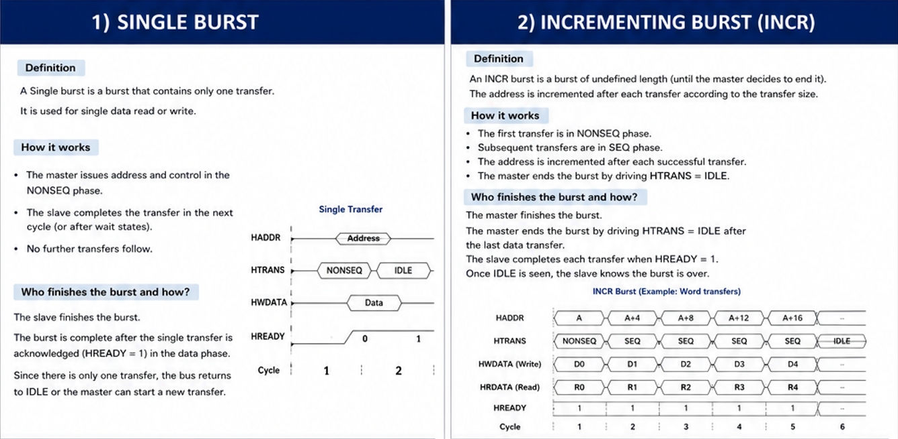

Slide 5
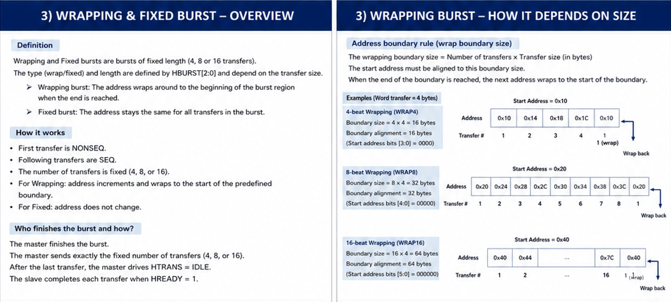

Slide 6
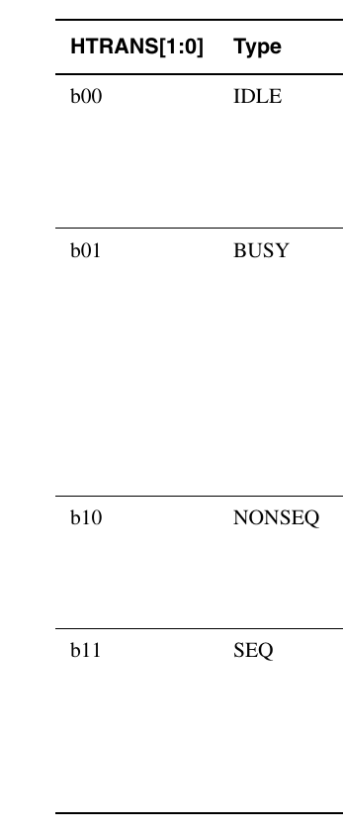
Transfer Types
IDLE:
no transfer is taking place; the master is not requesting the bus.
BUSY:
the master keeps the burst active but inserts a wait-like cycle inside the burst.
NONSEQ:
the first transfer of a burst or any single transfer; it starts a new address sequence.
SEQ:
a transfer that continues the previous burst with a sequential address.
The master changes HTRANS according to the current bus activity and the transfer pipeline.

Slide 7
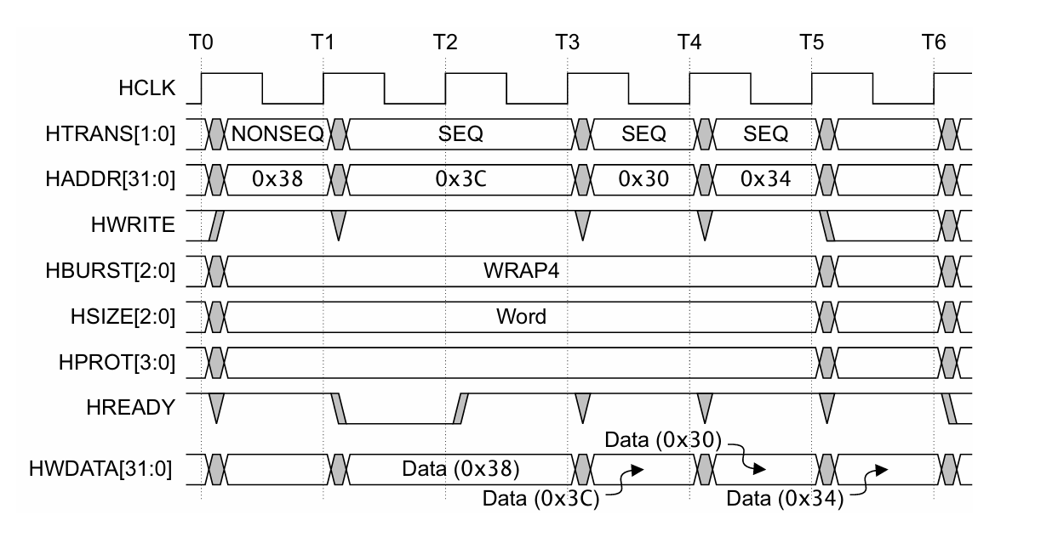
Handshake, Wait States, and Response
HREADY tells whether the bus is ready to complete the current transfer.
If HREADY is LOW, the slave inserts wait states and the master must hold address/control stable.
HREADYOUT is the slave-side ready signal; HREADY is the final bus-level ready.
If an error occurs, HRESP indicates an error response instead of a normal OKAY response.
The master can only update the address when the previous transfer is accepted.
During a wait state, address and control remain unchanged.
Read data becomes valid only after the data phase completes.
Write data is driven in the data phase, following the address/control phase.

Slide 8
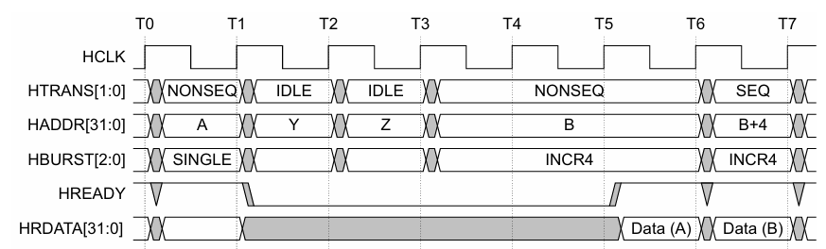
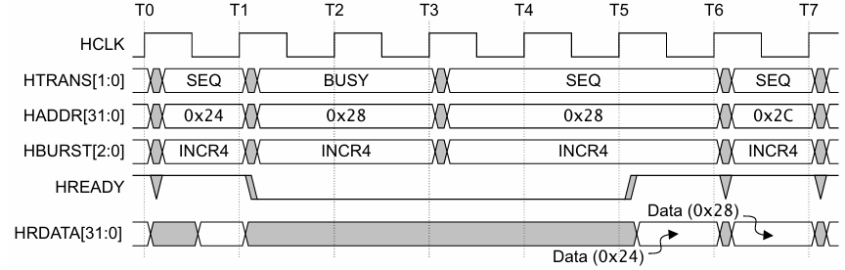
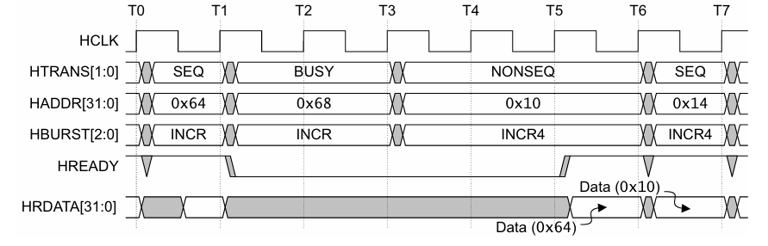
Waited Transfers
Overview
A slave inserts wait states by driving HREADY = LOW when it needs additional time to complete a transfer. During a wait state, the current transfer is extended, and the master is restricted in what it can change until HREADY returns HIGH.
General Rule
When HREADY = LOW, the master must keep the current address and control signals stable.
Only specific HTRANS changes are permitted during wait states.
Transfer Type Changes During Wait States
The master must not change HTRANS while HREADY = LOW, except in the following cases:
Current Transfer | Allowed Change
IDLE | NONSEQ
BUSY (Fixed-length burst: INCR4/8/16, WRAP4/8/16) | SEQ
BUSY (Undefined-length burst: INCR) | SEQ, NONSEQ, or IDLE

Slide 9
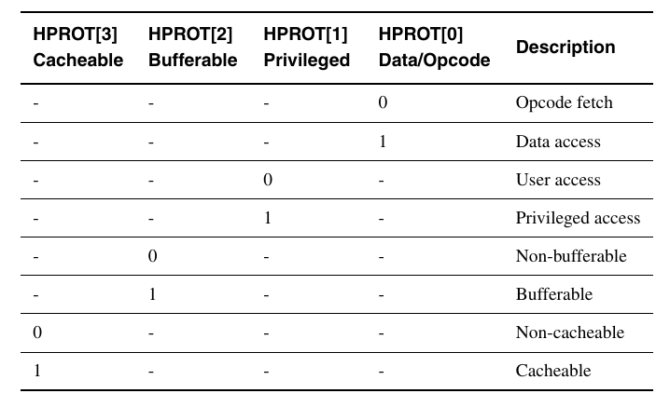
Protection Control
Overview
The HPROT signals provide additional information about the current bus transfer. They allow slaves and memory systems to determine how the transfer should be handled, such as whether it is a data or instruction access, privileged or user access, and whether it is cacheable or bufferable.
Purpose
HPROT is used to:
Distinguish between instruction fetch and data access.
Indicate privileged or user mode access.
Specify whether the transfer is cacheable.
Specify whether the transfer is bufferable.

Slide 10
Address Decoding
Overview
In an AHB-Lite system, a central address decoder monitors the address from the master and generates one slave-select signal, HSELx, for each slave. The master itself does not see the individual slaves; it only interacts with the decoder’s select lines.
Decode Boundary Rule
Each slave is normally allocated at least a 1KB address region.
This ensures that a burst transfer (NONSEQ followed by SEQ transfers) never crosses an address decode boundary into a different slave.
Default Slave
If an address does not map to any real slave, the decoder selects a default slave.
The default slave always returns the ERROR response, so an unmapped access never wrongly appears to complete with OKAY.

Slide 11
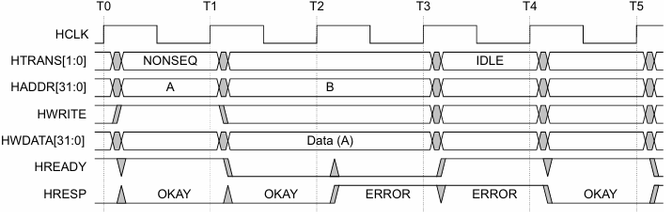
Slave Transfer Response
Overview
Every slave signals the outcome of a transfer to the master using HRESP together with HREADY. For each transfer, a slave does one of the following:
Completes the transfer immediately.
Inserts one or more wait states before completing the transfer.
Signals an error.
Error Response Timing
An error response always takes a minimum of two cycles to complete:
Cycle 1: HRESP = ERROR, HREADY = LOW.
Cycle 2: HRESP = ERROR, HREADY = HIGH, signaling the transfer is done.
This gives the master and any pipelined slaves time to safely cancel the remaining transfers in a burst.
HRESP | Meaning
0 – OKAY | Transfer completed successfully
1 – ERROR | A problem occurred with the transfer

Slide 12
Data Buses: HWDATA and HRDATA
Overview
AHB-Lite implements separate read and write data buses. HWDATA carries data driven by the master to the selected slave; HRDATA carries data driven back by the slave to the master. Both are commonly implemented as 32-bit buses, but any width the protocol allows can be used.
[1] HWDATA
Write data driven by the master. If HREADY is LOW, the slave keeps waiting and HWDATA is held stable until the write completes.
[2] HRDATA
Read data driven by the selected slave back to the master once the transfer completes.
Byte Lane Selection
HSIZE indicates the transfer size (byte, halfword, word, and so on).
HADDR[1:0], together with HSIZE, selects which byte lane of the 32-bit word is active: Byte0, Byte1, Byte2, or Byte3.
The receiving side, master for HRDATA and slave for HWDATA, is responsible for reading or placing data in the correct byte lane.

Slide 13
Data Bus Width
Overview
One method to improve bus bandwidth without increasing the operating frequency is to make the on-chip data path wider. Increased metal layers and the use of large on-chip memory blocks, such as embedded DRAM, are driving factors that encourage wider on-chip buses.
Allowed Bus Widths
The AHB-Lite data bus can be 8, 16, 32, 64, 128, 256, 512, or 1024 bits wide.
Recommended minimum bus width: 32 bits. A maximum of 256 bits is adequate for almost all applications.
Byte Lane Rule
For read and write transfers, the receiving module must select the data from the correct byte lane on the bus.
Replication of data across all byte lanes is not required.

Slide 14
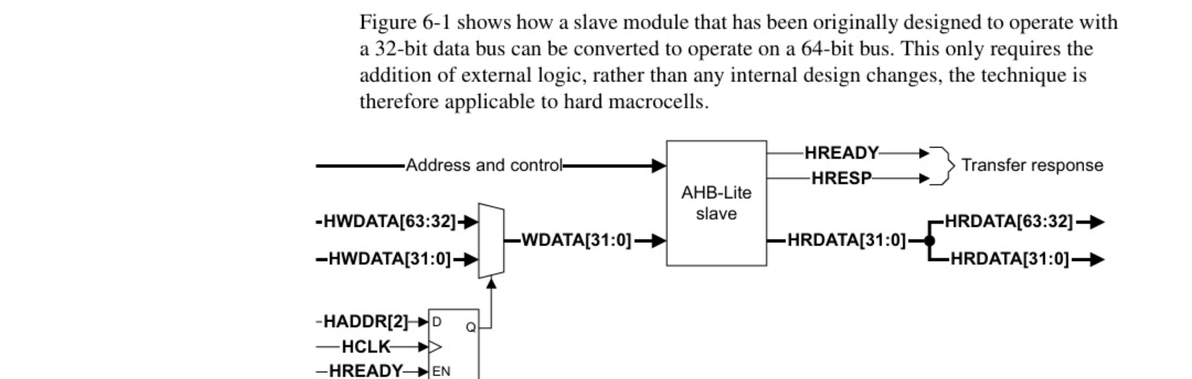
Narrow Slave on a Wide Bus
Overview
A slave module originally designed for a 32-bit data bus can be converted to operate on a 64-bit bus by adding external logic only, with no internal design changes. This makes the technique applicable to hard macrocells.
Handling the Output
When converting a narrow bus to a wider bus, do one of the following:
Replicate the data on both halves of the wide bus.
Use additional logic so only the appropriate half of the bus changes, which reduces power consumption.
Note
A slave can only accept transfers as wide as its natural interface. If a master attempts a wider transfer than the slave supports, the slave returns the ERROR response.

Slide 15
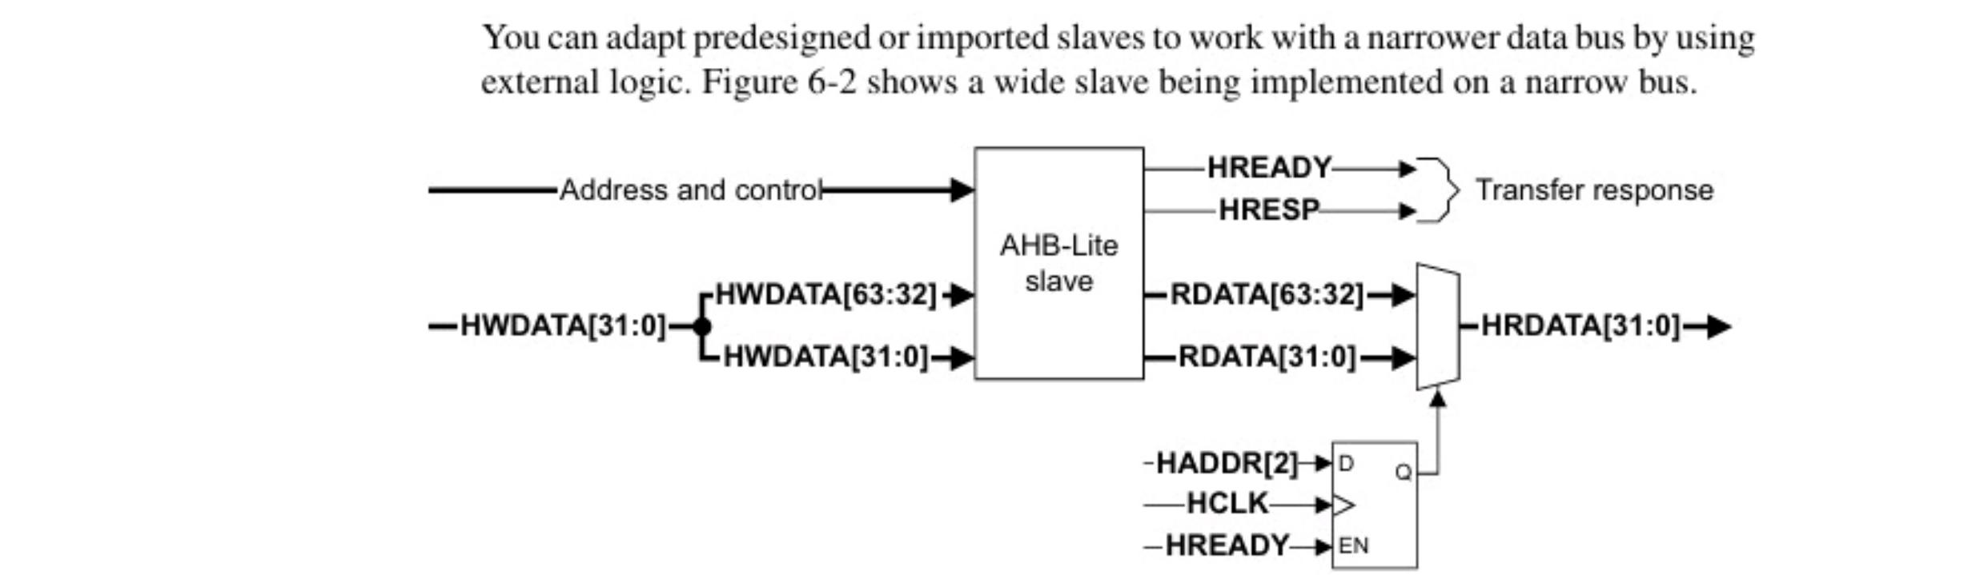
Wide Slave on a Narrow Bus
Overview
Predesigned or imported slaves can be adapted to work with a narrower data bus by using external logic. Figure 6-2 shows a wide slave being implemented on a narrower bus.
How It Works
The slave still drives its full-width RDATA output internally.
A multiplexer, controlled by a registered HADDR[2] (captured on HCLK when HREADY is asserted), selects the correct half of RDATA.
The selected half is driven out as the narrow HRDATA[31:0] bus.
Write Data
HWDATA[31:0] on the narrow bus is duplicated onto both halves of the wide slave’s write data input, HWDATA[63:32] and HWDATA[31:0].

Slide 16
Implementing a Master on a Wide Bus
Overview
Masters can be modified to work on a wider bus than they were originally designed for, using the same technique applied to slaves.
How to Do It
Multiplex the input bus.
Replicate the output bus.
Note
You cannot make a master work on a narrower bus than it was originally intended for unless the master includes a mechanism to limit the width of the transfers it attempts. The master must never attempt a transfer where the width, as indicated by HSIZE, is wider than the data bus it connects to.

