Slide 1
AMBA AHB-Lite
AHB-Lite is a simplified version of the AMBA AHB bus used to connect a master to one or more slaves.
The bus uses address and control signals, then a separate data phase follows.
The design is pipelined: while one transfer is in the data phase, the next transfer can be in the address phase.
Main blocks: Master, Decoder, Mux, and Slaves.
Master
Decoder
Mux
Slave

Slide 2
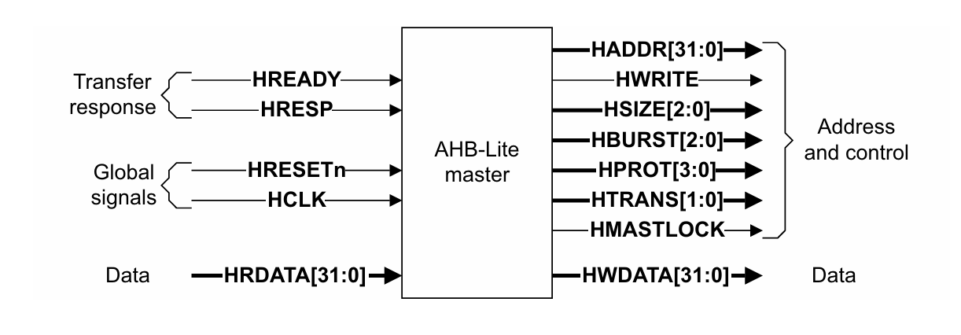
AHB-Lite Architecture and Signal Groups
Handshake and data signals:
  HREADY - global bus ready
  HREADYOUT - slave ready output
  HRESP[1:0] - response (OKAY/ERROR)
  HRDATA[31:0] - read data
  HWDATA[31:0] - write data
  HSELx - slave select from the decoder
Address and control signals:
  HADDR[31:0] - address bus
  HWRITE - read/write control
  HTRANS[1:0] - transfer type
  HBURST[2:0] - burst type
  HSIZE[2:0] - transfer size

Slide 3
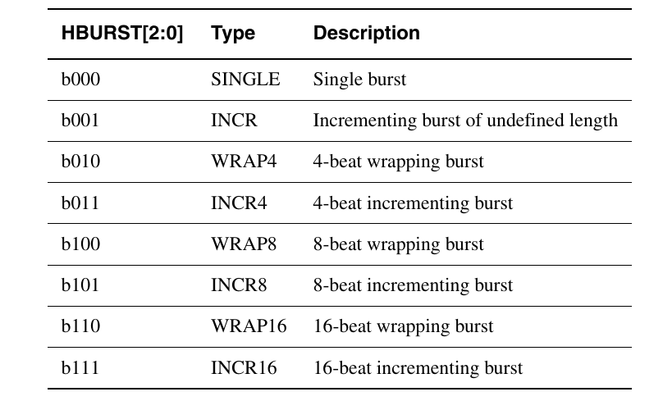
Burst Types and Address Behavior
What is a Burst?
A burst transfer is a sequence of consecutive data transfers performed under a single bus request. Instead of requesting the bus for every data transfer, the master keeps control of the bus and transfers multiple data words continuously.
Why Use Burst Transfers?
Reduce bus arbitration overhead.
Increase data throughput.
Improve memory access efficiency.
Support high-speed peripherals such as DMA, caches, and memory controllers.

Slide 4
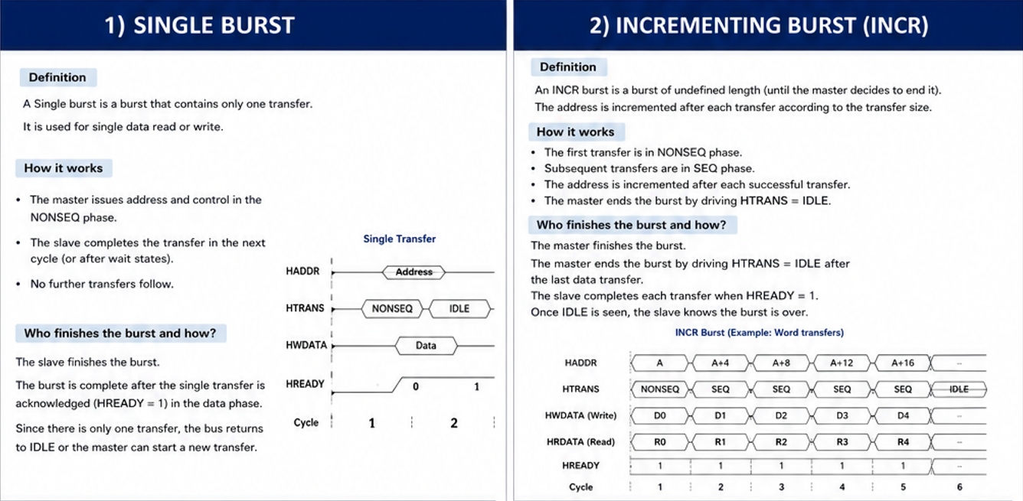

Slide 5
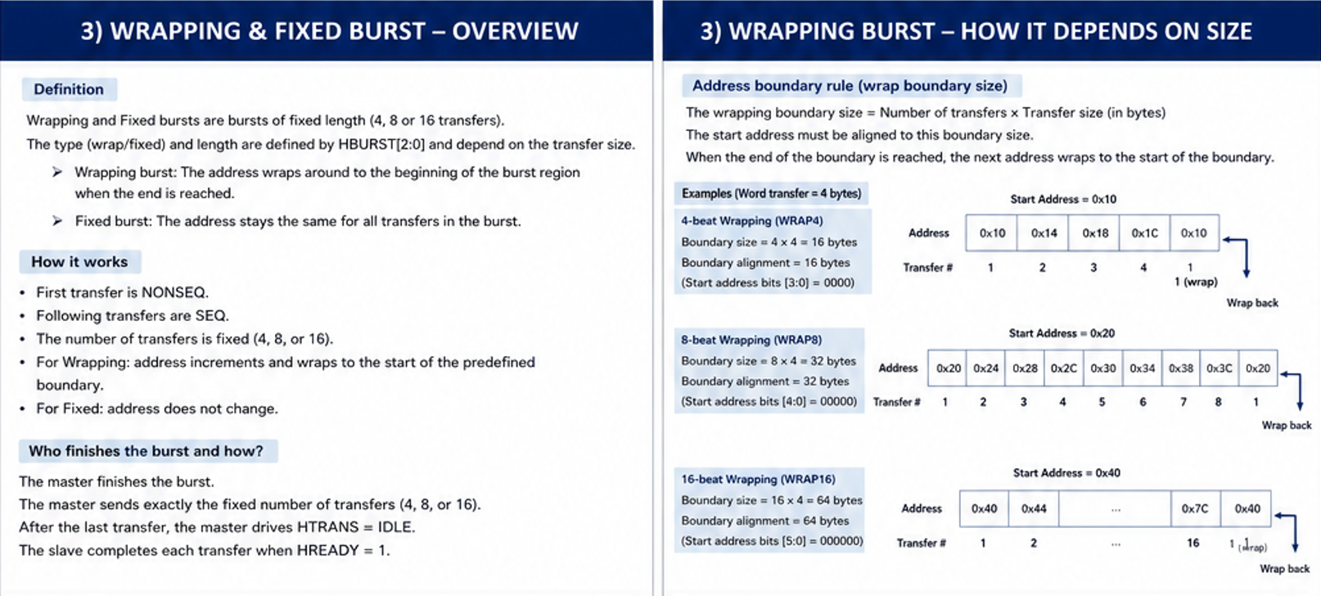

Slide 6
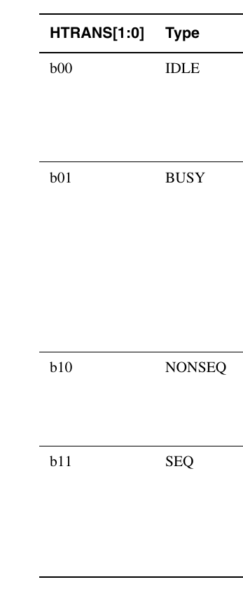
Transfer Types
IDLE:
no transfer is taking place; the master is not requesting the bus.
BUSY:
the master keeps the burst active but inserts a wait-like cycle inside the burst.
NONSEQ:
the first transfer of a burst or any single transfer; it starts a new address sequence.
SEQ:
a transfer that continues the previous burst with a sequential address.
The master changes HTRANS according to the current bus activity and the transfer pipeline.

Slide 7
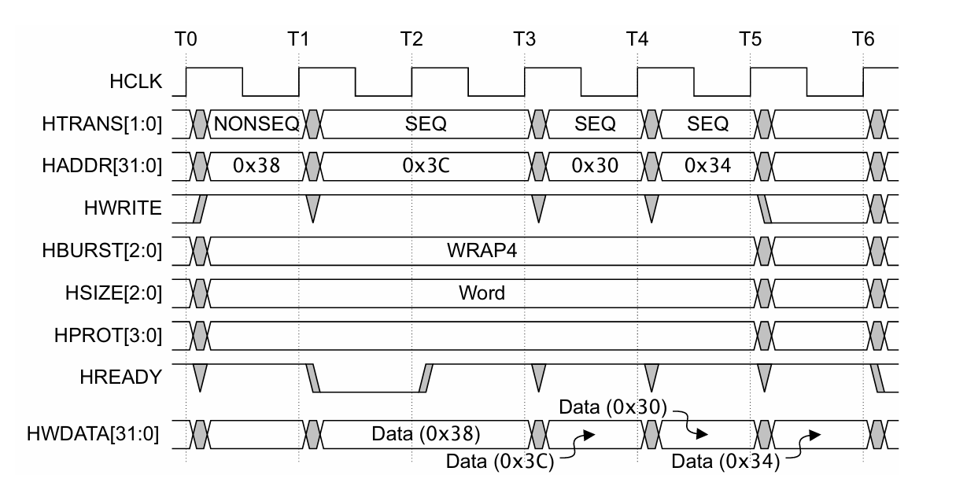
Handshake, Wait States, and Response
HREADY tells whether the bus is ready to complete the current transfer.
If HREADY is LOW, the slave inserts wait states and the master must hold address/control stable.
HREADYOUT is the slave-side ready signal; HREADY is the final bus-level ready.
If an error occurs, HRESP indicates an error response instead of a normal OKAY response.
The master can only update the address when the previous transfer is accepted.
During a wait state, address and control remain unchanged.
Read data becomes valid only after the data phase completes.
Write data is driven in the data phase, following the address/control phase.

Slide 8
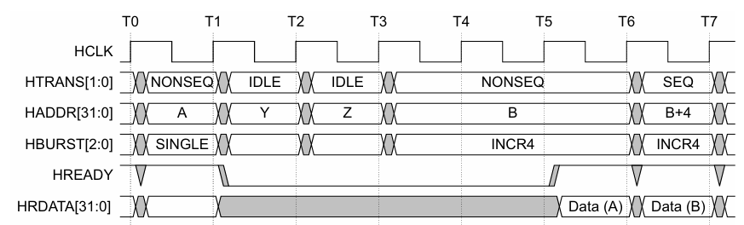
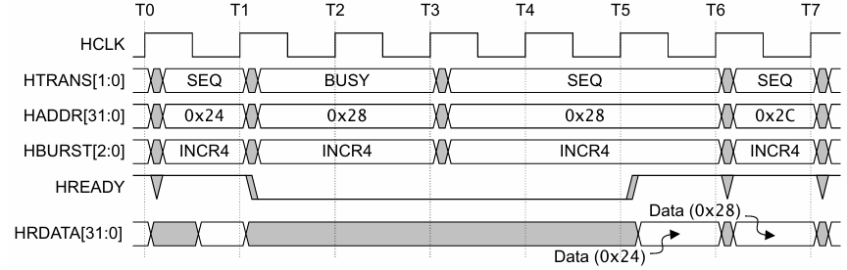
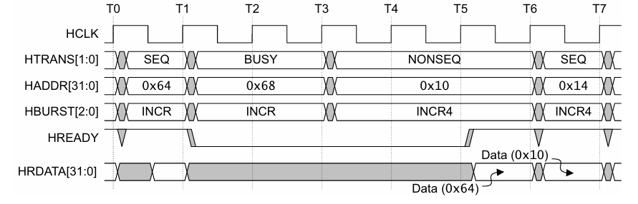
Waited Transfers
Overview
A slave inserts wait states by driving HREADY = LOW when it needs additional time to complete a transfer. During a wait state, the current transfer is extended, and the master is restricted in what it can change until HREADY returns HIGH.
General Rule
When HREADY = LOW, the master must keep the current address and control signals stable.
Only specific HTRANS changes are permitted during wait states.
Transfer Type Changes During Wait States
The master must not change HTRANS while HREADY = LOW, except in the following cases:
Current Transfer | Allowed Change
IDLE | NONSEQ
BUSY (Fixed-length burst: INCR4/8/16, WRAP4/8/16) | SEQ
BUSY (Undefined-length burst: INCR) | SEQ, NONSEQ, or IDLE

Slide 9
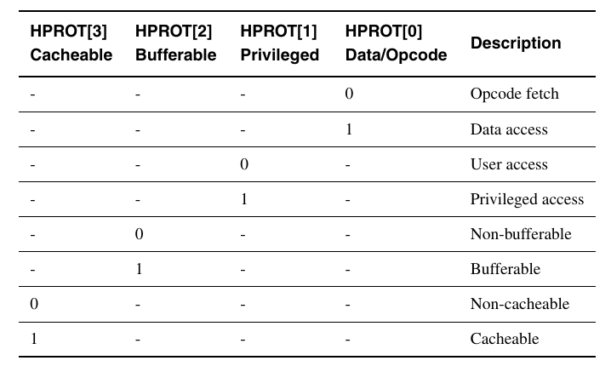
Protection Control
Overview
The HPROT signals provide additional information about the current bus transfer. They allow slaves and memory systems to determine how the transfer should be handled, such as whether it is a data or instruction access, privileged or user access, and whether it is cacheable or bufferable.
Purpose
HPROT is used to:
Distinguish between instruction fetch and data access.
Indicate privileged or user mode access.
Specify whether the transfer is cacheable.
Specify whether the transfer is bufferable.

