Slide 1
Autonomous E-car
Development Progress
New Business Planning Dept.
Smart Factory Planning
Toyota Motor Asia (Thailand)
16 Sep 2026
CONFIDENTIAL

Slide 2
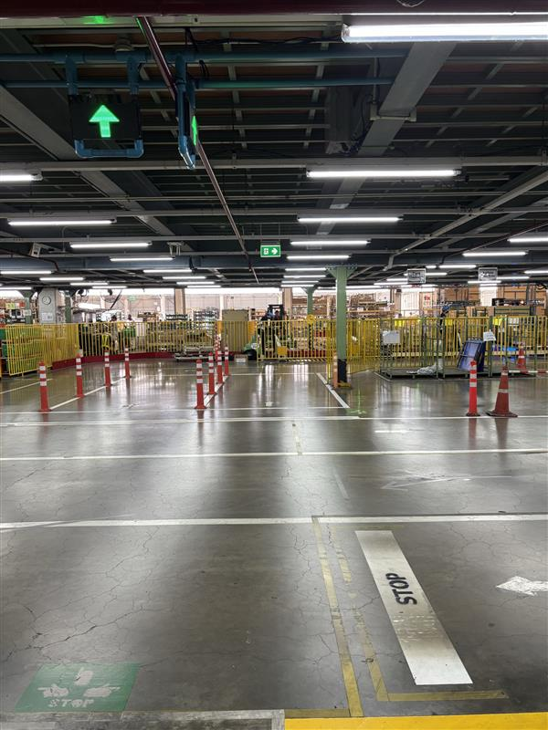
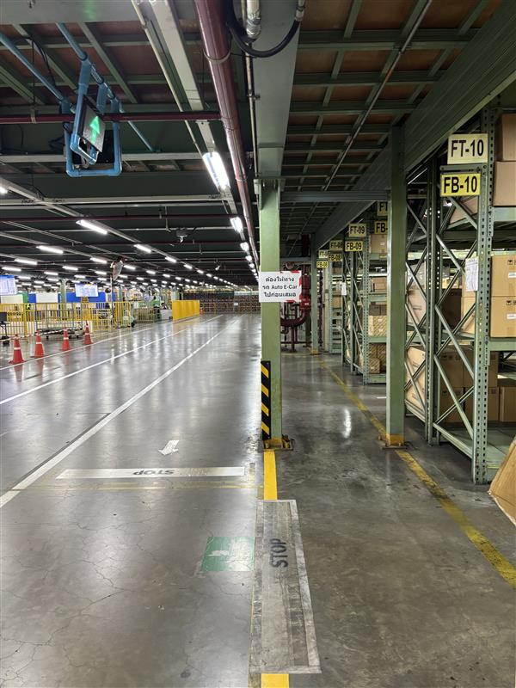
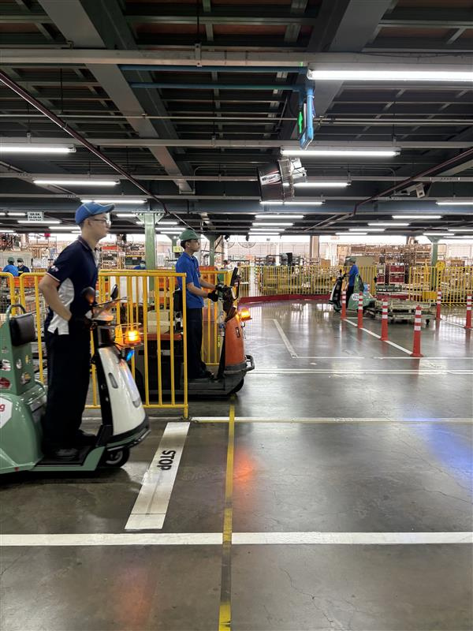
Display Position Adjustment
2
Conclusion : Display repositioned farther from the STOP line
Display 1 :
Display 2 :
Display 3 :

Slide 3
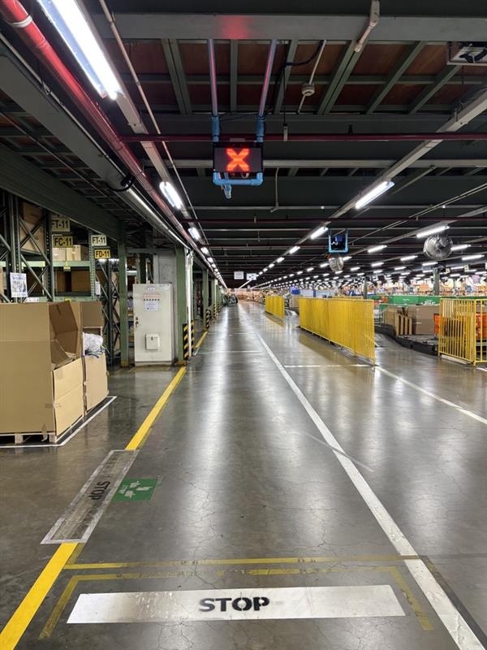
RED Visibility Enhancement
3
Conclusion : RED X enlarged for improved visibility.

Slide 4
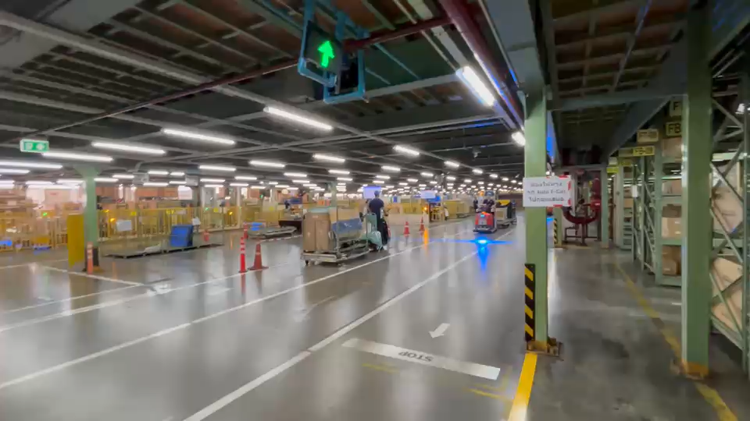
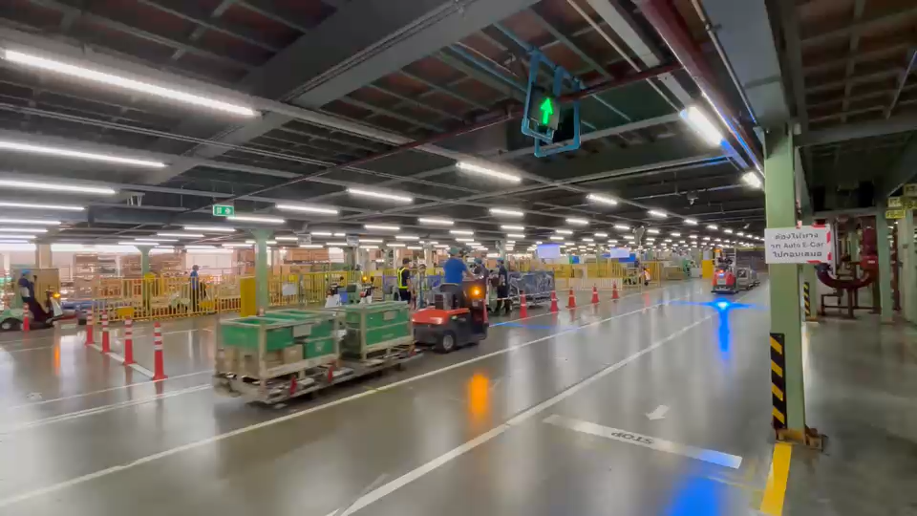
Traffic State Adjustment
4
Conclusion : RED activation from the first sensors and transition from RED to GREEN without YELLOW.
ENTER
Before : GREEN → YELLOW → RED
After : GREEN → RED
LEAVING
Before : RED (1 s) → YELLOW (5 s) → GREEN
After : RED (1 s) → GREEN (YELLOW skipped)
Notes:
เขียว เขียวกระพริบ แดง
แดง เขียว

Slide 5
Thank You

