Slide 1
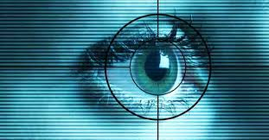
Seminar
On
Blue Eyes Technology
Submitted To: Submitted By:
Seminar Guide:
Mrs.Betty Joseph Amrutha Aji

Slide 2
CONTENTS
Blue Eyes technology
About Blue Eyes
Designing
System Overview
Working
Hardware and software
Application
Advantage and Disadvantage
Future Enhancement
Conclusion
Reference

Slide 3
BLUE EYES TECHNOLOGY
The BLUE EYES technology aims at creating computational machines that have perceptual and sensory ability like those of human beings.

Slide 4
TYPES OF EMOTIONAL SENSORY
For Hand: Emotion Mouse
For Eyes: Expression Glasses

Slide 5
For Hand: Emotion Mouse
The mouse includes a set of sensors, including infrared detectors and temperature-sensitive chips.

Slide 6
For Eyes: Expression Glasses
A wearable device which allows any viewer to visualize the confusion and interest levels of the wearer. Other recent developments in related technology are the attempt to learn the needs of the user just by following the interaction between the user and the computer in order to know what he/she is interested in at any given moment.

Slide 7
TECHNOLAGIES USED
Emotion mouse
Magic pointing
Artificial Intelligence Speech identification
Simple User Interest Tracker(SUITOR)

Slide 8
MAGIC POINTING
Reduce the cursor movment needed for target selection
Click on the target with a regular manual input device

Slide 9
APPLICATION OF ARTIFICIAL INTELLIGENCE SPEECH IDENTIFICATION
To control Weapons by voice commands
Pilot give commands to computer by speaking into microphones
Can be connected to word processor and instead of writing,simply detect to them

Slide 10
SUITOR
Help by fetching more information at desktop
Notice where the user’s eye focus on the sreen
Fills a scrolling ticker on a computer screen with information related to user’s task
Ex.if reading headline,pops up the story in the browser window

Slide 11
DESIGNING
A personal area network for linking all the operators and the supervising system
Two major units
DAU (data acquisition unit )
CSU (central system unit )

Slide 12
SYSTEM OVERVIEW
Data Acquisition Unit
Central System Unit
Visualization
Module
Connection
Manager
Atmel 89C52
microcontroller
Bluetooth
Bluetooth
Data
Logger
Jazz
Multisensor
Data Analysis
Bluetooth technology provides means for creating a Personal Area Network linking the operators and the central system

Slide 13
WORKING
The major parts of the blue eyes system are DAU & CSU.
The task of the mobile DAU is to maintain bluetooth connections to get information from the sensor and sending it over the wireless connection.
To deliver the alarm message sent from the CSU to the operator & handle personalized ID cards.
CSU maintain the other side of the bluetooth connection, buffers incoming sensor data performs online data analysis, records the conclusion for further exploration & provide visualization interface.

Slide 14
THE HARDWARE
Data Acquisition Unit
Data Acquisition Unit is a mobile part of the Blue eyes system. Its main task is to fetch the physiological data from the sensor and to send it to the central system to be processed.

Slide 15
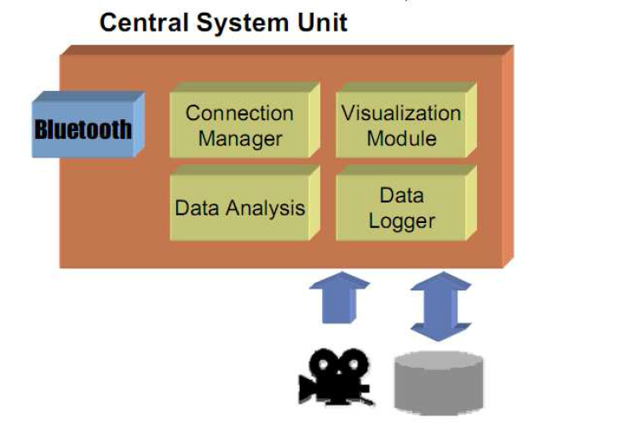
Central System Unit
Central System Unit hardware is the second peer of the wireless connection. The box contains a Bluetooth module (based on ROK101008) and a PCM code for voice data transmission. The module is interfaced to a PC using a parallel, serial and USB cable. The audio data is accessible through standard mini-jack sockets

Slide 16
THE SOFTWARE
Blue Eyes software’s main task is to look after working operators' physiological condition. To assure instant reaction on the operators' condition change the software performs real time buffering of the incoming data, real-time physiological data analysis and alarm triggering. The Blue Eyes software contains several functional modules System core facilitates the transfers flow between other system modules (e.g. transfers raw data from the Connection Manager to data analyzers, processed data from the data analyzers to GUI controls, other data analyzers, data logger etc.).

Slide 17
FUTURE IMPROVEMENTS
DAU
small CMOS camera to monitor the operator’s point of gaze
single PCB (SMD technology)
low voltage ICs - LiIO batteries power
CSU
data mining algorithms
advanced database encryption using e.g. AES algorithm

Slide 18
DATA SECURITY
Only registered mobile devices can connect to the system
Bluetooth connection authentication
Bluetooth connection encryption
Access rights restrictions
Personal and physiological data encryption

Slide 19
APPLICATIONS
Generic control rooms
(System can be applied in every working environment
requiring permanent operator’s attention)
Power station
Captain bridge
Flight control centers
Common application
A simpler system version for drivers

Slide 20
ADVANTAGES
Prevention from dangerous incidents
Physiological condition monitoring
Operators position detection
• The reconstruction of the course of operator’s work
Notes:
reat

Slide 21
DISADVANTAGES
Not 100% accurate
Expensive,and system is bulky,need some minimization

Slide 22
8.FUTURE ENHANCEMENTS
1.In the future, ordinary household devices-such as Televisions, Ovens may be able to do their jobs when we look at them and speak to them.
2.Future applications of blue eye technology is limitless

Slide 23
CONCLUSION
In the near future ,ordinary household devices- such as television , refrigerators, ovens may be able to do their jobs when we look at them and speak to them.
Unlimited Future applications of blue eye technology would boom the market.

Slide 24
REFERENCES
www.scribd.com
www.seminar4u.com
www.whitepapers.com
www.ibmresearchcenter.com
www.studymafia.org

Slide 25


