Slide 1
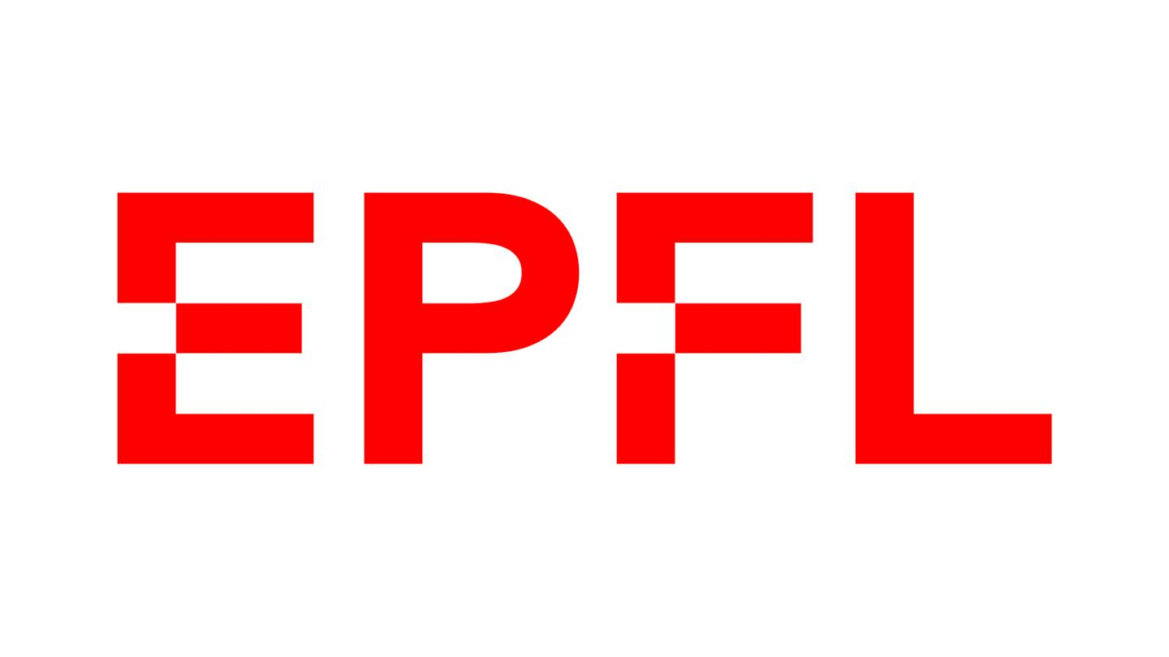

Generative Adversarial Networks:
Synthetic Data for Fun and Profit
Alex Rusnak

Slide 2
What is a GAN?
Simply: it is a way to learn the characteristics of a dataset, and then generate fake samples that mimic these characteristics.
Complicated: Stay tuned!

Slide 3
Why should I care?
Synthetic data is useful in many contexts in Data Science / STEM
  Creating more samples of challenging outliers in a dataset
  Changing distributions of datasets for ethical or functional reasons
  Useful anonymous data

Slide 4
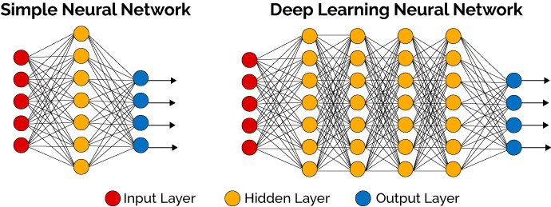
Building Blocks
GANs are a type of neural network
  Utilizing convolutional layers for up / downscaling

Slide 5
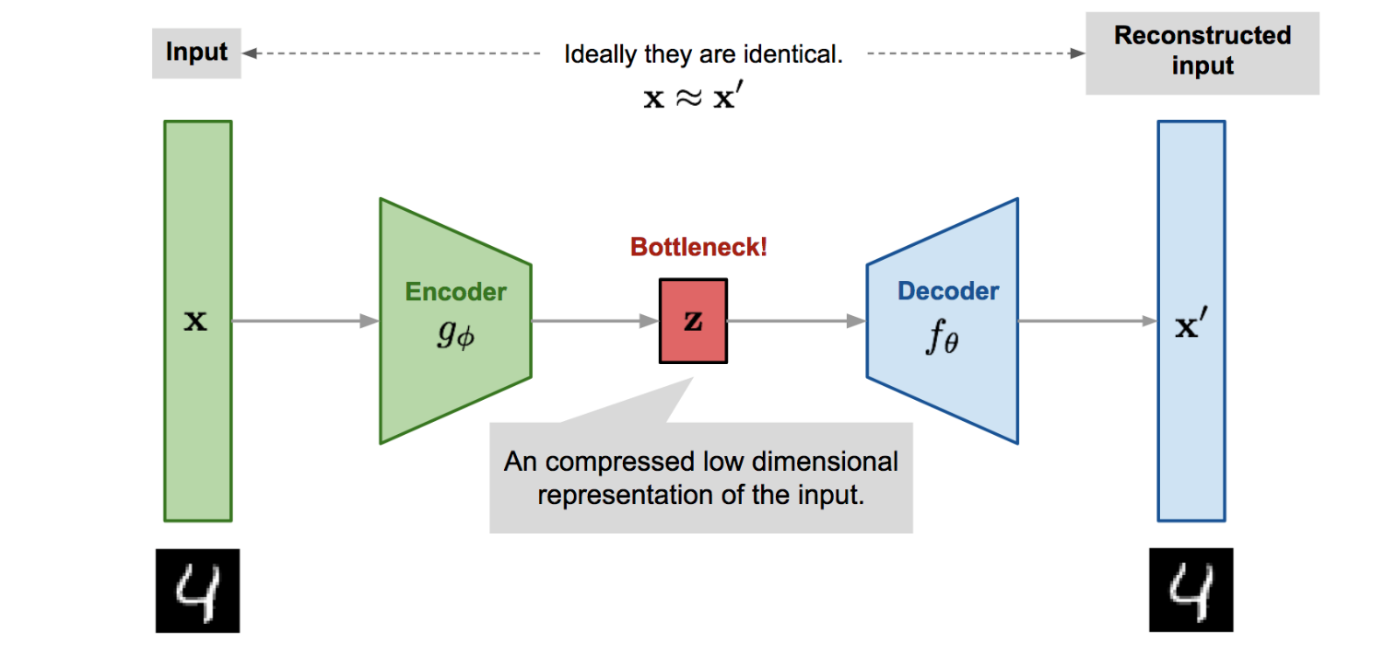
Autoencoder

Slide 6
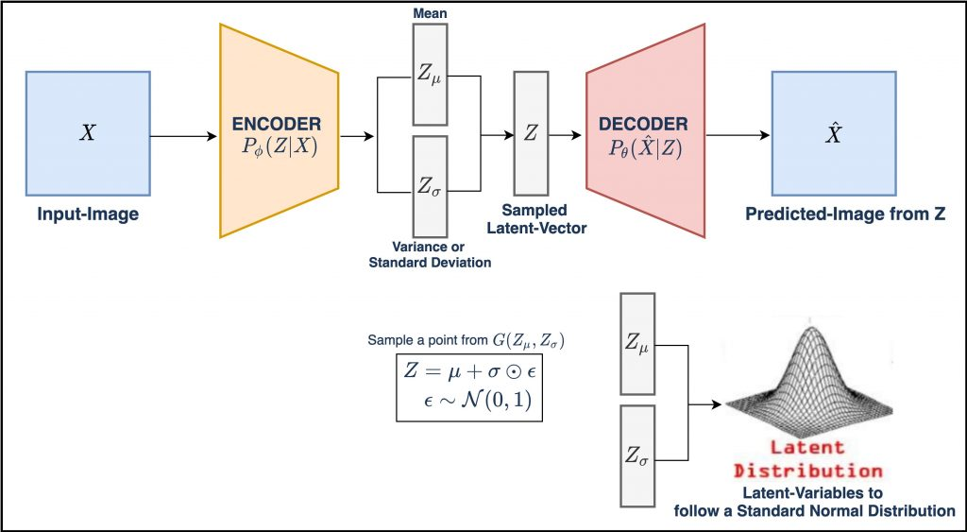
Variational Autoencoder

Slide 7
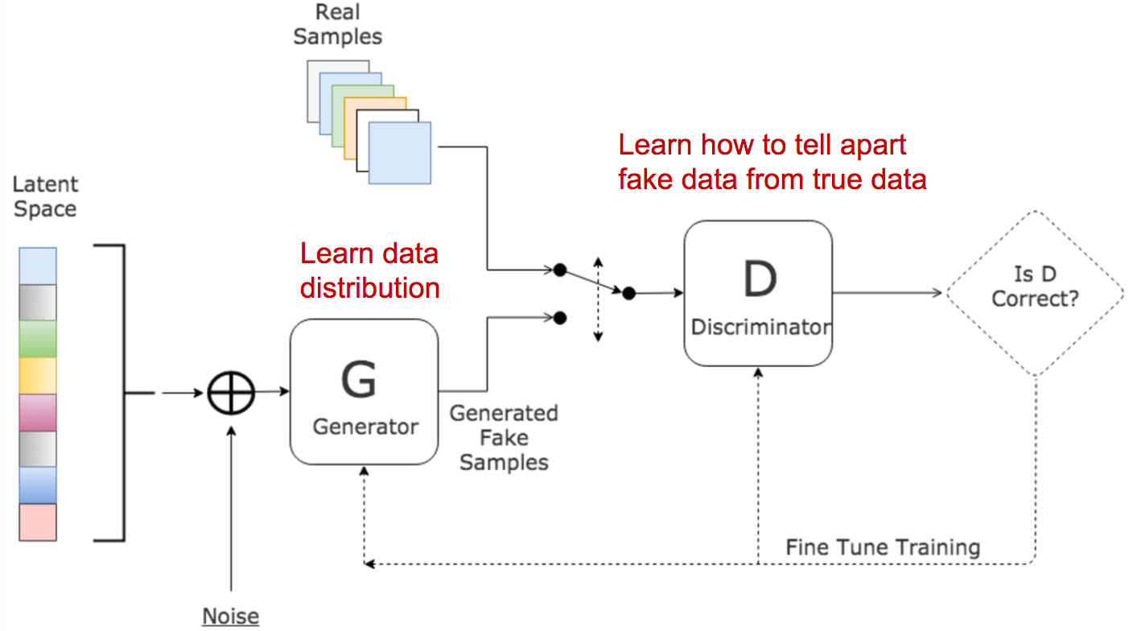
GAN
Simple generator is basically just the distribution and the decoder of the VAE
Latent Space

Slide 8
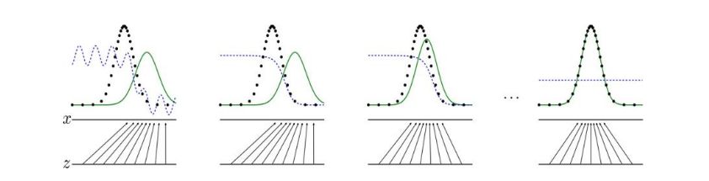
Training
- Black dotted line is the real data distribution.
- Green line is the generated distribution.
- Blue dotted line is the discriminator success relative to that part of the distribution.
- Z is the latent space, mapping to x (the generated sample)

Slide 9
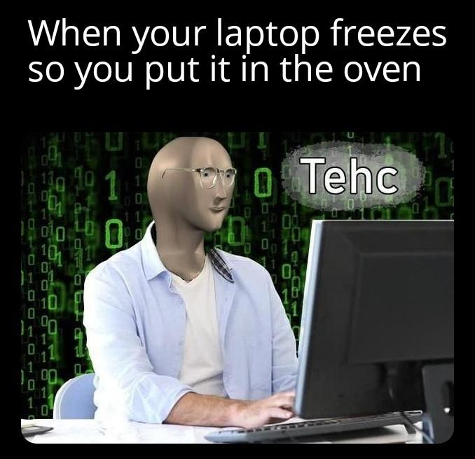
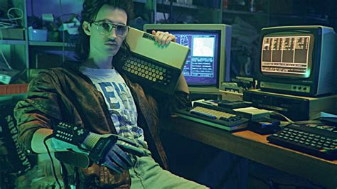
Let’s dig into some code!

