Slide 1

Business profile manager
This validates Business profile data before updating data to DB.

Slide 2
Problem statement

Slide 3
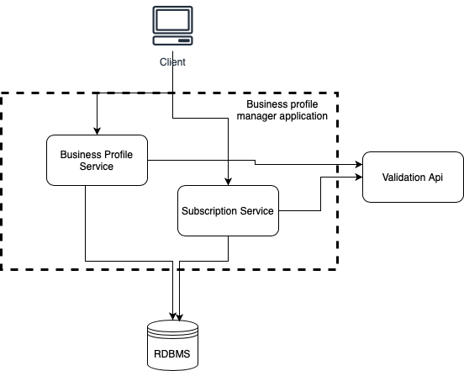
High level Design

Slide 4
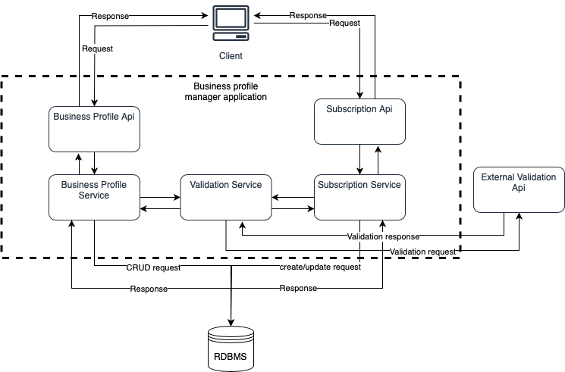
Low level Design

Slide 5
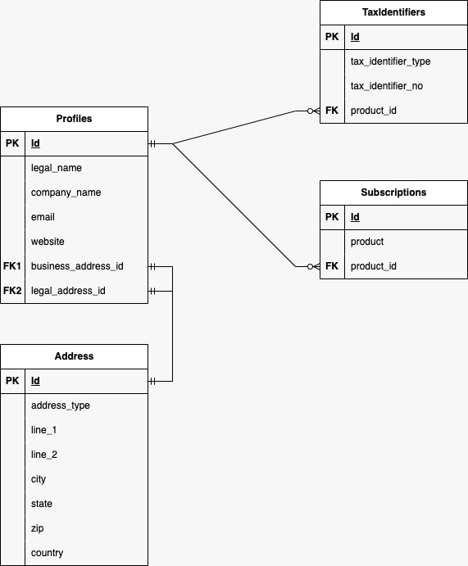
DB relations

Slide 6
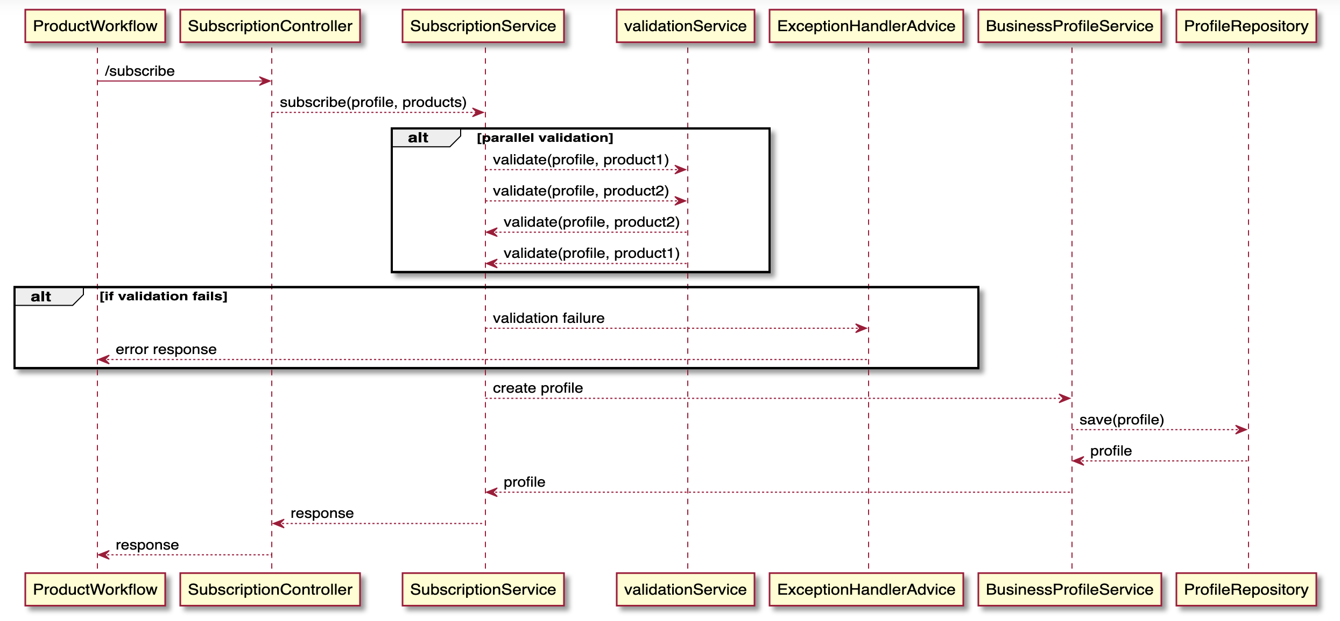
Sequence diagram: CREATE profile

Slide 7
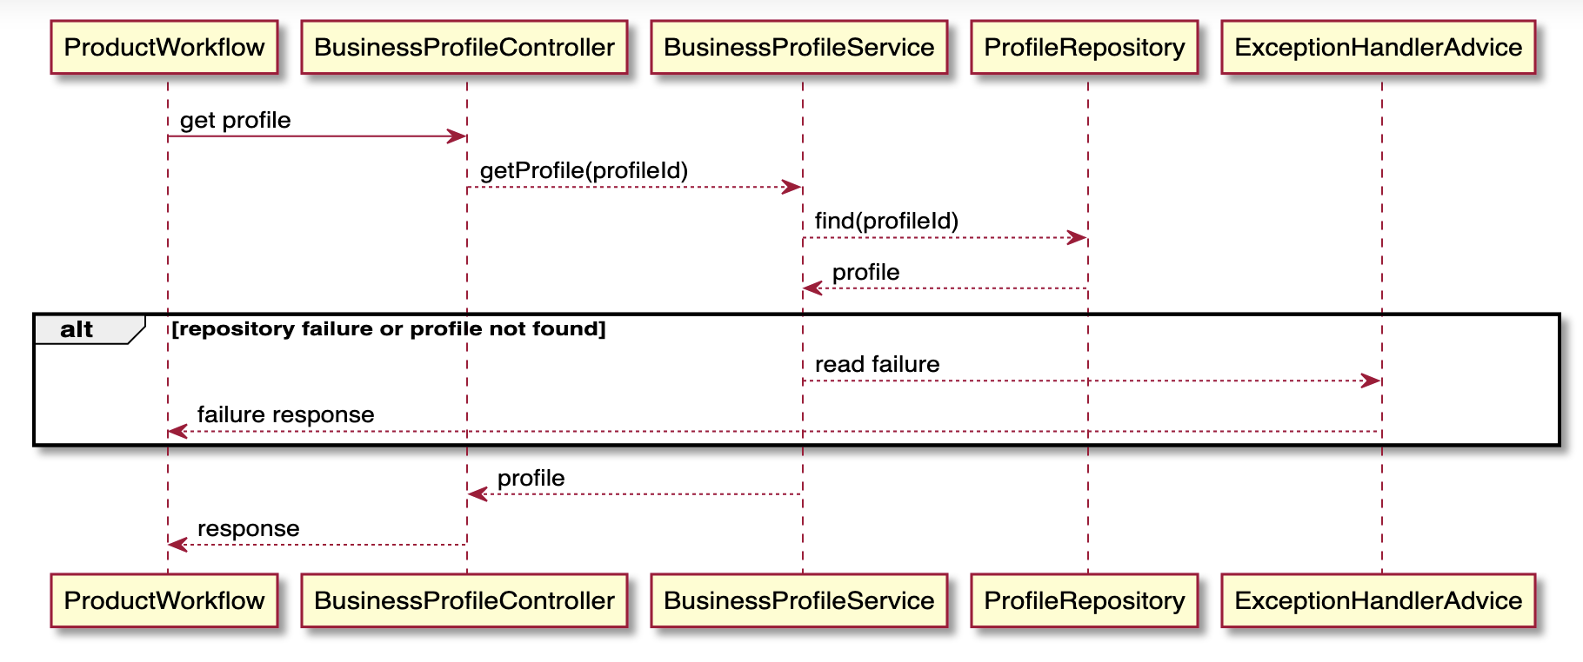
Sequence diagram: READ profile

Slide 8
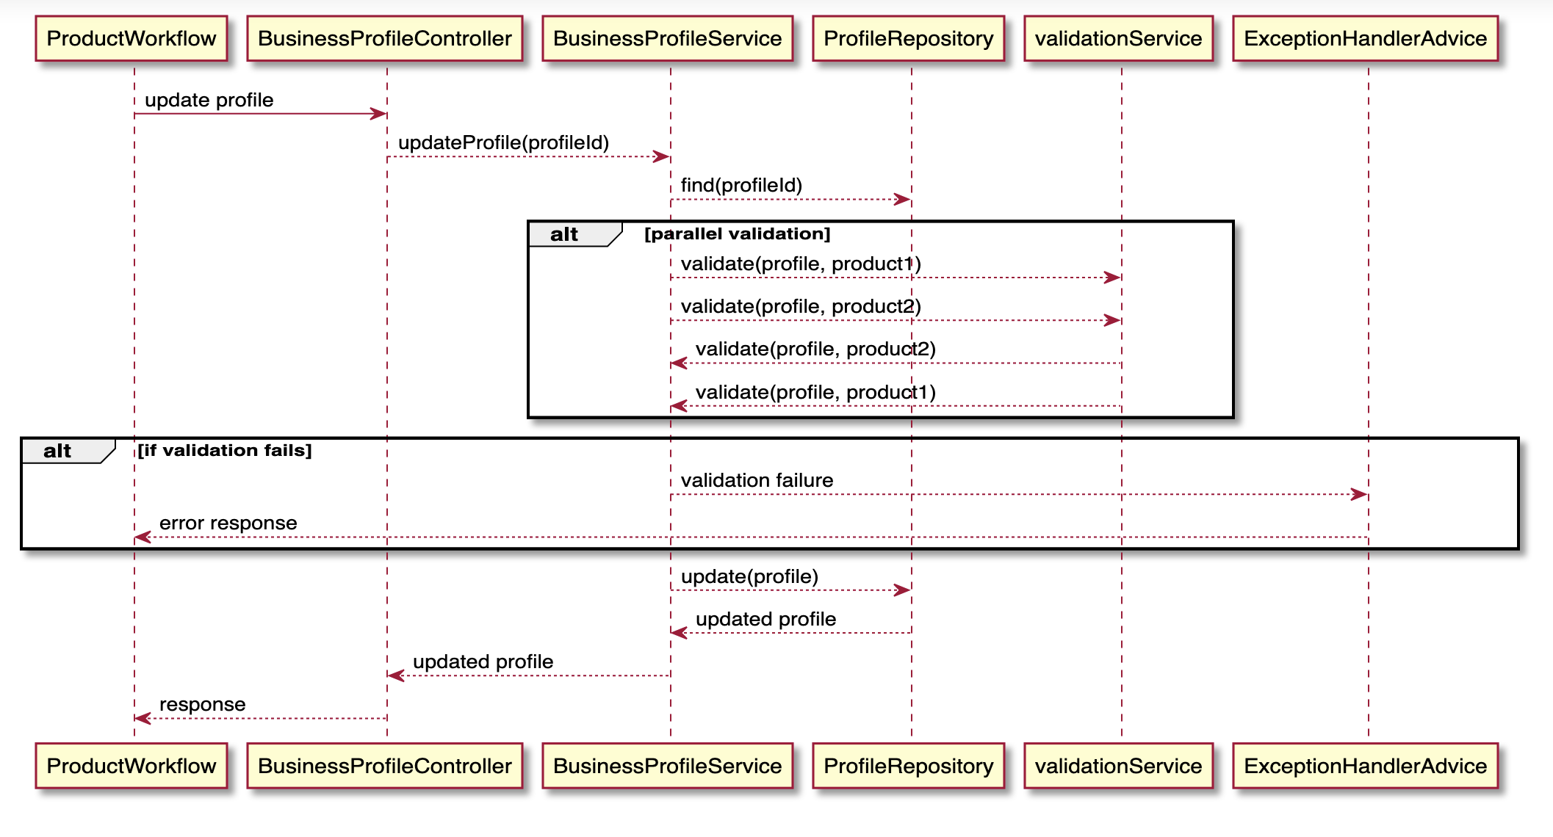
Sequence diagram: UPDATE profile

Slide 9
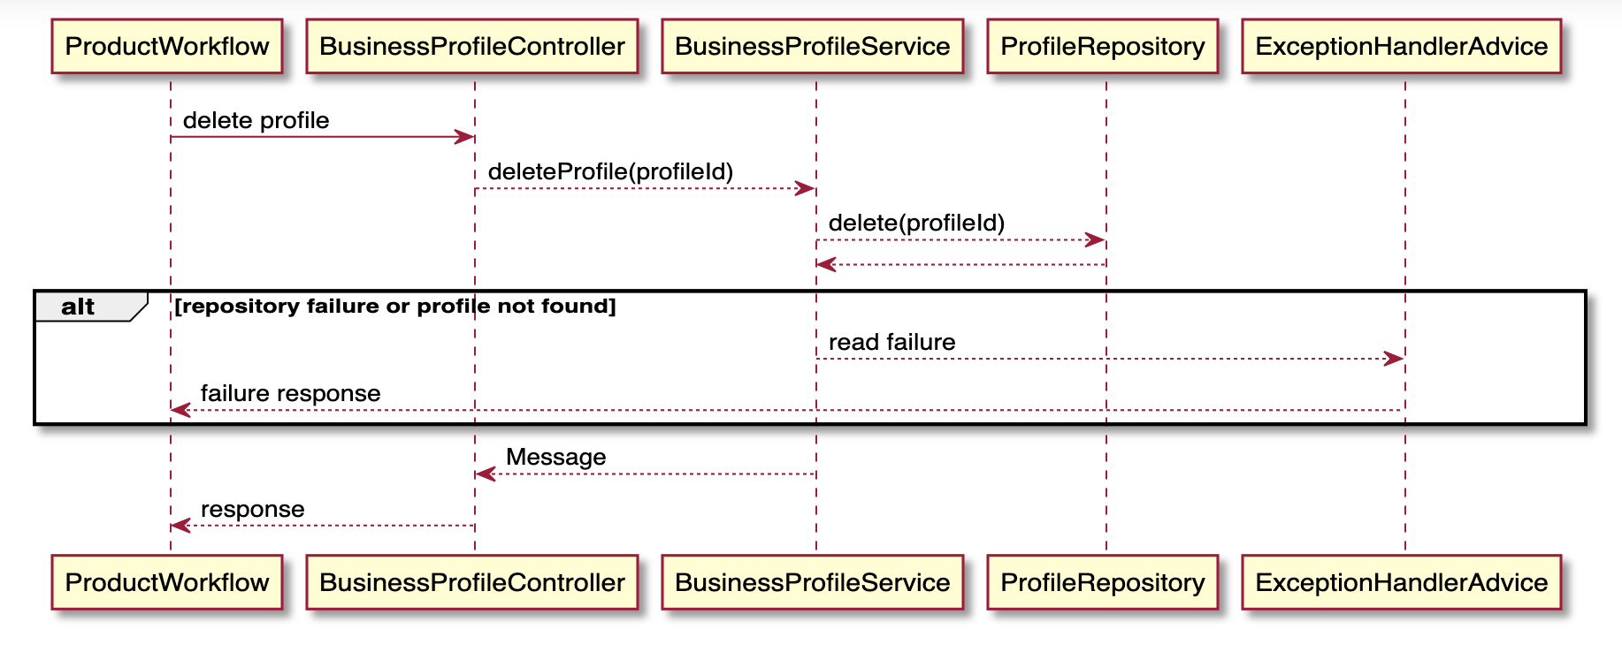
Sequence diagram: DELETE profile

Slide 10
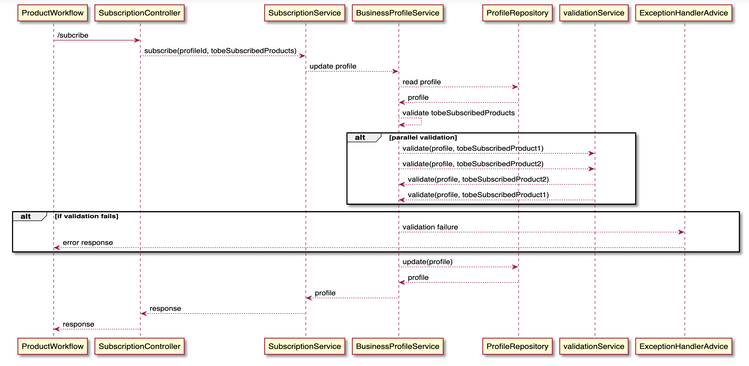
Sequence diagram: Add subscription

Slide 11

Demo

Slide 12

Q & A

Slide 13

Thank you

