Slide 1
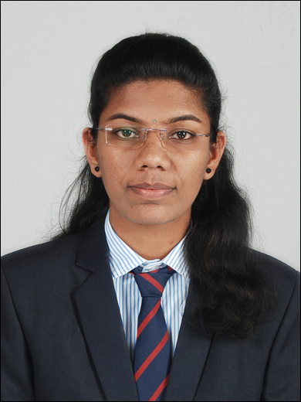


Amruta Ashok Patil
Analyst/Software Engineer
Bachelor of Technology
Electronics and Telecommunication : 2017 - 2021
Skills
Mumbai
Java 8 /J2EE | Java Basics, OOPS, Generics, Collections, Arrays, Loops, Lambda Exp, Stream API Junit
Spring core | IOC & Dependency Injection, Autowire
Spring REST | REST controllers, Implementation of GET, POST, PUT & DELETE, Bean Validation & Exception Handling, Testing Services, Controller & Repository layer
Spring Data JPA | Implement DAO layer using spring Data repositories, Transaction Management
Spring Boot Microservices | Spring Boot Starters, annotations, Messaging Service, Sync/Async comms, Swagger API documents
Spring Cloud | Eureka, Netflix Ribbon, Feign Client, Netflix Hystrix, Netflix Zuul & Config Server
Angular | Components, Services, Modules, Routing, Forms and validation
Database | MongoDB No Sql Basics My SQL RDS Basics
UI Tech | HTML 5 & CSS 3,JavaScript, ES6 & TypeScript Reusable templates, Optimized UI Designed
Tools | Git, Postman, Maven, IDE
amruta.a.ashok-patil@capgemini.com
+91 9834033329
A4
Full Stack Developer
Hands on experience in creating microservices with Spring boot, Spring Security, Spring Cloud API Gateway, Eureka server.
Proficient in creating Single page Web Application in Angular with Angular reactive forms, angular routing.
Hands on experience in creating documentation with Java docs and swagger and unit testing using Junit
Eager to improve myself by learning new technologies and increasing my overall skills
E-Commerce Shopping Cart Application
Created E-commerce Shopping Cart Application case study using Java Full Stack with Angular.
Multiple micro-service implemented using Spring Boot , Spring Cloud and connecting them via Discovery Server i.e Netflix Eureka including routing using Netflix Zuul as a API Gateway.
Frontend with Angular 12 using Angular CLI for creating user friendly UI.
Backend with MongoDB Atlas No Sql database.
Check out my work on GitHub & Video Profile

