Slide 1
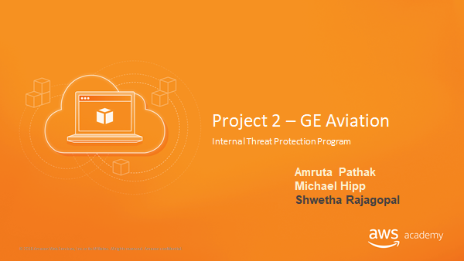

Slide 2
Architecture Details

Slide 3
Requirements
New system will run in a Docker container that will be hosted in Amazon ECS using AWS Fargate.
The data will be a stored in a PostgreSQL instance hosted in AWS RDS.
Implementing several machine learning models that will provide predictive analytics for ITPP.
Transport data from ITPP to the ML engine and from the ML engine to our database tables

Slide 4
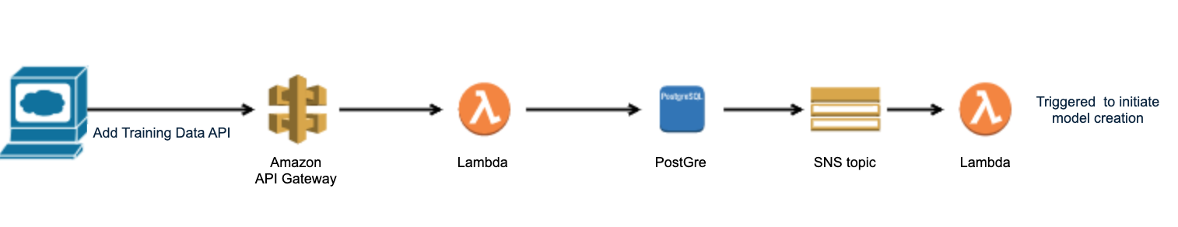
Transporting data from ITPP to the ML engine
All access to infrastructure is segregated through the use of API Gateway
IAM role–based restrictions are in place for API Gateway to call the Lambda function
Lambda function connects to the Postgres and loads the data
When the data is uploaded successfully to PostGre, an SNS topic is created to trigger lambda
The lambda function initiates the new model creation for the data provided.

Slide 5
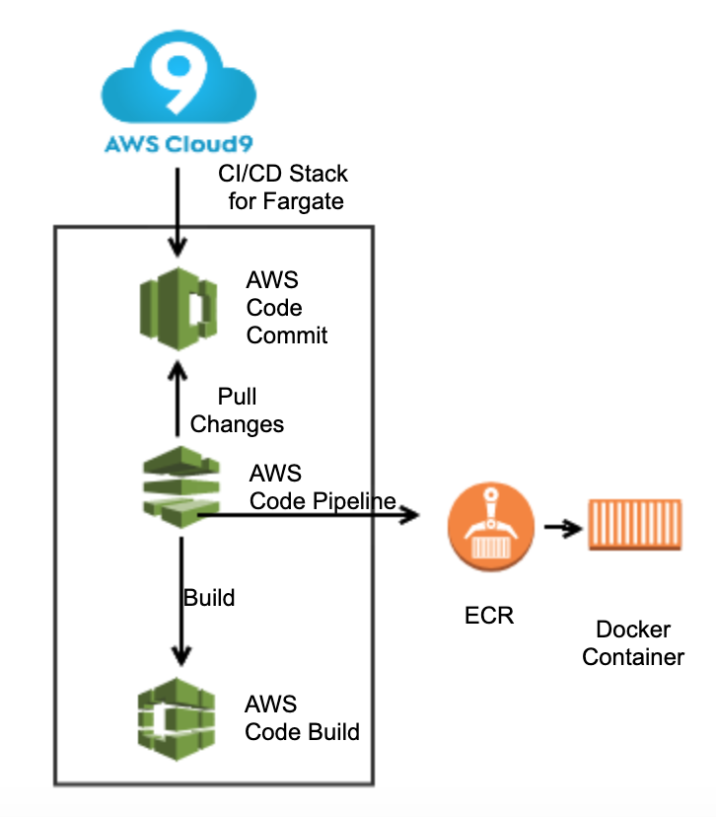
Build Stage for the ML Model
Code is committed to source code repository by Data Engineer/Data Scientist
AWS Code Pipeline is triggered when new code is pushed to Cloud9.
AWS CodePipeline begins the execution of the build stage. AWS CodeBuild pulls the data from source and builds the application package.
Docker image is created with the compiled code and pushed into AWS ECR service. Docker image is available for consumption for the training stage.

Slide 6
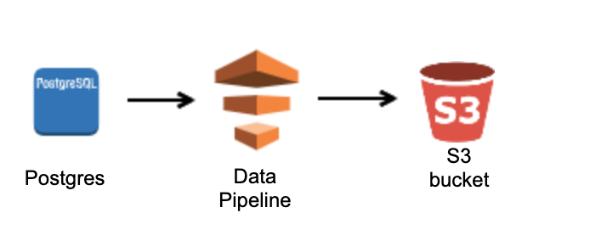
Train Stage for the ML Model
SageMaker is an excellent platform for model development, training and hosting activities
Input to Sagemaker can be from S3 or File System.
Hence to copy data from a Postgres RDS instance to S3, we would need data pipeline

Slide 7
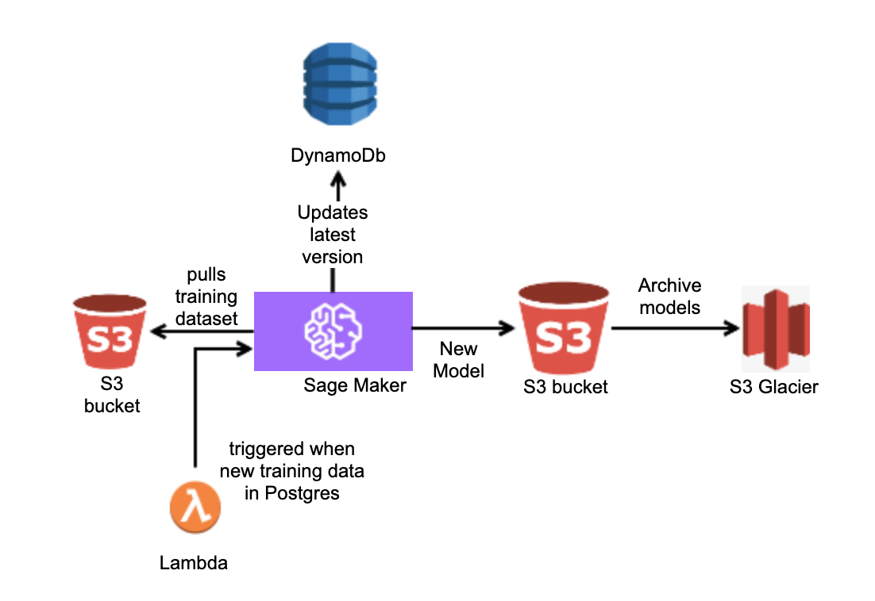

Train Stage for the ML Model
Lambda function is triggered to execute a training job using SageMaker API, referencing the custom docker container
Training job is created on SageMaker. When training job finishes , it saves model artifacts to S3 bucket.
It is the archived to Glacier.
Lambda function is triggered to store model version along with SageMaker Training job status/meta data in DynamoDB table
Docker Container

Slide 8
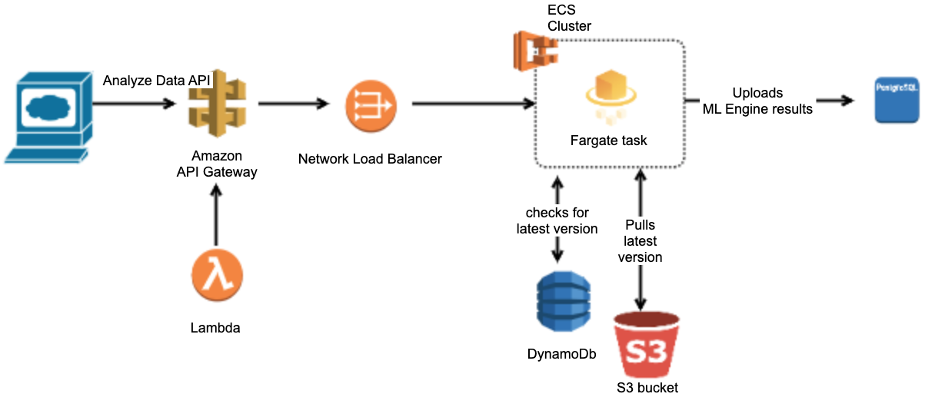
Transfer Data from ML engine to database
Network load balancer distributes incoming traffic across multiple fargate tasks in ECS
Fargate will check the dynamo for the latest version of the ML model and pulls it from S3
Run our data analysis task using the newest Docker image and ML model on Fargate (serverless container deployment)
Uploads the result to ITPP PostgreSQL RDS instance using the POST API call

Slide 9
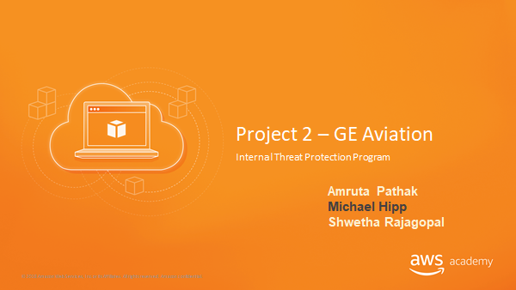
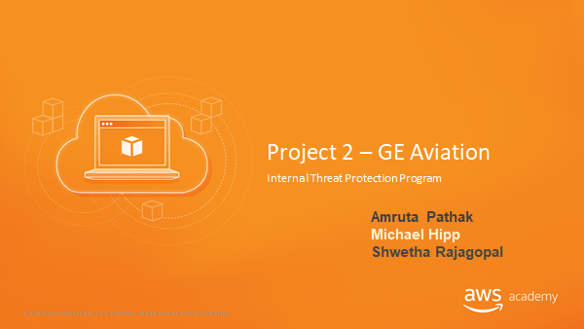

Slide 10
API Details

Slide 11
Requirements
API should possess the following traits:
Data should be encrypted as it moves between systems.
The API must be able to support the needs of multiple machine learning models. Meaning data should be sent in a format like XML or JSON.
The ML engine should be able to call the API and send a list of fields that it would like to receive back.
The ML engine should be able to send its results to the API and the API should handle saving the data to the database.
Any other traits that occur to you to be potentially useful or desirable.

Slide 12




Amazon API Gateway
Managed AWS service for creating and maintaining APIs
Integrated with WAF to protect from web exploits
Only allows HTTPS endpoints, so all data is encrypted in transit
Integrated with CloudTrail to log all calls to API

Slide 13




API: POST Data into ITPP
Amazon API Gateway
AWS Lambda function to add data to ITPP
ITPP on PostgreSQL RDS Instance
JSON document containing data to add
Log activity
Amazon
SNS Topic
Here we describe an API call to add data to the ITPP database. We use a call to our API in the Amazon API Gateway, with an attached body file in JSON format containing the data to add to the ITPP database. It invokes an AWS Lambda function that adds the data to the appropriate tables in the database. Depending on the table, it triggers an Amazon SNS Topic. Can be used by ML model when sending results, or user adding training data.

Slide 14
API: GET Data from ITPP
JSON document fields and tables to get data from
Amazon API Gateway
AWS Lambda function to query data from ITPP
ITPP on PostgreSQL RDS Instance
Log activity
JSON document containing requested data
Here we describe an API call to get data from the ITPP database. The user makes a GET call to the Amazon API Gateway with an attached JSON file containing fields requested, and from which tables. The AWS Lambda function queries the ITPP database, and returns a JSON document to the user containing the requested data. Can be used by user when requesting data, or by SageMaker to request training data when building models.

Slide 15
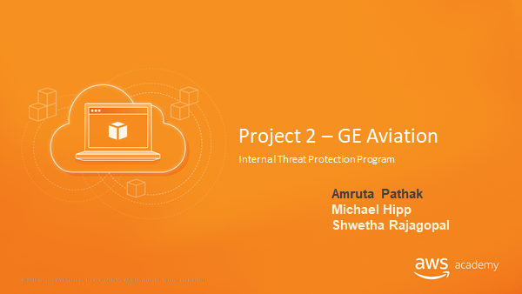

Slide 16
Implementation Details

Slide 17
VPCs AZs and Subnets
In the architecture, we have three VPCs (dev, test, and prod). We assume that most of the users are located in the USA east coast, hence a prod environment in us-east-2 would reduce the latency of serving requests.
For higher availability, each VPC has two availability zones (1a and 1b)
There are 3 subnets per availability zone.
Public subnet - To allow traffic from the internet. Also contains NAT gateway.
Private subnet - All the non db components will be present in this subnet
Private Subnet - The db components such as RDS and S3 would be present in this subnet.
We will secure our subnets using NACLs

Slide 18
VPC and Subnets
VPC | Region | Purpose | AZs | CIDR Range
1 | US West (Oregon) us-west-2 | Dev | 1a,1b | 10.0.0.0/16
2 | US East(N Virginia) us-east-1 | Test | 1a,1b | 10.0.0.0/16
3 | US East(Ohio) us-east-2 | Prod | 1a,1b | 10.0.0.0/16

Slide 19
Dev VPC
Subnet Name | VPC | Subnet Type | AZ | Subnet Address
Public-1 | #1 | Public | 1a | 10.0.1.0/24
Public-2 | #1 | Public | 1b | 10.0.2.0/24
Private-1 | #1 | Private | 1a | 10.0.3.0/24
Private-2 | #1 | Private | 1b | 10.0.4.0/24
Private-db-1 | #1 | Private | 1a | 10.0.5.0/24
Private-db-2 | #1 | Private | 1b | 10.0.6.0/24

Slide 20
Test VPC
Subnet Name | VPC | Subnet Type | AZ | Subnet Address
Public-1 | #2 | Public | 1a | 10.0.1.0/24
Public-2 | #2 | Public | 1b | 10.0.2.0/24
Private-1 | #2 | Private | 1a | 10.0.3.0/24
Private-2 | #2 | Private | 1b | 10.0.4.0/24
Private-db-1 | #2 | Private | 1a | 10.0.5.0/24
Private-db-2 | #2 | Private | 1b | 10.0.6.0/24

Slide 21
Prod VPC
Subnet Name | VPC | Subnet Type | AZ | Subnet Address
Public-1 | #3 | Public | 1a | 10.0.1.0/24
Public-2 | #3 | Public | 1b | 10.0.2.0/24
Private-1 | #3 | Private | 1a | 10.0.3.0/24
Private-2 | #3 | Private | 1b | 10.0.4.0/24
Private-db-1 | #3 | Private | 1a | 10.0.5.0/24
Private-db-2 | #3 | Private | 1b | 10.0.6.0/24

Slide 22
Load Balancer
Name | External/Internal | Subnets | SG Name | Rule | Source
ext-elb | External | Public-1 Public-2 | ext-elb-sg | Inbound: Allow TCP/http Port 80 Outbound:Allow outbound traffic to the VPC CIDR on the ephemeral ports | 0.0.0.0/0(Any)

Slide 23



IAM - Roles
Role | Permissions | Used By
SystemAdministratorRole | Manage IAM roles, Read/write to all resources, create service linked roles for ELBs Programmatic/AWS Console access | SystemAdministratorGroup
DatabaseAdminRole | Read/Write to RDS instances Programmatic/AWS Console access | DatabaseAdministratorGroup
DataScientistRole | Access to all the analytics components | DataScientistGroup
MonitoringRole | Read permissions to all instances, CloudWatch, CloudTrail Programmatic/AWS Console access | MonitoringGroup
ConsoleUserRole | AWS Management Console access Other permissions decided by System Administrator | Other Users

Slide 24
Encryption
Requirement | Solution
Encryption option for data at rest | Enable encryption on RDS instances. This must be done when first creating the instances. Enable server-side encryption by default for S3 buckets. For both, use AWS Key Management Service to keep track of encryption keys.
Encryption option for data in transit | API calls use HTTPS when transfering data, which is encrypted by default.

Slide 25
Monitoring and Compliance
CloudTrail :
It will monitor all the API activity.
The company can use it for compliance audits and security analysis.
CloudWatch :
The company can use it to get the application performance and operational health, in order to keep the overall application running smoothly.

Slide 26
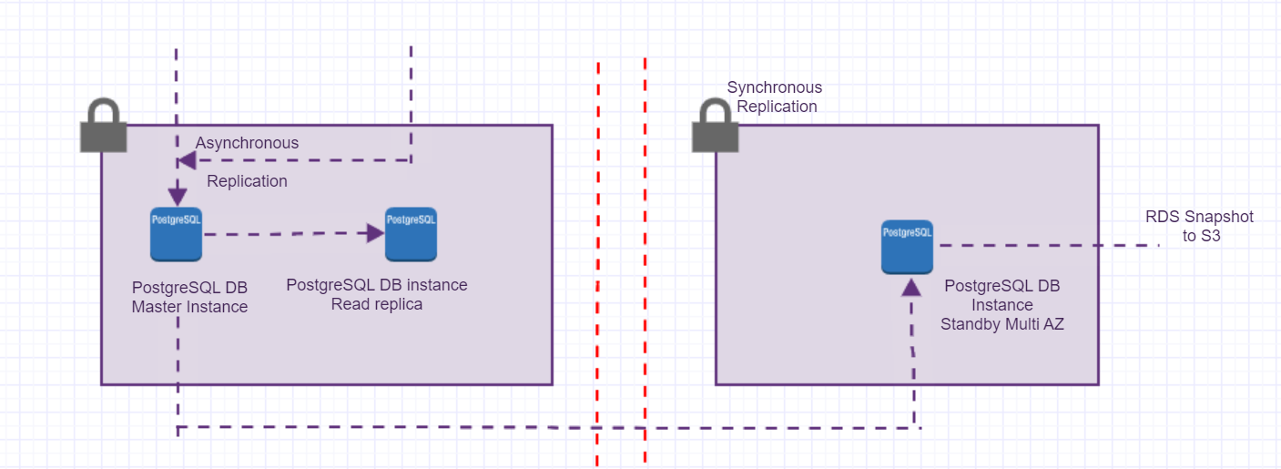
Multi-AZ Deployment for database
Managed RDS - PostGreSQL with Multi-AZ enabling

Slide 27
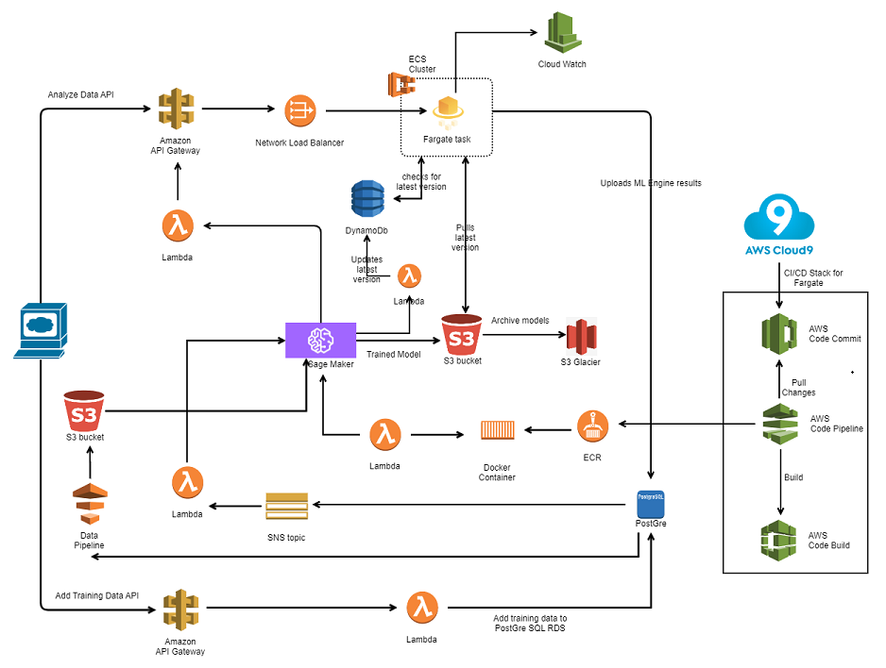
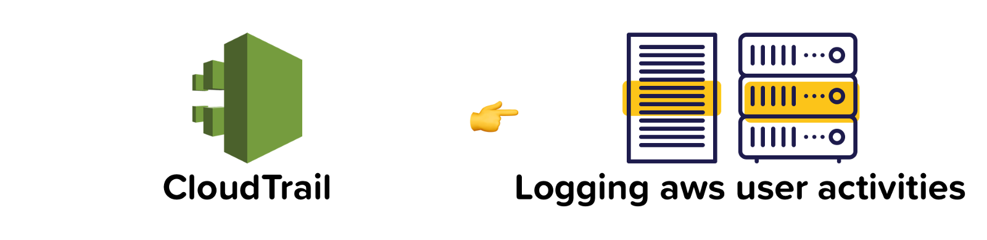
Overall Architecture

Slide 28
Thank you !

