Slide 1

Foodies Delight
Put your icon here
A paradise just for you!
Amruta Pathak pathak.am@northeastern.edu

Slide 2
Foodies Delight
Foodies Delight
Allows foodie to browse through variety of restaurants.
Select restaurant, browse through menus.
Select the dishes and place an order.
Restaurant receives the order and acts on it.

Slide 3
The Problem
Foodies Delight
Problem – Craving something yummy ?
Feeling low ?
Friends coming over ?
Really Busy so cooking is no option ?
Lets order it!
A one stop shop for different restaurants, various menus to select from and place orders.
I know its more like a Grubhub / Ubereats app but the motivation behind designing it was to understand underlying tech ! :)

Slide 4
Innovation
Foodies Delight
Hmm I would say I have ideas to build on further but this was mostly similar to the current apps in the markets.
Well that said there is so much innovative stuff to do in the app , need time !

Slide 5






Going over the app

Slide 6
Details before Diving in!
Foodies Delight
The app is a combination of two sub apps
Customer specific app
Customer can browse various restaurants
Pick a restaurant
Browse menu, add menu to cart
Place order
Restaurant specific app
Get order.
Update their status

Slide 7
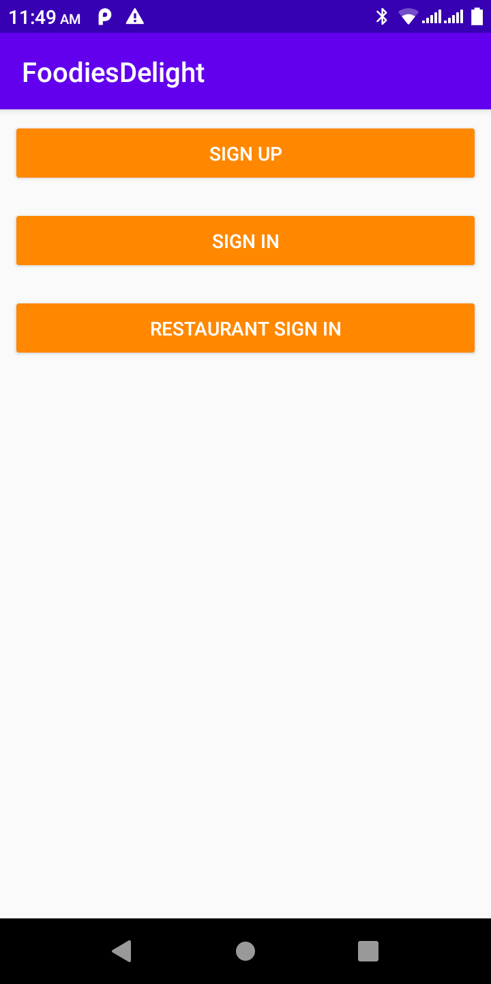
Login /Register
Foodies Delight
Two logins
Customer login
Restaurant Login
Register for both customer and restaurant

Slide 8
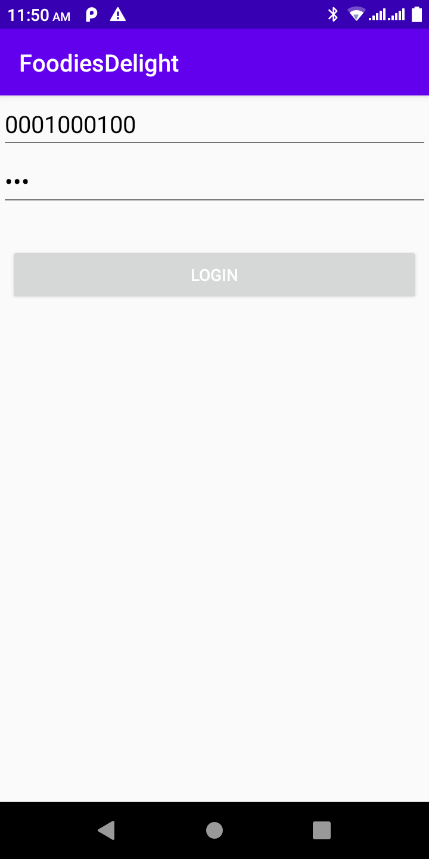
Customer Sign in
Foodies Delight

Slide 9
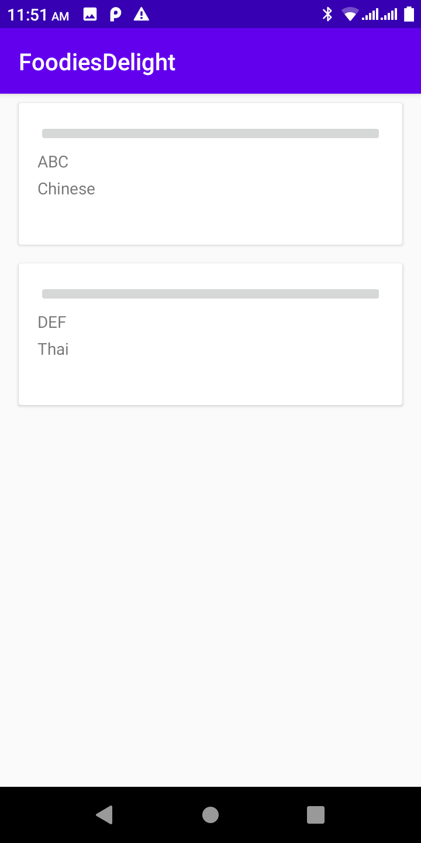
Restaurants to choose from
Foodies Delight
List of all the nearby restaurants shows up
You click on one of the restaurants and the next page is the menu!

Slide 10
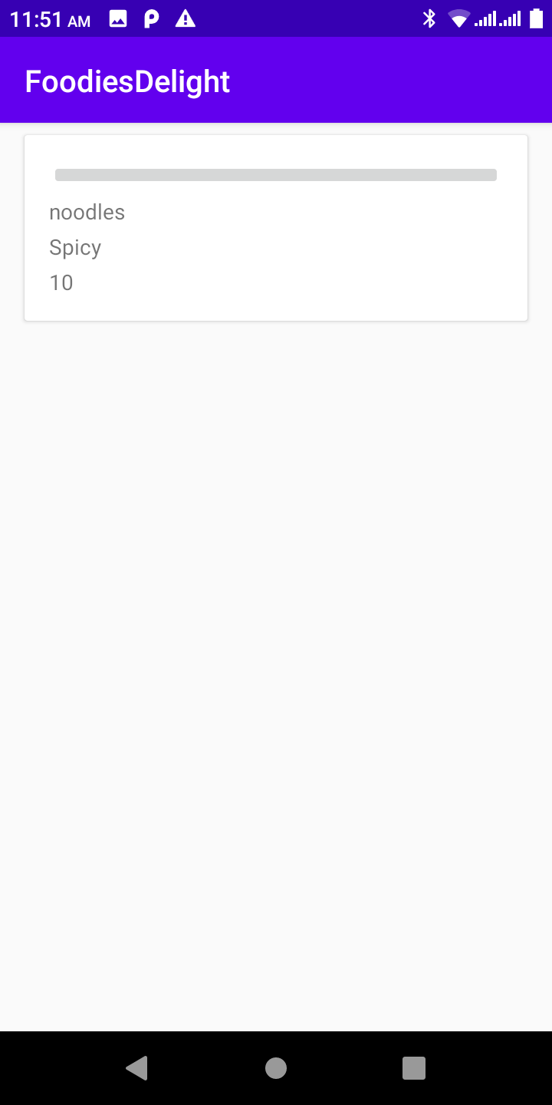
Menu
Foodies Delight
Menu has a title , description and the corresponding price associated to it.
On select will take you to add the menu

Slide 11
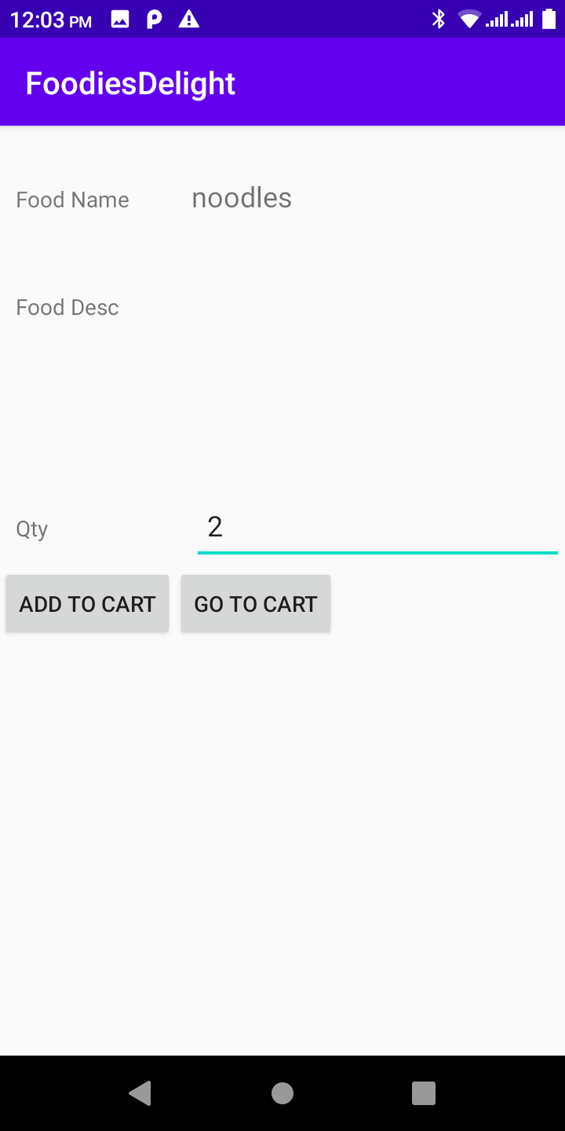
Add dish
Foodies Delight
Add the dish to cart.
Enter quantity and add to cart.
Then go to the cart.

Slide 12
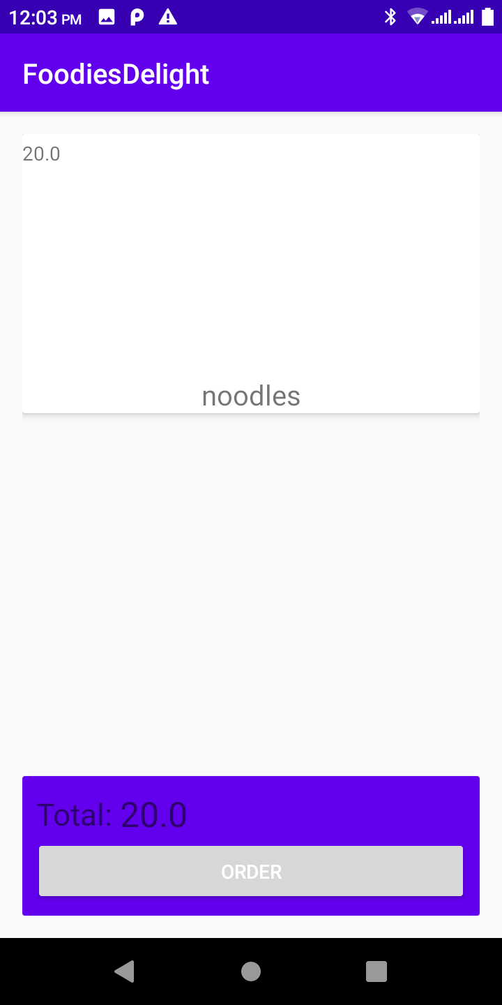
Cart
Foodies Delight
It lists all the items added to the cart with the total
Click Order to place an order

Slide 13
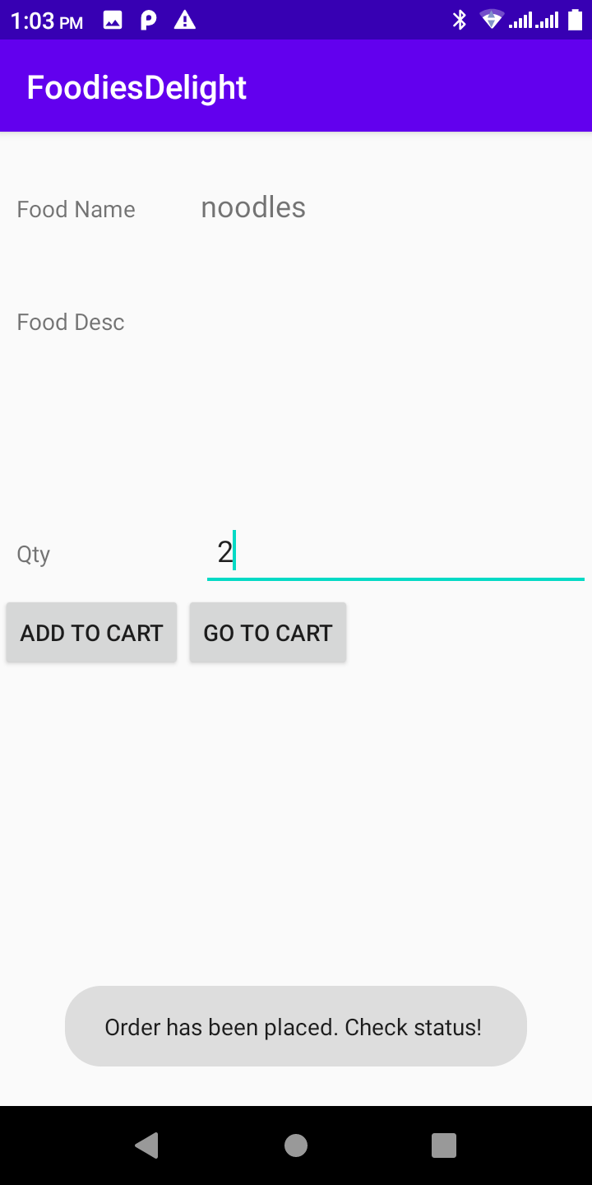
Cart
Foodies Delight
Order Placed

Slide 14
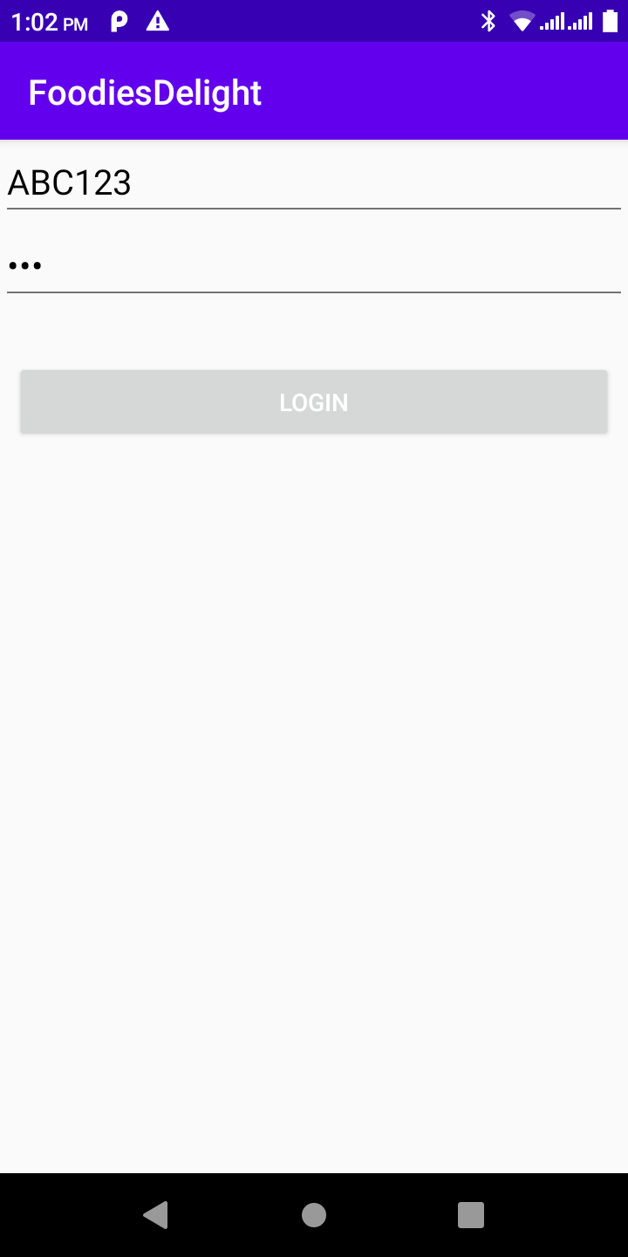
Restaurant Sign In
Foodies Delight

Slide 15
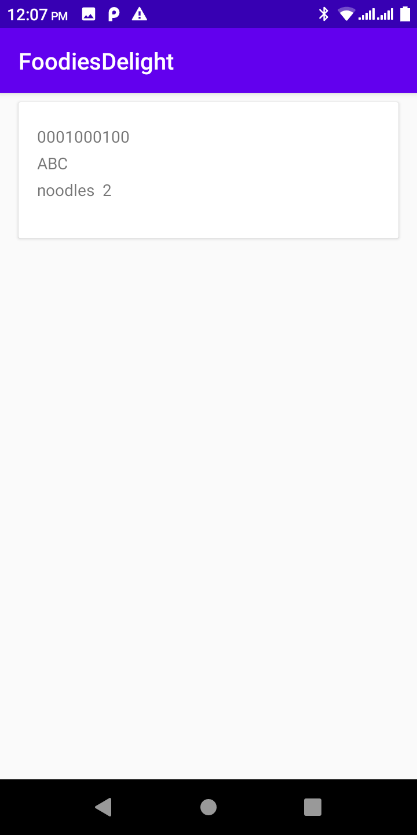
Look at all the orders and take action
Foodies Delight
Gets all orders
Update status for each order.
On click – context menu that lists all the actions

Slide 16
Tricky programming problem.
Foodies Delight
Entire app is data driven.
So if one view doesn’t show up , no data on screen.
Combination of static and dynamic pages.
Quite understandable that companies must be going through lot of iterations before releasing it to prod.

Slide 17
Tech Stuff used
Foodies Delight
Used a lot of recycler views
Firebase
SqlLite

Slide 18
Ideas to build further!
Foodies Delight
Make this app unique by having the user fill out a preferences form and apply machine learning to pull out restaurants and menus that interest the user.
Adding menus and restaurants to favorites.
Also, a separate sub app which lets the restaurants talk to and suggest users.
This would definitely make it a killer app!

Slide 19
References Acknowledgements & Credits
Foodies Delight
Reused some of the components. Credits to below:
https://firebase.google.com/docs
https://developer.android.com/reference/android/database/sqlite/SQLiteDatabase
https://developer.android.com/jetpack/androidx/releases/recyclerview
https://antonioleiva.com/recyclerview-listener/
https://abhiandroid.com/ui/nesting-of-layouts-android.html
https://www.youtube.com/channel/UCllewj2bGdqB8U9Ld15INAg
https://github.com/hanishk/Eat_It/

Slide 20
Thank you!
Foodies Delight
A big thanks to Adrienne for everything!
And to Curt and Dennis for their support!
And last but not the least NEU for this amazing 2 yr journey.
I will miss everyone and everything. :(

