Slide 1
Apps and Their Application
1.Digilocker
2.Geeks for geeks
3.Replit
4.Cybrary
5.Learn ethical hacking

Slide 2

1.Digilocker
Logo :

Slide 3
Introduction
i. DigiLocker is a key initiative under Digital India.
ii. DigiLocker is a digitization service provided by the Indian ministry of Electronics and Information Technology .
iii. Digilocker allows to digital versions of various documents .

Slide 4
Application
1. It is use to store important and
official documents such as educational certificates , pan cards , Aadhar cards ,voter IDS on your mobile phone.
2. Access your documents anytime ,anywhere , using mobile phone or computer. No need to carry physically documents.
3. This app is secure document wallet for citizens, etc.

Slide 5
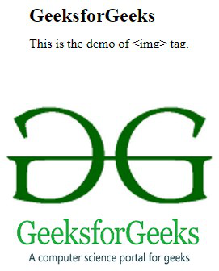
2.Geeks for geeks
Logo:

Slide 6
Application
1.This app provides computer science resources.
2.It provides coding challenges for programmers and technology enthusiasts, along with interview and exam preparation for aspirants.
3.With the help of this app you can easily Elevate your interviewing skills
4.Also Expand your Knowledge with courses & abundant collection of free resources.
5.In this app hug content is available & also there is an option to add topics from interest.

Slide 7

3.Replit
Logo:

Slide 8
Application
1. Replit Is the best way to code .
2. And Ship real projects, apps, games and more right from your phone.
3. With Replit, you can code Anything , Anywhere.
4.This app serves as a code collaboration platform,a cloud provider ,a Developer community and so much more.

Slide 9

4.Cybrary
Logo:

Slide 10
Application
Cybrary is an online platform that offers a wide
rang of Cybersecurity and IT Training and educational
resources.
2. It 0ffers the online courses and tools that allows people to learn from anywhere at any time.
3. Cybrary is accessible, affordable training platform provides curated career paths.
4. In this platform you can up skill your Team with Cybrary suits of learning activities and management tools and assessments.
5. also in this platform live certification prep in a Dynamic virtual Classroom is available .

Slide 11
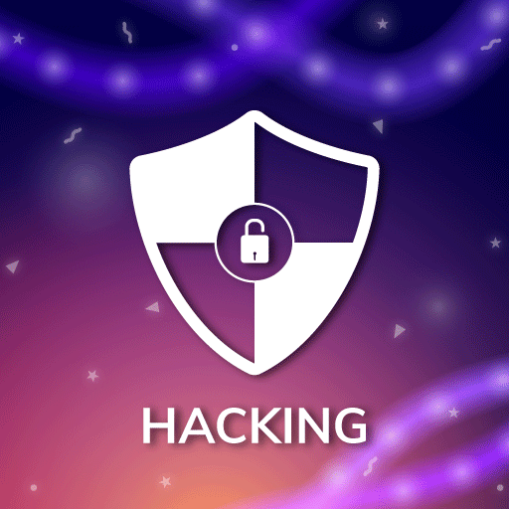
5.Learn Ethical Hacking
Logo:

Slide 12

1.With the help of this platform you can learn the basics of Networking , TCP/IP and protocols.
2. Ethical hacking is the best learned through hands-on experience.
3. In this platform also many hacking courses are available.
4. It helps to protect sensitive data form unauthorized access and theft.
5.Ethical hackers perform security testing on applications ,websites and systems .

Slide 13


