Slide 1
Face Recognition
Shubham S. Gomdhare
36047
Guide : Prof. Amruta Joshi

Slide 2
Content
Face Recognition
What is face detection?
Importance of face detection
How does it works?
Current state of research
Challenges
Different approaches
Demo Image
Pros And Cons

Slide 3
What is Face Detection?
Facial recognition systems are computer-based security systems that are able to automatically detect and identify human faces.

Slide 4
Importance of Face Detection
Face Detection is the very first step in many Human Computer Interaction systems
Expression Recognition
Cognitive State/Emotional State Recognition
A step towards Automatic Target Recognition(ATR) or generic object detection/recognition.

Slide 5
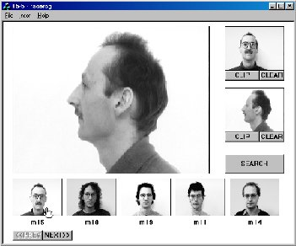
How Does it Works?
The first step for a facial recognition system is to recognize a human face and extract it from the rest of the scene.
Next, the system measures nodal points on the face.
These nodal points are then compared to the nodal points computed from a database of pictures in order to find a match.

Slide 6
Face Detection : current state
State-of-the-art:
Front-view face detection can be done at >15 frames per second on 320x240 black-and-white images on a 700MHz PC with ~95% accuracy.
Detection of faces is faster than detection of edges!
Side view face detection remains to be difficult.

Slide 7
Face Detection: challenges
Out-of-Plane Rotation: frontal, 45 degree, profile, upside down
Presence of beard, mustache, glasses etc
Facial Expressions
Occlusions by long hair, hand
In-Plane Rotation
Image conditions:
Size
Lighting condition
Distortion
Noise
Compression

Slide 8
Different Approaches
Knowledge-based methods:
Encode what constitutes a typical face,
e.g. the relationship between facial features
Feature invariant approaches:
Aim to find structure features of a face that exist even when pose, viewpoint or lighting conditions vary
Template matching:
Several standard patterns stored to describe the face as a whole or the facial features separately
Appearance-based methods:
The models are learned from a set of training images that capture the representative variability of faces.

Slide 9


Demo Image : Appearance-based method

Slide 10
Pros…
Security
Unlocking devices
Automatic

Slide 11

Cons...
Such systems may be fooled by hats, beards, sunglasses and face masks
Even changes of lighting and camera angle can have a significant effect on the accuracy of 2D systems

Slide 12
“false positives” which means wrongly matching innocent people with photos in the database
“false negatives” not catching people even when their photo is in the database
if a subject's face is stored in the database, a disguise or a minor change in appearance or even an unusual facial expression can confuse the system.

Slide 13
Thank You…!!!

