Slide 1
Welcome
27/8/2019
Topic Name : high security encryption using AES and visual cryptography
Presented By- krutika jagdale
Guided By-amruta joshi

Slide 2
CONTENT
Introduction
Brief on System
Conclusion
References

Slide 3
Introduction
high security encryption using AES and visual cryptography. This system provides high level of security as the message is now shielded with 2 layers of security
highly secure encryption methodology using a combination of AES and visual crypto. With the ever increasing human dependency on The Internet for performing various activities such as banking, shopping or transferring money, there equally exists a need for safe and secure transactions.

Slide 4
What is AES?
The Advanced Encryption Standard, or AES, is a symmetric block cipher to protect classified information and is implemented in software and hardware throughout the world to encrypt sensitive data.
The AES operates on 128-bit blocks of data. The algorithm can encrypt and decrypt blocks using secret keys.
The key size can either be 128 bit, 192 bit, or 256 bit.
AES is a subset of the Rijndael block cipher developed by two Belgian cryptographers, Vincent Rijmen and Joan Daemen, who submitted a proposal to NIST during the AES selection process.

Slide 5
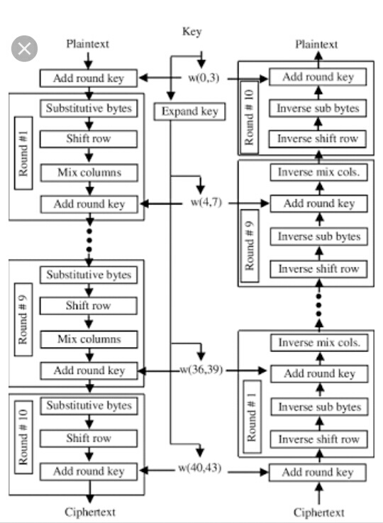
Block diagram for aes encryption and decryption

Slide 6
what is visual cryptography ?
Visual Cryptography is a special encryption technique to hide information in images in such a way that it can be decrypted by the human vision if the correct key image is used.
Visual cryptography is introduced by first in 1994 Noar and Shamir

Slide 7
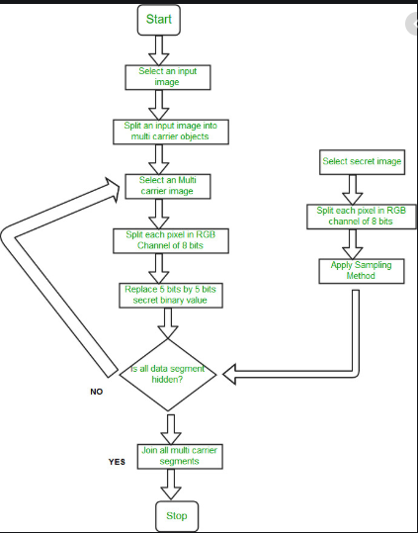
Flow chart for visual cryptography

Slide 8
Brief on system
This need a system that automatically translates to the requirement of increased network security and better and fast encryption algorithms.
This system addresses the above issue by introducing AES method of encryption and also further enhances the same with the help of visual cryptography.
In this method the secret message is divided into two parts after which the message the first half of the message is encrypted using AES and the second share of the message is embedded in the image using LSB.

Slide 9
applications
Application:This application is useful in sensitive information. For example any company important message.

Slide 10
THANK YOU

