Slide 1
Welcome
26/08/2019
E-Commerce Technology
Presented By-Ayush Pendkar
Guided By- Prof. Amruta Joshi

Slide 2
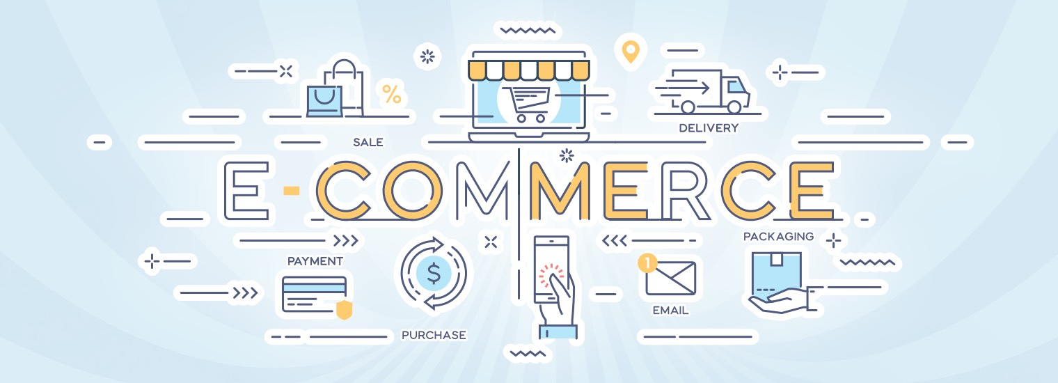
CONTENT
Introduction:
Literature Survey
Brief on System
Conclusion
References

Slide 3

Introduction
E-Commerce means activities that support commerce electronically by networked connections.
For Example business processes like manufacturing and inventory etc. Online:
E commerce is an electronic environment that allows sellers to buy and sell products, services, and information on the internet.

Slide 4
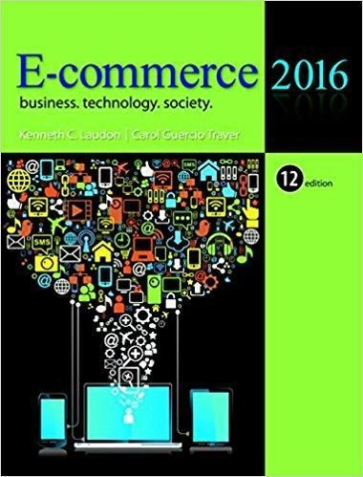
literature survey
The Main Objective of Literature Survey is to analyze the process of E-commerce Technology.E-commerce Technology is the most trending technology.
Sources::
IEEE
Research Gate
HushBlackWell
TutorialsPoint
Hcc.education
Kennith C Laudon

Slide 5
Brief On System
Omni-Channel Presence/Support
Extensive Personalization
The Mobile Shift
Conversational Marketing
Automation and Chatbots for customer communications
Image search
Fast & Easy Checkout Processes

Slide 6

Conclusion
By referring these topics we will be aware about the lead technologies used to build a perfect E-commerce platform.
E-commerce is the one of most Profitable platform and it will create a boom in upcoming future

Slide 7
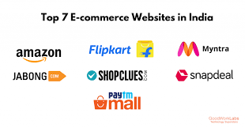
Referrences
Amazon.com
Myntra.com
Lenskart.com

Slide 8
THANK YOU

